Slide 1

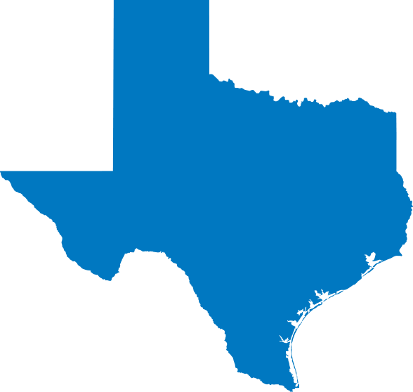
TDTMS Update
RMS
January 7th, 2025

Slide 2
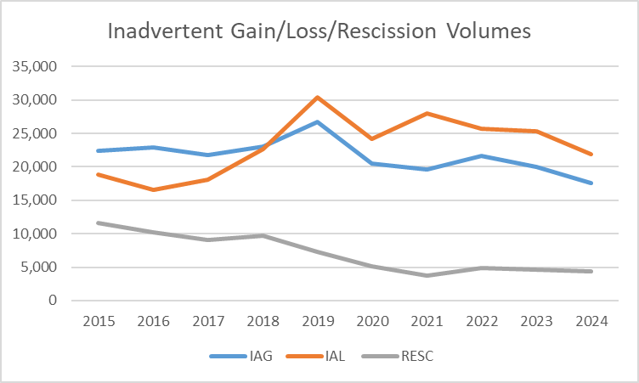
TDTMS
Inadvertent Gain/Loss/Rescission Historical Volumes
ERCOT MarkeTrak/IGL training started in mid 2015
RMGRR 152 modified date change/cancellation evaluation window effective 8/1/2018
RMGRR 170 modified acceptable applications of IGL uses effective 1/1/2023

Slide 3
TDTMS
MarkeTrak Subtypes – Inadvertent Gains
2 – 3.5% of IAGs are unexecuted
70% of IAGs are submitted within 7 days of OTRAN
Sweet spot is ~1-3 days of OTRAN
Only 11-13% of IAGs are submitted > 30 days
28% of IAGs are submitted same day or next day

Slide 4
TDTMS
MarkeTrak Subtypes – Inadvertent Gains – cont.
97% of completed IAGs, CRs reach agreement withing 7 days once acknowledged
50-56% of IAGs reach agreement same day MT is acknowledged
NEW WORKFLOW expectations:
IAGs: BDMVIs should be send immediately upon agreement of CRs
IALs: BDMVIs should be submitted within 2 days of agreement

Slide 5
TDTMS
MarkeTrak Subtypes – Inadvertent Gains – cont.
92 - 95% of IAGs are resolved within 21 days
47 – 60% are resolved within 7 days
GOALS of Analysis:
Provide awareness to REPs of MarkeTrak performance in comparison to peers
As each REP evaluates own processes, ability to identify opportunities for improvement
Establish benchmarks before and after implementation of TXSETv5.0/SCR817 improvements to validate changes

Slide 6
TDTMS
Next Meeting – Tuesday, January 14th
DRAFT Agenda:
Elections - Leadership
Tuesday, January 14th @ 1:00 PM WebEx Only
System Instances & MT Performance
MarkeTrak Subtypes Volume Analysis –IAL results
Listserv
RMG: Switch Hold language to allow for planned retail outages
Critical Care Flags – process to re-establish post an IGL
Goals & Accomplishments
ERCOT Reports

