Slide 1
Monthly Review of Reliability Unit Commitment Market Impacts – November 2024
Wholesale Market Working Group
ERCOT Market Analysis

Slide 2
RUC Resource-Hours
November 2024 | Total | Opt-Out | Non-Opt-Out
Instructed Resource-Hours
Total Count | 176.9 | 17.0 | 159.9
Effective Resource-Hours*
Total Count | 159.6 | 17.0 | 142.6
Average Megawatts (MW) for Effective Resource-Hours
Average LSL | 45.5 | 65.5 | 43.3
Average LDL | 93.3 | 162.5 | 85.5
Average BP | 102.8 | 191.2 | 92.9
Average HSL | 197.0 | 202.6 | 196.4
* The difference between “Instructed” and “Effective” values is a result of Resources starting up, shutting down, receiving partial hour instructions, or otherwise not being dispatchable by SCED.

Slide 3
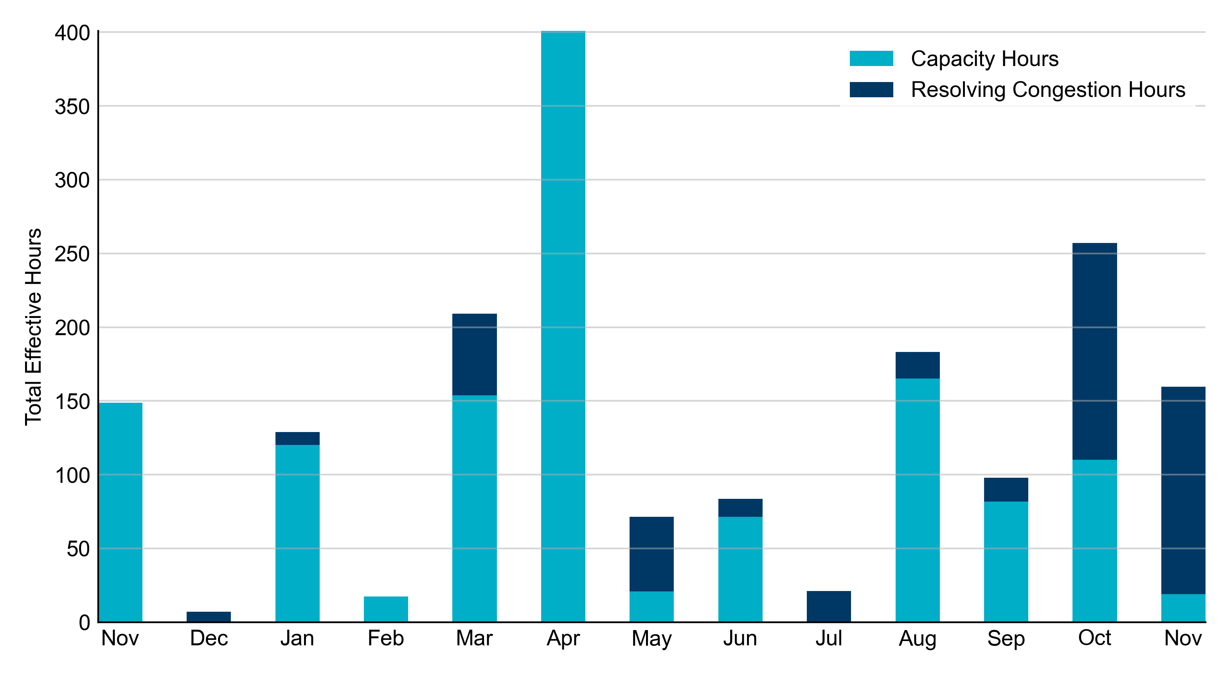
RUC Instruction Reasons: Last 13 Months RUC instructions in November 2024 were primarily to resolve congestion but also to ensure sufficient capacity.

Slide 4
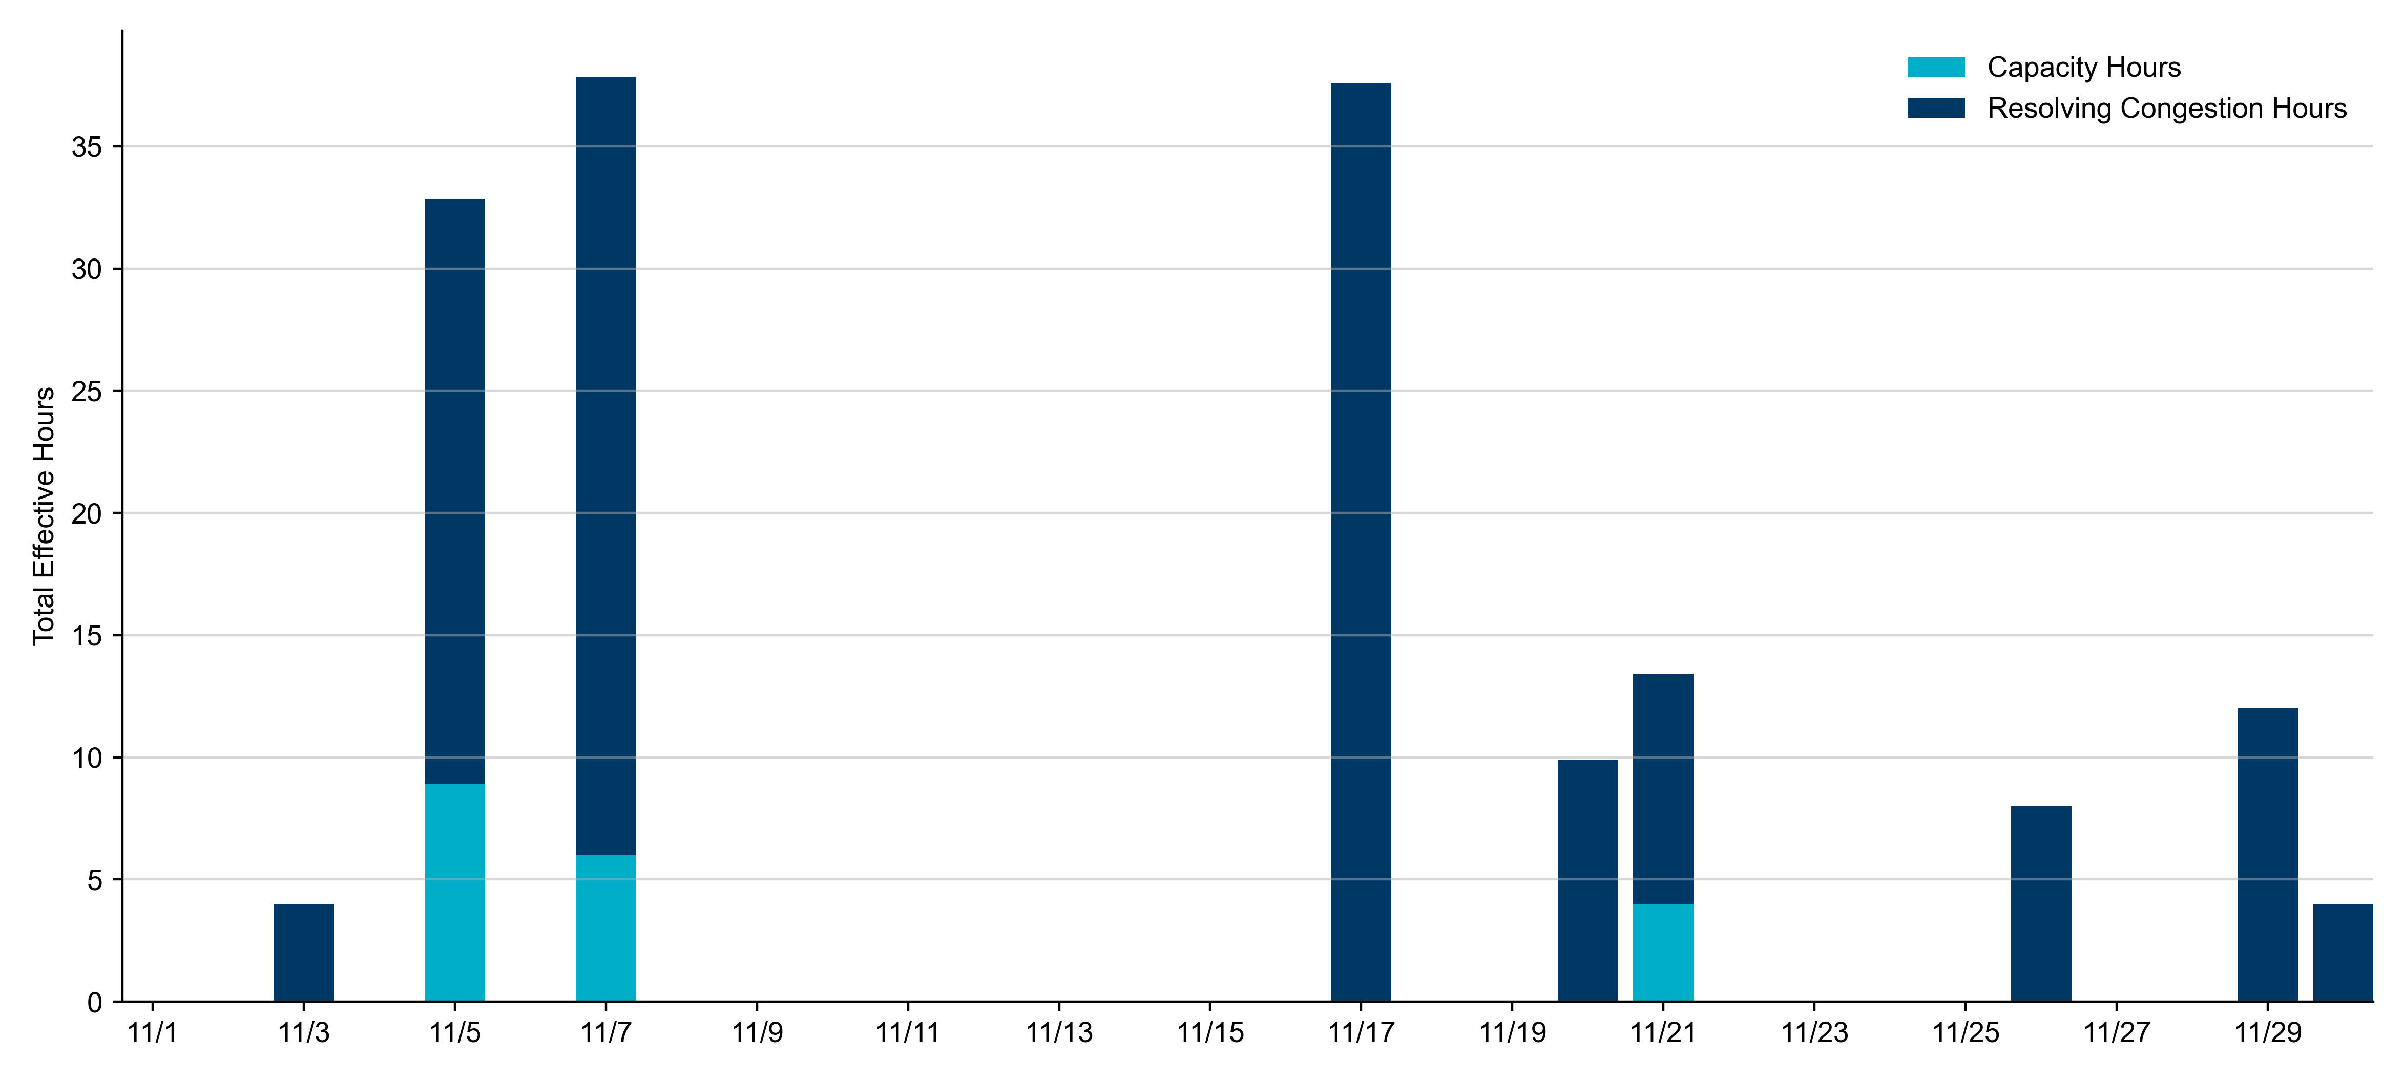
RUC Instruction Reasons in November 2024
159.6 RUC effective Resource-hours.
18.9 hours (11.85%) for capacity.
140.7 hours (88.15%) for congestion.

Slide 5
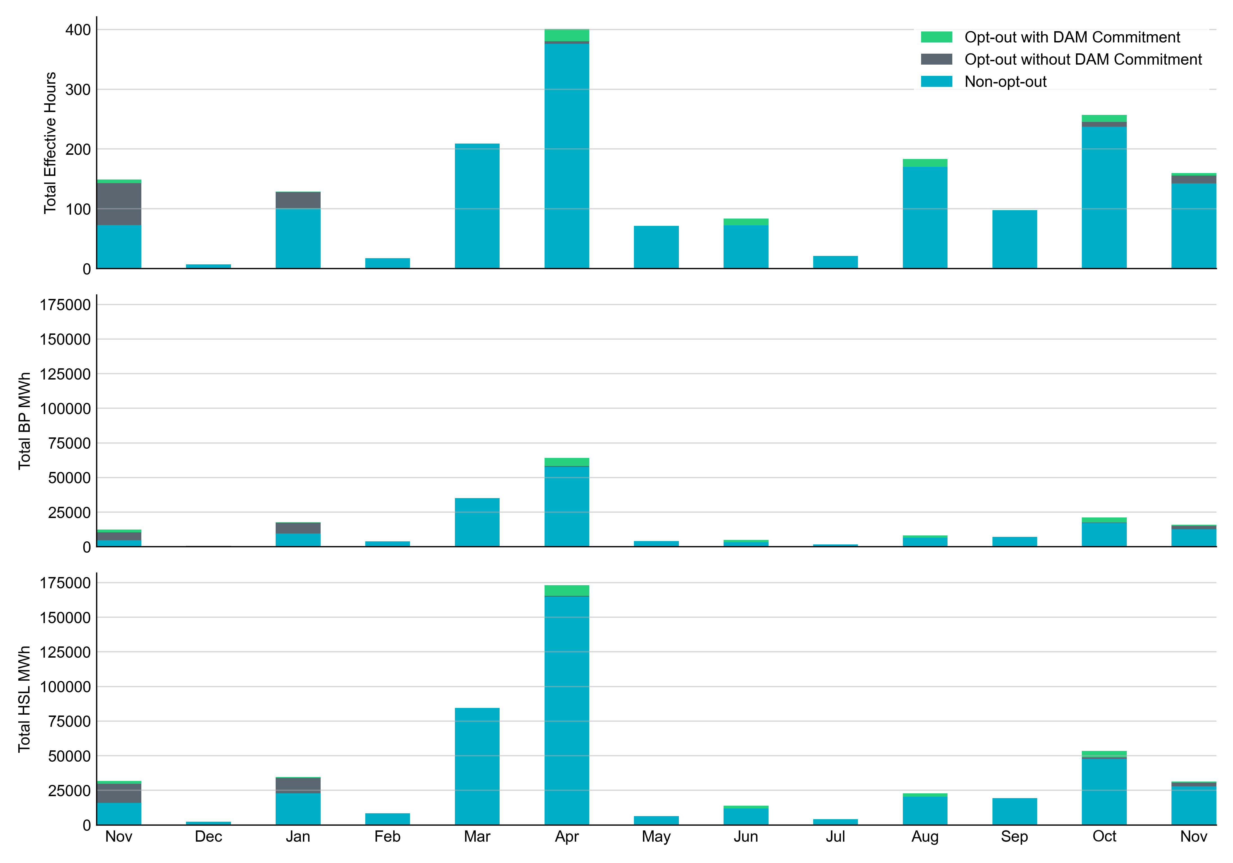
Non-opt-out and Opt-out Totals: Last 13 Months November 2024 had a total of 142.6 non-opt-out effective Resource-hours (89.35%) and 17.0 opt-out effective Resource-hours (10.65%).

Slide 6
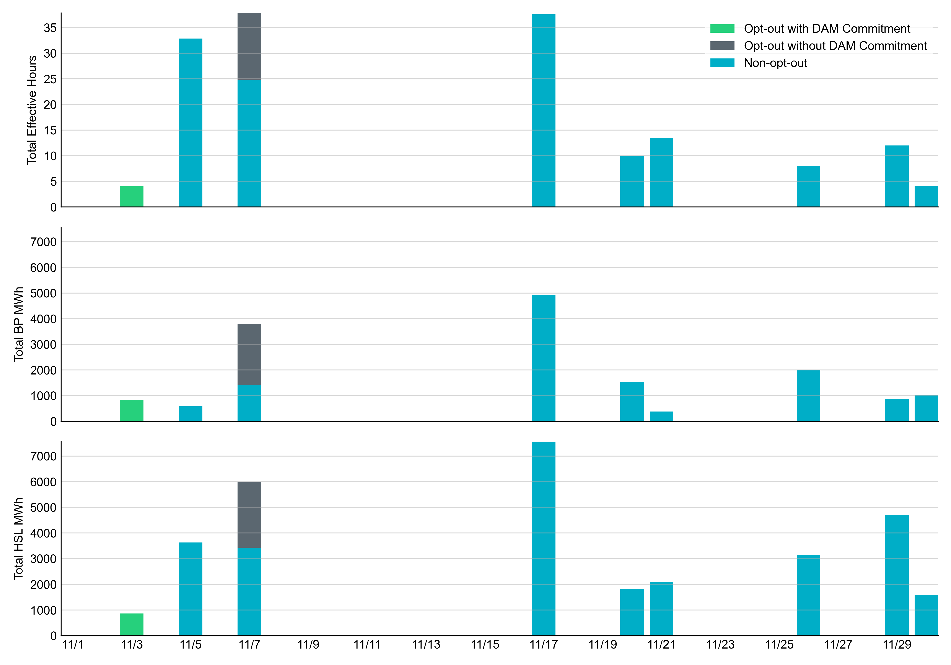
Non-opt-out and Opt-out Totals: November 2024

Slide 7
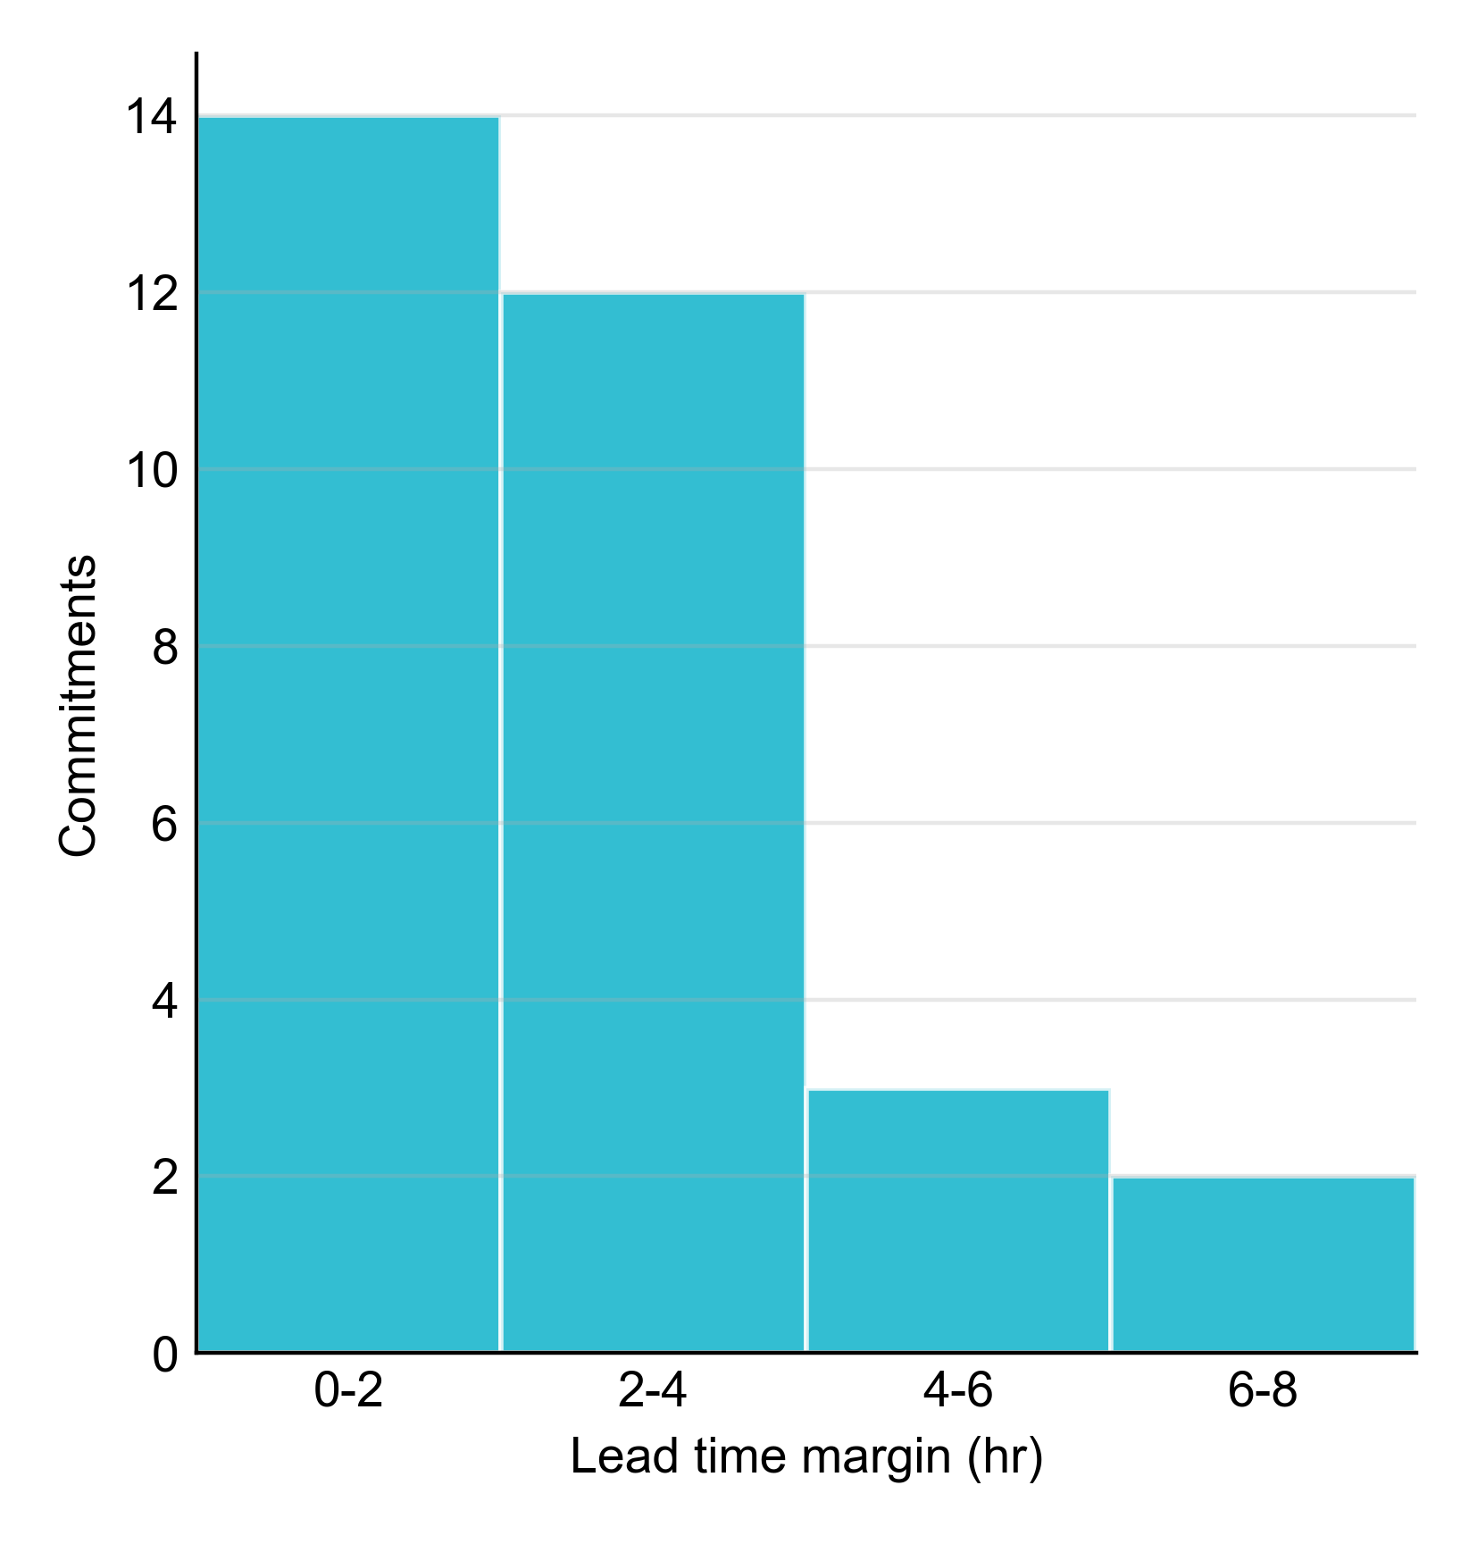
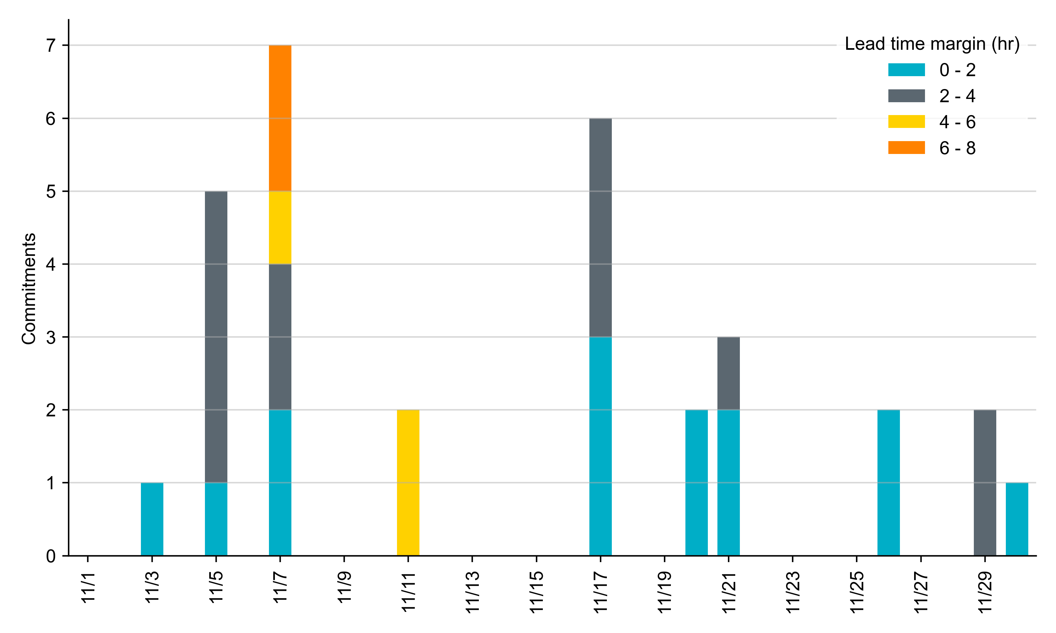
RUC Lead Time Margin: November 2024
Most RUC commitment windows (84%) had a lead time margin of 4 hours or less. However, 5 commitment windows (~16%) had lead times between 4 and 8 hours.
Lead time refers to the length of time between a RUC instruction and the start of the commitment window.
Lead time margin is the difference between lead time and the Resource’s startup time.
In cases where a Resource is committed for multiple back-to-back time blocks, lead time margin is calculated from the first instruction.

Slide 8
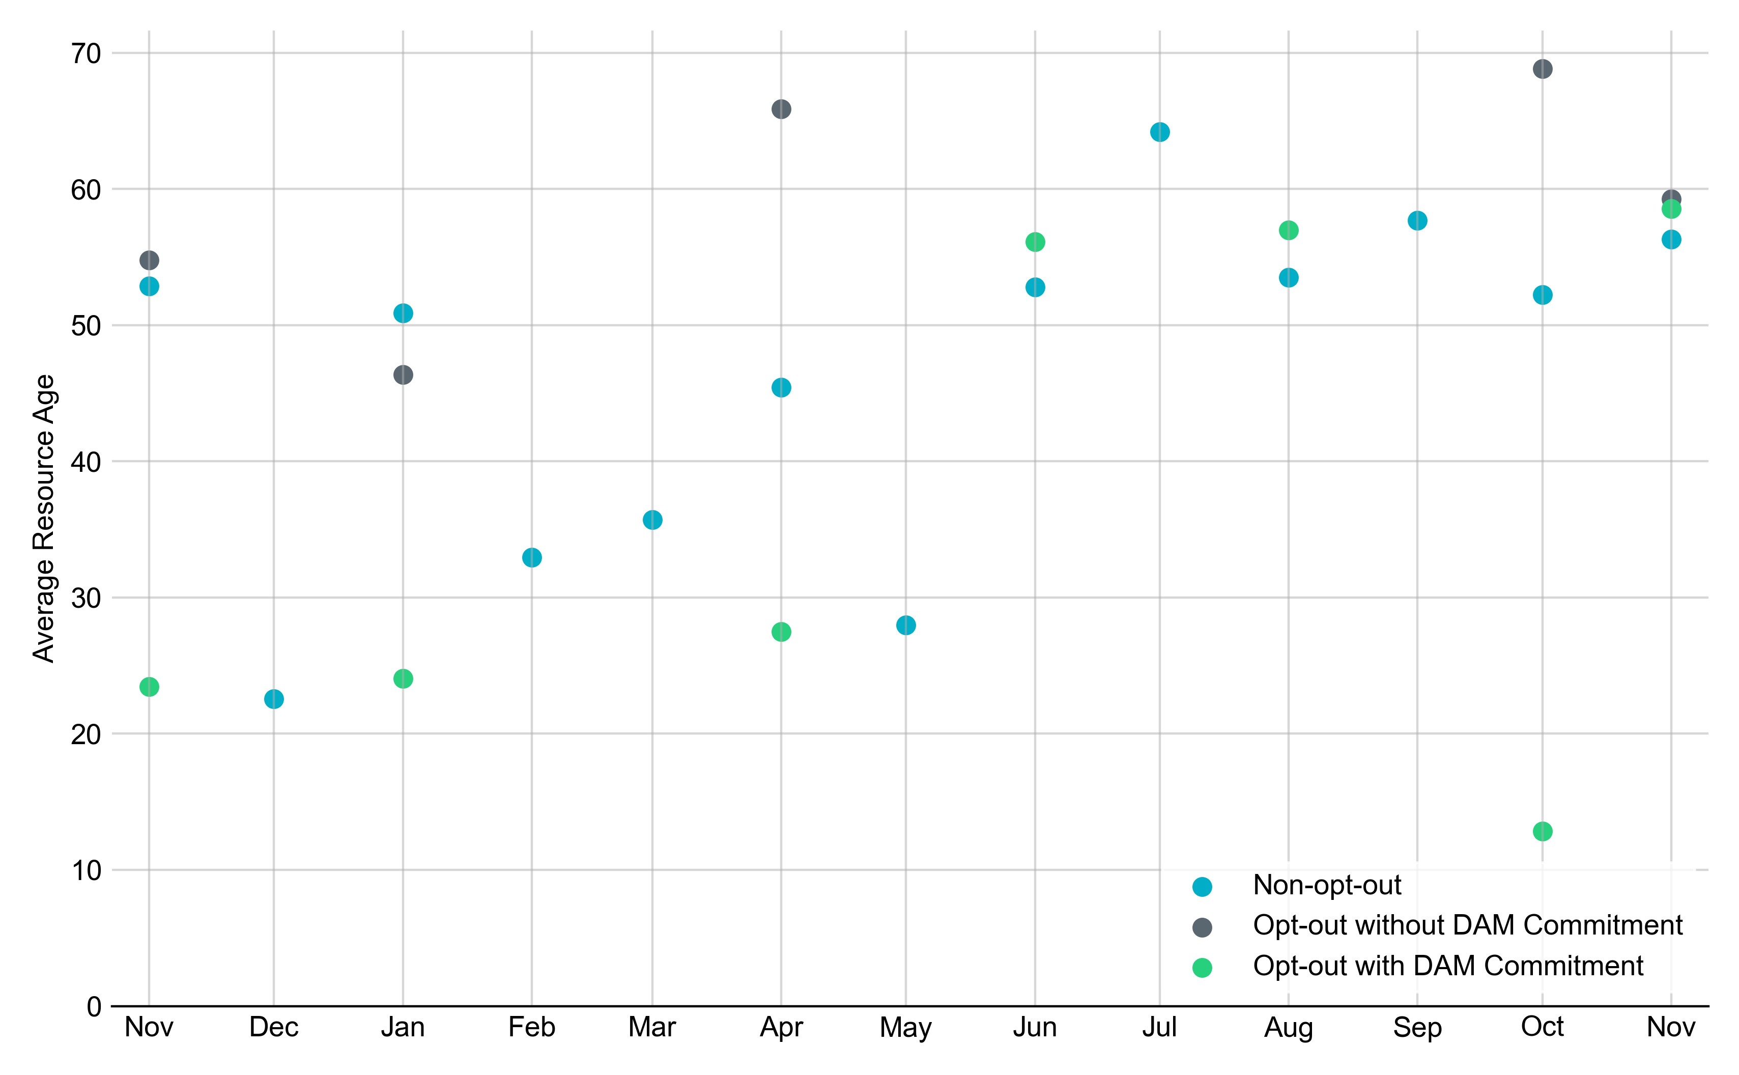
Average Resource Age: Last 13 Months In November 2024, the average age of RUC-committed Resources was 56.3 years for non-opt-out Resource-hours and 59.3 years for opt-out Resource-hours without DAM Commitments and 58.5 years for opt-out Resource-hours with DAM Commitments.
Note: For Resource configurations with multiple physical generators, the age of the oldest generator is used.

Slide 9
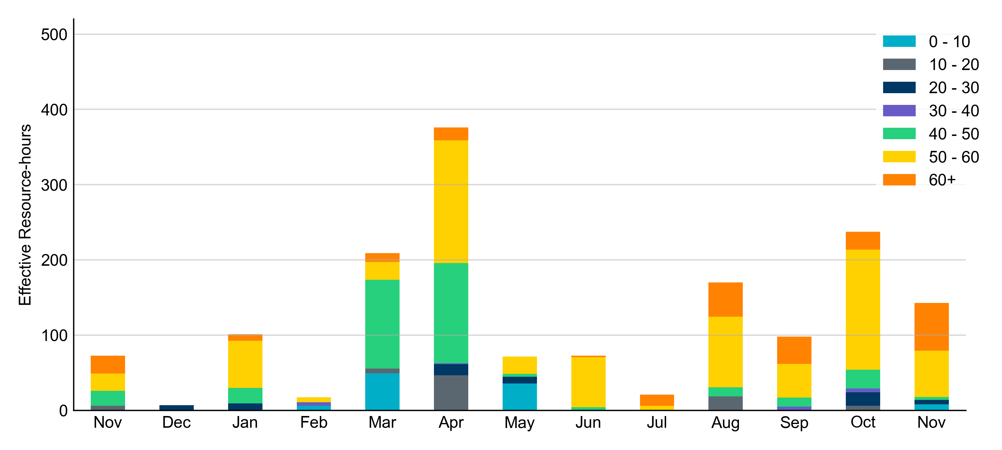
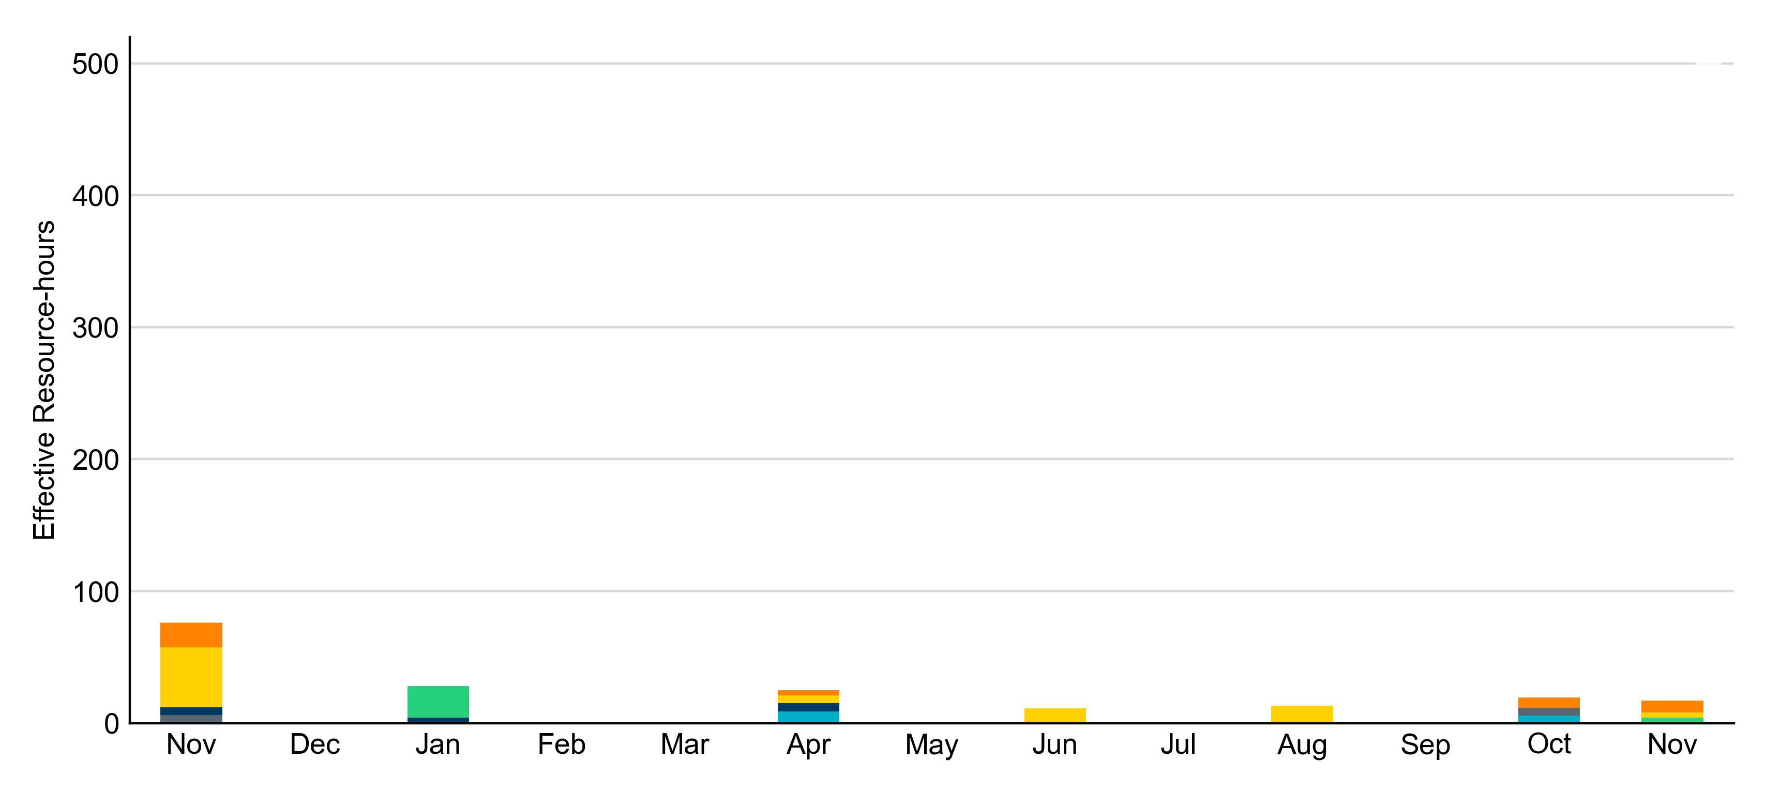
Age Category: Last 13 Months Most RUC-committed Resources in November 2024 were more than 50 years old.
Non-opt-out
Opt-out

Slide 10
RUC-Instructed Resource Dispatch above LDL
November 2024
There were 29.3 effective Resource-hours in which Resources that did not successfully opt out were dispatched above their LDL.
For 9.0 of these Resource-hours, the LMP for the RUC-instructed Resource was above the RUC offer floor.
For 20.3 of these Resource-hours, the LMP for the RUC-instructed Resource was below the RUC offer floor.
For these 20.3 Resource-hours, the RUC-instructed Resource was mitigated.
There were no Exceptional Fuel Cost submissions for any RUC-committed Resources.

Slide 11
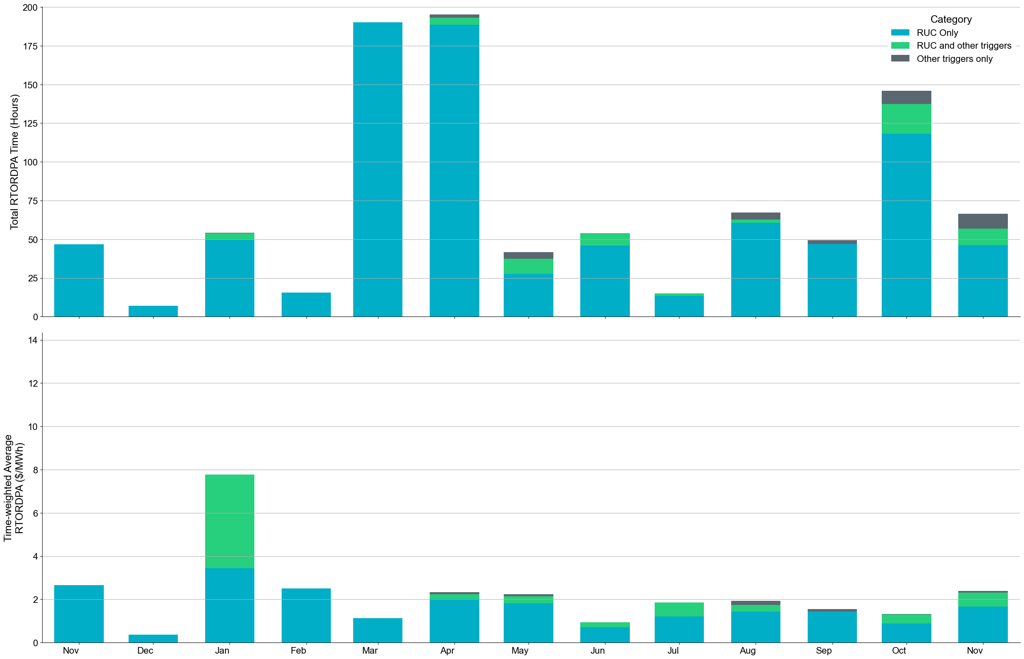
Reliability Deployment Price Adder: Last 13 Months November 2024 had a total of 70.44 RTORDPA hours with an average value of $0.77/MWh.
These graphs show RTORDPA instances by reliability action: 'RUC Only' for instances triggered solely by Reliability Unit Commitment, 'RUC and other triggers' for instances with RUC and additional triggers, and 'Other triggers only' for instances with non-RUC triggers. The daily average RTORDPA is calculated using the total duration across all categories. See ERCOT protocol section 6.5.7.3.1 for details.

Slide 12
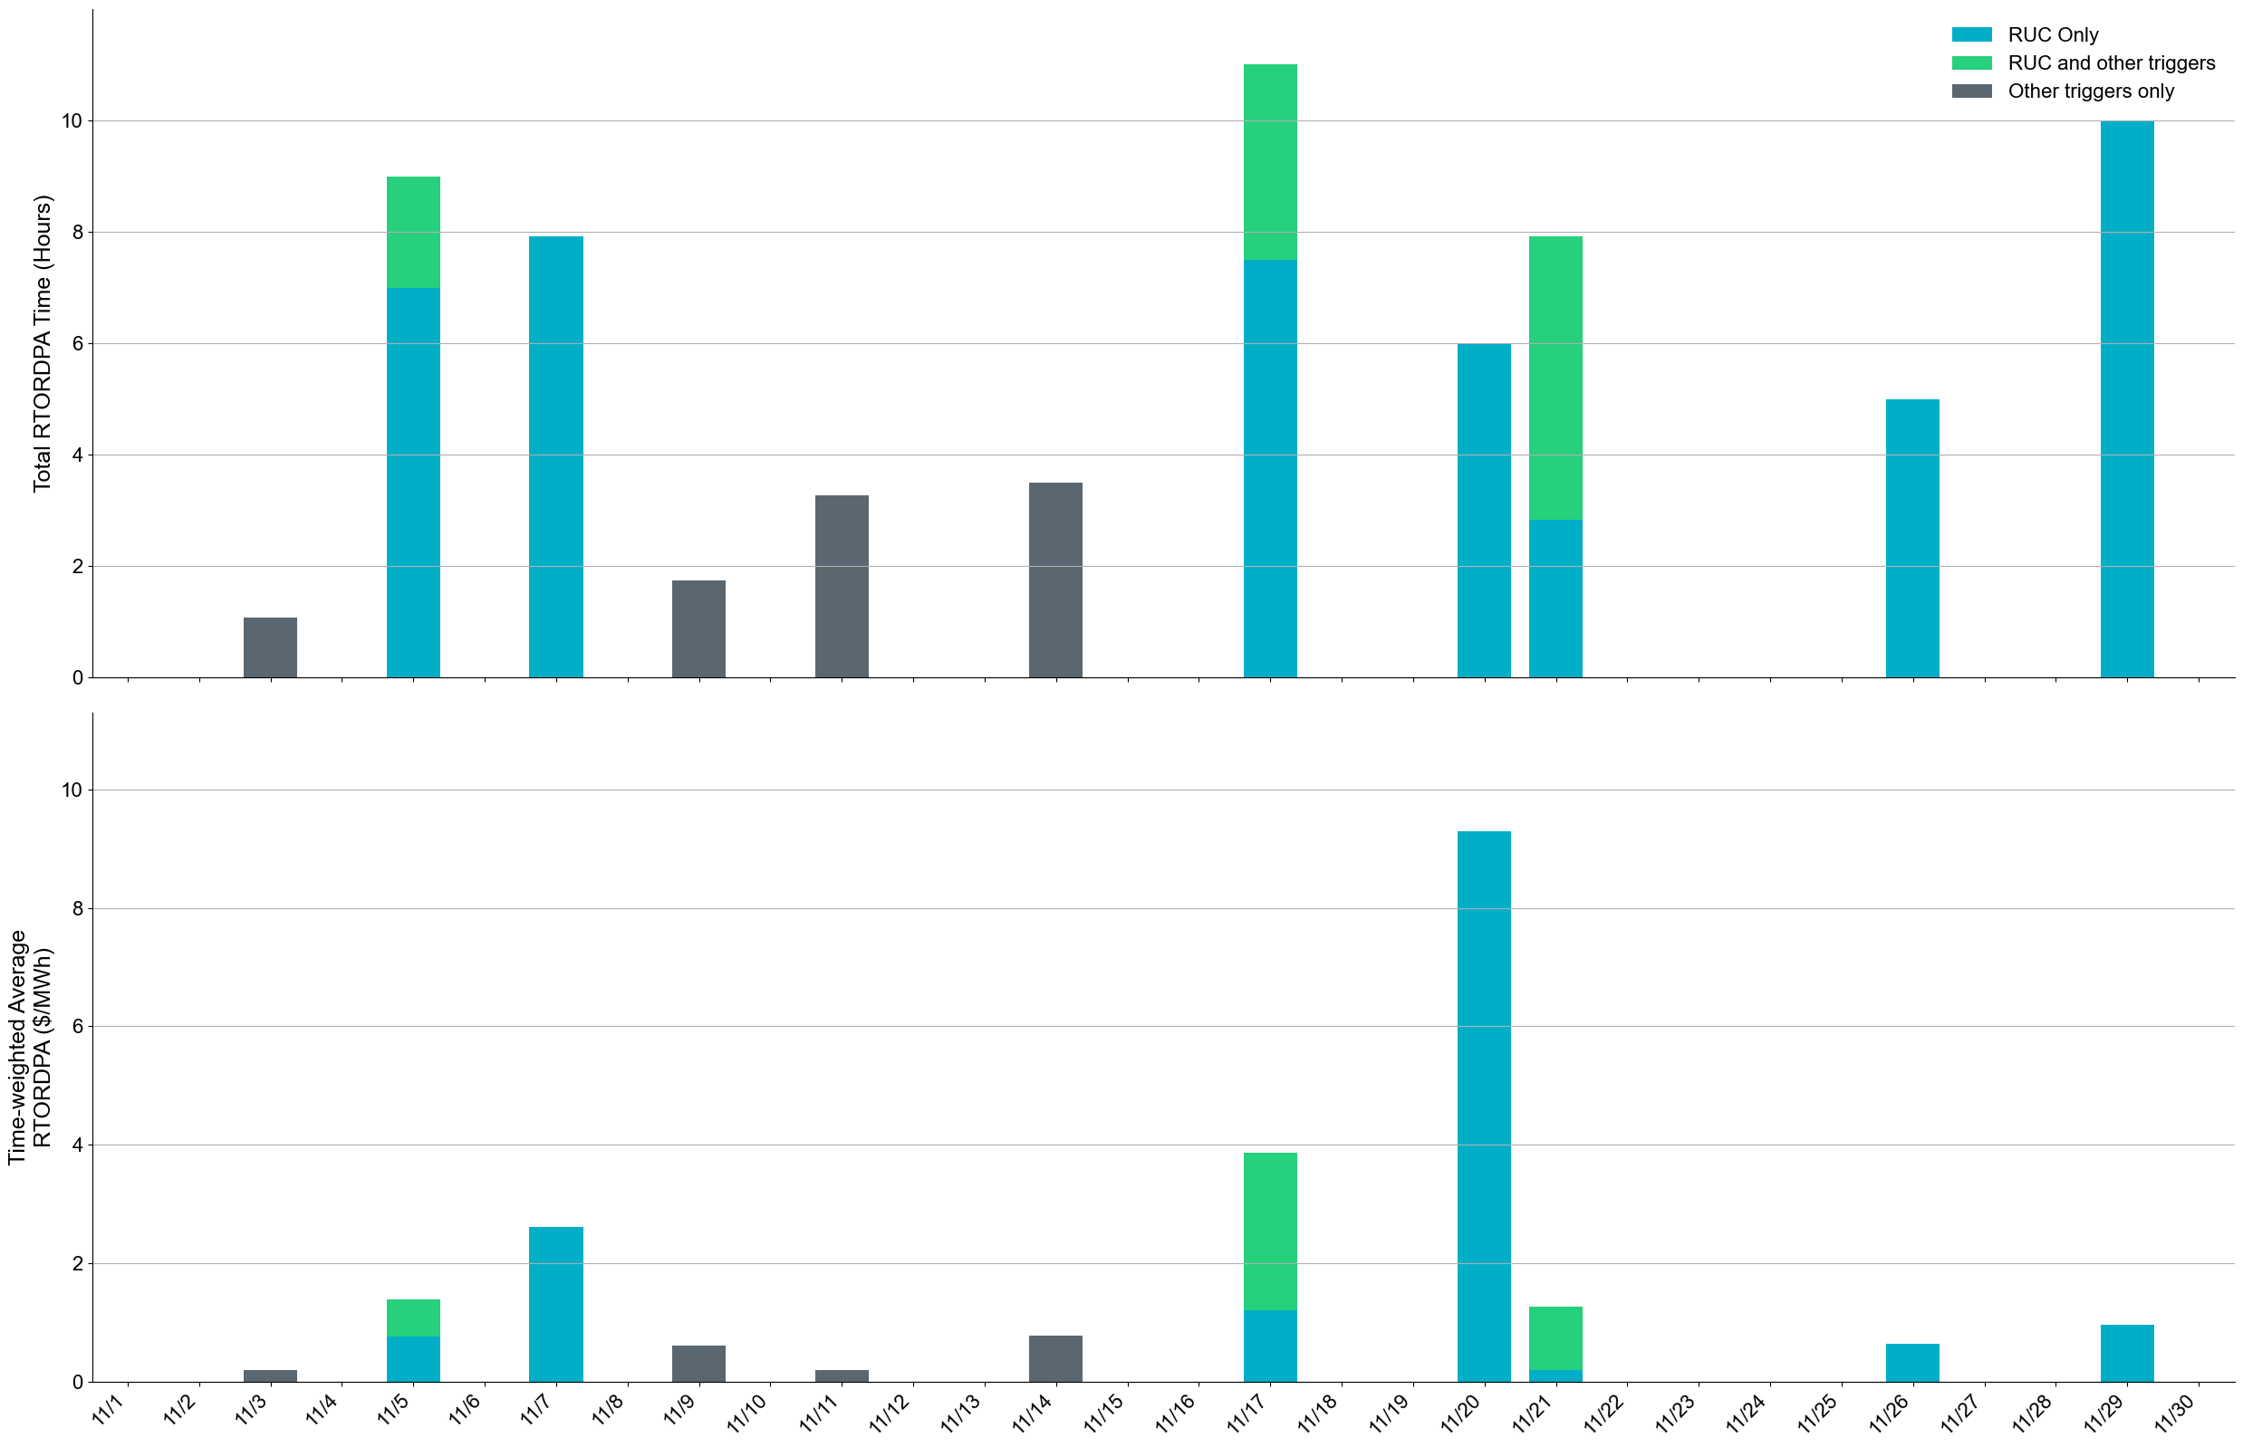
Reliability Deployment Price Adder: November 2024 OD 11/20 had the highest daily time-weighted average RTORDPA of $9.29/MWh.
These graphs show RTORDPA instances by reliability action: 'RUC Only' for instances triggered solely by Reliability Unit Commitment, 'RUC and other triggers' for instances with RUC and additional triggers, and 'Other triggers only' for instances with non-RUC triggers. The daily average RTORDPA is calculated using the total duration across all categories. See ERCOT protocol section 6.5.7.3.1 for more details.

Slide 13
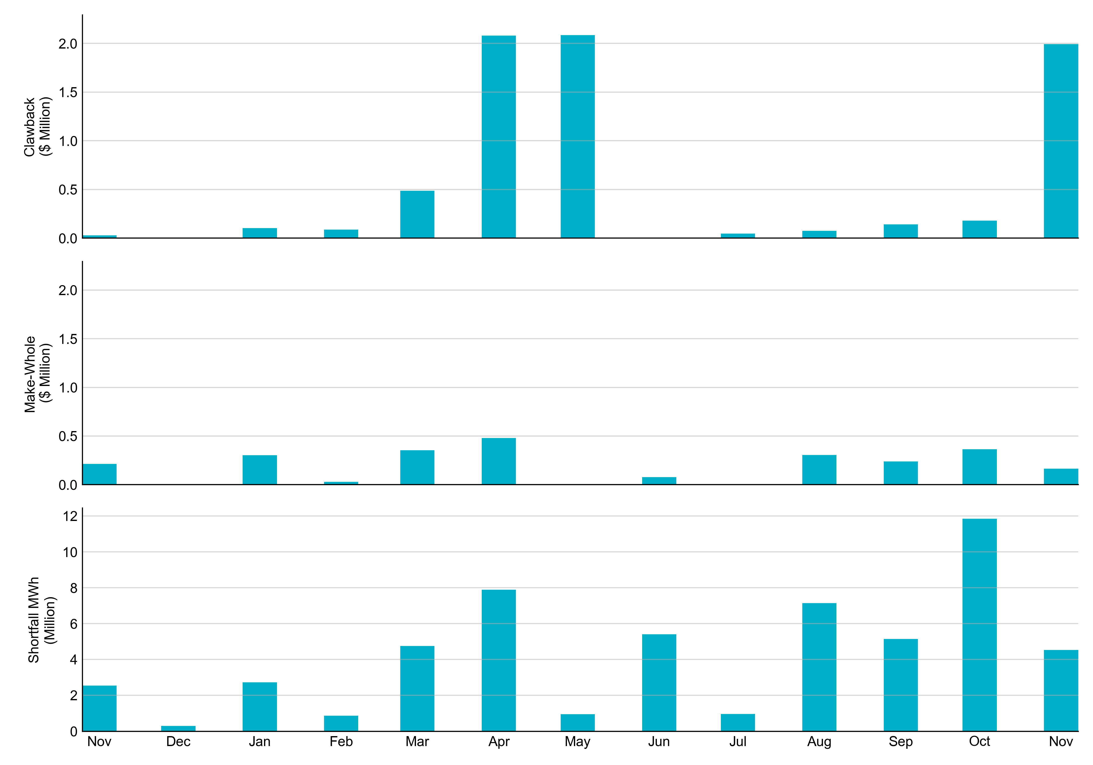
RUC Clawback, Make-Whole, and Shortfall For November 2024, the total Clawback Charge was $2.02M. The total Make-Whole Payment was $164,191.
Of the $2.02M in Make-Whole Payments made in November 2024, $0.91 was uplifted to load due to rounding.
The remaining amount was collected through Capacity-Short Charges.
Data as of December 6th, 2024

Slide 14
RUC Clawback by Settlement Type
Month | Initial Settlement ($) | Final Settlement Change ($) | True-up Settlement Change ($) | Net as of December 6, 2024 ($)
Nov ‘23 | 29,684 | 0 | 0 | 29,684
Dec ‘23 | 0 | 0 | 0 | 0
Jan ‘24 | 107,176 | -4,657 | 0 | 102,519
Feb ‘24 | 88,220 | 0 | 0 | 88,220
Mar ‘24 | 487,193 | 0 | 0 | 487,193
Apr ‘24 | 2,092,224 | 0 | -11,819 | 2,080,406
May ‘24 | 2,084,416 | 0 | 0 | 2,084,416
Jun ’24 | 58 | 0 | - | -
Jul ‘24 | 47,627 | 0 | - | -
Aug ‘24 | 73,690 | 0 | - | -
Sep ‘24 | 140,239 | 0 | - | -
Oct ‘24 | 179,331 | - | - | -
Nov ‘24 | 2,022,874 | - | - | -
Negative dollars represent a payment from ERCOT to a market participant
“-” indicates settlement has yet to be completed.
Net figures may differ slightly due to rounding.

Slide 15
RUC Make-Whole by Settlement Type
Month | Initial Settlement ($) | Final Settlement Change ($) | True-up Settlement Change ($) | Net as of December 6, 2024 ($)
Nov ‘23 | -194,731 | 0 | -17,934 | -212,665
Dec ‘23 | -5,316 | 0 | 0 | -5,316
Jan ‘24 | -253,466 | -79,942 | 31,417 | -301,990
Feb ‘24 | -19,673 | 0 | -9,004 | -28,678
Mar ‘24 | -353,562 | 0 | 0 | -353,562
Apr ‘24 | -443,178 | 0 | -35,271 | -478,449
May ‘24 | -2,957 | 0 | 0 | -2,957
Jun ’24 | -76,670 | 0 | - | -
Jul ‘24 | -4,297 | 0 | - | -
Aug ‘24 | -305,171 | 0 | - | -
Sep ‘24 | -239,681 | 0 | - | -
Oct ‘24 | -364,395 | - | - | -
Nov ‘24 | -164,191 | - | - | -
Negative dollars represent a payment from ERCOT to a market participant
“-” indicates settlement has yet to be completed.
Net figures may differ slightly due to rounding.

