Slide 1
Relay Loadability Ratings and ESR Data Collection
Joel Koepke

Slide 2
Review of Relay Loadability Ratings on Generation Facilities
ERCOT Operations has requested the review of facility ratings in which the 15-Minute Rating is equal to the Relay Loadability Rating (RLR)
“can operate for 15 minutes”
“relay tripping is expected”

Slide 3
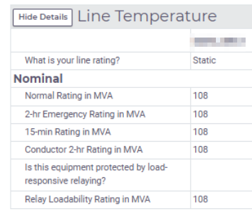
Review of Relay Loadability Ratings on Generation Facilities
The ERCOT Modeling team has sent out requests for verification for each Resource Entity where the 15-Minute and Relay Loadability ratings match
Request:
If needed, create a RIOO Change Request to modify the RLR value
Answer “no” to the relaying question if there is no relaying in the field, or
Update the RLR value
If no changes are necessary, please respond back to the initial request email with a brief explanation

Slide 4
Continuation of ESR Data Collection Requests
ERCOT will begin RTC+B Market Trials on May 5th 2025. To ensure quality testing, missing or invalid data associated with ESRs must be corrected.
In early January, ERCOT will send notification via Market Notice about the continuation of ESR data collection. Tentatively the due date for this effort is mid February.
The following type of information will be requested:
Verification of State of Charge values
Corrections to charging reactive capability curves
Population and/or correction of other data attributes within RIOO
https://www.ercot.com/files/docs/2024/11/18/11-rtcbtf-report.zip - Slide 3

