Slide 1
ERCOT Frequency Events
November 2024
ERCOT
Operations Planning
PDCWG | December 17, 2024

Slide 2
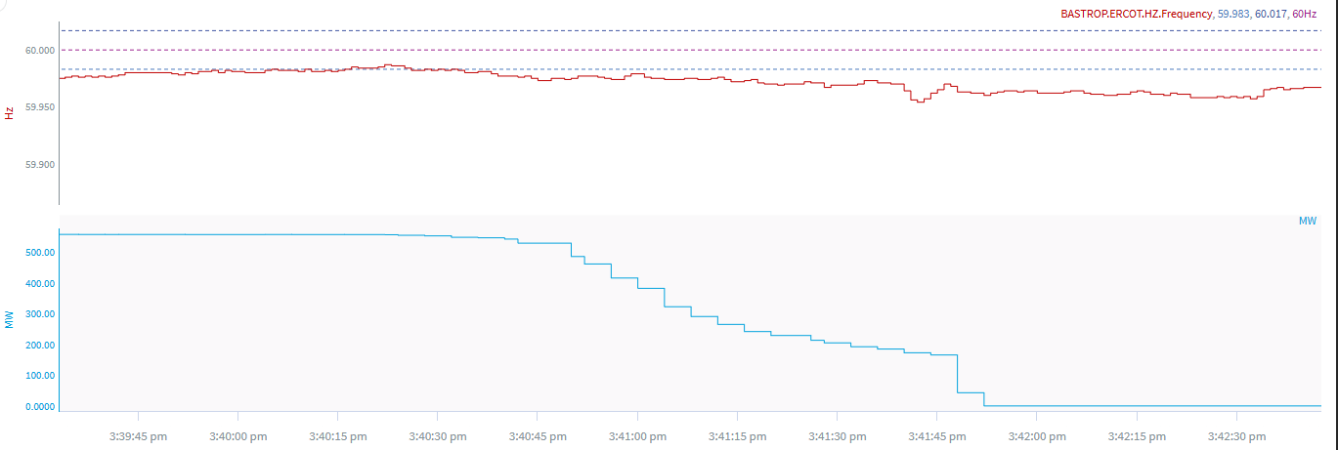
11/7/2024 15:41:39 (Non-FME)
Notes:
The unit tripped in blocks for a loss of approximately 543 MW
Starting Frequency: 59.970 Hz
Minimum Frequency: 59.954 Hz
A-C Time : 3 seconds
Recovery Time(back to deadband): 5 minutes 41 seconds
ECRS Released: 0 MW
Trip Reason: Unknown at this time.
Contextual Information: A total of 265 MW of regulation Up was deployed during the event
No Selection Reason: Unit trip is not clean and small event

Slide 3
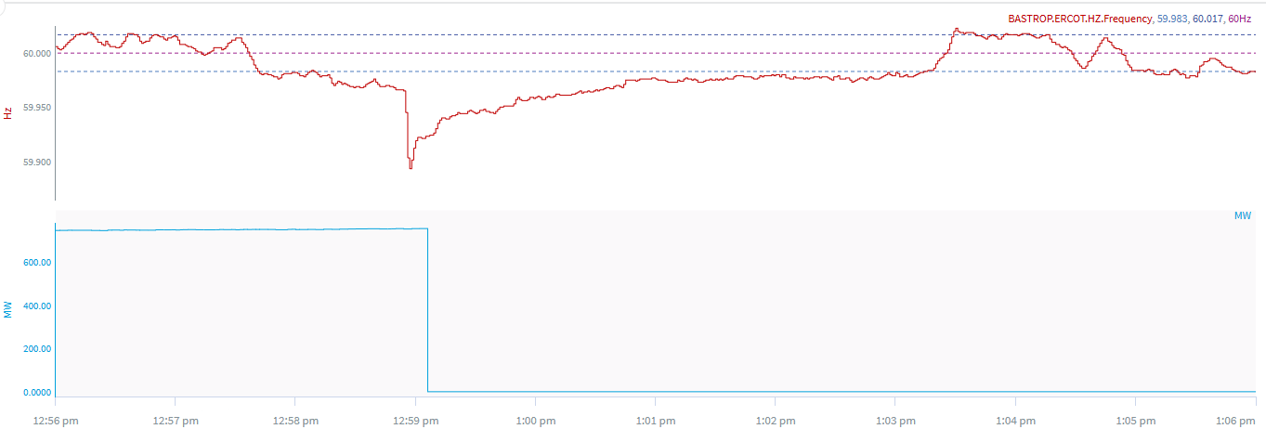
11/17/2024 12:58:54 (Non-FME)
Notes:
The unit tripped for a loss of approximately 754 MW
Starting Frequency: 59.965 Hz
Minimum Frequency: 59.893 Hz
A-C Time : 3 seconds
Recovery Time(back to deadband): 4 minutes 20 seconds
ECRS Released: 476 MW
Trip Reason: Unknown at this time.
Contextual Information: A total of 285 MW of regulation Up was deployed during the event
No Selection Reason: Frequency is outside low deadband

Slide 4
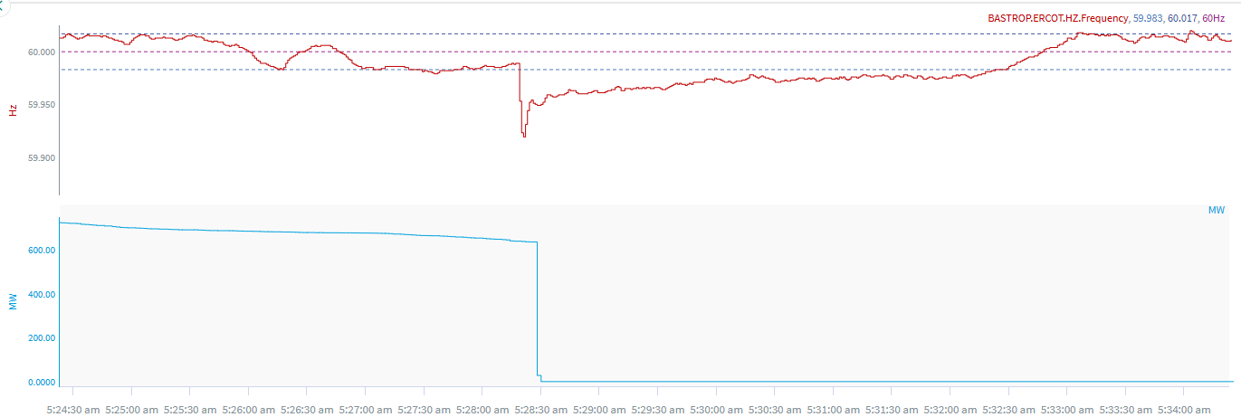
11/21/2024 5:28:17 (Non-FME)
Notes:
The unit experienced runback and tripped offline while carrying ~637 MW
Starting Frequency: 59.989 Hz
Minimum Frequency: 59.921 Hz
A-C Time : 4 seconds
Recovery Time(back to deadband): 4 minutes 6 seconds
ECRS Released: 0 MW
Trip Reason: Instrument air issues
Contextual Information: A total of 415 MW of regulation Up was deployed during the event
No Selection Reason: Frequency is outside low deadband

Slide 5
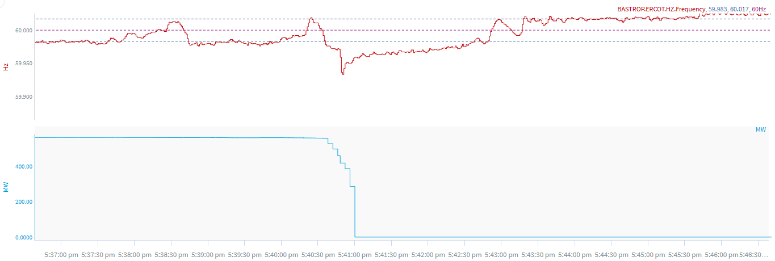
11/23/2024 17:40:33 (Non-FME)
Notes:
The unit tripped offline while carrying ~557 MW
Starting Frequency: 59.998 Hz
Minimum Frequency: 59.934 Hz
A-C Time : 17 seconds
Recovery Time(back to deadband): 2 minutes 16 seconds
ECRS Released: 0 MW
Trip Reason: ID fan
Contextual Information: A total of 611 MW of regulation Up was deployed during the event
No Selection Reason: Frequency is outside low deadband and unit experienced runback

Slide 6
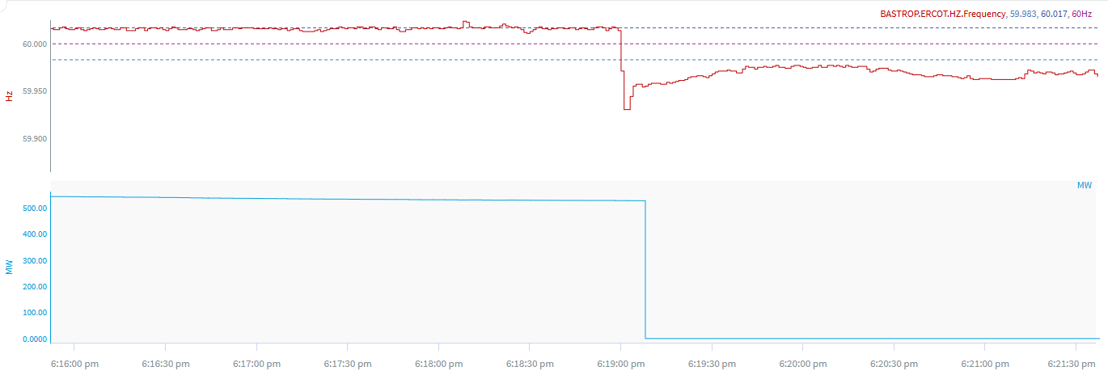
11/23/2024 18:18:58 (Non-FME)
Notes:
The unit tripped offline while carrying ~527 MW
Starting Frequency: 60.018 Hz
Minimum Frequency: 59.928 Hz
A-C Time : 3 seconds
Recovery Time(back to deadband): 12 minutes 44 seconds
ECRS Released: 0 MW
Trip Reason: Unknown at this time.
Contextual Information: A total of 716 MW of regulation Up was deployed during the event
No Selection Reason: Unit trip was not clean

Slide 7
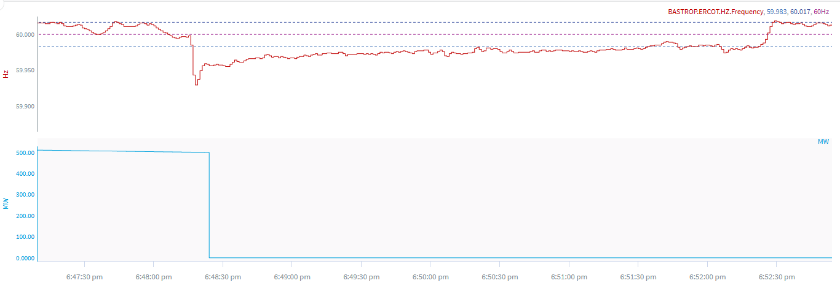
11/23/2024 18:48:15 (Non-FME)
Notes:
The unit experienced runback and tripped offline while carrying ~499 MW
Starting Frequency: 59.998 Hz
Minimum Frequency: 59.929 Hz
A-C Time : 3 seconds
Recovery Time(back to deadband): 3 minutes 20 seconds
ECRS Released: 0 MW
Trip Reason: Unknown at this time.
Contextual Information: A total of 716 MW of regulation Up was deployed during the event
No Selection Reason: Unit experienced runback

Slide 8
11/27/2024 6:59:36 (Non-FME)
Notes:
The two units tripped offline while carrying a total of ~630 MW
Starting Frequency: 60.012 Hz
Minimum Frequency: 59.978 Hz
A-C Time : 26 seconds
Recovery Time(back to deadband): 8 minutes 38 seconds
ECRS Released: 0 MW
Trip Reason: Unknown at this time.
Contextual Information: A total of 290 MW of regulation Up was deployed during the event. Units had bad quality data at time of trip.
No Selection Reason: Unit trip was not clean

Slide 9
Questions?
Thank you!

