Slide 1
PGRR088, PGRR094 and other RIOO Updates
December 19, 2024

Slide 2
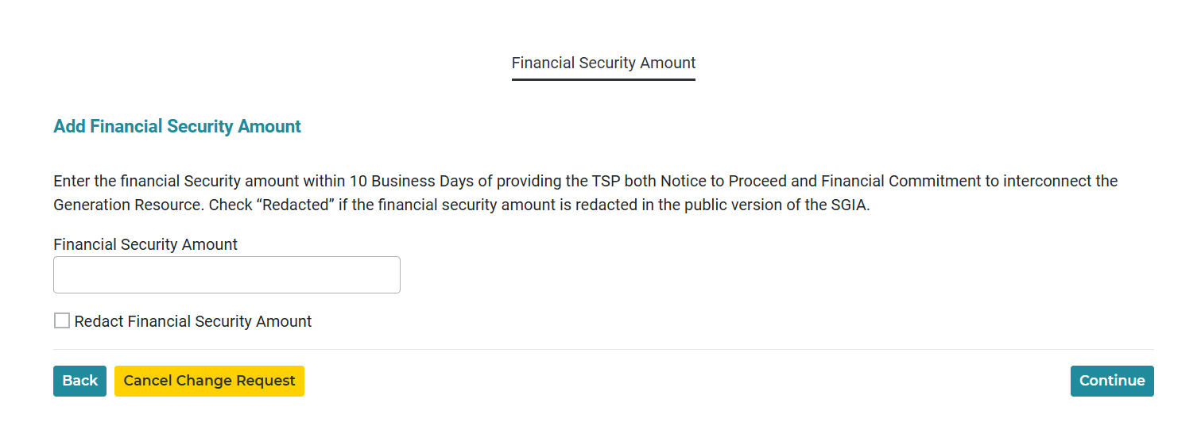
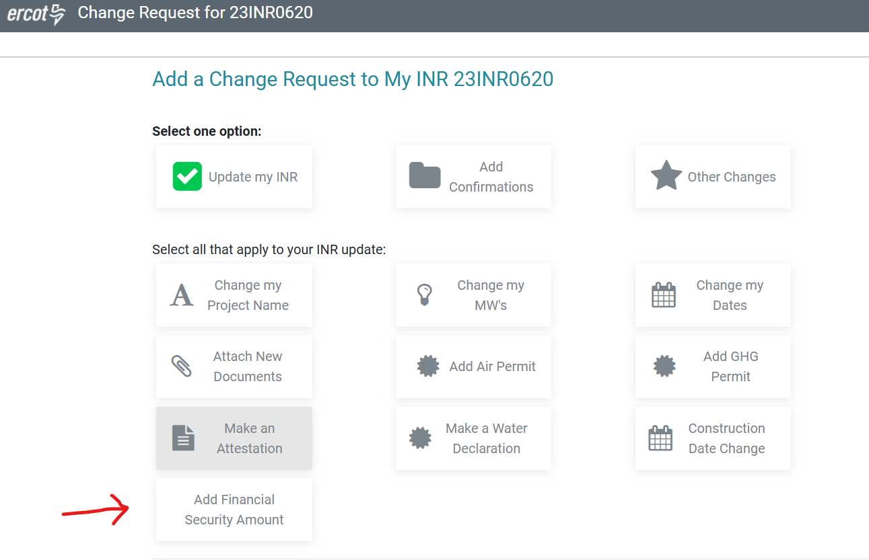
PGRR088 – Capture Financial Security Amount
PGRR088
  RE/IE can provide the financial security amount as a change request in RIOO-IS within 10 business days of providing the TSP both the notice to proceed and financial commitment to interconnect the Generation Resource.
  Option to redact if the financial security amount is redacted in the public version of SGIA.
RIOO Application changes

Slide 3
Added new Technology and Fuel Types
New Technology Types
  BL – Battery storage, lithium-ion
  BO – Battery storage, other
  SO – storage, other (thermal, flywheel, gravity, etc.)
  SG – storage, geopressured steam
New Fuel Type
  Energy Storage
ESR Workflow
  BAT/BL
  BST/BO
  MWH/SO
  GEO/SG

Slide 4
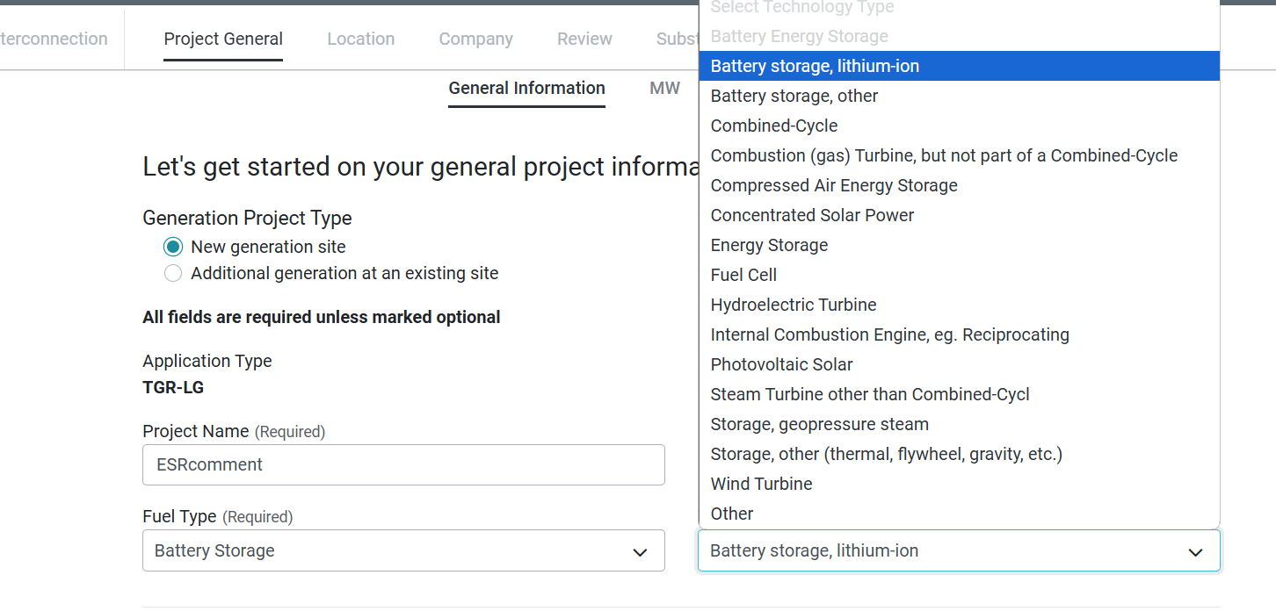
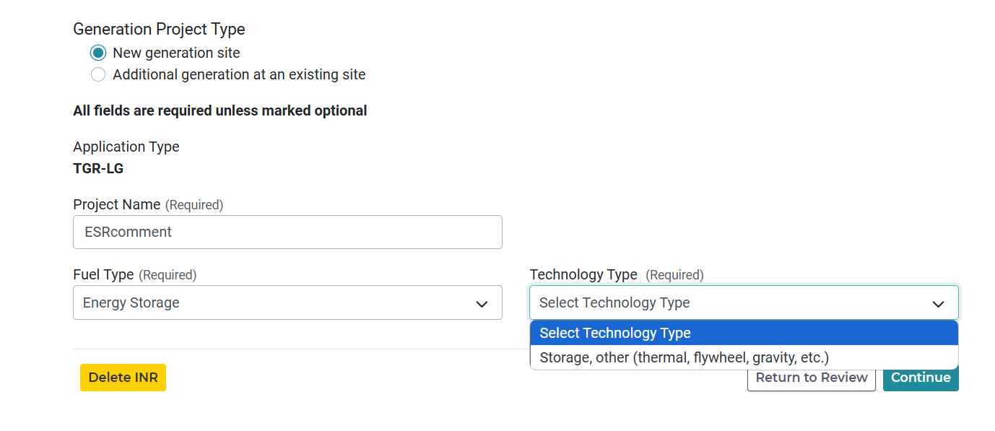
Added new Technology and Fuel Types

Slide 5
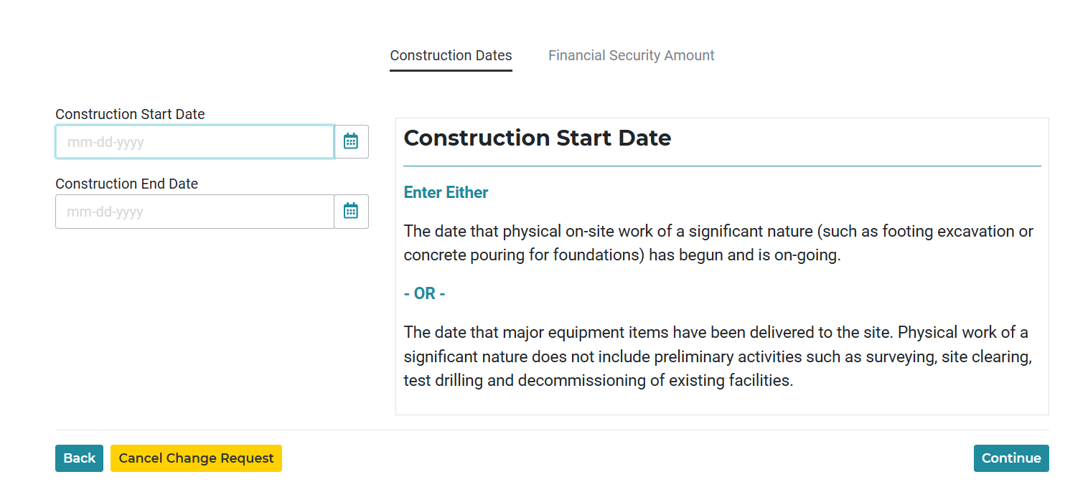
PGRR094 – Construction Dates

Slide 6
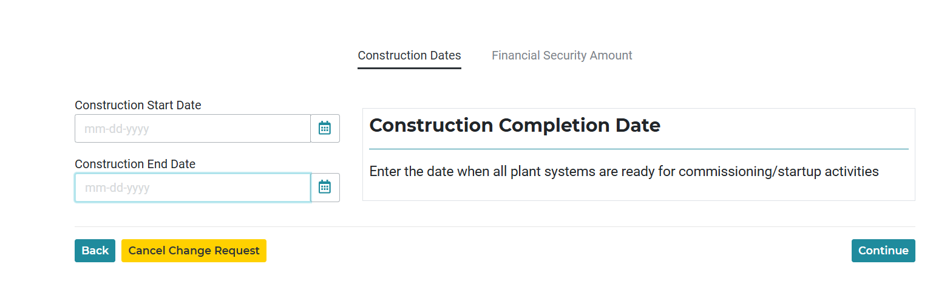
PGRR094 – Construction Dates

Slide 7
RIOO-IS ESR Conversions
Migration of Combo to Single model ESRs in RIOO-IS
  In the process of converting Combo models with the PLD of December, January, February and March.
  Targeting to convert the remaining models in the first quarter of 2025

