Slide 1
ERCOT Technology Working Group (TWG)
December 19, 2024

Slide 2
ERCOT TWG
WELCOME

Slide 3
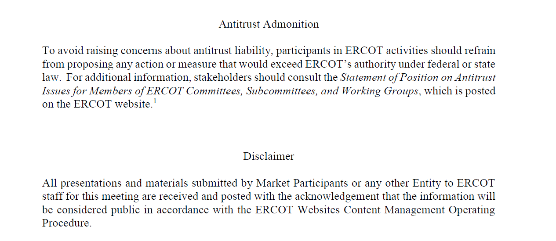
ERCOT TWG

Slide 4
ERCOT TWG Agenda
Item # | Item Description | Presenter | Start Time
1 | Antitrust admonition | Blake Holt (LCRA) | 2:00 PM
2 | Project Updates | Troy Anderson | 2:05 PM
3 | RTC+B Updates | Sruthi Hariharan/Kevin McGarrahan | 2:15 PM
4 | NPRR1253 and NPRR1226 Updates | Mark Patterson | 2:30 PM
5 | ERCOT.COM Dashboard Roadmap | Amy Lofton | 2:40 PM
6 | Center Point DPC Submission Process | Y-M Yatar (CNP) | 2:55PM
7 | Round Table Discussion | Blake Holt (LCRA)/Sreenivas Badri | 3:25 PM
8 | Adjourn | Blake Holt (LCRA) | 3:40 PM

Slide 5
Project Updates
Project Updates – Troy Anderson

Slide 6
RTC+B Updates
RTC+B Updates – Sruthi Hariharan/Kevin McGarrahan

Slide 7
NPRR1253 and NPRR1226 Updates
NPRR1253 and NPRR1226 Updates – Mark Patterson

Slide 8
ERCOT.COM Dashboard Roadmap
ERCOT.COM Dashboard Roadmap – Amy Lofton

Slide 9
Center Point DPC Submission Process
Center Point DPC Submission Process – Y-M Yatar (CNP)

Slide 10
ERCOT TWG – Round Table Discussion
ERCOT TWG – Round Table Discussion
  2025 TWG Meeting Schedule
  Seeking Vice-Chair Nominations
  Future Topics of Interest
  Topics and presentations from TWG members

Slide 11
ERCOT TWG
Thank You
You can reach Sreenivas at
Sreenivas.Badri@ercot.com and Blake at Blake.Holt@LCRA.ORG

