Slide 1
Credit Exposure Update
Market Credit Work Group
ERCOT Public
December 19, 2024

Slide 2
Monthly Highlights: October 2024 – November 2024
Market-wide average Total Potential Exposure (TPE) decreased from $1.73 billion in October 2024 to $1.62 billion in November 2024
TPE decreased due to lower real-time forward adjustment factors
Discretionary Collateral is defined as Secured Collateral in excess of TPE,CRR Locked ACL and DAM Exposure
Average Discretionary Collateral increased from $3.82 billion in October 2024 to $3.99 billion in November 2024
One trade-only entity defaulted on collateral requirements (no uplift to the market)

Slide 3
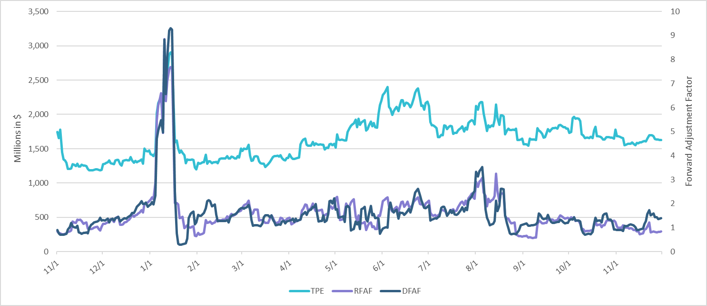
TPE and Forward Adjustment Factors: November 2023 – November 2024

Slide 4
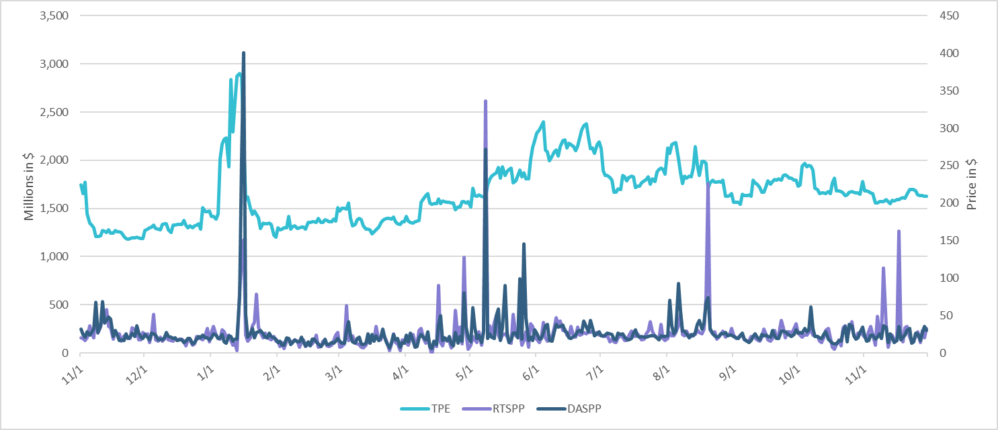
TPE/Real-Time & Day-Ahead Daily Average Settlement Point Prices for HB_NORT:H November 2023 – November 2024

Slide 5
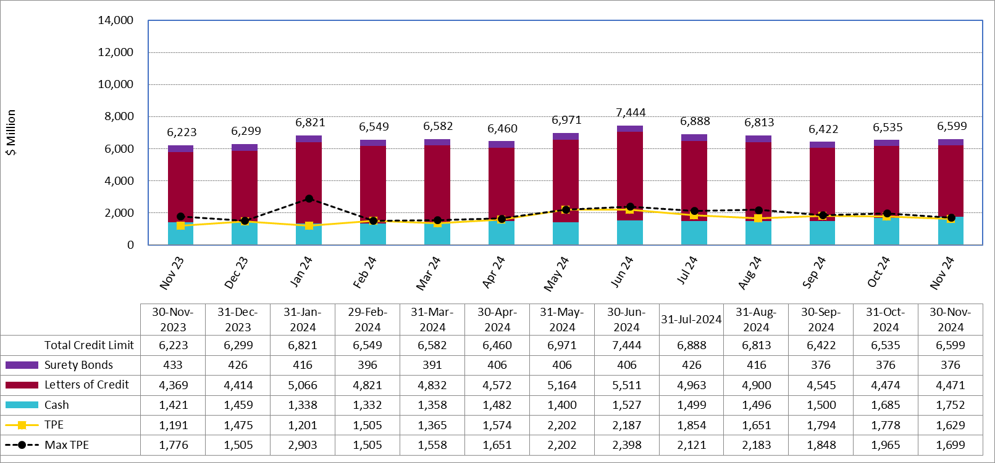
Available Credit by Type Compared to Total Potential Exposure (TPE): November 2023 – November 2024
Numbers are as of month-end except for Max TPE
Max TPE is the highest TPE for the corresponding month

Slide 6
Issuer Credit Limits vs Total LC Amounts Per Issuer: End-November 2024
As of November 30, 2024
There are a total of 35 banks that have issued LCs.

Slide 7
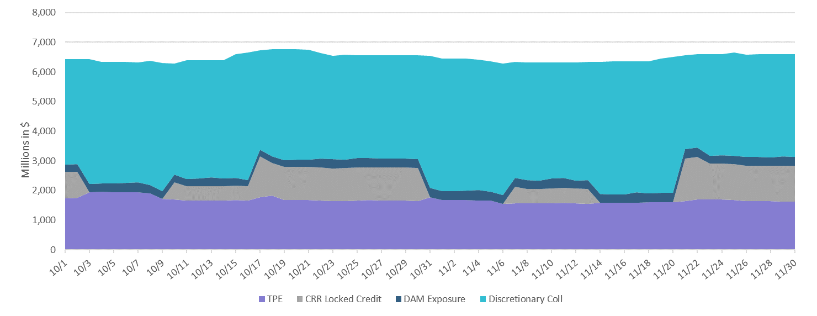
Discretionary Collateral October 2024 – November 2024

Slide 8
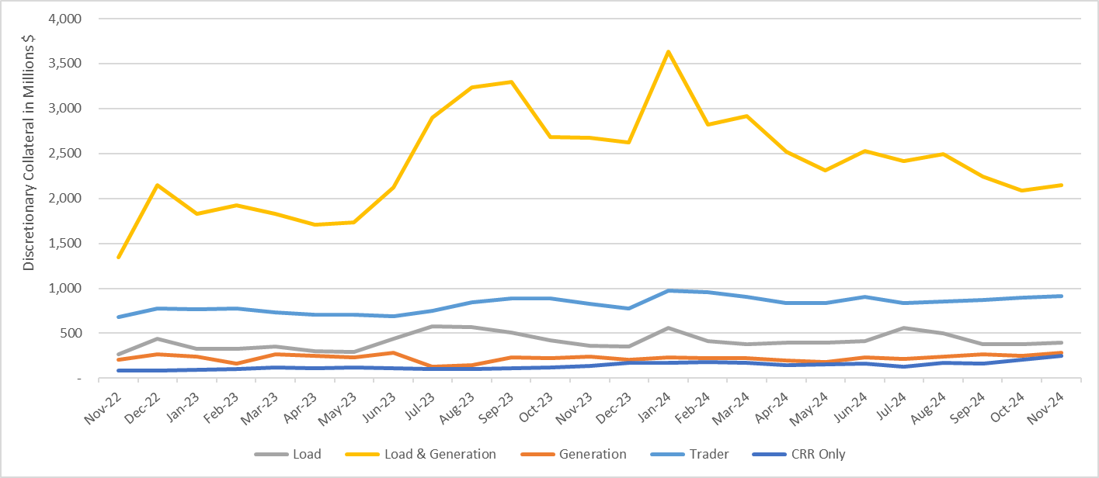
Discretionary Collateral by Market Segment November 2022 - November 2024
* Discretionary Collateral adjusted to exclude short pay amounts eliminating data skew

Slide 9
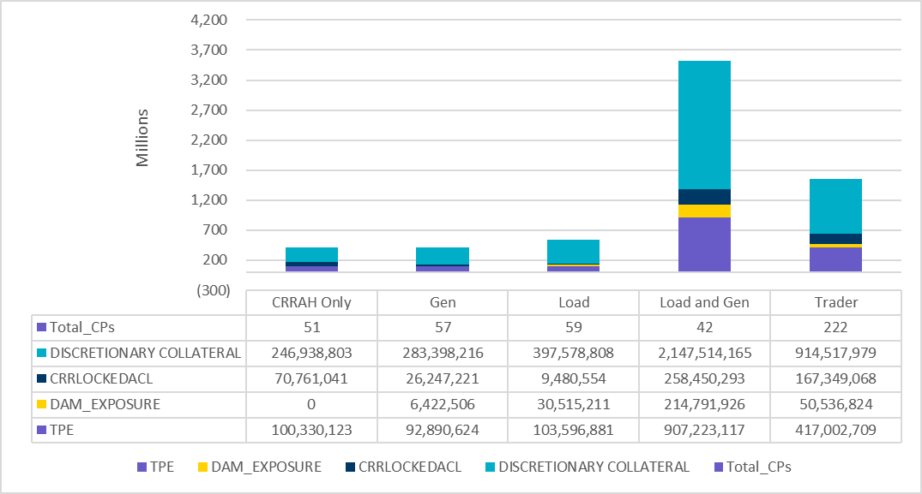
TPE and Discretionary Collateral by Market Segment - November 2024
Load and Generation entities accounted for the largest portion of discretionary collateral

Slide 10
TPEA Coverage of Settlements October 2023 - October 2024
Invoice Exposure | Historical | Future
Existing Invoice Exposure | RTLCNS + UDAA | M1 Days (including current day) Forward Charge Invoice Amounts
New Invoice Exposure | 7 Days Back Net Invoice Amounts (Charges & Credits) | M1 Days (including current day) Forward Net Invoice Amounts (Charges & Credits); Excluding: 1) Securitization Invoices; 2) CRR Auction Invoices; and 3) Subchapter N Funds Distribution Invoice
TPEA closely approximates actual/invoice exposure

Slide 11
TPEA Coverage of Settlements October 2023 - October 2024
Invoice Exposure | Historical | Future
Existing Invoice Exposure | RTLCNS + UDAA | M1 Days (including current day) Forward Charge Invoice Amounts
New Invoice Exposure | 7 Days Back Net Invoice Amounts (Charges & Credits) | M1 Days (including current day) Forward Net Invoice Amounts (Charges & Credits); Excluding: 1) Securitization Invoices; 2) CRR Auction Invoices; 3) Subchapter N Funds Distribution Invoice
*TPEA exceeds invoice exposure

Slide 12
TPEA Coverage of Settlements October 2023 - October 2024
Invoice Exposure | Historical | Future
Existing Invoice Exposure | RTLCNS + UDAA | M1 Days (including current day) Forward Charge Invoice Amounts
New Invoice Exposure | 7 Days Back Net Invoice Amounts (Charges & Credits) | M1 Days (including current day) Forward Net Invoice Amounts (Charges & Credits); Excluding: 1) Securitization Invoices; 2) CRR Auction Invoices; 3) Subchapter N Funds Distribution Invoice
Invoice exposure generally exceeds TPEA

Slide 13
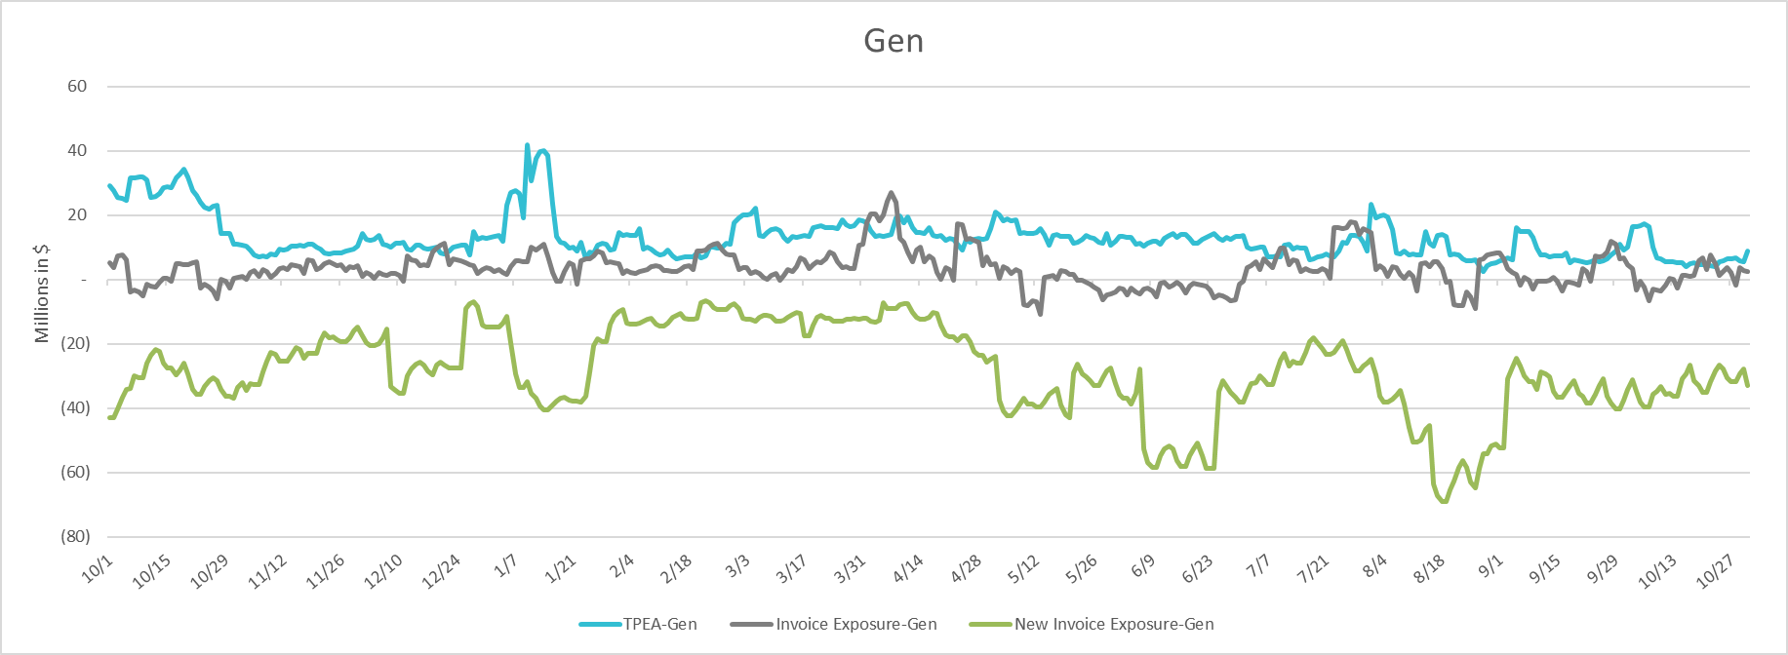
TPEA Coverage of Settlements October 2023 - October 2024
Invoice Exposure | Historical | Future
Existing Invoice Exposure | RTLCNS + UDAA | M1 Days (including current day) Forward Charge Invoice Amounts
New Invoice Exposure | 7 Days Back Net Invoice Amounts (Charges & Credits) | M1 Days (including current day) Forward Net Invoice Amounts (Charges & Credits); Excluding: 1) Securitization Invoices; 2) CRR Auction Invoices; 3) Subchapter N Funds Distribution Invoice
* TPEA generally exceeds Invoice exposure

Slide 14
TPEA Coverage of Settlements October 2023 - October 2024
Invoice Exposure | Historical | Future
Existing Invoice Exposure | RTLCNS + UDAA | M1 Days (including current day) Forward Charge Invoice Amounts
New Invoice Exposure | 7 Days Back Net Invoice Amounts (Charges & Credits) | M1 Days (including current day) Forward Net Invoice Amounts (Charges & Credits); Excluding: 1) Securitization Invoices; 2) CRR Auction Invoices; 3) Subchapter N Funds Distribution Invoice
*TPEA generally exceeds invoice exposure

Slide 15
TPEA Coverage of Settlements October 2023 - October 2024
Invoice Exposure | Historical | Future
Existing Invoice Exposure | RTLCNS + UDAA | M1 Days (including current day) Forward Charge Invoice Amounts
New Invoice Exposure | 7 Days Back Net Invoice Amounts (Charges & Credits) | M1 Days (including current day) Forward Net Invoice Amounts (Charges & Credits); Excluding: 1) Securitization Invoices; 2) CRR Auction Invoices; 3) Subchapter N Funds Distribution Invoice
*TPES exceeds actual/invoice exposure

Slide 16
Questions

