Slide 1
A Global Update on GFM Specifications and Incentives
Julia Matevosyan
Associate Director and
Chief Engineer
ESIG
12/13/2024

Slide 2
What is Grid Forming?
NERC definition:
Grid Forming IBR controls maintain an internal voltage phasor that is constant or nearly constant in the sub-transient to transient time frame. This allows the IBR to immediately respond to changes in the external system and maintain IBR control stability during challenging network conditions. The voltage phasor must be controlled to maintain synchronism with other devices in the grid and must also regulate active and reactive power appropriately to support the grid
There are many variations of both grid-forming and grid-following controls. Both are subject to physical equipment constraints including voltage, current and energy limits, mechanical equipment constraints (on WTGs) as well as external power system limits.
Further, performance requirements for GFL plants, will also apply to GFM inverters unless explicitly identified as inapplicable.
Sources: NERC, Grid Forming Technology Bulk Power System Reliability Considerations , December 2021
ESIG, Grid Forming Technology in Energy Systems Integration, March 2022
Notes:
UNIFI: For a disturbance the shortest sub-transient timescales is roughly 0-5 cycles after a disturbance

Slide 3
Potential Use-Cases for Grid Forming Controls
Weak grid operation
Damping of voltage and frequency oscillations
Resisting voltage phase angle change (phase jump response)
Resisting frequency change / limiting RoCoF (substituting/supplementing inertial response of synchronous generation)
Fast fault current injection (balanced and unbalanced)
Mitigation of sub-synchronous control interactions
Support of islanded operation (when required)
Black start (when required)
Source: Adapted from Y. Cheng, Preliminary assessment of Grid Forming Inverter-based Energy Storage Resources in the ERCOT Grid ERCOT IBRWG, August 2023

Slide 4
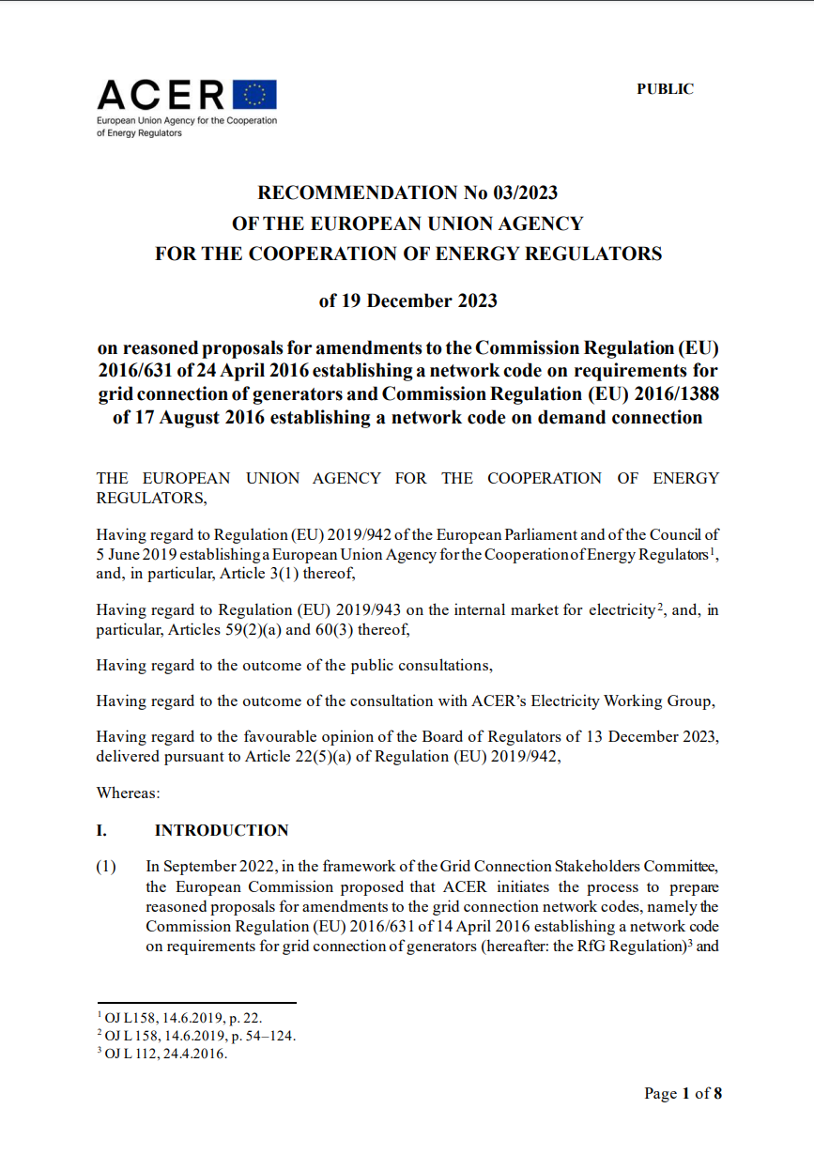
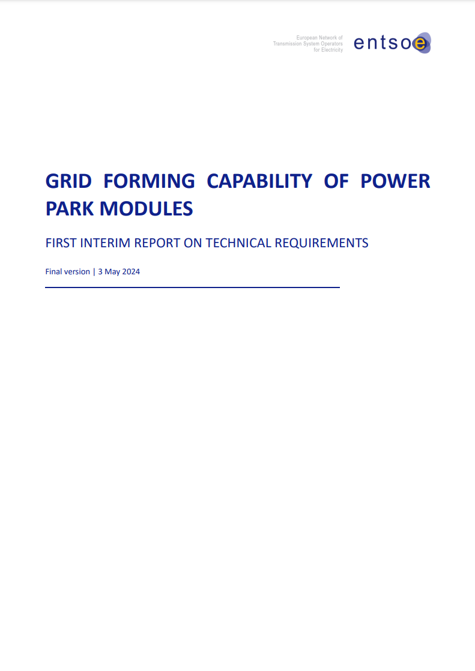
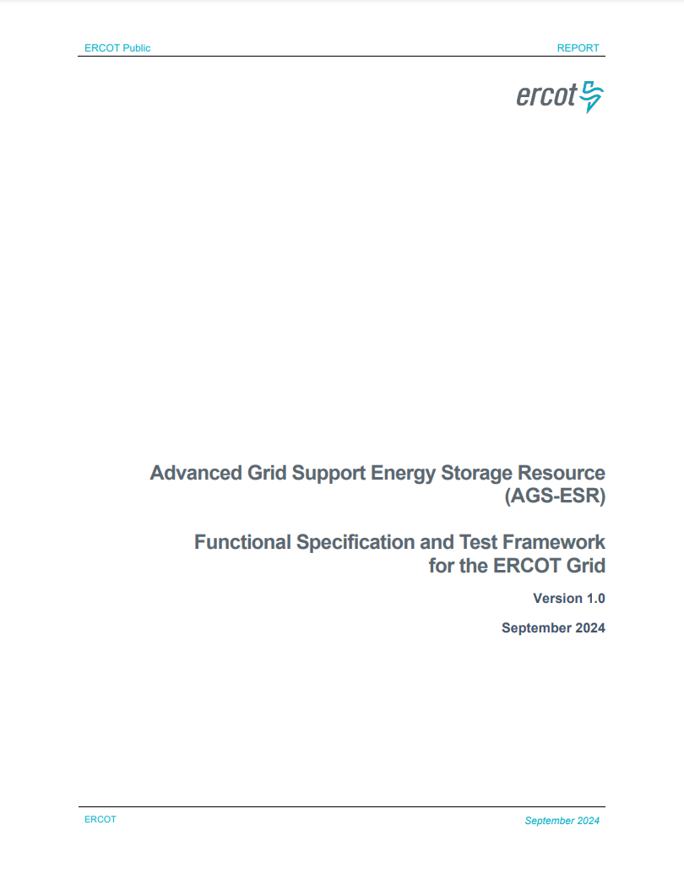
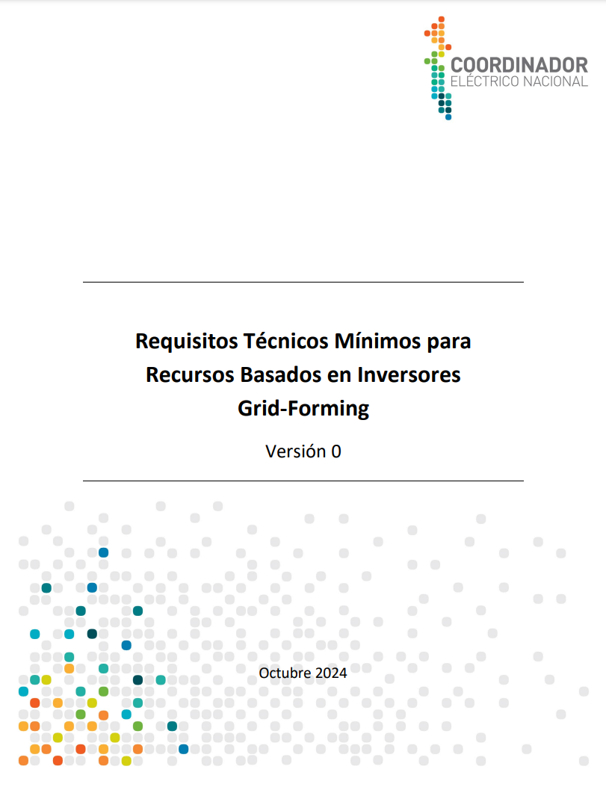
Grid Forming Testing and Specs Landscape At Glance
Links to all these specification documents can be found here
MISO
ACER/ENTSO-E
ERCOT
CEN
Draft
Draft
Draft
Draft
Draft
Draft
Notes:
Fingrid: Specific Study Requirements for Grid Energy Storage System, applies for Type D energy storage connected in specific locations in Fingrid network where the use of GFM controls is seen as necessary.
Latest VDE FNN Germany: Installations participating in the market procurement of instantaneous reserve must qualify for this and meet appropriate requirements and provide evidence.

Slide 5
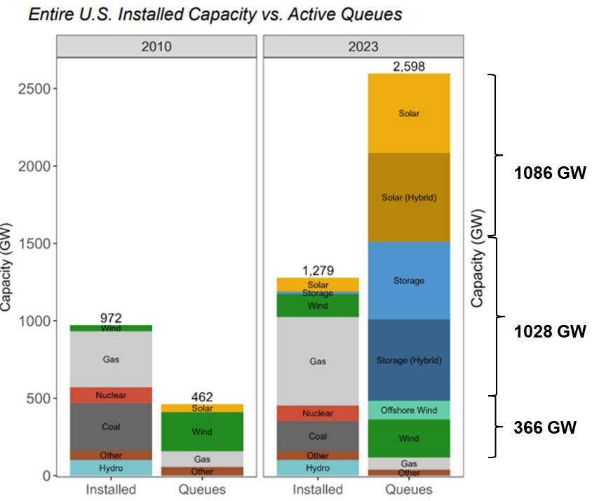
Grid Forming Testing and Specs Landscape, cont.
 | System Operator or Regulatory Body | Research Orgs or Industry WGs
Published | NG ESO GC & Guide FNN VDE HECO AEMO Fingrid | MIGRATE / OSMOSE UNIFI V.2 NERC IRPS
Draft | ACER/ ENSTO-E RfG 2.0 ERCOT MISO (almost published) CEN
Planned | AESO IESO Florida Power & Light | CIGRE JWGB4/C4.93 IEEE SA
High level vs slightly more detailed
Functional specifications vs test-based vs both
Split into “core” & advanced capabilities vs not split
Voluntary vs mandatory
In addition to existing GFL req., unless conflicts
For all types of resources vs all IBRs vs just BESS
The table is not exhaustive but provides some examples
Source: LBNL, Queued Up https://emp.lbl.gov/queues
Source: E. Quitmann, ESIG Spring Technical Workshop, 2020

Slide 6
Specifications for All IBRs vs Just for BESS
All IBR | Just Battery Energy Storage
NESO (Great Britain) | HECO
ENTSO-E | MISO
AEMO (Australia), but specifies that for GFM capability storage is needed | ERCOT
VDE FNN (Germany) | NERC
NESO, but specifications call for availability of energy buffer. | Fingrid
 | CEN

Slide 7
GFM Progress Globally
Operator Specifications
HECO – Hawaii, U.S.
NESO – Great Britain
AEMO – Australia
Fingrid – Finland
MISO – U.S.
ERCOT (drat) – U.S.
ENTSO-E (draft) - Europe
OEMs
SMA
Tesla
Sungrow
Power Electronics
Hitachi Energy
Siemens (e-STATCOM)
EPC Power
GP Tech
GE
https://www.esig.energy/working-users-groups/reliability/grid-forming/gfm-landscape/projects/

Slide 8
GFM Requirements vs Incentives for at Glance
Voluntary (no market) | Incentive: Market , Tender for Stability Products, Other Forms of Payment | Requirement
NESO (Great Britain) => | NESO (Great Britain) => | Fingrid (Finland)
AEMO (Australia) | Germany => | MISO
 |  | ERCOT
 |  | ENTSO-E draft
 |  | HECO
 |  | CEN (Chile)

Slide 9
GFM Requirements v.s. Incentives: HECO
From recent studies, it was found that GFM BESS is the most effective resource to maintain our grid stability (this is not a general conclusion necessarily applicable to other grids)
GFM requirement for BESS in HECO’s service territories (Oahu, Maui, Hawaii island, Molokai and Lanai) transmission and sub-transmission grid is a mandatory requirement for all future BESS until HECO’s study shows that they have enough GFM resources.
HECO’s RFPs have a MWh target (but not necessarily has a MW target) for GFM BESS, and also asks for firm capacity, wind, wind/BESS and PV/BESS.

Slide 10
GFM Requirements v.s. Incentives: NESO
Great Britain – Stability Pathfinder, Phase 2 in 2022 awarded five GFM BESS, GB Grid Forming Requirements apply to these projects.
NESO followed up with development of Stability Market Design, developing eligibility rules, contract structures, procurement strategies for the future stability market. Mid-term stability market launched in 2023.
As of September 2024, NESO is proposing from 12/31/25, to mandate GFM capability on:
Type D Power Generating Modules (50 MW and above and/or connected at 110 kV or above) and:
HVDC Systems (including Interconnectors)
with compliance required by the end of 2028. This will not be retrospective on pre 12/31/25 plants

Slide 11
GFM Requirements v.s. Incentives: AEMO
AEMO has minimum system strength requirements in certain areas:
Transmission owner determines minimum required system strength and obliged to maintain it
GFL IBRs connecting in these areas are assessed for their impact on system strength and have to pay to bring the system strength level back to the minimum required
TO builds system strengthening assets of procures from third party providers, GFM is not valued for provision of system strength.
New GFL IBRs may chose to co-locate GFM BESS to offset their impact on system strength and avoid payments.
In December 2022, Australian Renewable Energy Agency announced $176 million in conditional funding for eight grid-scale GFM BESS to promote deployment (a total project value of $2.7 billion and a capacity of 2.0 GW / 4.2 GWh)

Slide 12
MISO GFM BESS Requirements Moving Forward
MISO presented the latest draft of the proposed performance requirements for GFM BESS at October Planning Advisory Committee (PAC) meeting.
The proposal was to require GFM control capabilities from all BESS, starting with the DPP 2023 Cycle* (i.e. next gen interconnection cycle).
The requirements and process are outlined in Business Practice Manual (BPM-015) redlines (Section 5.3.7 on Page 52).
PAC stakeholders were invited to review and submit feedback to MISO’s proposal
MISO responded to stakeholder feedback submitted by 2 parties and shared requested clarifications in the responses and November PAC meeting materials.
Next Steps: Finalize BPM-015 redlines to implement proposed requirements
* DPP – Definitive Planning Phase

Slide 13
GFM Requirements v.s. Incentives: Fingrid, ENTSO-E, Germany
Fingrid currently allows only GFM BESS to build in weak grid areas, ERCOT proposed a similar idea in their Dynamic Stability Assessment of High Penetration of Renewable Generation in 2018.
Fingrid grid code update is looking to require all future BESS to be GFM.
ENTSO-E RfG 2.0 aims to require from all future Type B-D power park modules
German Inertia Market, payment for “new” inertia to all resources fulfilling VDE FNN specs. This initiative still under development and will be implemented in 2025.

Slide 14
Limits for Thresholds for Type B, C and D _ower-Generating Modules in ENTSO-E RFG
Synchronous areas | Limit for maximum capacity threshold from which a power-generating module is of Type B (<110 kV) | Limit for maximum capacity threshold from which a power-generating module is of Type C (<110 kV) | Limit for maximum capacity threshold from which a power-generating module is of Type D (≥ 110 kV)
Continental Europe | 1 MW | 50 MW | 75 MW
Great Britain | 1 MW | 50 MW | 75 MW
Nordic | 1,5 MW | 10 MW | 30 MW
Ireland and Northern Ireland | 0,1 MW | 5 MW | 10 MW
Baltic | 0,5 MW | 10 MW | 15 MW
Connection point below 110 kV and maximum capacity of 0,8 kW or more – Type A;

Slide 15
German inertia market model (BNetzA’s draft)
A market with unlimited volume & fix regional prices* (over 2-10 years) for different product types:
* The regional price for each product is proportional to the offered inertia constant of power plants.
Minimum availability over a year
1. Positive inertia „Basic Product“
2. Positive inertia „Premium Product“
3. Negative inertia „Basic Product“ 4. Negative inertia „Premium Product“
30 %
90 %
30 %
90 %
Source: “Requirements and verification procedures for gridforming units – the German approach to ensure power system stability under very high penetration of inverter-based sources”, presented by K. Malekian, E. Quitmann (Enercon), T. Bülo (SMA), J. Massmann (Amprion), M. Schmieg (DigSilent), C. Wulkow (VDE FNN), 23rd Wind & Solar Integration Workshop, Helsinki, Finland, October 8-11th

Slide 16
Meeting the system needs with the help of three pillars
Today
2025
2030
TSO-Assets (VINKs)
1
Goal: Further development of the state of technology of TSO assets and
Reactive power compensation units will have grid forming properties and short-term storages
Amprion will build approx. 10 units (with 2,1 GVAr and 15 GWs) contributing towards inertia and system strength until 2030
2
Market based procurement of inertia
Goal: Accelerate the market maturity of generation units, storages and loads with grid forming properties and inertia
Implementation of a bonus system
Differentiation between positive and negative inertia
Close monitoring of procured quantities and delivery levels
FNN will define technical requirements and verification/compliance procedures
3
Grid Code Requirements
Goal: Contribution from generation units, storages and loads
Implementation of amended European Guidelines (RfG, HVDC)
Source: “Requirements and verification procedures for gridforming units – the German approach to ensure power system stability under very high penetration of inverter-based sources”, presented by K. Malekian, E. Quitmann (Enercon), T. Bülo (SMA), J. Massmann (Amprion), M. Schmieg (DigSilent), C. Wulkow (VDE FNN), 23rd Wind & Solar Integration Workshop, Helsinki, Finland, October 8-11th

Slide 17
Grid-Connected GFM BESS Projects
Project Name | Location | Operator/Utility | MW | Year | Operational (Y//N)
Dalrymple | Australia | AEMO | 30 | 2018 | Y
Project #1 | Kauai, USA | KIUC | 13 | 2018 | Y
Bordesholm | Germany | Versorgungsbetriebe Bordesholm | 15 | 2019 | Y
Hornsdale Power Reserve | Australia | AEMO | 150 | 2022 | Y
Province Town BESS | USA, MA | Eversource Energy | 25 | 2022 | Y
Kauai PMRF | Kauai, USA | KIUC | 14 | 2022 | Y
Wallgrove | Australia | AEMO | 50 | 2022 | Y
Broken Hill BESS | Australia | AEMO | 50 | 2023 | Y
Kapolei Energy Storage | USA, Hawaii | HECO | 185 | 2023 | Y
New England BESS | Australia | AEMO | 50 | 2023 | Y
Riverina and Darlington Point | Australia | AEMO | 150 | 2023 | Y
Blackhillock, Phase 1 | Great Britain | NESO | 200 | 2024 | N
Victorian Big Battery | Astralia | AEMO | 300 | 2024 | N
Blackhillock, Phase 2 | Great Britain | NESO | 100 | 2025 | N
Liddell Battery | Australia | AEMO | 500 | 2025 | N
Western Downs Battery | Australia | AEMO | 200 | 2025 | N
Blyth Battery | Australia | AEMO | 200 | 2025 | N
Bungama BESS | Australia | AEMO | 200 | 2025 | N
Lappeenranta BESS | Finalnd | Fingrid | 38 | 2025 | N
Kilmarnock South | Great Britain | NESO | 300 | 2026 | N
Terang BESS | Australia | AEMO | 100 | 2026 | N
Mortlake BESS | Australia | AEMO | 300 | 2026 | N
TagEnergy BESS | Australia | AEMO | 300 | 2026 | N
Links to the table and additional details on these project is here

Slide 18
Julia Matevosyan
julia@esig.energy

