Slide 1
Market Participant Guide
for Dashboard Roadmap
Amy Lofton
Manager, ERCOT Digital Content Management
PRS, Other Business
December 12, 2024

Slide 2
Purpose & Overview
Outline the ERCOT Dashboard Roadmap
Define Process
  Introduce New Dashboards
  Change Existing Dashboards
Communication

Slide 3


Dashboards & Displays Process Flow: Implemented in 2025
1
2
3
4
5
ERCOT Schedules Implementation of Dashboard/Display Changes
Dashboard Requests
Complete Dashboard & Display Request Form.
ERCOT Impact Analysis Review
Project Review & Prioritization
ERCOT Consideration
4
Rejected
Roadmap & Status Updates

Slide 4
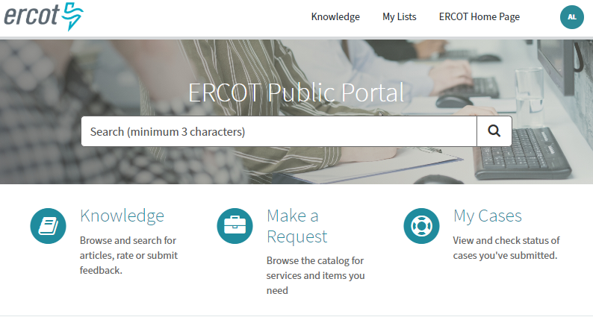
Considerations for Dashboards
Submit request in form; available in 2025
ERCOT consideration
  Does it provide broad value to ERCOT stakeholders?
  What is the level of effort?
  Does the data exist/available?
  Is the data public?
  Does it duplicate existing effort?
  Does it support a long-term process?
  Does a report or other format exist?

Slide 5
Impact Analysis, Project Review and Prioritization
Impact Analysis
  Costs
  Hardware/software
  Hours per department
ERCOT project review
  Budget
  Other ongoing/projected projects
  Priority
  Schedules status with requester & MPs
  Backlog and prior suggestions will be available to follow

Slide 6
Questions & Contact Info
Contact Us Page: https://www.ercot.com/about/contact
Users may submit feedback related to ercot.com content, design, and usability by emailing: userexperience@ercot.com or webmaster@ercot.com.
Feedback is also received via the ERCOT committees and groups.

