Slide 1
RTC+B Task Force
Update
Matt Mereness
RTCBTF
December 11, 2024

Slide 2
Outline
Program update: RTC+B Program Update from Board T&S
Reminder of RTCBTF Review Cycle (no change)
Reminder of Scope of RTC+B Program (no change)
Current Issues for RTCBTF Review
Proceed with rest of RTCBTF Agenda

Slide 3
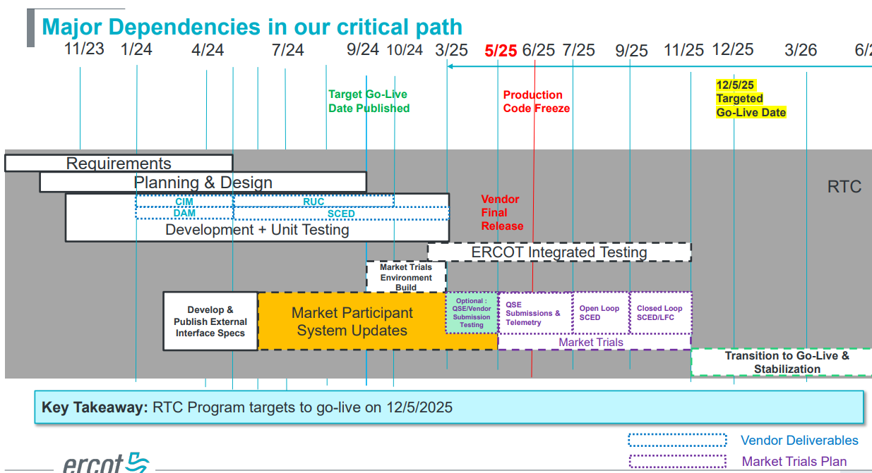
RTC+B Program Update
(excerpt from December Board T&S RTC Update)

Slide 4
Sequence and Dates for Market Trials to Go-Live
NEW
30-day Market Notice
11/5/25
March/April
2025
Start
5/5/25
Start
7/7/25
Start
9/2/25
Go-Live
12/5/25*
May 2025
June 2025
July 2025
Aug 2025
Sep 2025
Oct 2025
Nov 2025
Dec 2025
QSE Scorecards & Exit Criteria for each Trial Phase
RTC QSE Submission Testing
(Submit COP, RT AS Offers,
DAM Virtual AS, Outages for ESRs)
Open-loop RTC SCED
(QSE offers, SCED non-binding award/dispatch)
Ongoing Open-Loop
& Periodic Closed-loop SCED/LFC
(QSE RTC offers and telemetry to support closed-loop frequency control test 2-3 tests of 2-4 hour durations)
Transition to Go-Live
Upon completion of testing, confirmation of ERCOT and market readiness for Go-Live.
Optional: QSE/Vendor Submission Sandbox
RTC QSE Telemetry Check-out (QSEs add/verify new telemetry points for UDSP, New ramp rates, ESR telemetry)
QSE Telemetry Tests
(Individual QSE to follow UDSP and support new ramp rate and ESR telemetry)
Day-Ahead Market
(Non-binding DAM using QSE offers for at least 2 tests)
* Go-Live date reflects 12/5/2025 as first Operating Day
where 12/4/2025 is planned software migration.

Slide 5
Plans for Meetings and Review Cycles
Reminder of RTC+B Program Scope
  RTC Key Principles were approved to lay foundation of NPRR1007-1013
    Consolidated Key Principles: https://www.ercot.com/files/docs/2020/04/01/RTC_Key_Principle_Quick_Reference.docx
    Library of Key Principles: https://www.ercot.com/mktrules/puctDirectives/rtCoOptimization
  Battery Key Topic Concepts approved to lay foundation of NPRR1014
    https://www.ercot.com/mktrules/keypriorities/bes
  RTC State-of-Charge accounting in NPRR1204
Objective is to present concepts or issues that need to be resolved for an effective implementation.
  Coordinating timelines for interface requirements and testing,
  Providing the forum for any analysis or policy decisions (such as parameter values)
  Coordinating market readiness and cutover activities,
  Review draft Revision Requests or other artifacts necessary to successfully implement the program within the identified timeframes, and discussing other details as needed.
Lessons learned from RTCTF to avoid being delayed in decisions:
  Meeting #1: Initial concept presented by ERCOT staff
  Meeting #2: Comments and alternatives presented by MPs
  Meeting #3: RTCTF consensus achieved or escalated to TAC for a vote to decide the matter.

Slide 6
Reminder of Details Scope of RTC+B Program
(Excel version posted with meeting)
No change from
last month

Slide 7
RTCBTF Issues List
Policy issues to be Protocol/Board/PUCT approval
TAC approval for Handbooks, or working Docs?

Slide 8
Proceed with rest of meeting
3. Training Update
    Dave share slides for RTC+B Basics video
4. Discussion of NPRR(s) for RTC+B Parameters
    Outline issues to be codified in protocols
    Discuss RUC ASDC approach
5. RTC Operations Feedback and Approach to 2 Issues
    AS Deliverability (Freddy Garcia)
    IRR AS Qualification (Nitika Mago)
    Vistra Comments on both topics
6. Draft Market Trial Handbooks
    QSE Market Submissions
    QSE Telemetry Check-Out
7. Review of Parameters for AS Proxy Offer Curves
    If needed, ERCOT/Dave to review proposed concept from last meeting
    Vistra comments
8. Discussion of AS Demand Curves
    IMM ASDC Proposal from Nov meeting
    Market commenters: Vistra, Shams, Shell
8. RTC Simulator update
    Deferred to January
    Request to post support data files for Oct RTBTF analysis

Slide 9
January 14th RTCBTF Meeting

