Slide 1
Lubbock
Retail Integration Task Force – LRITF
December 10th, 2024
Chris Rowley Michael Winegeart Sheri Wiegand

Slide 2
LRITF meeting
10/15/24 & weekly market call update
10/31/24
The Task Force reviewed the following:
Decimals – TXSET to take up clarifying language in the guides to understand the applicability of decimals in 867s and 810s.
Reversioned LSE files – LP&L indicated gap retrieval is in place, however, manual updates are sent to ERCOT prior to true-up settlement. Automated process to send reversioned files is still being tested.
LP&L’s New Tariff – LP&L reviewed at a high level the approved revisions to their tariff effective November 1, 2024:
    Separating the Franchise Fee from the Delivery Service Fee. SAC04 will be ADJ006 Franchise Fee Adjustment
    Two new discretionary fees are planned:
      PMVI for AMSM and non-standard meters – a fee of $75 will be assessed under SAC04 SER019 Service Connection
      Clearance requests received within 3 days of requested date – a fee of $150 will be assessed under SER021 Requested Clearance Request
Distribution Loss Factors – DLFs were thought to have improved. If changing, LP&L will send market notice.
Meter Read & Holiday Calendars – LP&L is in the process of finalizing calendars and will be distributed by 10/18/24.

Slide 3
Stabilization issues
Weekly Market Calls
The weekly market calls will be held on Thursdays @ 10:00 AM to discuss any on-going issues:
https://us06web.zoom.us/j/89361889543?pwd=olviNzrBXvZJHnEHKgOUZprYTpSDDV.1
Meeting ID: 893 6188 9543
Passcode: 112233
DNP 650_01 RCNs processing – Fix to not push DNP/RCNs out two days with an ROL indicator is in production
Discretionary Service Fees for DNP/RCNs –
  LP&L was originally assessing on a separate 810 in lieu of the appropriate periodic
  LP&L was also charging a premium fee of $61.25 vs $30.00 when the ROL flag was included
  Some customers were double billed, both on a periodic and a standalone 810 (LP&L’s system was only showing one charge, thus a cancel would not align their system)
  The standalone 810s were being received with tampering code of A5 sometimes aligning the current customer of record
  LP&L working toward a solution to cease A5s, ensure charges are assessed to appropriate customer, and send cancel/rebill for overcharges
  LP&L is indicating cleanest approach is to align all systems – REP and TDSP
    If REP paid 810 then a cancel/rebill would be provided
    If REP had not paid, then a cancel with a negative adjustment would credit overcharge

Slide 4
Stabilization issues
Weekly Market Calls
867IDR – a couple of issues were identified: overlapping dates on start and end dates fix was pushed to production on 10/24. All missing bills should have been caught up by early November.
Siebel Changes for Out of Sync conditions– ERCOT working with LP&L to ensure RORs are aligned in systems. LP&L was completed review of the list from ERCOT and only billing corrections needed to go out
BDMVIs submitted from transition until mid to late May – LP&L was working to cancel the incorrect 810s to allow the BDMVI to process
810s received, missing 867s – missing start and end dates fix should have been in place by 11/4
867 cancels received, 810 cancel TRAN IDs not aligning – fix should be in place
End read/start read mismatch – LP&L reported when the end read is estimated and a later start read is obtained, the actual read is used for the next billing period. LP&L working toward a solution.

Slide 5
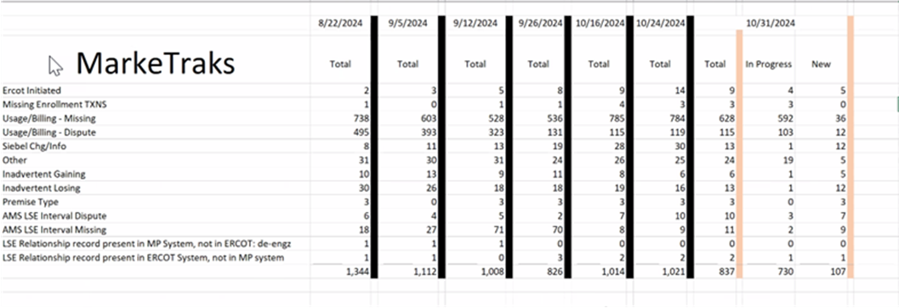
OPEN MARKETRAK STATS as of 10/31/24

Slide 6
Lessons learned
Customers with Multiple ESIs and DREP Process
Find a way to compare before defaulting – possibly provide customers with ESIs on their bundle bill prior to competition; create ESIs earlier in the process
TXSET Guides need updating
We need to take some time and ensure we’ve captured the areas that need to be changed – ‘combo’ 814_05 kH vs KMON; Decimals; generalized practices - perhaps a ‘utility orientation’
Need Regulatory/Legal decisions at beginning of project
Full awareness of any impacting legislation
Early conversations
LP&L has paved the way for additional MOU/ECs
Impact of Cycle Dates locked down and true MVI situations
Impacts stacking logic at go-live
Clear determination so REPs may design systems accordingly

Slide 7
Lessons learned - continued
Phone Number formats & Country Code issue
Update TXSET Guide
Clean data for ESI creation
Avoid creation of ‘bad’ ESIs only to have to retire
Eliminates downstream confusion – customers, REPs
Understanding for Munis, other utilities may be associated
Addresses without descriptions
Systems should be able to use secondary address fields to help avoid inadvertent gain situations
Decimals in meter reads
With AMI being the standard meter type, this is an opportunity to allow decimals in meter reads. We are already using them in IDR situations

Slide 8
Lessons learned - continued
Priority Codes for MVIs &Reconnects
Should be included in the RMG along with other priority codes (service orders)
TDSP Matrices in one location
One place for: AMS Data Practices, Emergency Operating Plans, Solar Practices, Transaction Timelines
Including list in ERCOT opt-in checklist
Online enrollments – what options for multiple ESIs?
Better customer experience if more than one ESI is to be enrolled
Providing a postcard to each customer with ESI information prior to sales window
Cancel/rebill timing and LSE files
This information is not captured in any protocols or guides at ERCOT… it is more of an ERCOT business process that impacts utilities processes. How can we capture for the next entrant? Opportunity to include in operating guide for settlements

Slide 9
Lessons learned - continued
Full testing
Robust end to end testing with ‘real’ data including billing
Awareness of all files and extracts on ERCOT MIS
Understanding of extracts available and purpose of data, Missing Usage Report
WIN! Having a media market in a condensed geographical area resulted in effective communications to the residents
Providing questions for consideration – shopping guide and partnership with PUCT
Knowing the audience and conducting business/enrollments how the community wants to conduct business
Shopping Fairs
Market Participants
Market participants were disengaged until the last minute
Requiring participation in the task force meeting if REP wants to become active in the territory

Slide 10
Lessons learned - continued
EPS Meters
Understanding if territory has EPS meters, Muni will need to accept 867s from ERCOT
Understanding market processes
DCN/RCN processes and billing
ESI Maintenance and updating attributes
ERCOT Settlement Process
Understanding of the settlement differences of BUSIDRRQ, significance of LSE files and reversions, and impacts of cancel/rebills
Smart Meter Texas Onboarding
Expectations and requirements for integration
Updating Distribution Loss Factors
Calculation methodology, expectations and revisions

Slide 11
TIMELINE of Actions
Pro Forma Tariff
Access Agreement
POLR Process
Safety Net Process
Q4 2022
ERCOT Activities: SAC04s, Load Profiles
TSDP Activities: Critical Care, DLFs, Solar/DG, Switch Hold Files, BUSIDDRQ, Call Center, OGFLT, Weather Moratoriums, Proration
LP&L Rates
Customer Enrollment Process – Detailed Timeline
PUCT Complaint Process / Application of PUCT Rules
Transaction Timelines / TXSET Timelines
CSA Process
Q1 2023
Q2 2023
ESI IDs in TDSP Extract
RMG Chapter 8 Revisions
Historical Usage Requests
TDSP AMS Data Practices
Mass Customer Lists
Power to Choose website
Customer Forums/Town Halls
Flight Testing / Bank Testing
Q3 2023
CBCI files
Default REP Selection Process
DNP Blackout Period
Market Operations Group Established
Tampering Information Process
Smart Meter Texas
Q4 2023
March 2024
GO LIVE – Transition to Competition
Completed
Q3 2023
Q4 2023
Q1 2024
Q4 2024 Q1 2025

Slide 12
Lritf meeting
12/10/2024 @ 1:00PM following RMS –via Webex
AGENDA ITEMS:
AMS Data Practices –
  Reversioned LSE files
  Smart Meter Texas Readiness
Stabilization
  DNP Discretionary Service Charges on 810s - Remediation
  867_03 IDRs
  Seibel Changes with ERCOT
  BDMVIs and 810s (IAGs)
  810s not referencing correct 867s
  810s received, missing 867s
    Missing start/end Reads
  867_03s – mismatch of end & start reads
814_20 ESI ID Maintenance
Open MarkeTraks
LP&L Weekly Market Calls
DLF Updates
Lessons Learned
Open Discussion
  Sunsetting LRITF

