Slide 1
CRR Technology Update
Sreenivas Badri
December 06, 2024

Slide 2
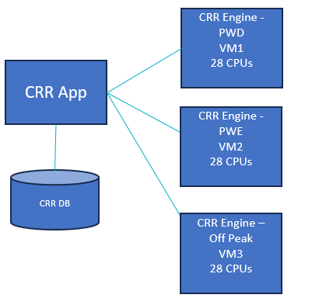
Current State
CRR High Level Architecture
Hardware changes implemented early this year (April)
Increased CRR Engine Servers (Virtual Machines – VMs) CPUs to 28 from 16.
Tuned Hardware Parameters
CRR performance improved by around 20% due to hardware changes
Why can’t we add more CPUs or more VMs to improve the CRR auction performance?
Adding more CPUs beyond 28 did not improve the CRR performance further due to saturation of CPU/RAM bus with current hardware configuration (DDR4 Memory configuration).
CRR Engine supports multi threading but due to the sequential and interlinked nature of budget constraints across all months in a long-term auction, using multiple VMs or servers for parallel processing is not viable.

Slide 3
Testing CRR Performance with New Hardware Configurations
POC – On-Prem – Work In Progress
Built a Sandbox Environment with new hardware configuration – DDR5 Memory
Faster Memory access with DDR5 hardware configuration
CRR system is being built, performance testing will start next week
Plan to complete the performance testing by early January
Expecting approximate 30% performance enhancement.
POC – In Cloud - Planned
Vendor supports CRR applications running in Cloud
Test CRR performance in cloud environment utilizing other advanced hardware configurations.
Plan to complete the testing by end of Q1 2025.
Evaluate CRR performance improvements from POCs and plan for next steps.

Slide 4
CRR Technology Road Map
Project – ERCOT Cloud Foundations
Initiated
Establishes robust Cloud Foundation and connections ensuring secure, compliant, and optimized cloud services
Expected to complete by Q2 2025
Project – CRR Tech Refresh
Tentatively scheduled to start Q1 2026
Key drivers: Upgrading Oracle DB and Operating system, 3rd party software
Containerize CRR Apps (On-Prem)
Will look at options to run CRR long term auctions only in Cloud with more advanced hardware configurations to enhance CRR auctions performance.

