Slide 1
ASDCs for use in RUC Studies
Ryan King
Manager, Market Design
RTC+B Task Force
December 11, 2024

Slide 2
Agenda
Recap: RUC under RTC
RUC ASDCs
Overview
Analysis
Questions/Discussion/Next Steps

Slide 3
Recap: RUC under RTC
To effectively project system conditions and potential needs, RUC will be modified to co-optimize energy and Ancillary Services (AS).
Co-optimization will already inherently reduce the need for RUC by giving more flexibility to the RUC optimization engine
Today, RUC looks at the Resources planned to be available and from where AS is being provided to determine whether additional Resource commitments are needed to meet the load forecast, as well as resolve transmission congestion.
Under RTC, RUC will look at the Resources planned to be available to determine whether additional Resource commitments are needed to meet the load forecast and AS Plan, as well as resolve transmission congestion.
RUC will use new information contained in the COP to determine how much capability for each AS product each Resource will be capable of providing
RUC is a reliability backstop that is required to meet NERC requirements and maintain reliability. Ensuring RUC can meet the full AS Plan is critical to this function.

Slide 4
RUC ASDCs - Overview
The RUC and SCED optimizations consider different problems
The SCED optimization is solving for dispatch
Only considers the incremental offers and penalty costs of AS
The RUC optimization is solving for commitment
Considers additional costs in the form of startup and minimum energy costs
RUC will be built with the capability to use RUC ASDCs. RUC will attempt to solve for a Resource commitment that meets the Load forecast and AS Plan considering Resources’ COPs and using defined penalty curves.
Where RUC commits resources to ensure sufficient capacity to meet the Load forecast and AS Plan, this will be accounted for in the SCED pricing run.
The Reliability Deployment Price Adder process will apply to both energy and AS, and the adder for each AS product will be the positive increase in MCPC between the dispatch and pricing run

Slide 5
RUC ASDCs- Analysis
ERCOT staff are conducting some internal analysis using the AORDC to understand the level of ASDCs required to meet the Load Forecast and AS Plan
Objective is to determine whether current AORDC penalty curves are sufficient to meet the Load Forecast and AS Plan or whether an adjustment to penalty curves is required.

Slide 6
RUC ASDCs - Analysis
Looking at historical Operating Days with significant negative < 2000 MW HASL Margins where units received RUC commitments
Reviewing and determining the total commitment cost of the units which were RUC-committed on that day
Using current AORDC-derived curves (bounded by AS Plan) to determine the estimated value of the AS shortage and comparing it with the commitment cost of RUC’d units to determine whether or the extent to which these units would have been committed
If the change in the AS shortage value (from the AORDC) from committing a unit based on its HSL is greater than that unit’s commitment cost, we assume RUC would have committed this resource.
If the change in AS shortage value is less than a unit’s commitment cost, we assume RUC would have committed something less than the total capacity required to meet the AS Plan for that day.

Slide 7
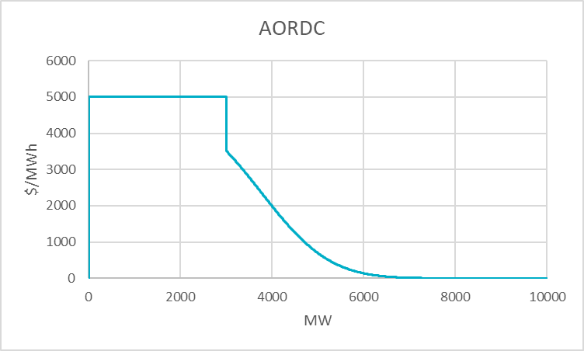
RUC ASDCs - Analysis
Graphic below illustrates this comparison
Unit Commitment Cost
AS PLAN
AS Shortage

Slide 8
Next Steps
ERCOT plans to share additional analysis and discussion around the design penalty curves for use in RUC at the next RTC+B Task Force meeting

