Slide 1
Proposed ASDC Improvements
Andrew Reimers, Jonas Kersulis
ERCOT IMM
RTCBTF
November 13, 2024

Slide 2
Introduction
Under Real-Time Co-optimization, the Ancillary Service Demand Curves (ASDCs) reflect system demand for real-time reserves. Each ASDC represents demand for one AS product.
ASDCs are typically “nested” in other market jurisdictions, meaning each product is substitutable for any lower-quality product.
The currently approved ERCOT ASDCs are described in RTC Key Principle (KP) 1.1(4) and 1.1(5). The IMM has concerns with these curves:
  SCED cannot efficiently trade off between products, as pricing is strictly hierarchical.
  KP 1.1(5) ASDCs tend to underprice ECRS and Non-Spin during shortages.
The IMM has developed an ORDC disaggregation approach to address these shortcomings, creating what we call “blended” ASDCs.
This presentation provides a comparative analysis of: (a) ERCOT KP 1.1(5) ASDCs, (b) nested ASDCs, and (c) “blended” ASDCs.

Slide 3
Motivating Questions
Can the KP 1.1(4) aggregate ORDC be disaggregated to produce ASDCs that:
Allow SCED to trade off efficiently between products, rather than enforcing a strict price hierarchy?
Achieve comparable market efficiency and reliability to the nested curves in place in other US ancillary service markets?
Produce prices for each AS product and Energy during shortage conditions that provide efficient short and long-term incentives?

Slide 4
ASDC Design
ERCOT KP 1.1(5) Curves, Nested Curves, and Blended Curves

Slide 5
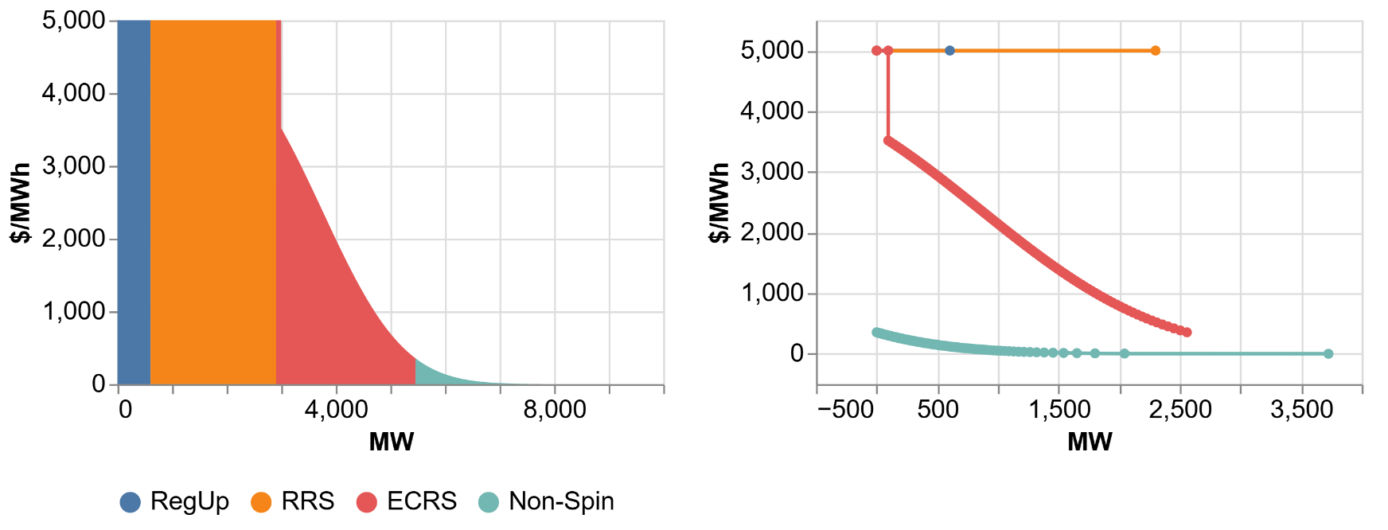
RTC KP 1.1 ASDCs
To promote continuity in pricing outcomes relative to today’s Operating Reserve Demand Curve (ORDC), KP 1.1(4) describes an aggregate ORDC based on historical pricing outcomes as a starting point for ASDC design.
KP 1.1(5) then defines each ASDC as a contiguous vertical slice of this curve. This enforces a strict price hierarchy and prevents trade-offs between products.
Left: KP 1.1(4) aggregate ORDC, with ASDCs colored according to AS plan for 8/19/24 1900.
Right: Same ASDCs, all shifted to the origin.

Slide 6
Nested ASDCs
Nested curves are based on substitutability (RRS may stand in for ECRS or Non-Spin, etc.).
  Efficient performance demonstrated in other US ancillary service markets.
  Sound theory. Example: marginal cost of 1 MW of Non-Spin shortage depends on shortages in other products.
Substitutability poses challenges in an ERCOT context:
  ERCOT’s AS suite was not designed around substitutability.
  Duration requirements and deployment risk/cost vary by product.
  Modifying today’s RTC SCED formulation to nest the ASDCs could delay implementation.
The IMM developed nested ASDCs that roughly reflect ERCOT’s aggregate ORDC.
Left: Nested ASDCs that roughly approximate the aggregate demand of ERCOT’s ORDC.
Right: Same ASDCs shown as independent curves.

Slide 7
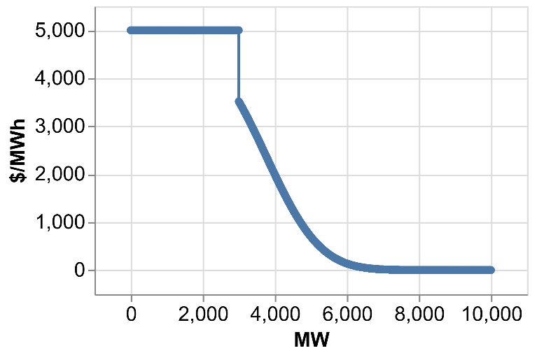
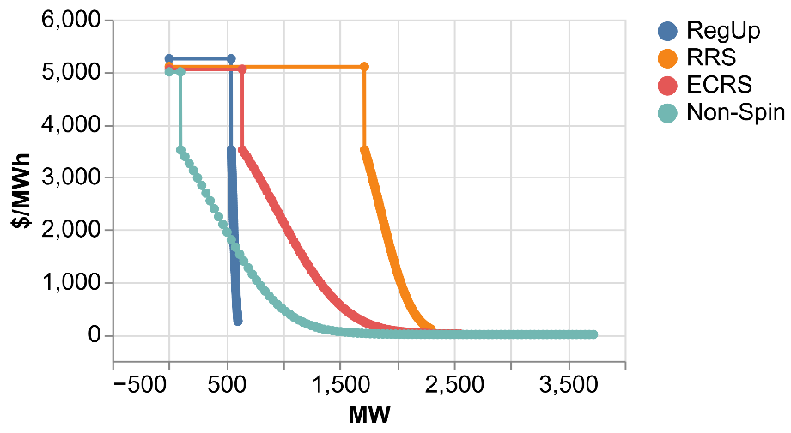
IMM “Blended” ASDCs
Using the same KP 1.1(4) aggregate ORDC as a starting point, the IMM developed curves that overlap, as opposed to each curve having its own distinct ORDC block.
Design goals:
  Aggregate demand must match the ORDC.
  Individual ASDC shapes and max prices exhibit a product hierarchy.
  Each curve reaches a max price near VOLL.
  RegUp and RRS shortages should occur only during extreme scarcity.
Left: RTC KP 1.1(4) aggregate ORDC.
Right: IMM blended ASDCs based on AS plan amounts for 8/19/24 1900.

Slide 8
Are Nested ASDCs Necessary for ERCOT?
Comparing Independent and Nested ASDCs

Slide 9
Nested Curve Study: Methodology
Simulation tool: Potomac Economics SCED.
  We did not use the ERCOT RTC SCED Simulation Tool, which cannot model nested ASDCs.
Days studied: 8/17/23, 9/6/23, 8/19/24. 6-9 PM each day.
Load (GTBD) increased by 2 GW, to better illustrate performance under shortage conditions.

Slide 10
Nested Curve Study: Results
With nested curves, Non-Spin prices approach VOLL during shortages, because Non-Spin contributes to the total reserve need.
KP 1.1(5) curves undervalue ECRS and Non-Spin due to strict price hierarchy.
Blended ASDCs substantially mitigate this issue.
Conclusions:
Nested curves are not required – Independent ASDCs can produce reasonable results.
However, the methodology for producing disaggregated curves should be reconsidered.
ECRS
Non-Spin

Slide 11
Comparing Blended ASDCs to KP 1.1(5) ASDCs
Comparing Performance of Blended and Nested ASDCs Using ERCOT RTC SCED Simulator Tool

Slide 12
Blended Curve Study: Methodology
Simulation tool: ERCOT RTC SCED Simulator Tool
Two scenarios presented here:
  9/6/23, to illustrate behavior during tight conditions.
  8/17/23, with GTBD increased by 2 GW to illustrate extreme shortage and max price behavior.

Slide 13
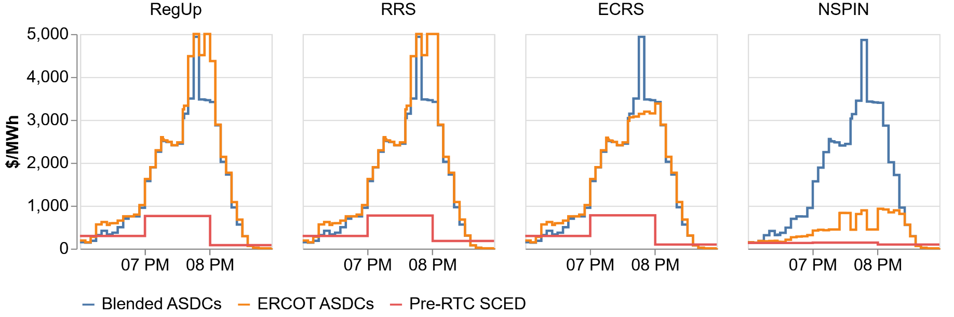
Blended Curve Study: 9/6/23 Pricing Results
Blended ASDCs price all products similarly.
KP 1.1(5) ASDCs tend to underprice ECRS and Non-Spin.
  This result is consistent with the Nested Curves study.
Concern: ERCOT ASDCs provide less incentive to build or own Resources that can provide longer-duration reserves like Non-Spin.

Slide 14
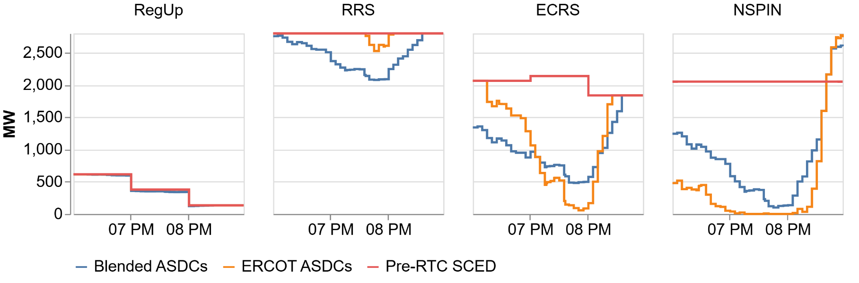
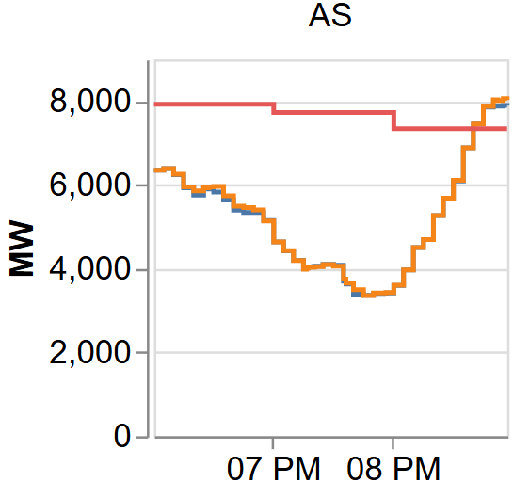
Blended Curve Study: 9/6/23 Procurement Results
Blended ASDCs balance procurement/shortage across all products.
Total AS procurement is nearly identical. Both sets of ASDCs represent the same aggregate demand.
Concern: Under extreme shortage, KP 1.1(5) ASDCs procure minimal ECRS and Non-Spin.

Slide 15
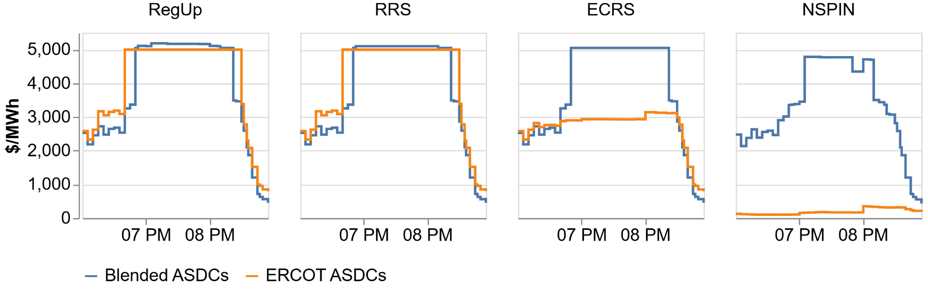
Blended Curve Study: 8/17/23 Pricing Results
GTBD was increased by 2 GW in this scenario.
Blended ASDCs ensure all reserve prices rise to the max ORDC price.
  This is efficient and consistent with nested curves.
ERCOT curves produce inefficiently low prices for ECRS and Non-Spin under these conditions.
Note: while optimization prices can exceed $5,000/MWh, settlement prices would not.

Slide 16
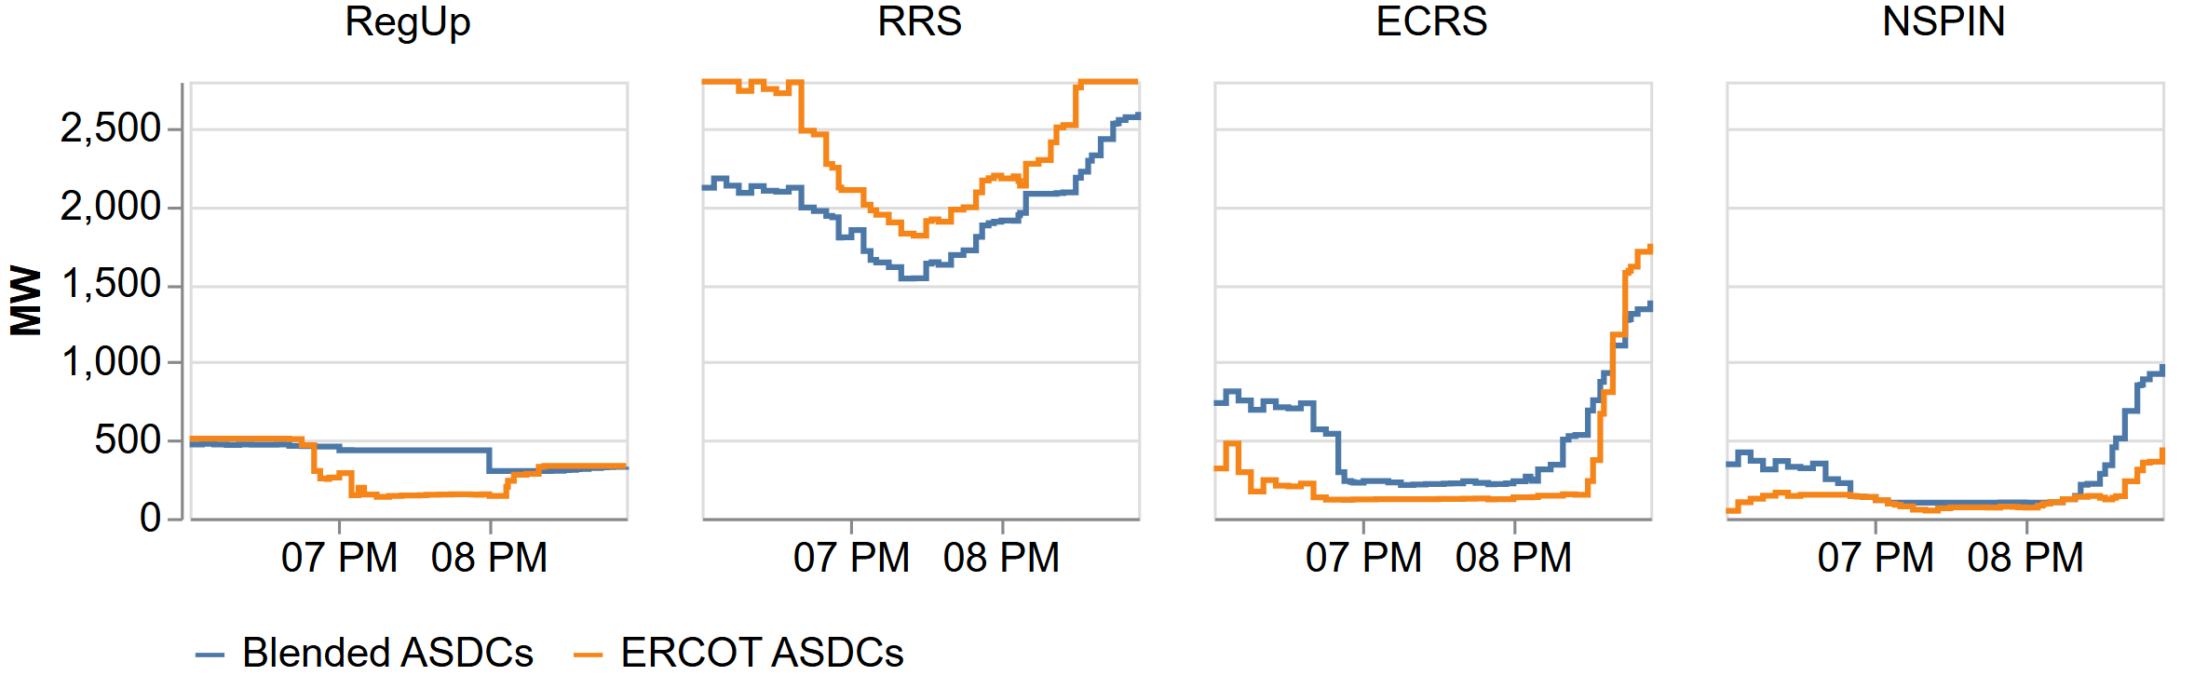
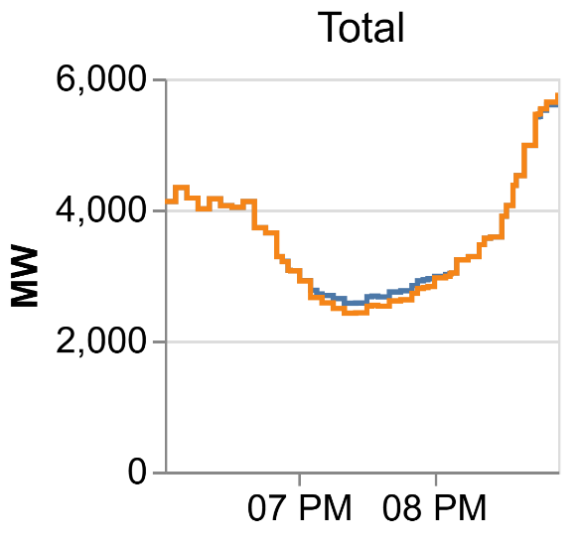
Blended Curve Study: 8/17/23 Procurement Results
More extreme, but same takeaway as 9/6/23 study.
Notes:
- Drop this slide?

Slide 17
Conclusions
Nested ASDCs are not necessary for ERCOT, provided that proper adjustments are made to the independent ASDCs.
  Implementation of any independent ASDCs under ERCOT’s RTC software is straightforward and should not affect the project timeline.
Compared with KP 1.1(5) ASDCs, blended ASDCs:
  Produce more predictable and efficient pricing outcomes under shortage; and
  Provide a stronger investment incentive for Resources that provide long-duration reserves.

Slide 18
Comments on RTC KP 1.1(4)
The aggregate ORDC is comparable to the total reserve curve in a nested ASDC context.
A disaggregation of the ORDC into ASDCs was primarily motivated by a desire for RTC to produce outcomes comparable to the ORDC price adders.
The IMM is concerned about this approach because:
  The simulations show that KP 1.1(4) and (5) will not produce market outcomes that mimic today’s ORDC outcomes;
  KP 1.1(4) limits ERCOT’s ability to produce ASDCs that reflect marginal reliability value of each product;
  The static MCL value (3,000 MW) is particularly difficult to accommodate efficiently under any methodology given the variation in the AS plan.

Slide 19
Recommendations
Formalize and adopt blended ASDCs to replace KP 1.1(5) ASDCs.
  Conduct further analysis to determine the relative shapes and maximum prices of the ASDCs, particularly in consultation with ERCOT Operations. How would they prefer for shortage to be distributed among AS products?
  Establish a connection between the final ASDCs and each product’s contribution to system reliability.
Study the impacts and trade-offs of adopting various duration requirements. Establish requirements that promote efficient performance.
Evaluate the benefits of relaxing the requirement that the ASDCs match the aggregate ORDC under KP 1.1(4)
  ASDCs could be better aligned with the marginal reliability benefit of each product.
  ASDCs could be specified using a few parameters, rather than a complex derivation that starts with the AORDC.

Slide 20
Appendix: Blended ASDC Derivation
An Alternative Approach for Disaggregating the Aggregate ORDC

Slide 21
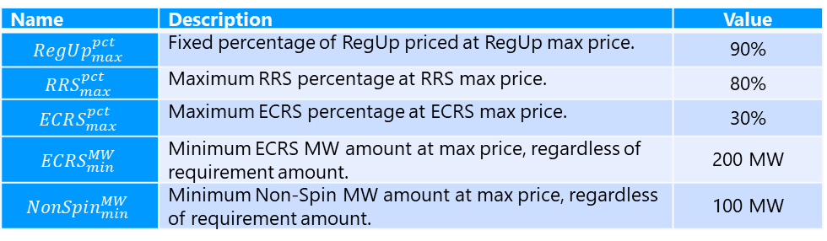
Blended ASDCs: Flat Portion of ORDC
Based on the 3,000 MW Minimum Contingency Level (MCL), the first 3,000 MW of the aggregate ORDC are priced at VOLL.
As the AS plan amounts vary, how should the flat MCL portion of the aggregate ORDC be divided up among the upward-AS products?
IMM derived five parameters which, when fixed, allow for a unique map from a given set of AS requirement amounts to a set distribution of the 3,000 MW across the four up-AS products:
IMM also selected max prices for each product, enforcing the product hierarchy:
Name | Description | Value
$$RegUp_{max}^{pct}$$ | Fixed percentage of RegUp priced at RegUp max price. | 90%
$$RRS_{max}^{pct}$$ | Maximum RRS percentage at RRS max price. | 80%
$$ECRS_{max}^{pct}$$ | Maximum ECRS percentage at ECRS max price. | 30%
$$ECRS_{min}^{MW}$$ | Minimum ECRS MW amount at max price, regardless of requirement amount. | 200 MW
$$NonSpin_{min}^{MW}$$ | Minimum Non-Spin MW amount at max price, regardless of requirement amount. | 100 MW
RegUp | $5,250/MWh
RRS | $5,100/MWh
ECRS | $5,050/MWh
Non-Spin | $5,000/MWh

Slide 22
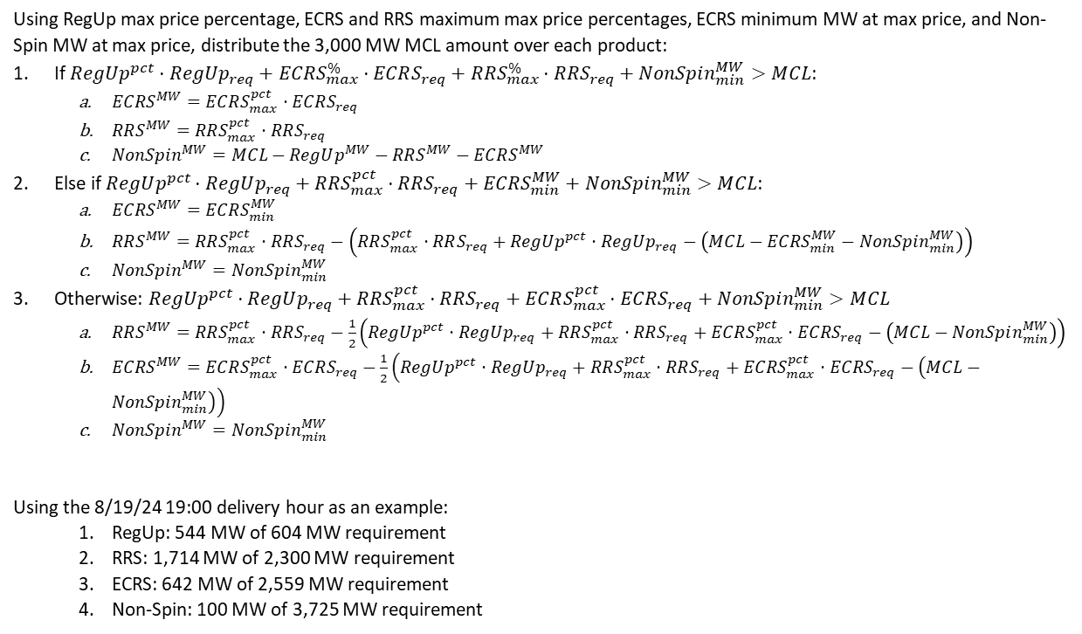
Blended ASDCs: Flat Portion of ORDC
Using RegUp max price percentage, ECRS and RRS maximum max price percentages, ECRS minimum MW at max price, and Non-Spin MW at max price, distribute the 3,000 MW MCL amount over each product:
If $RegUp^{pct}⋅RegUp_{req}+ECRS_{max}^{\%}⋅ECRS_{req}+RRS_{max}^{\%}⋅RRS_{req}+NonSpin_{min}^{MW}>MCL$:
  $ECRS^{MW}=ECRS_{max}^{pct}⋅ECRS_{req}$
  $RRS^{MW}=RRS_{max}^{pct}⋅RRS_{req}$
  $NonSpin^{MW}=MCL−RegUp^{MW}−RRS^{MW}−ECRS^{MW}$
Else if $RegUp^{pct}⋅RegUp_{req}+RRS_{max}^{pct}⋅RRS_{req}+ECRS_{min}^{MW}+NonSpin_{min}^{MW}>MCL$:
  $ECRS^{MW}=ECRS_{min}^{MW}$
  $RRS^{MW}=RRS_{max}^{pct}⋅RRS_{req}−\left(RRS_{max}^{pct}⋅RRS_{req}+RegUp^{pct}⋅RegUp_{req}−\left(MCL−ECRS_{min}^{MW}−NonSpin_{min}^{MW}\right)\right)$
  $NonSpin^{MW}=NonSpin_{min}^{MW}$
Otherwise: $RegUp^{pct}⋅RegUp_{req}+RRS_{max}^{pct}⋅RRS_{req}+ECRS_{max}^{pct}⋅ECRS_{req}+NonSpin_{min}^{MW}>MCL$
  $RRS^{MW}=RRS_{max}^{pct}⋅RRS_{req}−\frac{1}{2}\left(RegUp^{pct}⋅RegUp_{req}+RRS_{max}^{pct}⋅RRS_{req}+ECRS_{max}^{pct}⋅ECRS_{req}−\left(MCL−NonSpin_{min}^{MW}\right)\right)$
  $ECRS^{MW}=ECRS_{max}^{pct}⋅ECRS_{req}−\frac{1}{2}\left(RegUp^{pct}⋅RegUp_{req}+RRS_{max}^{pct}⋅RRS_{req}+ECRS_{max}^{pct}⋅ECRS_{req}−\left(MCL−NonSpin_{min}^{MW}\right)\right)$
  $NonSpin^{MW}=NonSpin_{min}^{MW}$
Using the 8/19/24 19:00 delivery hour as an example:
  RegUp: 544 MW of 604 MW requirement
  RRS: 1,714 MW of 2,300 MW requirement
  ECRS: 642 MW of 2,559 MW requirement
  Non-Spin: 100 MW of 3,725 MW requirement

Slide 23
Blended ASDCs: Curved Portion of ORDC
Additional design parameters to limit RegUp and RRS shortages:
  Min RegUp price: $250/MWh
  Min RRS price: $100/MWh
Disaggregation process:
  Extract evenly spaced 1 MW ORDC segments extending from the start of the curved portion out to the min RegUp price. These segments form the curved portion of the RegUp demand curve.
  Extract evenly spaced 1 MW ORDC segments extending from the start of the curved portion out to the min RRS price. These segments form the curved portion of the RRS demand curve.
  Assign the remaining 1 MW segments of the ORDC to ECRS and Non-Spin alternately, until the requirements for both products have been met.
  Assign any remaining 1 MW segments of the ORDC priced above $0.01/MWh to Non-Spin.
Finally, use linear interpolation to represent each ASDC with 100 price-quantity pairs.

