Slide 1
TDTMS Update
RMS
December 10th, 2024

Slide 2
TDTMS
ERCOT Reporting
2025 SLO & Release Calendar – TDTMS supports ERCOT’s Retail Release calendar aligning production releases with retail releases. Market participants agreed to support mid-week outages scheduled during the 4:30 to 5:30 timeframe. ERCOT expects the full hour will not be utilized and anticipates detailed market notices on the expected releases before the outage and once the outage concludes.
System Instances & MT Performance – All September, October, and November SLAs met. MarkeTrak performance remains well within SLO each month.
Listservs – No issues.
VOTE

Slide 3
TDTMS
SCR 817 – SUCCESS!!!
Find Transaction will now resize to user’s screen
Market notices were sent out on 10/26, 11/4, and 11/11 offering instruction on in-flight IGL activities
Switch Hold API issue was corrected and solution was put into production on 12/2
New ERCOT MIS views for Find ESI and Find Transaction – UPDATE:
Second ‘back’ button was added to the top of both Find ESI and Find Transaction
Extra lines between attributes on Find ESI will be removed to compress view
Market Training was held September 18, 2024 and October 24th, 2024 for the SCR817 - MarkeTrak Changes Associated with TXSET v5.0. It was largely attended by market participants with more than 163 attendees on 9/18 and 225 on 10/24.

Slide 4
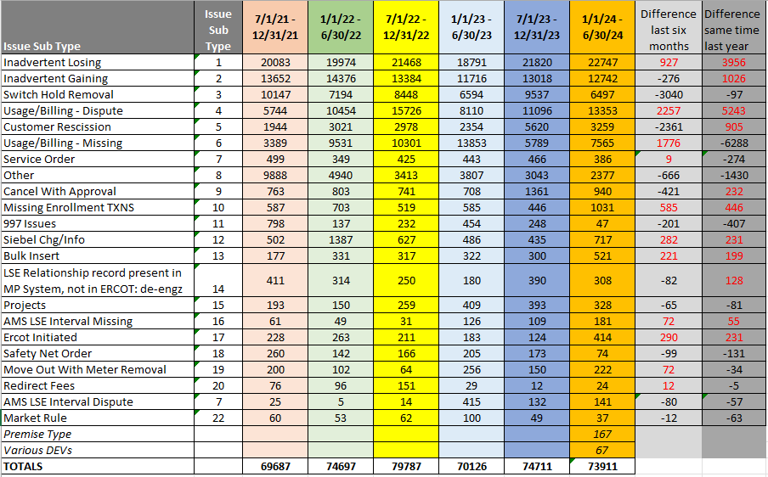
TDTMS
MarkeTrak Subtypes Volumes Analysis 2024(1)
Observations:
IALs – seasonal until first half is higher this year
IAGs – up from same time last year
SH – seasonal with second half of year higher – off heels of heat moratoriums
U&B – Dispute – system/transition/weather related
Rescissions – over time tracking up
Missing TXNs – higher with new entrant
More market participants are submitting Bulk Insert MTs
Siebel Changes - higher with new entrant
ERCOT Initiated – exceptions in ERCOT system (e.g. special characters)
Other – reducing with TDSPs redirecting and providing guidance

Slide 5
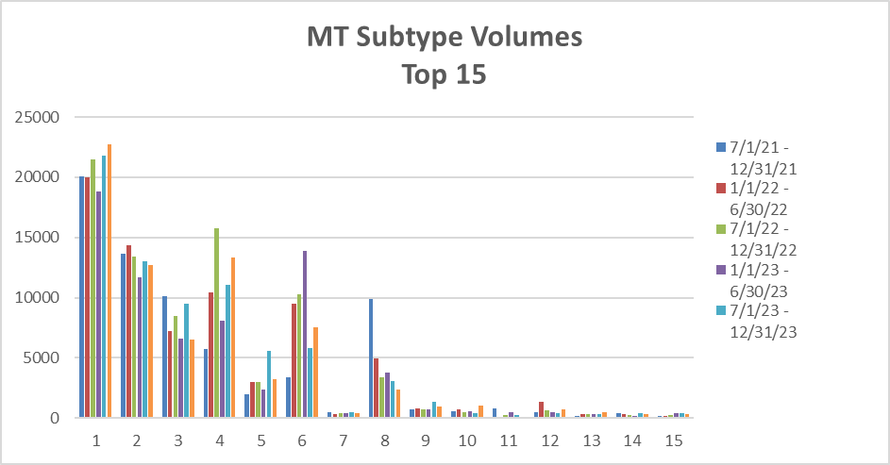
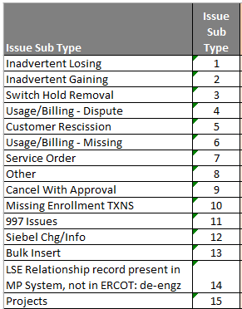
TDTMS
MarkeTrak Subtypes Volumes Analysis – 2024(1)

Slide 6
TDTMS
MarkeTrak Subtypes – Switch Hold Data
Switch Hold volumes are seasonal, typically higher in second half of the year due to weather moratoriums.
Most REP have a >80% removal rate.
With SCR817 functionality, ‘no SH’ and ‘not ROR’ will pop warning messages upon submittal.
Opportunities exist with valid supporting documentation.

Slide 7
TDTMS
MarkeTrak Subtypes – Rescission Data
One REP has submitted > 50% of Rescission volume.
Most REPs align with the market guidelines in processing Rescissions :
80 – 90% reach agreement within 2 days
~70% of BDMVIs are submitted within 2 days

Slide 8
TDTMS
Next Meeting – Tuesday, January 14th
DRAFT Agenda:
Elections - Leadership
Tuesday, January 14th @ 1:00 PM WebEx Only
System Instances & MT Performance
MarkeTrak Subtypes Volume Analysis –IAL results
Listserv
RMG: Switch Hold language to allow for planned retail outages
Critical Care Flags – process to re-establish post an IGL
Goals & Accomplishments
ERCOT Reports

