Slide 1
Update on CRR Auction Items
Samantha Findley
CRR Market Operations
CMWG
December 6, 2024

Slide 2
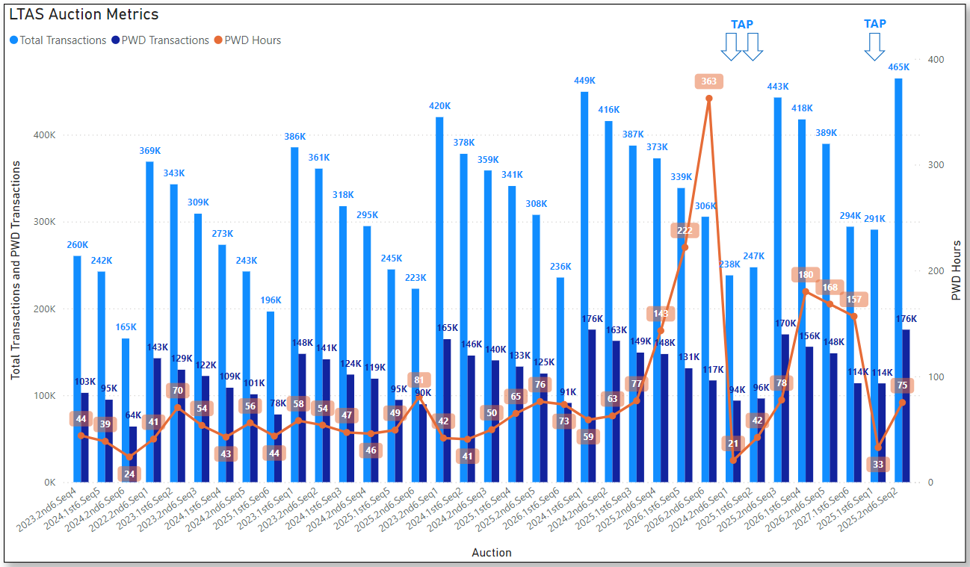
Historical LTAS transactions and solution times

Slide 3
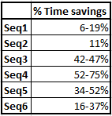
Update on Market Redesign options
Removing Multi-Month Bid Functionality
Studies in progress
Best improvements seen in Seq 3-5 so far
Draft NPRR language review
Option Pricing Report
ERCOT continues to work with vendor to explore possible concepts for how the Option Pricing Report could work.
Draft NPRR language review
As a reminder, all CRRs in baseload are priced in each auction. The updated ShadowPricePerMWH can be found in the Baseloading report for each auction after auction results are posted. The Baseloading report is in the CRR MUI and also posted with CRR Auction Results on MIS public.

Slide 4
Draft NPRRxxxx Remove Multiple Month Transactions in CRR Auctions
Nodal Protocol Sections Requiring Revision | 7.5.1 Nature and Timing 7.5.2.1 CRR Auction Offer Criteria 7.5.2.3 CRR Auction Bid Criteria
Revision Description | This NPRR removes the ability to transact in multiple month strips that create additional optimization issues for ERCOT. Although ERCOT has offered this capability since nodal market go-live, this functionality can cause substantial solve times for ERCOT. By removing this functionality, there can be greater overall participation in the CRR Auction, and market participants can still transact for any given month in an auction.
Justification of Reason for Revision and Market Impacts | In order to simplify the CRR auction and avoid other limitations on participation.

Slide 5
Draft NPRRxxxx Remove Multiple Month Transactions in CRR Auctions
7.5.1 Nature and Timing
The Congestion Revenue Right (CRR) Auction auctions the available network capacity of the ERCOT transmission system not allocated as described in Section 7.4, Preassigned Congestion Revenue Rights Overview, or sold in a previous auction. The CRR Auction also allows CRR Owners an opportunity to offer for sale CRRs that they hold. Each CRR Auction allows for the purchase of CRR products as described in paragraph (5) of Section 7.3, Types of Congestion Revenue Rights to Be Auctioned, in strips of one or one-month strips more consecutive months and allows for the reconfiguration of all CRR blocks that were previously awarded for the months covered by that CRR Auction.
7.5.2.1 CRR Auction Offer Criteria
A CRR Auction Offer indicates a willingness to sell CRRs at the auction clearing price, if it equals or exceeds the Minimum Reservation Price. It must be submitted by a Participating CRR Account Holder and must include the following:
(d) The month, or strip of consecutive months, for which the block of CRRs is being offered, including time-of-use designation except that a 7x24 offer may not be designated;
(3) A Participating CRR Account Holder can only offer to sell one-month or multi-month strips of CRRs for which it is the CRR Owner of record at the time of the offer. Multi-month CRR offers must consist of consecutive months that are within the period of the relevant CRR Auction and can only be submitted as part of a CRR Long-Term Auction Sequence.

Slide 6
Draft NPRRxxxx Remove Multiple Month Transactions in CRR Auctions
7.5.2.3 CRR Auction Bid Criteria
(1) A CRR Auction Bid indicates a willingness to buy CRRs at the auction clearing price, if it is equal to or less than the Not-to-Exceed Price. It must be submitted by a Participating CRR Account Holder and must include the following:
(d) The month or strip of consecutive months for which the block of CRRs is being bid, including time-of-use designation, which may include a 7x24 block in a CRR Monthly Auction but not in a CRR Auction held as part of a CRR Long-Term Auction Sequence;

Slide 7
Draft NPRRxxxx Option Price Report and Establish 1 MW Bid Minimum
Nodal Protocol Sections Requiring Revision | 7.5.2.1 CRR Auction Offer Criteria 7.5.2.3 CRR Auction Bid Criteria 7.5.3.1 Data Transparency
Revision Description | This NPRR will provide an option pricing report following each auction that will be posted on the ERCOT website. The option pricing report will contain shadow prices for all biddable source-sink paths for each month within each time-of-use (TOU) for the Congestion Revenue Rights (CRR) auction period after auction results are posted. Additionally, this NPRR will establish a minimum CRR bid quantity of 1 MW. Currently, the CRR application accepts bid quantities as small as 0.1 MW. The minimum CRR offer quantity will remain 0.1 MW.
Justification of Reason for Revision and Market Impacts | The purpose of this NPRR is to reduce constraints and increase efficiency in the CRR auction optimization and reduce overall solution time. Having an Option Price Report will reduce the number of price discovery option bids that are submitted to the CRR auction optimization by providing clearing prices for all option paths. Reducing option bids in the optimization will increase efficiency in the optimization and reduce overall solution time. Establishing a 1 MW minimum bid quantity will also reduce constraints on the CRR auction optimization caused by bids submitted with quantities <1 MW, increasing efficiency in the CRR auction optimization.

Slide 8
Draft NPRRxxxx Option Price Report and Establish 1 MW Bid Minimum cont’d
7.5.2.1 CRR Auction Offer Criteria
(1)(e)The quantity of CRRs in MW with a minimum of 0.1 MW, which must be the same for each hour within the block, for which the Minimum Reservation Price is effective; and
7.5.2.3 CRR Auction Bid Criteria
(1)(e) The quantity of CRRs in MW with a minimum of 1 MW, which must be the same for each hour within the block, for which the Not-to-Exceed Price is effective; and
7.5.3.1 Data Transparency
(4) Following each CRR Auction, ERCOT shall post to the ERCOT website an option pricing report containing Shadow Prices for all biddable source, sink, and time-of-use combinations for each month of the auction period.

Slide 9
Next Steps
NPRR1261 Operational Flexibility for CRR auction limits will go to December 12 PRS.
https://www.ercot.com/mktrules/issues/NPRR1261
Until NPRR1261 is implemented, 3,000 limit will be used for all LTAS auctions.
ERCOT will work on IAs for NPRRs for Removing Multi-month Bidding functionality and Option Pricing Report.

