Slide 1
PDCWG Report to ROS
Chair: Kevin Bunch, EDF Trading North America
Vice Chair: Chad Mulholland, NRG
ROS
December 5th, 2024

Slide 2
Report Overview & Notes
Report Overview
Meeting Minutes
NPRR 1257 and NOGRR251 Discussion
Load Loss Analysis
ERCOT Frequency Control Metrics and Regulation Reports
TRE Report
Analysis of Disturbances
BAL-001-TRE-2 FMEs and IMFR
0 FME in the month of October
Frequency Control Report
New Leadership for 2025

Slide 3
Frequency Measurable Events Performance

Slide 4
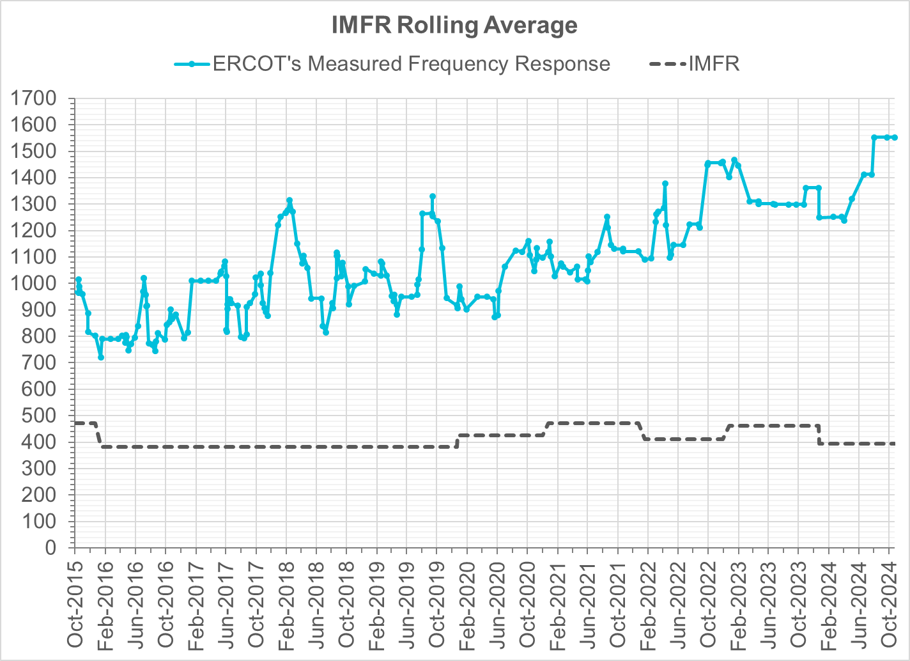
Interconnection Minimum Frequency Response (IMFR) Performance
IMFR Performance currently
1552.00 MW/0.1HZ
Frequency Response Obligation (FRO): 395 MW/0.1 Hz

Slide 5
Questions?

Slide 6
Frequency Control Report
October 2024

Slide 7
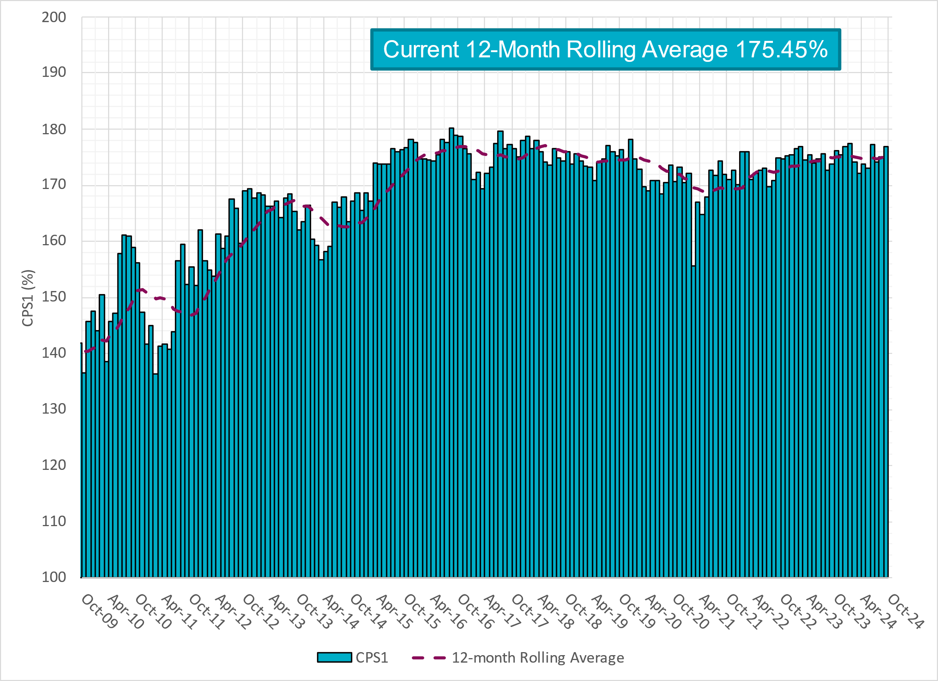
CPS1 Performance

Slide 8
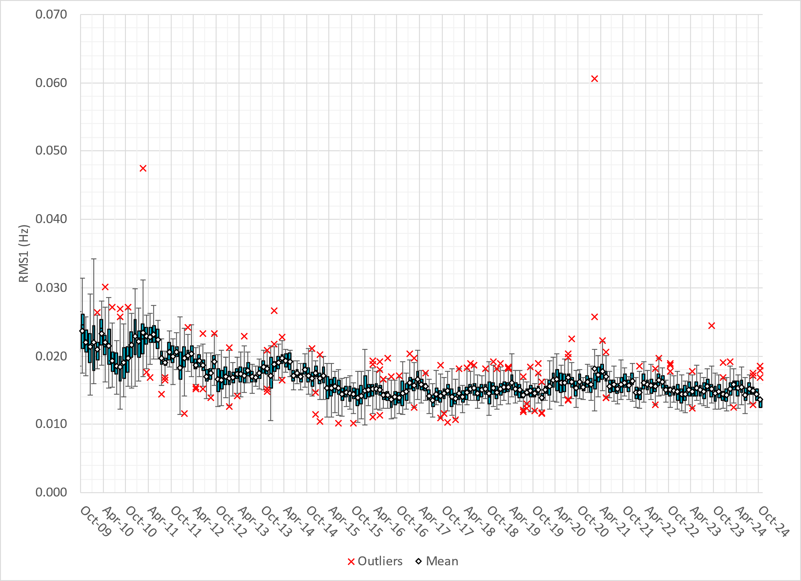
RMS1 Performance of ERCOT Frequency
Notes:
13.6 mHz on avg for October 2024

Slide 9
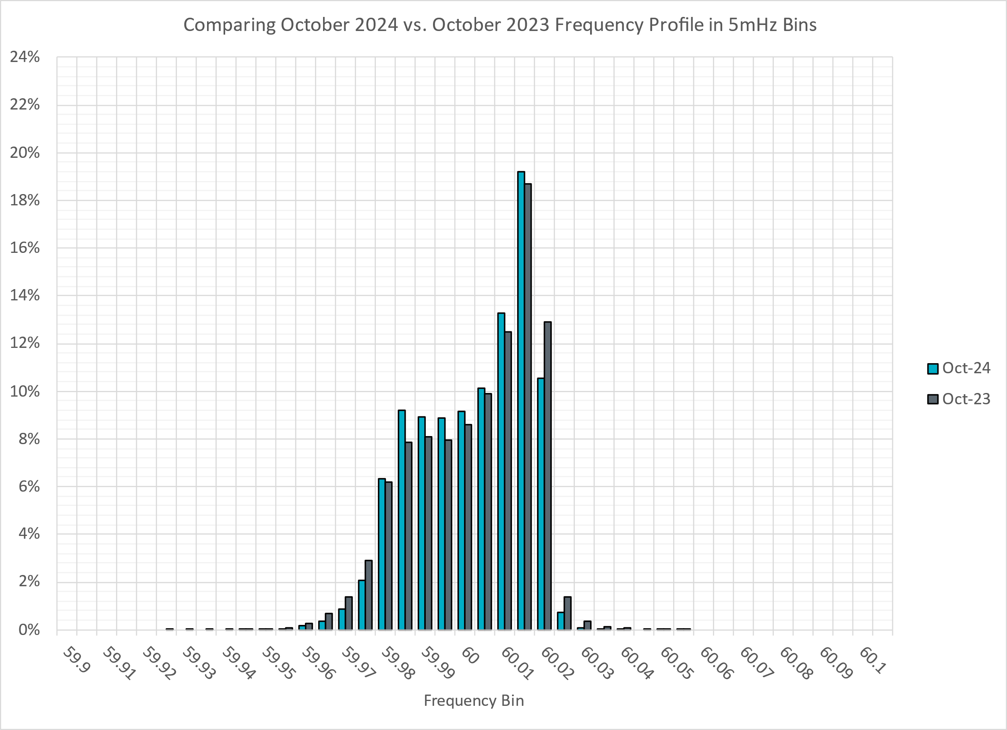
Frequency Profile Analysis

Slide 10
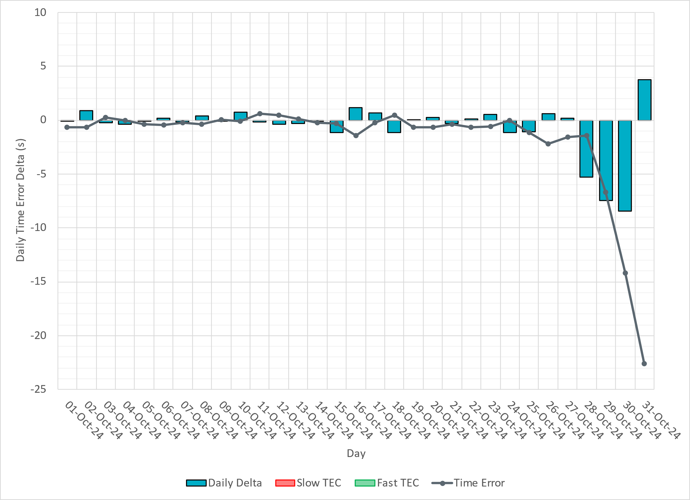
Time Error Corrections
Notes:
We see significant time error accumulation towards the end of October. IRR unit operation (HSL jump) was one contributing factor and we adjusted ACE integral factor to correct the time error.

Slide 11
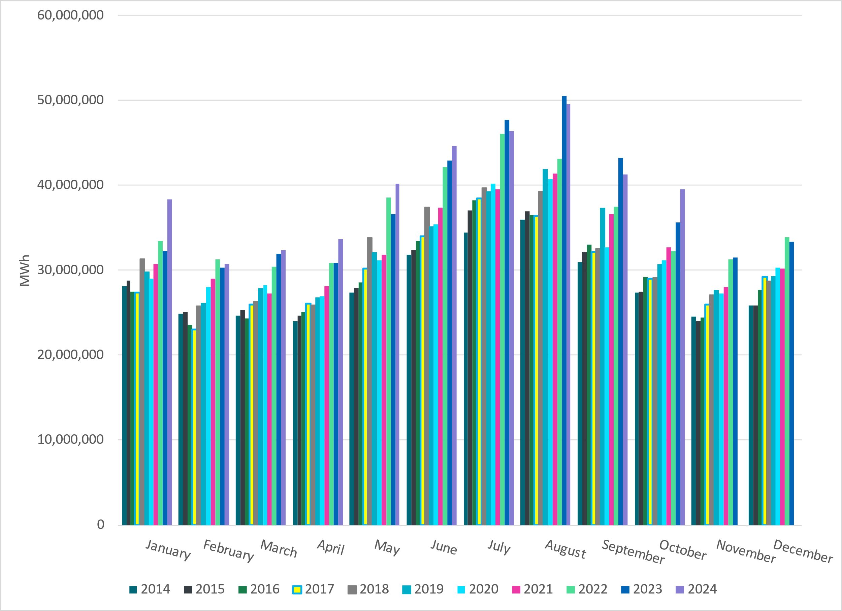
ERCOT Total Energy
Notes:
39,558,950 MWh

Slide 12
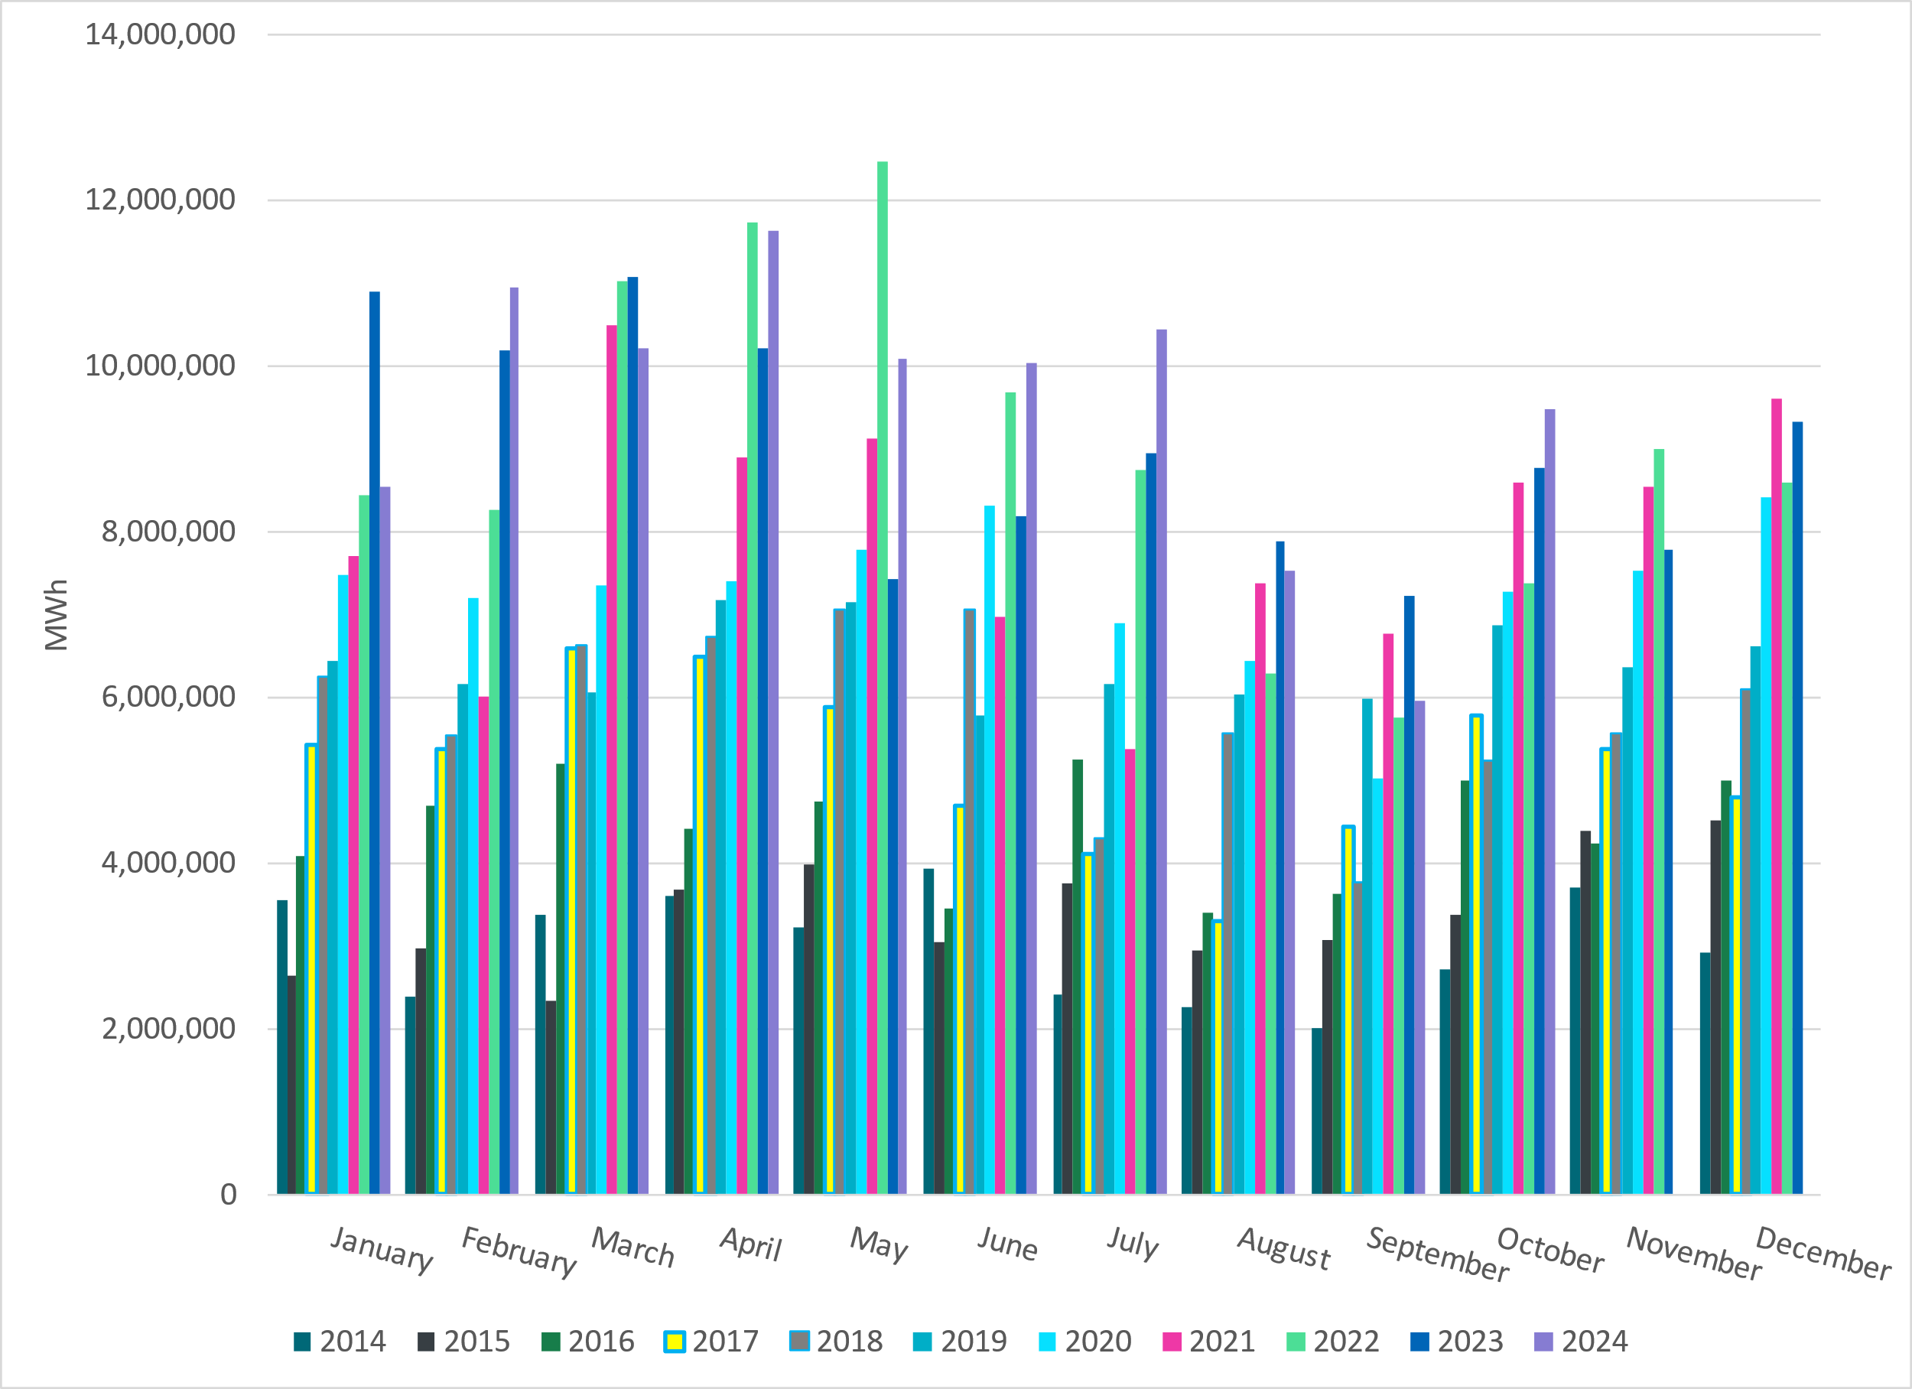
ERCOT Total Energy from Wind Generation
Notes:
9,476,562 MWH

Slide 13
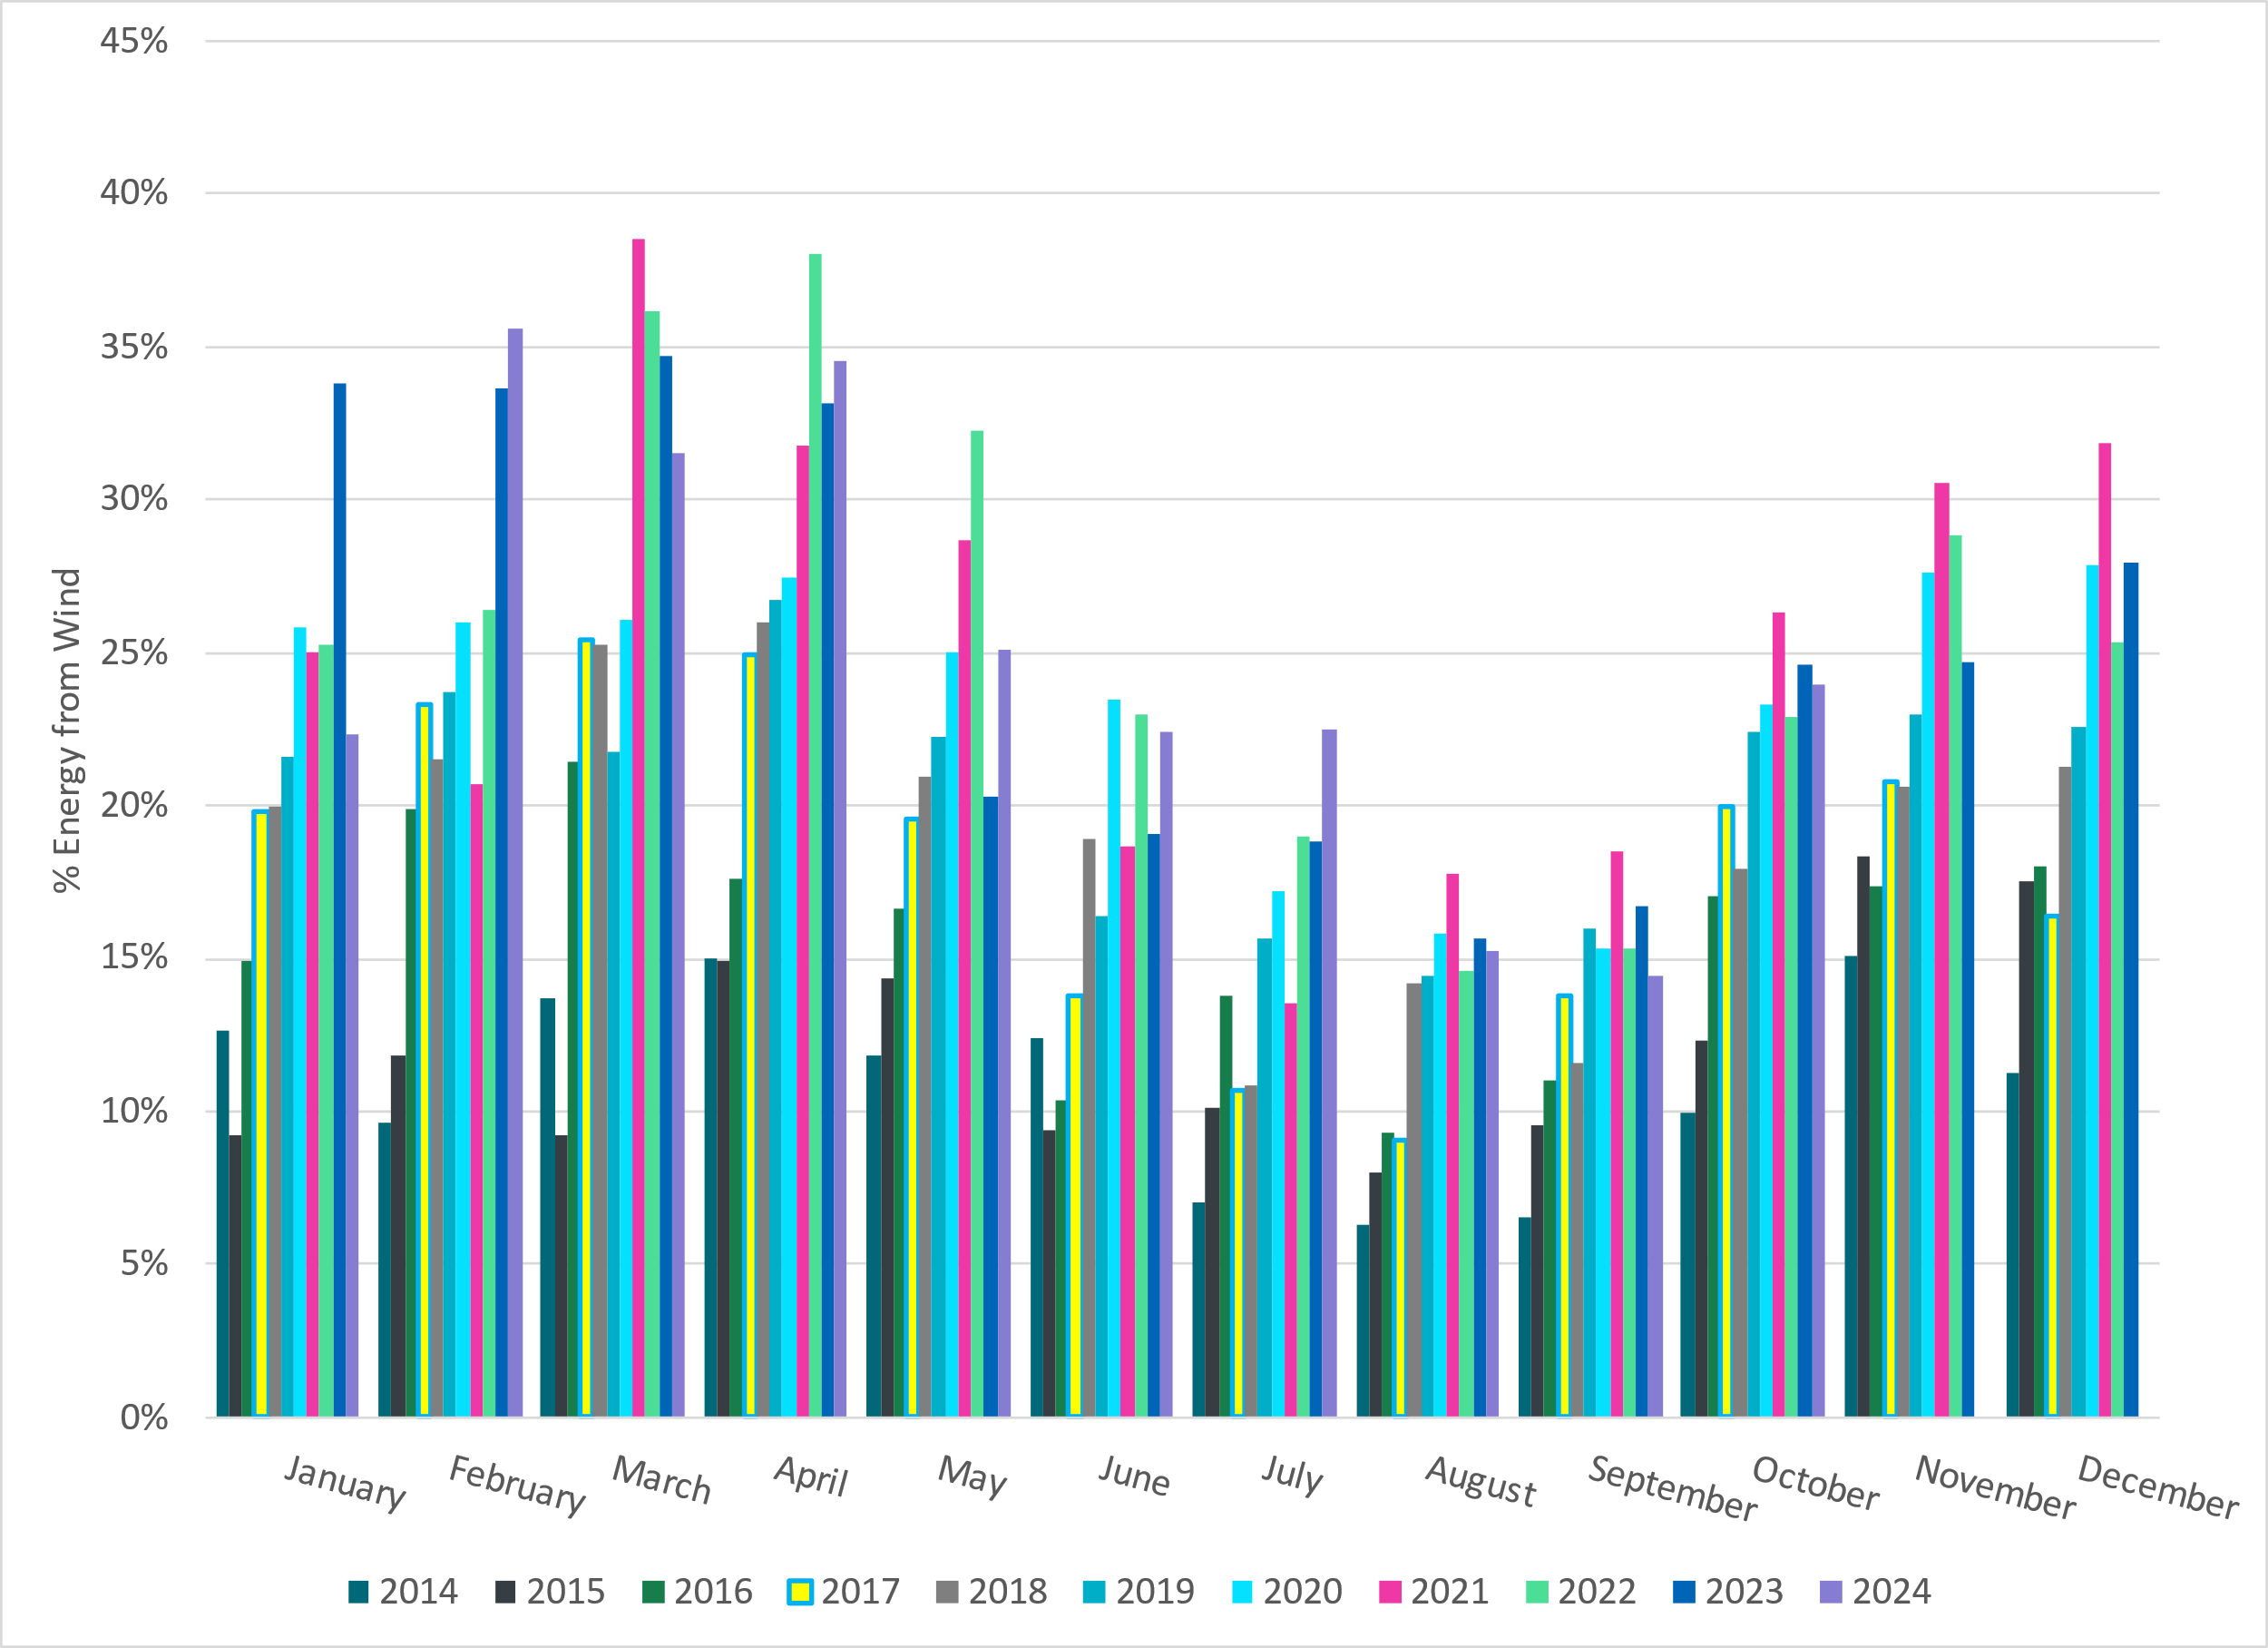
ERCOT % Energy from Wind Generation
Notes:
23.96% of total energy was provided by wind generation

Slide 14
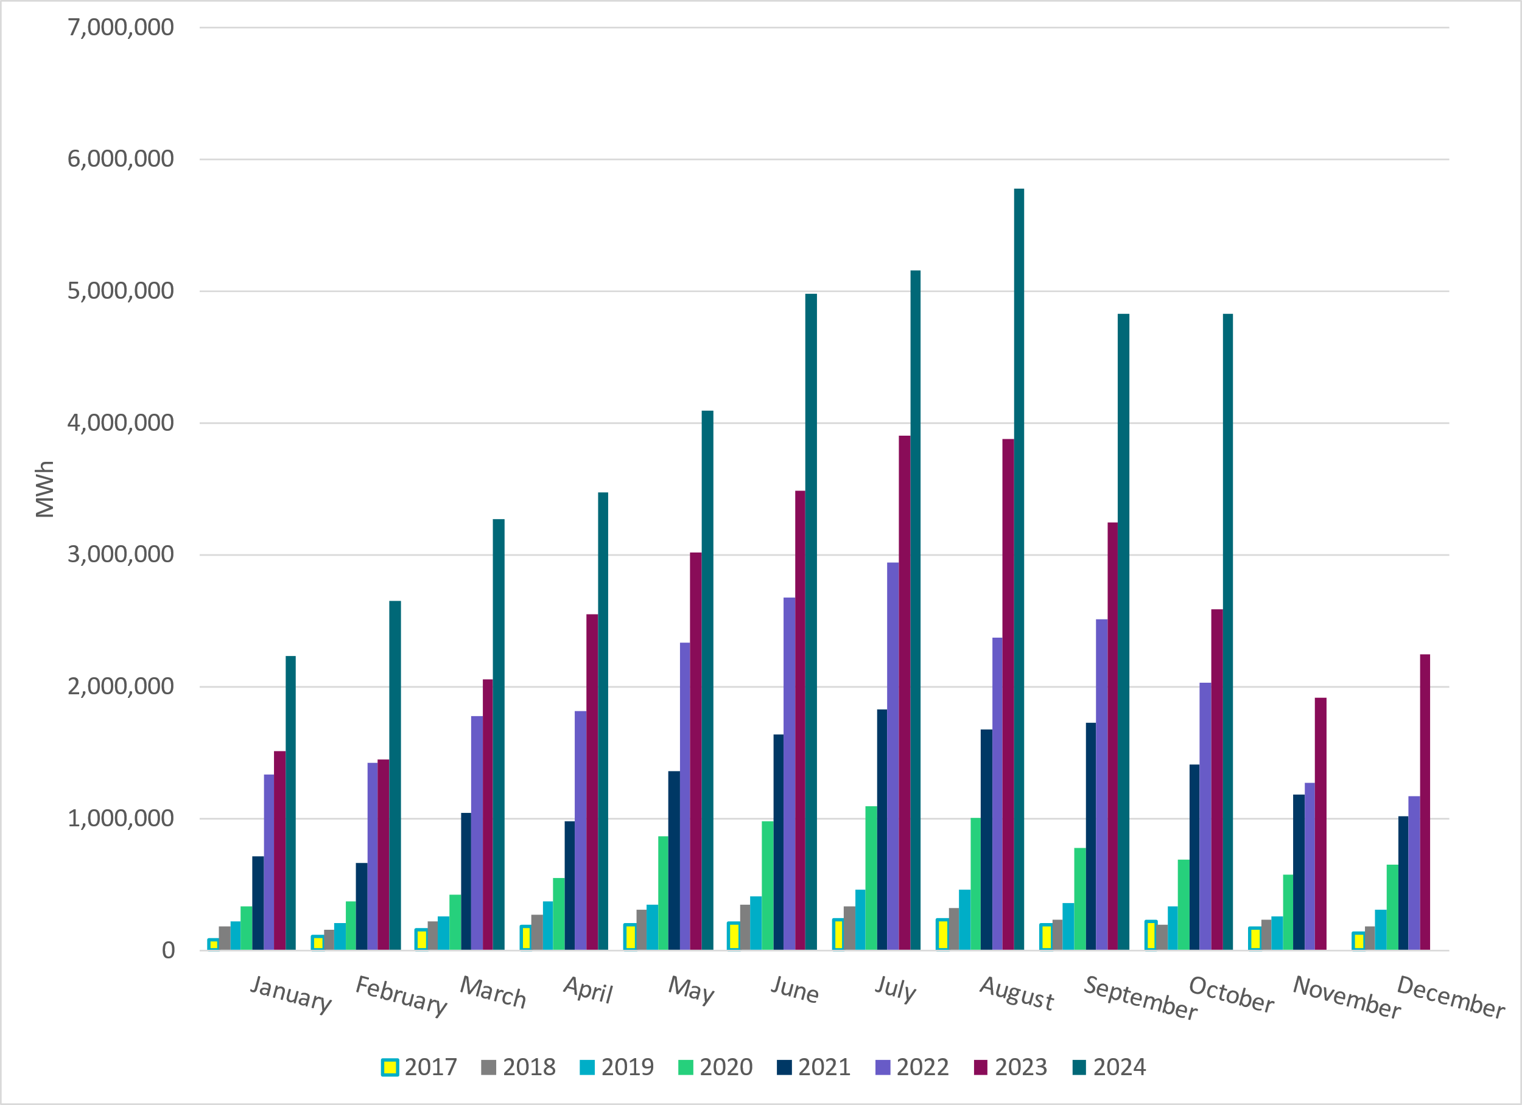
ERCOT Total Energy from Solar Generation
Notes:
4,825,974 MWh

Slide 15
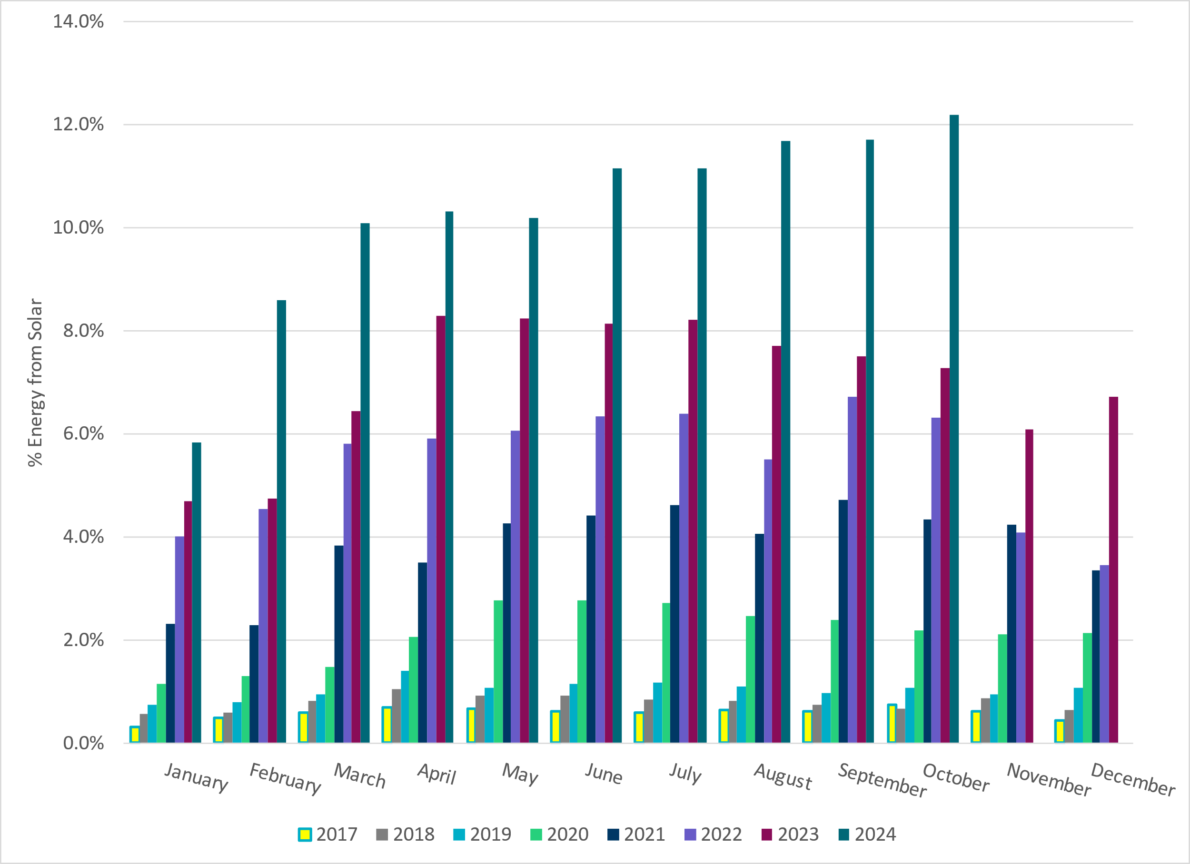
ERCOT % Energy from Solar Generation
Notes:
12.20% of total energy was provided by solar generation

Slide 16
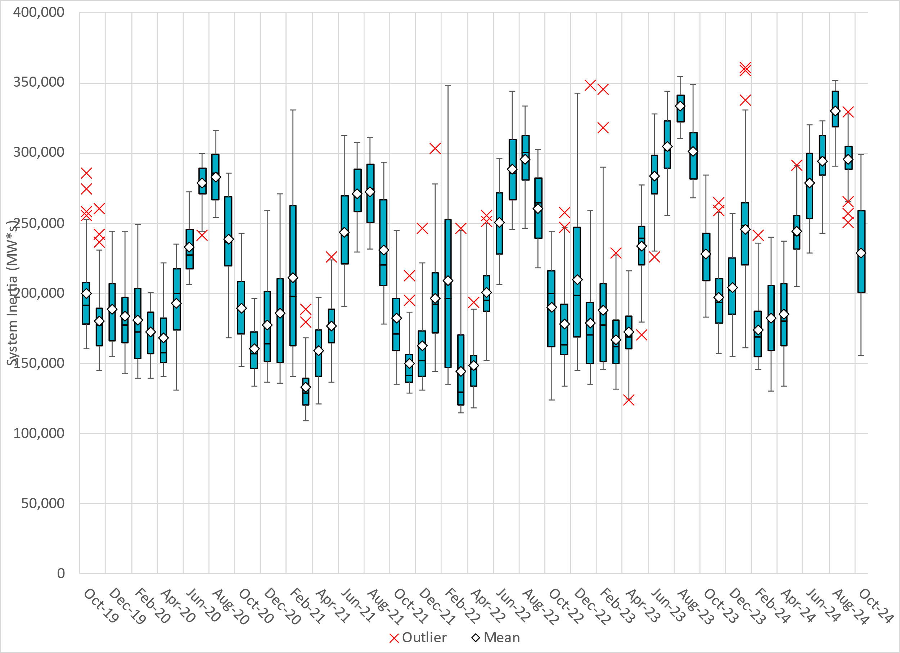
ERCOT Daily Minimum System Inertia
Notes:
Minimum Inertia in October 2024 = 155,165 MW*s on October 18th
Historical Overall Minimum was 109,029 MW*s on 3/22/2021
October Data:
Mean: 228,417 MW*s
Max: 299,001 MW*s on October 7th
Min: 155,165 MW*s on October 18th

Slide 17
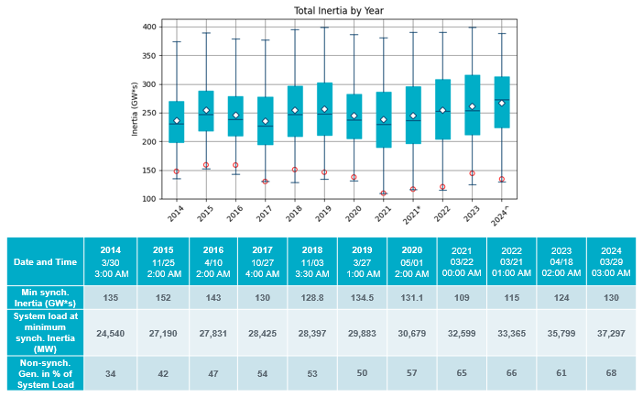
ERCOT Inertia Trend
Notes:
Summary of ERCOT intertia for the previous 10 years. Lowest inertia this year was on March 29th.
For each box, the central mark (red line) is the median, the edges of the box (in blue) are the 25th and 75th percentiles, the whiskers correspond to +/- 2.7 sigma (i.e., represent 99.3% coverage, assuming the data are normally distributed. The corresponding lowest inertia in each year is given in the table.
The circle on each boxplot is showing inertia during time when highest portion of load was served by wind/solar generation in that year.

