Slide 1
Oncor DPC Process Overview
TWG – 11/21/2024
David Amend
Oncor – ERCOT Discussion

Slide 2
Oncor NOMCR/CAMR Groups and Roles
TMS Modeling Group
    Line ratings (static and dynamic)
    Modeling of equipment (breaker and switch status)
    ERCOT OS (Outage Scheduler) outages (new equipment, pseudo switches, equipment retirement)
    ACF (Asset Commissioning Form) sign-off
TGO Support Engineering
  NOMCR review
  Contingency definitions and CAMR submission
  Tagging of N.O. switches and by-pass requiring DPC_CAMRs in iTOA (Outage Mgmt Tool)
  DPC_CAMR submissions
  ACF (Asset Commissioning Form) sign-off
TGO Control Room
  ACF (Asset Commissioning Form) approval
  Coordination of DPC_CAMR execution with ERCOT Control Room
  Equipment switching and energization oversight/accountability

Slide 3
NOMCR Lead Time Requirements
TMS Modeling Group
Stricter lead time requirements have reduced situations where ERCOT rejects outages because the associated NOMCR has not been submitted. http://www.ercot.com/gridinfo/transmission/opsys-change-schedule.html
 | Standard 90 – 120 days | Interim 65 days | Interim 3 weeks
Line (including new rungs which control line flow) | X
Station with new physical line | X
Station without new physical line |  | X
Circuit Breaker (including new rungs which don’t control line flow) |  |  | X
Switch (including temporary air gaps, jumpers and pseudo switches) |  |  | X
Transformer (including mobiles and load serving transformers) |  |  | X
Equipment Removal |  |  | X
Line Rating Change (static and dynamic) |  |  | X
Addition or Removal of ICCP |  |  | X

Slide 4
DPC Eligible Changes
Static Line ratings (TMS Model Group)
  Can make changes to existing ratings
  Can change from static to dynamic provided the new ratings are based static temperature tables using ERCOT temperature telemetry
  Cannot add a second owner
  Cannot add any new telemetry information
Dynamic Line ratings (TMS Model Group)
  Can make changes to existing ratings
  Can change from dynamic to static
  Cannot add a second owner
  Cannot add any new telemetry information
Breaker and Switch status (TMS Model Group)
  Subject to ERCOT discretion. The preferred method is for the status to be submitted according to the 3.10.1 timeline with the appropriate outage entry in the ERCOT Outage Scheduler. New telemetry information is not allowed.
Contingency Definitions (TGO Support Engineering)
  Subject to ERCOT discretion. Each request will be examined to determine feasibility.
RAP and SPS changes or additions (ERCOT)
  Subject to ERCOT discretion. Each request will be examined to determine feasibility.
Net Dependable and Reactive Capability (NDCRC) values (ERCOT)

Slide 5
Oncor DPC Submission Criteria
DPC_NOMCRs are only submitted for:
  Line rating changes.
    Requires Oncor executive approval unless rating change due to equipment failure
DPC_CAMRs are only submitted to:
  Enable/disable already defined contingencies for topology changes
    Goal to minimize the DPC_CAMRs that require defining a new contingency definition
Oncor Historical DPC Submissions
Type | 2017 | 2018 | 2019 | 2020 | 2021 | 2022 | 2023 | 2024 | Grand Total
CAMR |  | 5 | 31 | 101 | 69 | 59 | 102 | 74 | 441
ICR |  | 17 | 4 | 6 | 3 | 3 | 1 |  | 34
NOMCR | 1 | 96 | 16 | 12 | 9 | 23 | 12 | 8 | 177
Grand Total | 1 | 118 | 51 | 119 | 81 | 85 | 115 | 82 | 652

Slide 6
NOMCR to CAMR Review
TGO Support Engineering
NOMCR Submitted
Support Engineer team reviews all NOMCRs every week and identifies if a CAMR is required related to that particular NOMCR.
CAMR needed?
YES
Clean-up CAMR?
NO
Support Engineers submit CAMR to add manual single/double and permanent double as required for that particular NOMCR.
All new contingencies are DISABLED until new equipment is energized (triggered by ACF receipt and often aligned with pseudo switch triggers).
NO
YES
Submit CAMR
Do nothing
Submit Clean-up CAMR
Clean up NOMCR has been submitted by NOMCR team to remove old equipment, lines, pseudo switches etc..
ACF approved by NOMCR team. They fix all new equipment and retirement (if any) outages as per latest in-service date on ACF.
ACF Received
ACF Triggers Contingency Change?
Do nothing or wait for Clean Up NOMCR
NO
Clean up NOMCRs are processed just like other NOMCRs, but the resulting NOMCRs are merely to delete manual contingencies and enable any permanent doubles/disabled singles that need to be enabled.
YES
Up to 48 hrs in advance of Effective Date
Submit DPC CAMR and Email to identify all contingencies that will be enabled/disabled
Wait for Clean Up NOMCR

Slide 7
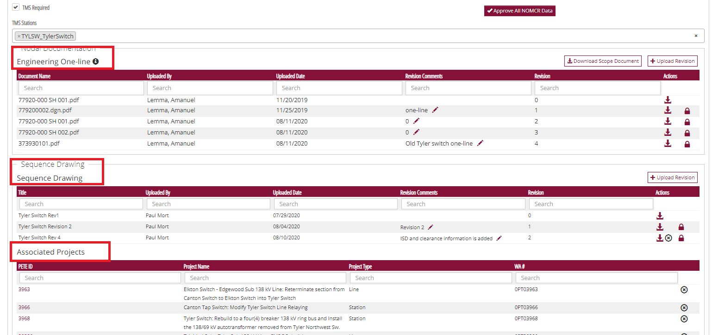
Oncor Program Management Tool (PETE) inc. NOMCR Stages and Asset Commissioning (AC)

Slide 8
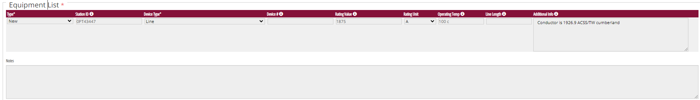
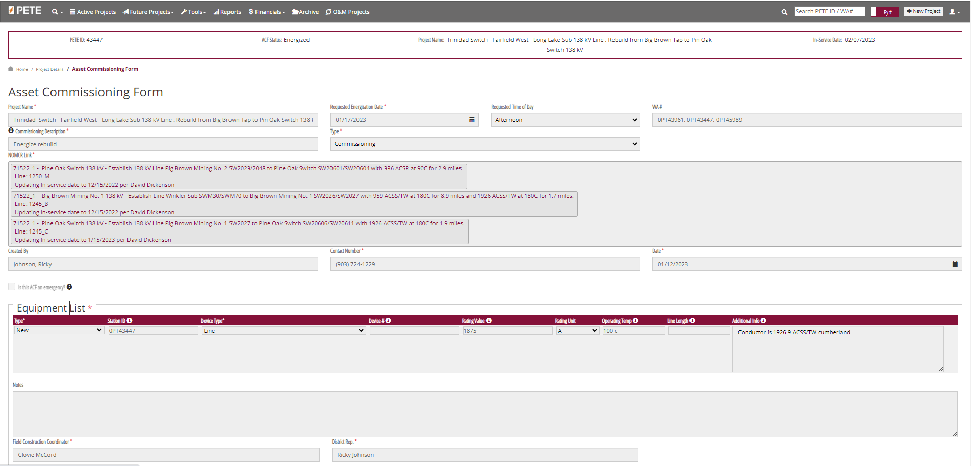
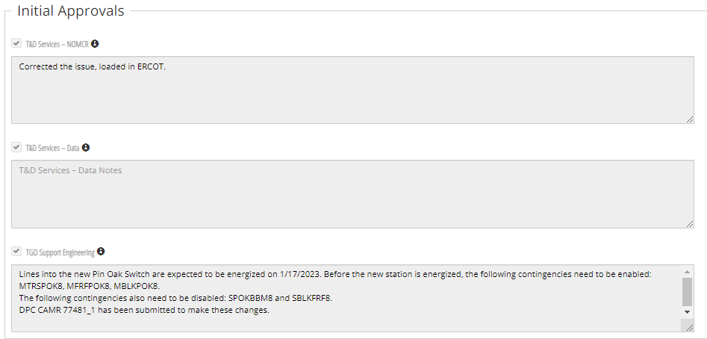
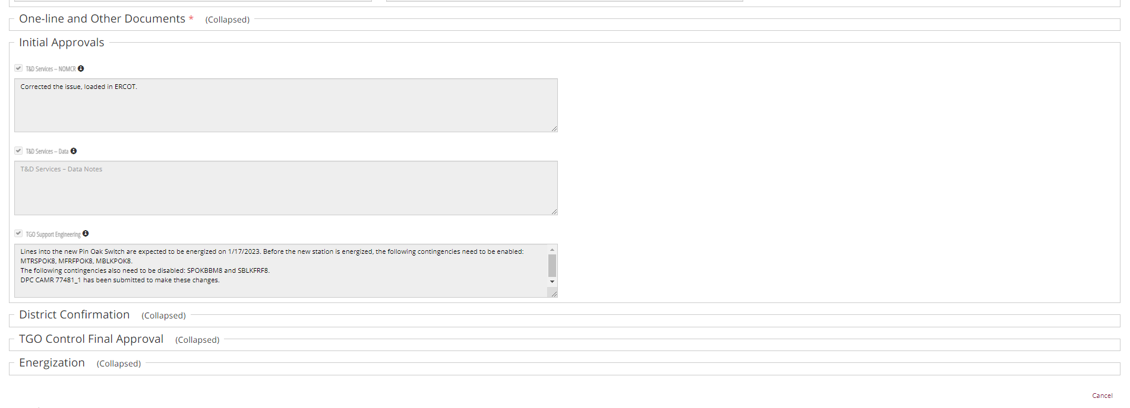
Triggered by a energizing a new line
Actions implement for ACF
TGO Support Engineering Actions
ACF “Initial Approval”

Slide 9
DPC_CAMR Process for Outages (i.e. by-passes)
Contingency Email Received from iTOA
When the CAMR is submitted to model the by-pass a CTG tag is set in iTOA (Outage Mgmt Tool).
An email notification is sent automatically for any outage containing this device.
Notify Clearance Coordinator of Contingency Actions to include in iTOA and for ERCOT
Do nothing
Two business days before outage start?
Two business days before outage end?
YES
Submit DPC CAMR and Email to identify all contingencies that will be enabled/disabled
NO
NO
Up to 48 hrs in advance of Effective Date
Do nothing
YES
Any changes to the start and/or end date of the outage will require submitted DPC_CAMRs to be withdrawn and resubmitted. Date changes for any outage identified as requiring a DPC_CAMR should be communicated to tgosupportengineers@Oncor.com as soon as possible.
Submit DPC CAMR and Email to identify all contingencies that will be enabled/disabled

Slide 10

Q & A
QUESTIONS?

