Slide 1
Series Current Limiting Reactor Loss Calculation
Nov 20, 2024

Slide 2
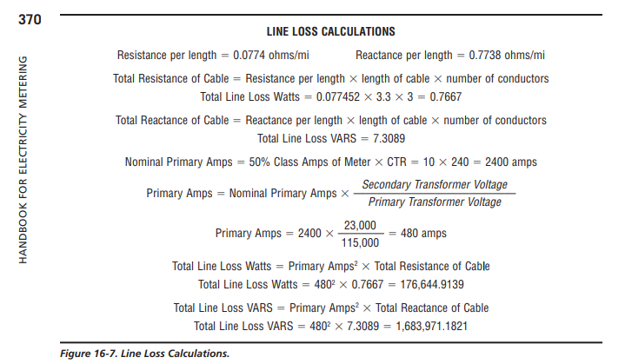
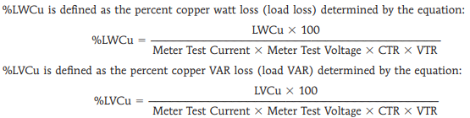
Line Loss Formulas from Handbook for Electricity Metering

Slide 3




SMOG Previously Defined Terms
$$Meter Class Amps=20$$
$$Meter Rated Volt=120$$
$$CTR=CT Ratio \left(XXX:1\right)$$
$$PTR=PT Ratio \left(YYY:1\right)$$
$Nominal CT Primary Amps=\frac{\text{Meter} \text{Class} \text{Amps}}{2}$ * CTR

Slide 4
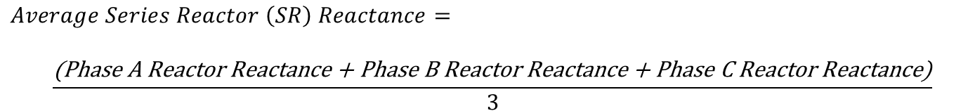
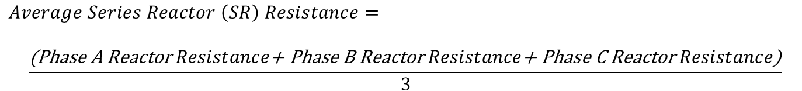
Line Loss Formulas Modified for Series Reactors (3 Element)
$$Average Series Reactor \left(SR\right) Resistance=$$
$$\frac{\text{(}\text{Phase} \text{A} \text{Reactor} Resistance\text{+ }\text{Phase} \text{B} \text{Reactor} Resistance\text{+ }\text{Phase} \text{C} \text{Reactor} Resistance\text{)}}{3}$$
$$Average Series Reactor \left(SR\right) Reactance=$$
$$\frac{\text{(}\text{Phase} \text{A} \text{Reactor} \text{Reactance}\text{ + }\text{Phase} \text{B} \text{Reactor} \text{Reactance}\text{ + }\text{Phase} \text{C} \text{Reactor} \text{Reactance}\text{)}}{3}$$
$$SR Loss Watts=Average SR Resistance{∗(Nominal CT Primary Amps)}^{2}$$
$$SR Loss Vars=Average SR Reactance{∗(Nominal CT Primary Amps)}^{2}$$
$$SR \% Watt Cu Losses=−\frac{\text{(}\text{SR} \text{Loss} \text{Watts}\text{ ∗ 100)}}{(CTR ∗PTR ∗Meter Test Current ∗Meter Rated Volt)}$$
$$SR \% Var Cu Losses=−\frac{\text{(}\text{SR} \text{Loss} \text{Vars}\text{ ∗ 100)}}{(CTR ∗PTR ∗Meter Test Current ∗Meter Rated Volt)}$$
*Negative sign used in Watt and Var Cu % formula to yield a co-efficient that results in a lower calculated load.

