Slide 1
Project Update
November 14, 2024
Troy Anderson
ERCOT Portfolio Management

Slide 2
Project Update Agenda
  Recent / Upcoming Project Highlights
  2024 Release Targets
  2025 Release Targets
  Major Projects
  Priority/Rank Recommendations for Revision Requests with Impacts
    NPRR1239 – Access to Market Information
    NPRR1240 – Access to Transmission Planning Information
  Technology Working Group (TWG)
    Next meeting is 11/21/2024
Location of Revision Request Project Information: http://www.ercot.com/services/projects

Slide 3
Recent / Upcoming Project Highlights
2024 November Off-Cycle Release – 11/1/2024 Complete
  NPRR1205(b) – Revisions to Credit Qualification Requirements of Banks and Insurance Companies
    Credit rating requirements
  NPRR1218 – REC Program Changes Per P.U.C. SUBST. R. 25.173, Renewable Energy Credit Program
2024 November TX SET 5.0 Release – 11/10/2024 Complete
  NPRR1095 – Texas SET V5.0 Changes
  NPRR1134 – Related to RMGRR168, Modify ERCOT’s Mass Transition Responsibilities
  NPRR1168 – Related to RMGRR172, Texas SET V5.0 Continuous Service Agreements Changes
  SCR817 – MarkeTrak Validation Revisions Aligning with Texas SET V5.0
  SCR823 – ERCOT Mass System “County Name” File Updates for Texas SET V5.0
  RMGRR168 – Modify ERCOT's Mass Transition Responsibilities
  RMGRR169 – Related to NPRR1095, Texas SET V5.0 Changes
  RMGRR172 – Texas SET V5.0 Continuous Service Agreements Changes
  RMGRR179 – TDSP Temporary Emergency Electric Energy Facility (TEEEF) Deployment Transactional Processing
2024 November Off-Cycle Release – 11/15/2024 In Flight
  NPRR1231 – FFSS Program Communication Improvements and Additional Clarifications
2024 December Off-Cycle Release – 12/1/2024 In Flight
  NPRR1217 – Remove VDI Requirement for Deployment and Recall of Load Resources and ERS Resources
    VDI discontinued (XML only from this point forward)
  SCR799(b) – ERCOT Outage Study Cases in the System Operations Test Environment (SOTE)
    Export functionality
2024 December Release – 12/12/2024 In Flight
  NPRR1184 – Update to Procedures for Managing Interest on Cash Collateral
  PGRR082 – Revise Section 5 and Establish Small Generation Interconnection Process
  PGRR094 – Clarify Notification Requirement for Generator Construction Commencement or Completion
Note: Projected Go-Live dates are subject to change.
Please watch for market notices as the effective dates approach.

Slide 4
2024 Release Targets – Approved NPRRs / SCRs / xGRRs
R1
R3
R5
January 1/25 | February 2/22 | March 3/28 | April 4/25 | May 5/30 | June 6/27
NPRR1092(b) PGRR098(a) ESR Telemetry Public API Enhancements | NPRR1132(a) RRGRR032 NOGRR249(b) NPRR1184(a) NPRR1026(b) NPRR1172(a) | NPRR1040 NOGRR247(a) NPRR1165 NPRR989(a) NPRR1038 NOGRR204(a) |  | SCR819 NPRR1111 Securitization Default Charge Supporting Data | NPRR1149 NPRR1186 NPRR1196 NPRR1121 NPRR1090 NPRR962 NPRR1139 NPRR1205(a)
R2
R4
R6
ü
ü
ü
ü
ü
ü
ü
ü
ü
ü
ü
ü
ü
ü
ü
ü
ü
ü
ü
ü
ü
ü
ü
ü
ü
ü
ü
ü
ü
ü
1/1
3/11
Various effective dates
2/1
2/26
4/1
6/1
2/16
3/1
ü
7/1
10/1
ü
NPRR1217
SCR799
R7
R9
ü
July 7/25 | August 8/22 | September 9/26 |  | TX SET 5.0 11/10 | December 12/11-12/12
 | NPRR1058 NPRR1131 NPRR1186(b) OBDRR040 SCR821 | Forecast Presentation Platform (CDR rpts) NPRR1002 RRGRR023 NOGRR208 | SCR799 SCR799 NPRR1205(b) NPRR1218 NPRR1231 | NPRR1095 NPRR1134 NPRR1168 SCR817 SCR823 RMGRRs: 168,169, 172,179 | NPRR1184 PGRR082 PGRR088 PGRR094 NPRR945
R8
R11
10/9
ü
ü
ü
ü
ü
ü
ü
E
E
E
E
ü
ü
ü
ü
11/1
ü
ü
11/15
12/18
E
Go-live dates can differ from Protocol effective dates – Please refer to market notices for more details
APPENDIX
Red Text: New additions and target release changes
Strike-Through Text: Previous target release
(a), (b), etc.: Multiple phase release
Project Status Codes
NS = Not Started
I = Initiation
P = Planning
E = Execution
H = On Hold
NPRR989(a) – ESR tech. req.
NPRR1026(b) – SLF – Reporting
NPRR1092(b) – Limit RUC Opt-Out
NPRR1132(a) – RIOO portion
NPRR1172(a) – RUC Process/Clawback
NPRR1184(a) – Interest calcs
NPRR1186(b) – 60 Day Reports
NPRR1205(a) – Credit Limit %
NPRR1205(b) – Credit Rating
NOGRR204(a) – ESR tech req
NOGRR247(a) – UFLS changes
NOGRR249(b) – MIS posting
PGRR098(a) – Section 4.1.1.8
Release targets are subject to change

Slide 5
2025 Release Targets – Approved NPRRs / SCRs / xGRRs
R1
R3
R5
January 1/30 | February 2/26 | March 3/26 | April 4/23 | May 5/28 | June 6/25
PGRR088 |  | NPRR1145 NPRR1183 |  | RTC+B Market Trials begin on 5/5/2025
R2
R4
R6
E
P
P
RTC QSE Submission Testing
RTC QSE Telemetry Check-out
RTC+B
12/5
July 7/24 | August 8/20 | September 9/24 | October 10/22 |  | December 12/10
 |  |  |  |  | RTC+B Stabilization begins
R7
R8
R9
R10
E
R11
NPRR1007-1013
NPRR963(a)
NPRR965
NPRR1000
NPRR1014
NPRR1054
NPRR1058
NPRR1172
NPRR1204
NPRR1216
NPRR1236
NPRR1245
NPRR1246
NOGRR211
NOGRR268
OBDRR020
OBDRR052
PGRR118
RTC QSE Submission Testing
Open-loop RTC SCED
Closed-loop SCED/LFC
RTC QSE Telemetry Check-out
QSE Telemetry Tests
Day-Ahead Market
Go-live dates can differ from Protocol effective dates – Please refer to market notices for more details
APPENDIX
Red Text: New additions and target release changes
Strike-Through Text: Previous target release
(a), (b), etc.: Multiple phase release
Project Status Codes
NS = Not Started
I = Initiation
P = Planning
E = Execution
H = On Hold
NPRR963(a) – Portion of NPRR
RTC+B Market Trials
RTC+B Stabilization
Release targets are subject to change

Slide 6
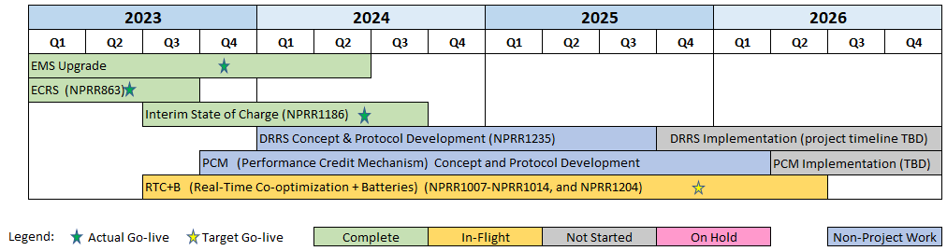
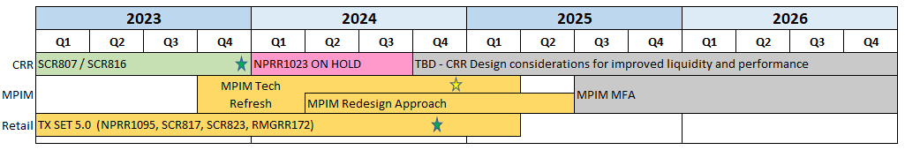
Major Projects
Other Project Highlights

Slide 7
Priority / Rank Recommendations for Revision Requests with Impacts
Recommendations for…
Revision Request | Description | Priority | Rank | Comments
NPRR1239 | Access to Market Information | 2025 | 4540 | $50k-$100k, 3-6 months Impacted System(s): Reporting Implementation will depend on impacts with RTC+B
NPRR1240 | Access to Transmission Planning Information | 2025 | 4540 | $40k-$60k, 3-6 months Impacted System(s): Reporting Implementation will depend on impacts with RTC+B
PPL Rank Information
Next available 2025 Rank in Business Strategy = 4540
Next available 2026 Rank in Business Strategy = 4720
Next available Rank in Regulatory = 400

Slide 8
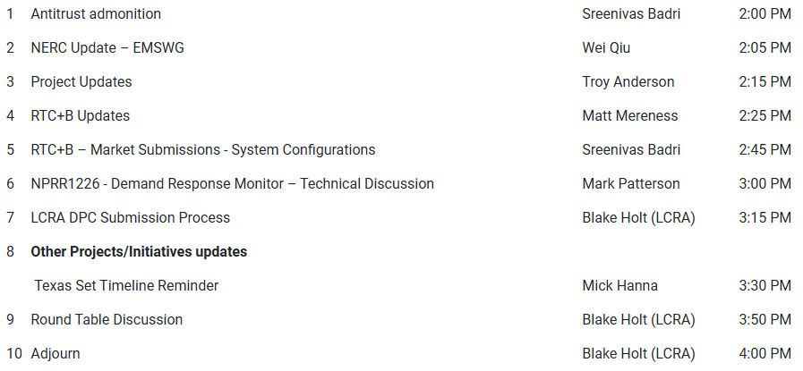
Technology Working Group (TWG)
Agenda for TWG meeting held on 10/24/2024:
Next TWG scheduled for 11/21/2024

