Slide 1
NDCRC – Automatic Tracing and Unit Tests
Bryan Luker/Ashwini Krishna
November 21, 2024

Slide 2
NDCRC – Automatic Tracing and Unit Tests
Timeline Update
  Next NDCRC release planned for production on December 12, 2024 to incorporate additional malware scanning for attachments as well as stabilization bug fixes and requested enhancements
  After December release, a final projected stabilization/enhancement release is tentatively scheduled for late January
  Platform feasible improvements to the submission form and process that are requested by both ERCOT and market users will continue in future releases if necessary

Slide 3
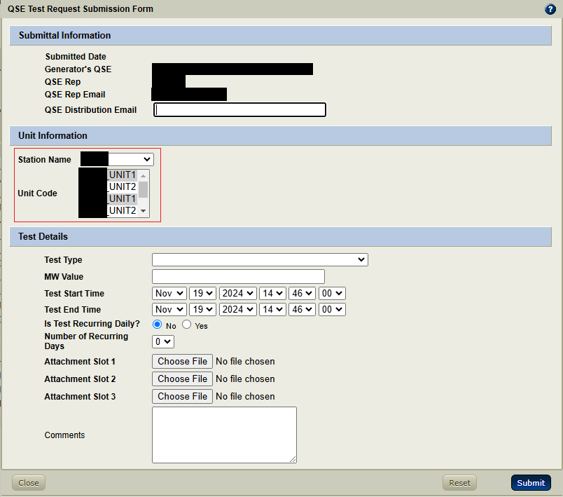
NDCRC – Automatic Tracing and Unit Tests
Changes in 12/12 release
  Test Requests can be submitted for multiple units at the same station
    Launch form with the “Create Bulk Request” button to open a version supporting multi-unit select, pictured below
    Hold CTRL while clicking in the “Unit Code” box to choose multiple units

Slide 4
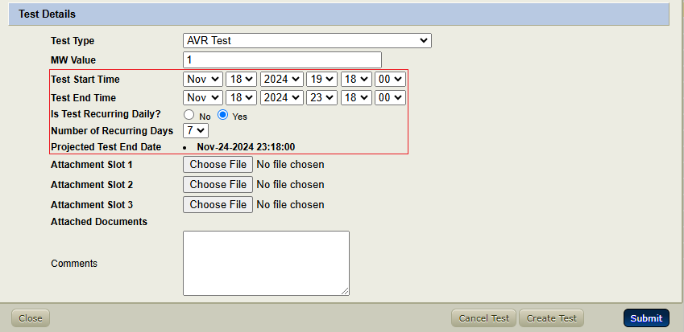
NDCRC – Automatic Tracing and Unit Tests
Changes in 12/12 release (continued)
  Test Requests can be scheduled as recurring
    In order to flag a test as recurring, start time and end time must fall on the same day. Set “Is Test Recurring Daily?” field to “Yes” and pick the “Number of Recurring Days” from the drop down
    After submission, the “Projected Test End Date” will be calculated and appear as read only on the form based on the selected “Test End Time” and “Number of Recurring Days” selection
    Use this feature if you only need to test for a small window on a single day, but need to repeat the test on subsequent days in the same time slot

Slide 5
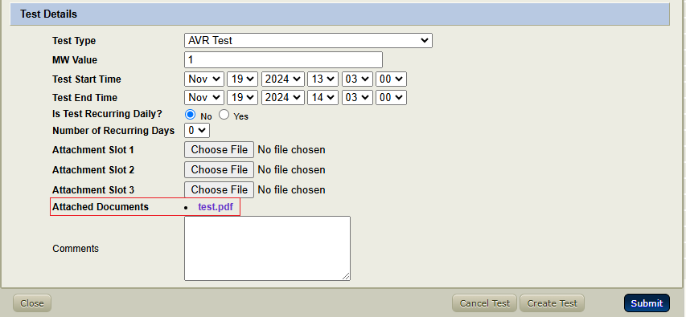
NDCRC – Automatic Tracing and Unit Tests
Changes in 12/12 release (continued)
  Attached files are not immediately downloadable until they complete malware scanning
    When viewing a submitted form, the “Attached Documents” hyperlinks will be disabled for up to 30 seconds while malware scanning is in progress
    After scanning is completed, the link should be active as it normally is unless the file was flagged as a threat, in which case the hyperlink will remain disabled

