Slide 1
ERCOT Technology Working Group (TWG)
November 21, 2024

Slide 2
ERCOT TWG
WELCOME

Slide 3
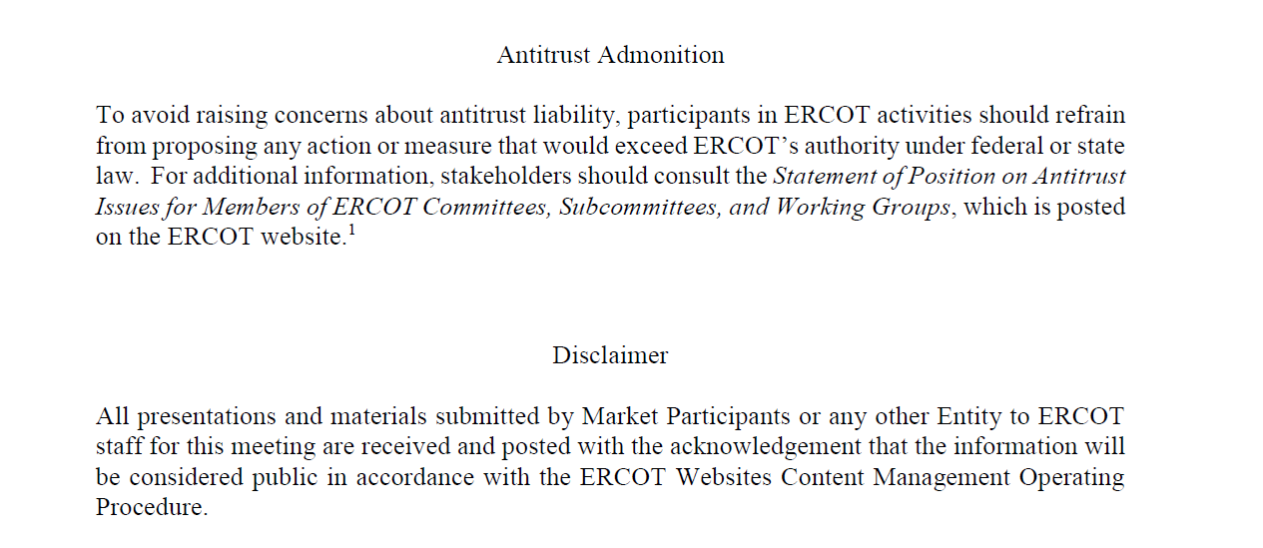
ERCOT TWG

Slide 4
ERCOT TWG Agenda
Item # | Item Description | Presenter | Start Time
1 | Antitrust admonition | Blake Holt (LCRA) | 2:00 PM
2 | Project Updates | Troy Anderson | 2:02 PM
3 | RTC+B Updates | Sreenivas Badri | 2:10 PM
4 | RTC+B Market Submissions Process – Digital Certificates Plan | Sreenivas Badri | 2:20 PM
5 | ONCOR DPC Submission Process | Amend David (ONCOR) | 2:30 PM
6 | Other Projects/Initiatives updates |  | 3:00PM
 | Secure API Pilot Updates | Balendu Mishra/Susan Jinright
 | NDCRC - Generating Unit Tests and Automatic Tracing Project updates | Bryan Luker/Ashwini Krishna
7 | Round Table Discussion | Sreenivas Badri | 3:50 PM
8 | Adjourn | Sreenivas Badri | 4:00 PM

Slide 5
Project Updates
Project Updates – Troy Anderson

Slide 6
RTC+B Updates
RTC+B Updates – Sreenivas Badri

Slide 7
RTC+B Market Submissions Process – Digital Certificates Plan
RTC+B Market Submissions Process – Digital Certificates Plan – Sreenivas Badri

Slide 8
ONCOR DPC Submission Process
ONCOR DPC Submission Process – David Amend (ONCOR)

Slide 9
Other Projects/Initiatives Status Updates
Secure API Pilot Updates - Balendu Mishra/Susan Jinright
NDCRC - Generating Unit Tests and Automatic Tracing Project updates – Bryan Luker/Ashwini Krishna

Slide 10
ERCOT TWG – Round Table Discussion
ERCOT TWG – Round Table Discussion – Sreenivas Badri
  Future Topics of Interest
  Topics and presentations from TWG members

Slide 11
ERCOT TWG
Thank You
You can reach Sreenivas at
Sreenivas.Badri@ercot.com and Blake at Blake.Holt@LCRA.ORG

