Slide 1
NPRR1230: Monitoring and Analysis
Matthew Schmidt
Market Analysis
Congestion Management Working Group (CMWG)
November 19, 2024

Slide 2
Purpose of NPRR1230 Update
TAC requested periodic updates from ERCOT in terms of monitoring the impacts of NPRR1230
At the October CMWG support was voiced for more event-based periodic monitoring updates

Slide 3
Recap: NPRR1230
Addresses operating conditions observed in Summer 2023 for what are now the South Texas Export Interconnection Reliability Operating Limits (IROLs)
ERCOT was previously dependent on using High Dispatch Limit (HDL) overrides to help mitigate the constraint
NPRR1230 increases the Shadow Price Cap for some IROLs
Establishes a transparent method for determining a new Shadow Price Cap for an individual IROL if needed
Security-Constrained Economic Dispatch (SCED) can further manage the IROLs, allowing for the use of market-based tools
Control Room Operators can focus on near-scarcity conditions
Updated Shadow Price Caps ($19,751/MWh) were implemented for the two South Texas Export IROLs (E_PASP, E_PATA) on 10/01/2024

Slide 4
11/17/2024
Reliability/Pricing Impacts:
Pre-NPRR1230 Counterfactual Analysis

Slide 5
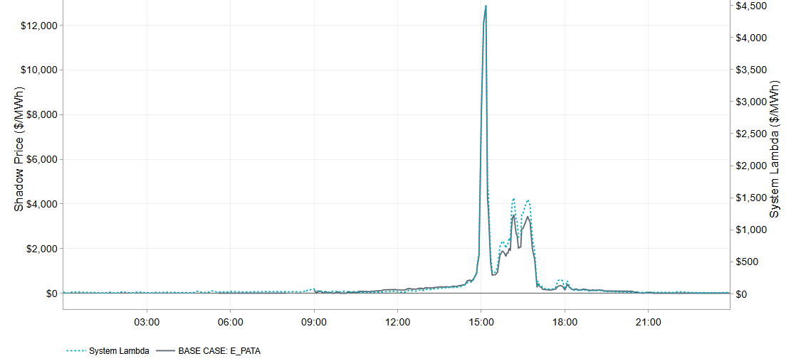
Pricing Event on 11/17 associated with Congestion on South Texas Export IROL
On Operating Day 11/17, the shadow price on the South Texas Export IROL (E_PATA) increased above the previous generic IROL Max Shadow Price of $5,251/MWh for three consecutive SCED intervals between 15:00 and 15:10 to manage the flow across the IROL.
The Shadow Price on the IROL peaked at $12,893/MWh during SCED interval 15:10.
This is the first time since the implementation of NPRR1230 on 10/01/24 that a shadow price above the previous generic Max Shadow Price of $5,251/MWh has been exceeded to manage the South Texas IROLs

Slide 6
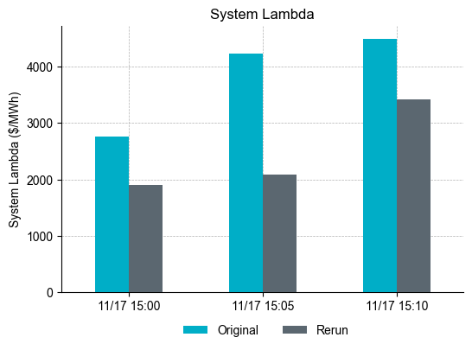
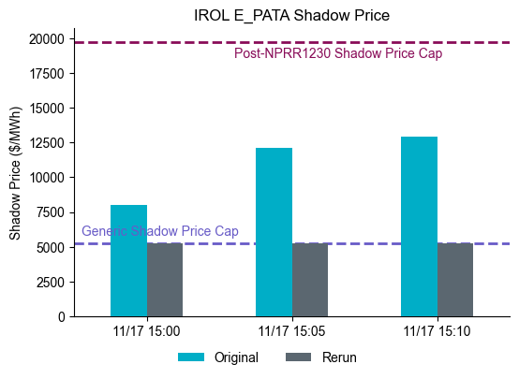
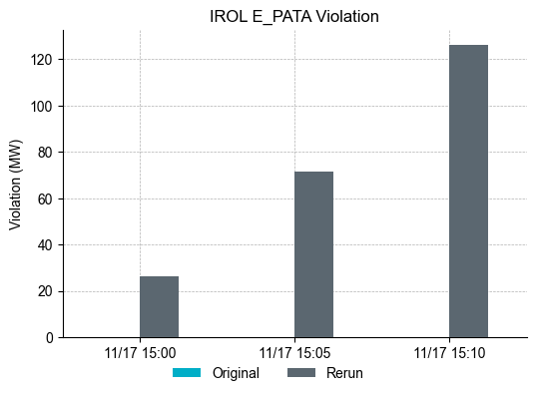
Counterfactual analysis w/ generic SP Cap for South Texas Export IROL for violated intervals on 11/17/2024
Violation of IROL E_PATA could have exceeded 120 MW (if no out-of-market actions were taken) with generic IROL Shadow Price Cap of $5,251/MWh
Largest decrease in System Lambda during SCED interval 15:05.
Decrease in System Lambda in counterfactual rerun due to more capacity available to SCED with transmission violation and less reliance on under-generation.
Due to the magnitude of the shadow price post-NPRR1230, generation on the hurting side of the constraint can be curtailed to mitigate the violation, which could increase under-generation for the interval (SCED leaning on regulation), causing System Lambda to jump to $4,500/MWh in SCED interval 15:10

Slide 7
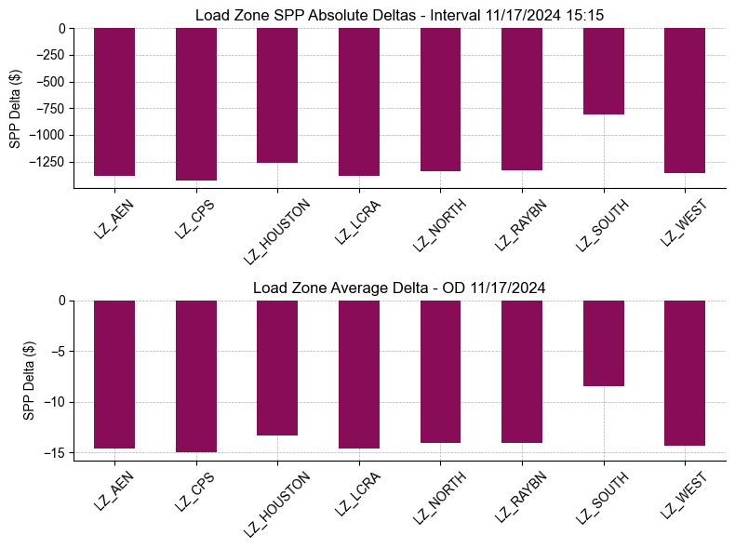
SPP Interval and Daily Average SPP Deltas by Load Zone
Largest negative Load Zone SPP deltas observed in Load Zone CPS and smallest in Load Zone South.
Average Daily Load Zone SPP Delta between - $7 and - $15

