Slide 1
ERCOT GEWG Meeting
Recent NAESB Gas-Electric Activities
November 18, 2024
NORTH AMERICAN ENERGY STANDARDS BOARD

Slide 2
North American Energy Standards Board
Quick Facts
Mission & Government Coordination
The North American Energy Standards Board serves as an industry forum for the development and promotion of standards to support the wholesale and retail natural gas and electricity markets
1994
2001
GISB
Founded
NAESB Established
Department of Energy
National Petroleum Council
National Institute of Standards and Technology
Federal Energy Regulatory Commission
North American Electric Reliability Corporation
National Association of Regulatory Utility Commissioners
29
4,000+
Years of Standards Development
Standards
American National Standards Institute (ANSI) Accreditation
Oct. 2001

Slide 3
NAESB G-E Coordination
Timeline of Previous Activities
NORTH AMERICAN ENERGY STANDARDS BOARD
November 2003
Chairman Wood submits request to NAESB concerning market coordination
June 2007
FERC issues Order No. 698 adopting Coordination Standards
September 2011
National Petroleum Council issues Prudent Development Study
April 2015
FERC issues Order No. 809 adopting NAESB Gas Day modifications
November 2021
Standards Request R21006 concerning market coordination submitted to NAESB
July 2023
NAESB publishes the NAESB Gas Electric Harmonization Report
June 2005
NAESB submits Gas Electric Status Report & Coordination Standards
September 2008
NAESB submits Additional Standards & Final Report
March 2014
FERC issues NOPR proposing modifications to Gas Day
March 2017
NAESB submits Report concerning “faster, computerized scheduling” standards
July 2022
Chairman Glick and Jim Robb submit request to NAESB calling for Forum
October 2024
NAESB adopts new communication standards
NG 17% of Resource Mix
NG 40% of Resource Mix
(Almost 3X kWh from 2003)
NG Becomes Largest Resource for Generation
Shale Gas Revolution

Slide 4
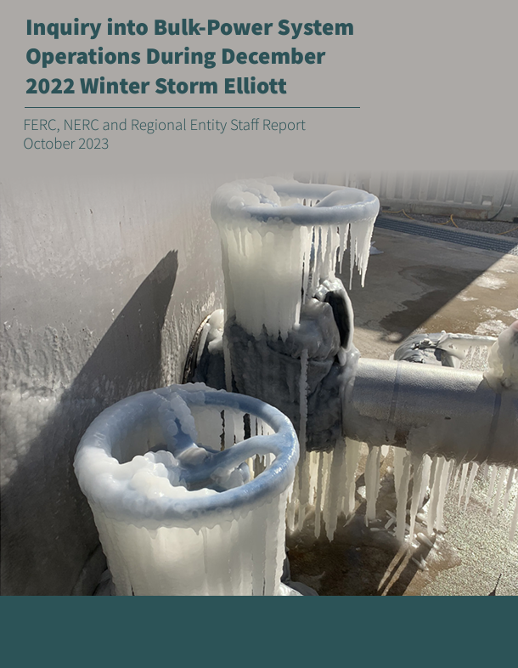
2022 Winter Storm
Elliott Report
NORTH AMERICAN ENERGY STANDARDS BOARD
October 2023
C. Natural Gas-Electric Coordination
for Cold Weather Reliability
Recommendation 5: The North American Energy Standards Board should convene natural gas infrastructure entities, electric grid operators, and LDCs to identify improvements in communication during extreme cold weather events to enhance situational awareness.

Slide 5
NAESB Joint
Standards Development
NORTH AMERICAN ENERGY STANDARDS BOARD
Wholesale Electric / Wholesale Gas / Retail Markets
NAESB 2024 Annual Plan Item Review and modify the Gas / Electric Coordination Business Practice Standards and any corresponding standards to improve communication among the operators of production facilities (producers, gatherers, processors) and pipeline and storage facilities for the timely dissemination of this coordinated communication from the these facilities to and from relevant natural gas infrastructure entities, BAs, shippers, and end-use customers (i.e., Local Distribution Companies) as needed to enhance situational awareness during extreme cold weather events without endangering sensitive commercial information
NAESB Business Practice Subcommittees
10 Joint Meetings – January to July 2024
Robust Participation
Cross Market Collaboration
Chairs’ Scenario Based Communication Gap Analysis
Recommendation Voted Out on July 29, 2024 Without Opposition
Two Changes to the NAESB WGQ Business Practice Standards
To be Reviewed by NAESB WGQ Executive Committee on October 24th (2 Comments Submitted)

Slide 6
NAESB WGQ Standards
NORTH AMERICAN ENERGY STANDARDS BOARD
Recommended Changes
NAESB WGQ Standard No. 4.3.23
New Category: Gas Electric Coordination (when applicable)
NAESB WGQ Standard No. 0.3.z1
New Requirement for Scheduled Quantity Information for Directly Connected Power Plants
Examples of Information that Could be Included
NAESB WGQ Standard No. 5.3.z1
New Information in Critical Notices to include geographic information of impacted areas, locations, or pipeline facilities

Slide 7
Chairs’ Work Paper
NORTH AMERICAN ENERGY STANDARDS BOARD
Concepts Only Presented to
Solicit Discussion
Ad hoc Work Paper on Gas-Electric Communication Submitted by BPS Chairs
There may be limited understanding of pipeline-initiated confirmation and/or nominations reductions that are not captured in OFOs and/or underperformance notices as this is hard to discern from operationally available data.
There is a lack of communication during extreme weather events of upstream supply issues, including invocations of force majeure, by parties with direct knowledge to critical stakeholders who are not part of the transactional and operational chain (e.g., Pipeline Operators, RTO/ISO). Consistent and ongoing communication primarily only occurs between parties with operational and/or contractual connections; therefore, only directly affected parties understand their real-time positions and situation, except in instances where such information is part of pipeline Critical Notices.
Because many end users purchase their gas from various parties rather than directly from producers and such gas can be transacted multiple times (i.e. “daisy-chain”), certain transactional communications, even ones as critical as force majeure, may take significant time (e.g., days) for information to flow through to all stakeholders.
Certain interstate pipeline Informational Postings lack specific location information to help parties better understand the area covered by the posting. (This is currently being discussed by the joint subcommittees.)
There may be limited stakeholder distribution and/or unclear and/or no communication of recovery timelines and expectations when supply is lost due to weather and/or operational disruptions. For example, interstate natural gas pipelines may observe a difference between shipper nominations and actual gas flows or system pressure changes. While the difference might indicate supply disruptions upstream, the difference does not indicate what is occurring or the anticipated length of the event.
There may be limited and/or delayed communication from end-users to pipeline operators of non-ratable or other consumption patterns that deviates from contractual commitments.

Slide 8
NAESB Contact Information
GEH Forum Website: https://naesb.org//naesb_geh_forum.asp
Phone – 713-356-0060
Fax – 713-356-0067
Email – naesb@naesb.org
NORTH AMERICAN ENERGY STANDARDS BOARD

