Slide 1
ERCOT IBRTF: NERC and Other Industry Updates
Julia Matevosyan
Chief Engineer
ESIG
11/15/2024

Slide 2
MISO GFM BESS Requirements Moving Forward
MISO presented the latest draft of the proposed performance requirements for GFM BESS at October Planning Advisory Committee (PAC) meeting.
The proposal was to require GFM control capabilities from all BESS, starting with the DPP 2023 Cycle* (i.e. next gen interconnection cycle).
The requirements and process are outlined in Business Practice Manual (BPM-015) redlines (Section 5.3.7 on Page 52).
PAC stakeholders were invited to review and submit feedback to MISO’s proposal
MISO responded to stakeholder feedback submitted by 2 parties and shared requested clarifications in the responses and November PAC meeting materials.
Next Steps: Finalize BPM-015 redlines to implement proposed requirements
* DPP – Definitive Planning Phase

Slide 3
GFM Progress Globally
Operator Specifications
HECO – Hawaii, U.S.
NESO – Great Britain
AEMO – Australia
Fingrid – Finland
MISO – U.S.
ERCOT (drat) – U.S.
ENTSO-E (draft) - Europe
OEMs
SMA
Tesla
Sungrow
Power Electronics
Hitachi Energy
Siemens (e-STATCOM)
EPC Power
GP Tech
GE
https://www.esig.energy/working-users-groups/reliability/grid-forming/gfm-landscape/projects/

Slide 4
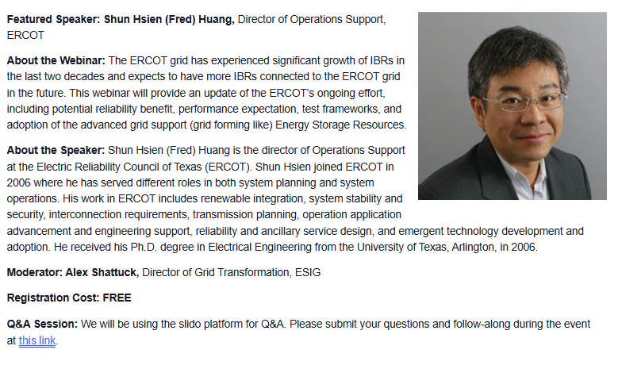
G-PST/ESIG Webinar: GFM Technology Adoption in ERCOT – Status Update
November 12 @ 4:00 pm - 5:00 pm EST
Download Presentation
View Webinar Recording
1003 registered / 302 attended

Slide 5
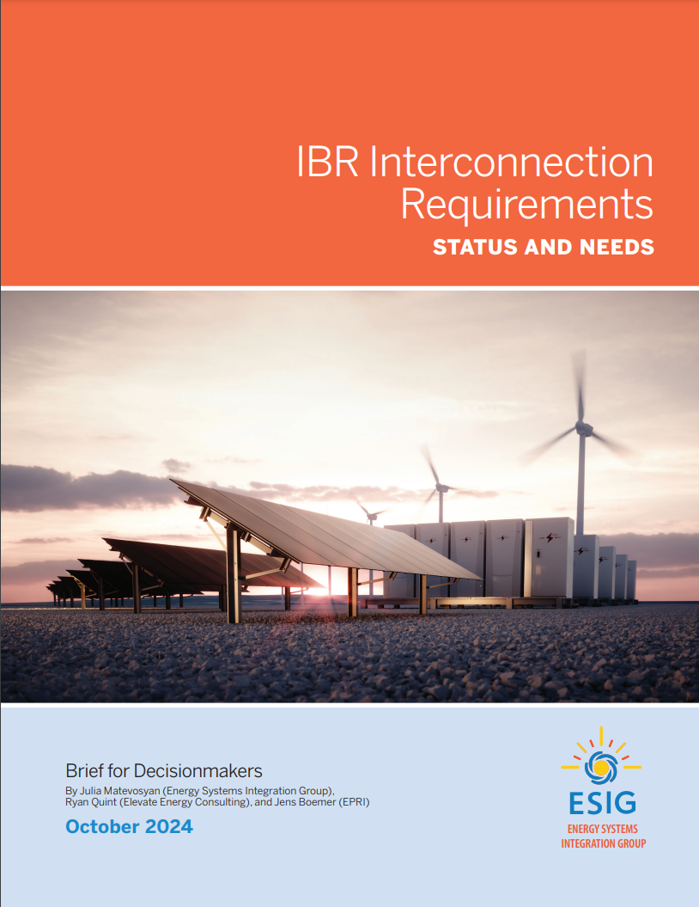
IBR Interconnection Requirements Status and Needs
ESIG’s new brief summarizes the current status of efforts to improve interconnection standards for IBRs, including:
  IEEE Standard 2800-2022, four adoption strategies and their pros and cons
  The status of continued industry discussion around updates to IEEE Standard 2800-2022
  FERC Order 901 and North American Electric Reliability Corporation (NERC) reliability standards
  Overarching efforts by the DOE i2X Forum for the Implementation of Reliability Standards (FIRST), which is focused on the cohesive implementation of solutions related to standards outlined in the i2X Roadmap and leverages insights from early adopters
  The rapid pace of the energy transition calls for proactive steps to mitigate risks, and industry stakeholders are encouraged to stay engaged

Slide 6

IEEE PES GM 2024 Panel on IBR Integration
Summary of the IEEE PES GM 2024 panel, focused on the integration of IBRs.
The panel included SMEs from Vestas, the MISO, EPE, Elevate Energy, and Dominion Energy.
Key points discussed included:
  the reliability challenges of IBRs,
  modeling issues, and
  the development of standards for their effective integration, as required by recent FERC Orders.

Slide 7
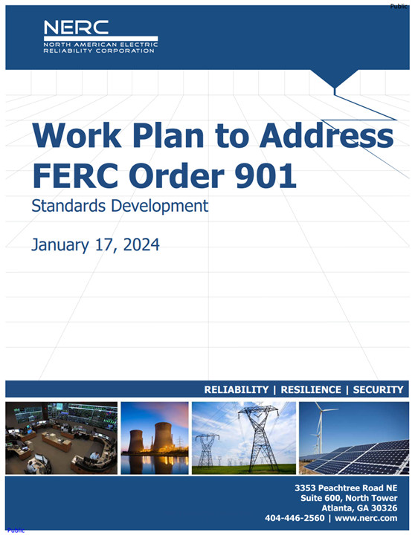
FERC Order 901 – NERC Milestone 2
NERC addressed Milestone 2 of FERC Order 901 through enhancements to the following projects:
  Project 2020-02 Modifications to PRC-024 (Generator Ride-through)
    Filed with FERC on 11/04/2024* – RM25-3-000
    *Required intervention from NERC Board of Trustees
  Project 2021-04 Modifications to PRC-002
    Filed with FERC on 11/04/2024 – RD25-2-000
  Project 2023-02 Analysis and Mitigation of BES Inverter-Based Resource Performance Issues
    Filed with FERC on 11/04/2024 – RD25-3-000

Slide 8
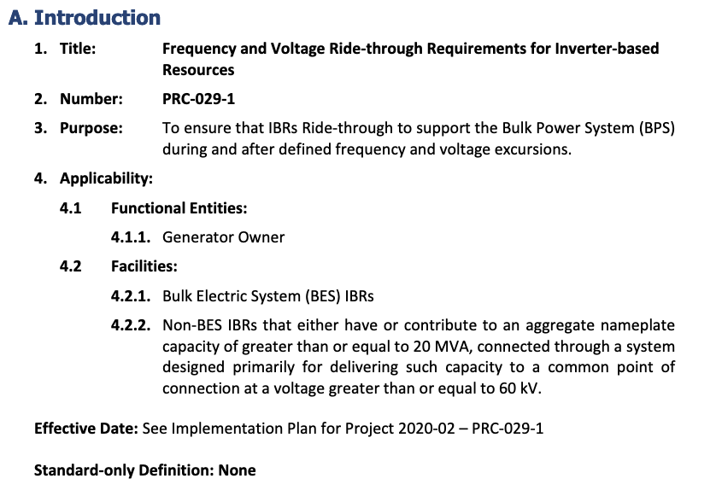
PRC-029 – NERC Board Invoked Rule 321
NERC Board of Trustees invoked Section 321 of NERC’s Rules of Procedure (ROP) after multiple failed ballots
  Consistent with Section 321.2 of the NERC ROP NERC convened a technical conference on September 4-5, 2024
This conference served as a venue for industry to discuss:
  Frequency ride through criteria
  Exemptions to frequency ride through criteria
Feedback was incorporated into the final balloted version of PRC-029-1
NERC Memo to: NERC Board of Trustees and Stakeholders

Slide 9
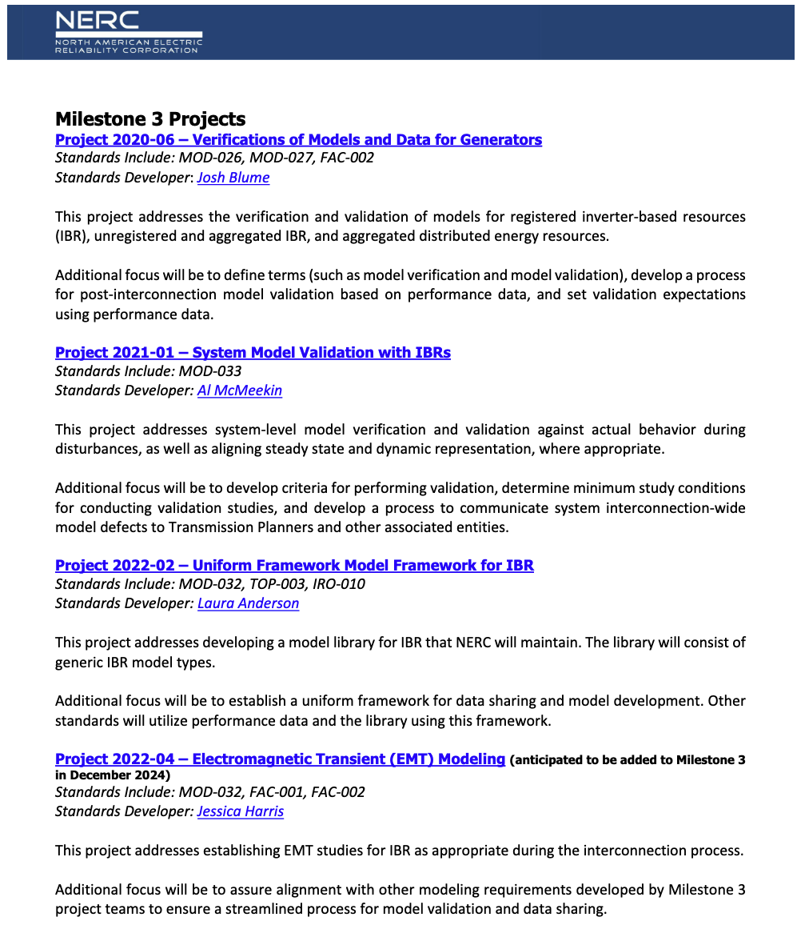
FERC Order 901 – NERC Milestone 3
NERC Issued a Summary of Milestone 3 in October, 2024
Key Messages:
  “… additional model types must be used for local reliability studies during the interconnection process, following commissioning to validate as-built performance, and through ongoing validation…”
  Not all projects address Order No. 901 directives directly but are included as a single solution approach
  Industry is encouraged to engage with drafting teams early
NERC is holding a Technical Workshop on January 15-16, 2025

Slide 10


DOE i2X FIRST - Forum for the Implementation of Reliability Standards for Transmission
Led by the SETO and WETO at the DOE in partnership with LBNL, ESIG and EPRI
Goal: To drive the implementation of standards cohesively, leveraging insights from early adopters.
Participants: Key stakeholders and industry participants interested in challenges around new standard implementation (OEMs, plant developers/owners, utilities, ISOs, consultants)
Format: Monthly virtual meetings. In-person (hybrid) meetings during ESIG workshops. Meetings are organized by DOE’s i2X Team, incorporating facilitated discussion of key issues. Register to attend.
Focus:
Transcend mere dissemination of standard language
Delve into specific requirements with the stakeholders to facilitate practical implementation
Integrate practices outlined in the draft of IEEE P2800.2 and best practices from early adopters
Track ongoing NERC standard efforts related to FERC Order 901 to ensure alignment with IEEE2800 adoption endeavors.
Sign up for all future i2X FIRST Meetings here:
Follow DOE i2X FIRST website: for meeting materials & recordings and for future meeting details & agendas

Slide 11
DOE i2x FIRST Past and Upcoming Meetings
May 28th, 2024, 11 a.m.- 1 p.m. ET: Introduction of Evolving Standards Landscape
June 25th, 2024, 11 a.m.- 1 p.m. ET: IEEE2800 Ride Through Requirements
July 30th, 2024, 11 a.m.- 1 p.m. ET: IEEE2800 Ride Through Requirements, OEM Readiness
August 20th, 2024, 11 a.m.- 1 p.m. ET: IEEE2800 Ride Through Requirements, OEM Readiness, cont.
September 24th, 2024, 11 a.m.- 1 p.m. ET: Measurement Data for Performance Monitoring and Model Validation
October 24th, 2024 hybrid, full day, during ESIG Fall Workshop, Providence, RI: Conformity Assessment
November 26th, 2024, 11 a.m.- 1 p.m. ET: IEEE 2800 Active-Power—Frequency Response Requirements
December 17th, 2024, 11 a.m.- 1 p.m. ET:
January 28th 2025, 11 a.m.- 1 p.m. ET:
February 25th 2025
March 20th, 2025 hybrid full day event during ESIG Spring Workshop, Austin, Texas
Sign up for all future i2X FIRST Meetings here: https://www.zoomgov.com/meeting/register/vJItceuorTsiErIC-HInpPbWuTUtrYQAuoM#/registration
Follow DOE i2X FIRST website: https://www.energy.gov/eere/i2x/i2x-forum-implementation-reliability-standards-transmission-first for meeting materials & recordings and for future meeting details & agendas

Slide 12
ESIG Fall Technical Workshop, Relevant Sessions
Recordings of workshop sessions are now available on the ESIG YouTube Channel.
Session 3A: Modeling, Protection and Application of GFM Technology
Modeling, Protection, Application of Advanced Grid Services from IBRs
Session Chair: Deepak Ramasubramanian, Senior Technical Leader, EPRI
Introduction of WECC-Approved Dynamic GFM Models
Wei Du, Solar Subsector Manager, PNNL
Deepak Ramasubramanian, Senior Technical Leader, EPRI
GFM Inverter Interoperability Through Hardware Testing
Jing Wang, Researcher, NREL
Technology Updates Associated with GFM Wind Testing
Ignacio Vieto, Senior Engineer, GE Vernova
Protection of Inverter-dominated Power Systems
Ulrich Muenz, Principal Research Scientist, Siemens
Session 4A: Planning and Interconnection of Large Loads
Session Introduction and ESIG LLTF Kick-Off
Session Chair: Sam Morris, Manager of Load Forecasting and Analysis, ERCOT, Chair of ESIG LLTF
Large Loads: Interconnection, Planning and Reliability Considerations
Julieta Giraldez, Director, Integrated Grid Planning,
Ahmed Rashwan, Director – Transmission Planning and Operations, Utilities, Electric Power Engineers
Long-term Impact of Large Load Growth in ERCOT
Pengwei Du, Supervisor, Economic Analysis & Long-Term Planning Studies, ERCOT
Interconnection and Integration of Large Loads
Pooja Shah, Chief of Staff for Power Delivery and Grid Transformation, Georgia Power Company
Harish Sharma, Chief Engineer, Transmission Planning – Stability and Special Studies, Southern Company Services

Slide 13
ESIG Fall Technical Workshop, Relevant Sessions
Session 5A: Reliability with High levels of IBRs
Session Chair: Julia Matevosyan, Chief Eng., ESIG
CAISO Reliability Issues
John Phipps, Exec. Director of Grid Operations, CAISO
NESO Perspective
Xiaoyao Zhou, Eng. Compliance Manager, NESO
Insights, Consensus, and Disagreement in the Power Systems Community About Dynamic Simulation Tools Necessary for Stability
Jacob Kravits, R&D Lead, encoord
Grid Stability Services: Demonstrating a New Framework on a Large, High IBR System
Matt Richwine, Co-Founder, Telos Energy
Small-Signal Stability Analysis of Black-Boxed IBRs: A Frequency-Domain Tool
Behrooz Bahrani, Assoc. Professor, Monash University
Session 8A: EMT Practices and Applications
Session Chair: Julia Matevosyan, Chief Engineer, ESIG
EMT Practices in ONS
Bruno Pestana Rosa, Electrical Studies Engineer, Planning Department, ONS
EMT Practices in ISO-NE
Brad Marszalkowski, Supervisor of Resource Integration, ISO-NE
EMT Studies: Industry Uptake and How to Make Them More Manageable
Andrew Isaacs, Vice President, Electranix (Canada)
NERC EMT Task Force Update
Aung Thant, Engineer, Inverter-Based Resource Specialist, NERC
Recordings of workshop sessions are now available on the ESIG YouTube Channel.

Slide 14
Julia Matevosyan
julia@esig.energy

