Slide 1
Physical basics of low power operation of wind turbines
ERCOT IBRWG 11-15-24
Nick Miller

Slide 2
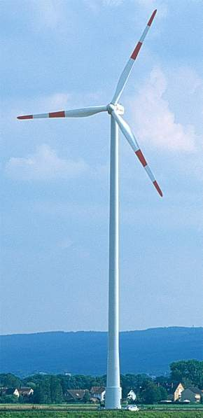
Wind Turbine Components
Rotor
35 metric tons
77 meters diameter
Hub
Gearbox
Generator
Nacelle
52 metric tons
Electrical
Torque
Aerodynamic
Torque
Tower
120+ metric tons
60 to 100 meters
Automobile (for scale)
GE 1.5 MW (c. 2002)
Image source: GE Energy
Notes:
A wind turbine generation system consists of a tower, a tower base standing on a foundation, the nacelle, and the rotor.
The rotor in modern units consists of three rotor blades which are mounted on the hub. The rotor blades must be marked with color above a defined unit height according to government regulations. This marking warns of the obstruction during the day. The unit may instead have white rotor blades and an additional so-called daytime obstruction marker (white flashing lights on the nacelle). The night marking is implemented with red flashing lights.

Slide 3
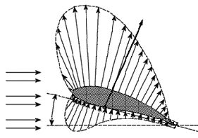
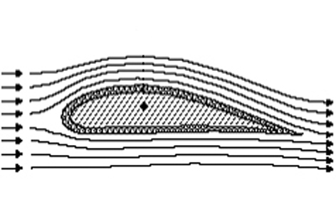
Aerodynamic Lift – Bernoulli Effect
Bernoulli’s principle:
Increased speed of fluid flow results in a decrease of pressure
Resulting
air power
The blade has to be moving through the air to get lift.
Lift in the right direction puts rotational torque on the drive train: T_{mech}
Fast air movement
Incoming
air
Vacuum
Angle of incidence
Slow air movement
Positive
pressure
Horizontal
The air moves faster above the rotor blade than under it. This creates lift.
All modern WTGSs are lift machines
Source: “Wind Energy Handbook”, Tony Burton et.al.; ISBN: 0471489972; 1st edition (November 15, 2001)
Notes:
In modern wind turbine generation systems, lift machines are used almost exclusively. The wind doesn't drive the windwheels primarily because the rotor blades present drag to the wind, but due to the fact that the rotors use the lift force like airplane propellers. The rotor blades are shaped like airplane wings. If the wind flows over a rotor blade, then a lift force results, just as in an airplane. The air moves faster on the upper side of the rotor blade than on the lower.

Slide 4
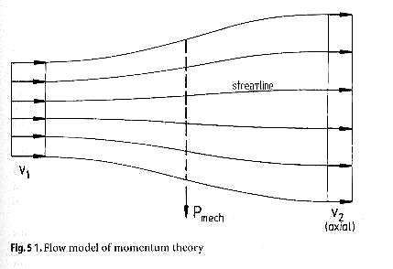
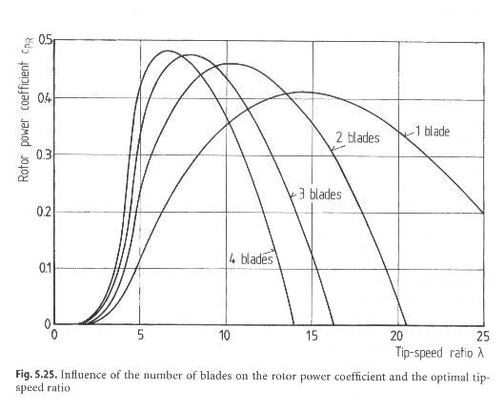
Conversion: Why 3 blades? What is Cp? Why variable speed?
  Rotor power: P = 1/2 c_{p} ρAv_{w}³
    c_{p} - rotor power coefficient
    ρ - air density
    A - rotor swept area
  Ideal c_{p} = 0.593 (Betz factor) [think “Carnot efficiency for wind”]
    where V₂ = 1/3 V₁ (wind velocity slows by 2/3)
  Tip speed ratio: λ = v_{t} / v_{w}
  c_{p} = f(λ)
    max for 3 blade rotor: c_{p} = 0.47 at λ = 7
    max for 2 blade rotor: c_{p} = 0.45 at λ = 10
    to operate at peak c_{p} requires variable rotor speed
    2 blade machine will spin 30% faster, slightly lower c_{p}
    diminishing returns for more than 3 blades
3 blades, maximum lift (pitch at minimum)
$
“Best” λ
Family of representative Cp curves for 1, 2, 3 and 4 bladed wind turbines
Rotation slows
Rotation speeds up
Source: “Windturbines: Fundamentals, Technologies, Application and Economics”, Erich Hau, ISBN: 3540570640; (April 30, 2000)

Slide 5
Wind Turbine Generator: allowing the turbine speed to vary
  Type 1 – Squirrel-cage induction generator
  Type 2 – Wound rotor induction generator with variable rotor resistance
  Type 3 – Doubly-fed asynchronous generator (DFIG)
  Type 4 – Full converter interface
  Type 5 – synchronous generator; mechanical slip

Slide 6
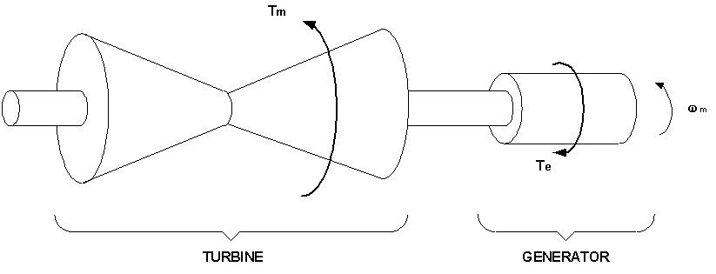
Rotor speed basics are the same
Mechanical
Torque, T_{m}
Electrical
Torque, T_{e}
Basic Notation:
J is the inertia of the entire drive-train in physical units
H is the inertia constant – it is scaled to the size of the machine.
A typical synchronous turbine-generator has an H of about 3.5 MW-sec/MW.

Slide 7
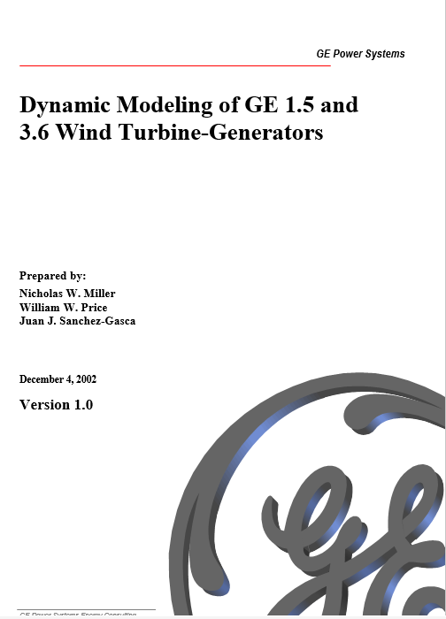
Controlling Active Power:
Models & Some History

Slide 8
Controlling mechanical power (and torque): blade pitch and rotor speed
v
w
= wind speed
~20%: 5°
Family of Cp curves for one representative 3 bladed wind turbine.
(User
-
provided function)
θ
= blade pitch angle
(From Turbine Model)
Rotation slows
P
mech
ω
= rotor speed
(From Turbine Model)
shaft power
tip speed ratio, λ = K_{b} (ω / v_{w})
ideal C_{p} = 0.593
maximum C_{p} = 0.47 at λ = 7 for
3 blade rotor
ρ,
A
r
,
K
b
(
constants
)
Modeling of GE Wind Turbine-Generators for Grid Studies
Version 1.0 December 2002

Slide 9
Turbine & Turbine Control
GE added the active power (frequency droop) control feature to the manual in 2008
Modeling of GE Wind Turbine-Generators for Grid Studies
Version 4.1 March 2008

Slide 10
Turbine & Turbine Control
Pmech vs Pelec balance: acceleration equations
Modeling of GE Wind Turbine-Generators for Grid Studies
Version 4.1 March 2008

Slide 11
Turbine & Turbine Control
Pmech vs Pelec balance: acceleration equations
Mechanical power: relationship between wind speed, rotor speed and blade pitch
Modeling of GE Wind Turbine-Generators for Grid Studies
Version 4.1 March 2008

Slide 12
Turbine & Turbine Control
Pmech vs Pelec balance: acceleration equations
Mechanical power: relationship between wind speed, rotor speed and blade pitch
Frequency response and curtailment command: issues upper power limit command
Modeling of GE Wind Turbine-Generators for Grid Studies
Version 4.1 March 2008

Slide 13
Turbine & Turbine Control
Pmech vs Pelec balance: acceleration equations
Mechanical power: relationship between wind speed, rotor speed and blade pitch
Frequency response and curtailment command: issues upper power limit command
Pitch control: satisfying speed and power objectives
Modeling of GE Wind Turbine-Generators for Grid Studies
Version 4.1 March 2008

Slide 14
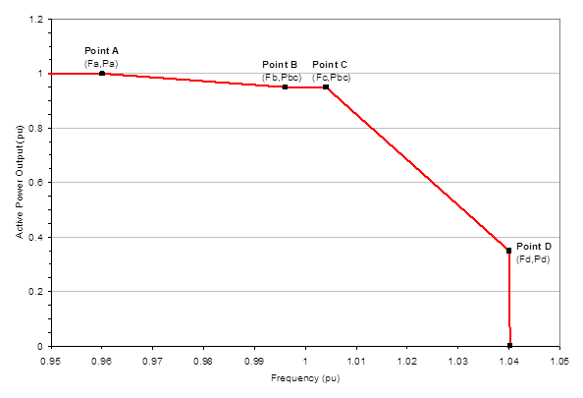
Over vs. Under-frequency Response
%5 curtailment (example)
Plant
Power
Plant Power Maximum
= rating for synchronous plants
= available for wind plants)
MUCH lower over-frequency droop
Headroom
Plant Power Dispatch
= actual production
Droop
Deadband
System short
of generation
System needs
Less power
Technical Minimum
100% (Normal Frequency)
Speed (for synchronous machines)
Frequency (for wind plants)
“Droop “
Is the change in power output per change in frequency. But be careful: higher (more) droop means less aggressive response; lower slopes in the curve.
Can be asymmetric. Wind, and especially PV, can easily have different over- versus under-frequency droop characteristics.
From the GE 2008 manual:
“An example frequency response curve is shown
Points A through D set to meet the needs of the host grid.
The value of Pd should be greater than or equal to the minimum power.
The minimum power is nominally 0.20 pu of maximum farm output. .”
Notes:
Provide under-frequency response when you can and only pre-curtail if you have to
ERCOT requires:
Generators provide FR when there is headroom
VER provides FR when curtailed for other reasons

Slide 15
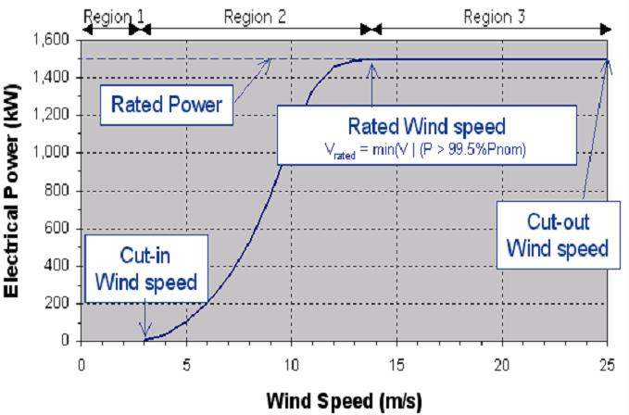
Power Curve Terminology
  Power output vs. wind speed
  at hub height – 10min average wind speeds
Example: official power curve for GE 1.5s
Pitch out to maintain (maximum) power in this range
Roughly proportional to cube of wind speed in this range
Image source: GE Energy

Slide 16
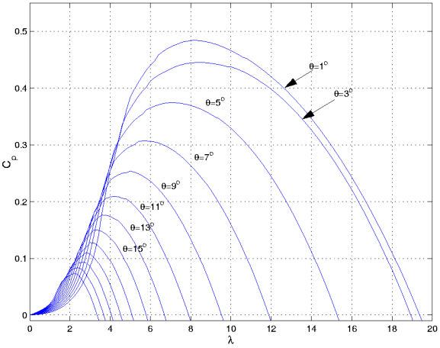
Slight Curtailment (from ≤ rated wind speed)
Pbc = 95%
5% curtailment
ΔP~5%: ~1-2°, 0-2RPM
Modeling of GE Wind Turbine-Generators for Grid Studies
Version 4.1 March 2008
Fully Pitched in; slightly off Cp max for stability
Credit: GE Vernova

Slide 17
Slight Curtailment (from > rated wind speed)
Pbc = 95%
5% curtailment
Modeling of GE Wind Turbine-Generators for Grid Studies
Version 4.1 March 2008
Partially Pitched Out: a range of rotor speed and pitch will satisfy P objective
Credit: GE Vernova

Slide 18
Deep Curtailment (from ≤ rated wind speed)
Full power
Pbc = 20%
80% curtailment
ΔP~80%: ~20°
D
B
C
Δω ~70%: ~-14 RPM*
Modeling of GE Wind Turbine-Generators for Grid Studies
Version 4.1 March 2008
Rotor speed low
δP/δω much higher (~4x): much less stable speed/power control
Credit: GE Vernova

Slide 19
Why a technical minimum?
Pbc = 20%
80% curtailment
B
C
D
Cp needs to approach zero.
Lift approaches zero.
Blade speed approaches zero.
Modeling of GE Wind Turbine-Generators for Grid Studies
Version 4.1 March 2008
Credit: GE Vernova

Slide 20

It’s not that simple: this real physical equipment
Blade
Flap
Blade
Edgewise
Tower Nod
Blade
Twist
Tower twist
Shedding ALL the lift is ugly.
Every sailor knows not to stay “in irons”…. Not stable. Things break.

Slide 21
“just pitch in!”
A blade for a 1.5MW turbine weights about 5 tons.
Turning it in fractions of seconds is mechanically challenging
Modeling of GE Wind Turbine-Generators for Grid Studies
Version 4.1 March 2008

Slide 22
Increasing Power during very low wind conditions
Reducing rotor speed rapidly reduces mechanical power
Pbc = 20%
80% curtailment
B
C
D
Δω ~70%: ~-14 RPM*
A lower wind speeds, risk of stall if Pelec > Pmech is greatly increased.
Can not let the electrical control “get in front” of the pitch control much
Rotor speed ~1/2 vs rated
δP/δω higher (~2x): much less inertial energy (~1/4) available
Credit: GE Vernova

Slide 23
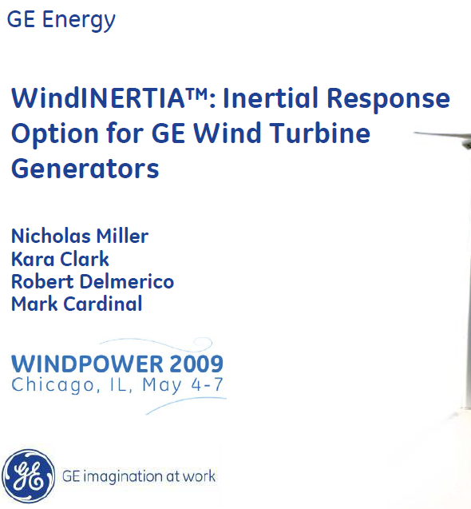
Drawing down stored inertial energy:
Field Tests Results:
Only a few MW-sec of “spare” inertial energy available at 40% power.
We didn’t publish results for lower wind speeds. Available energy is very small: meaning that margin to stall is very small
Test count:
8 m/s - 19 tests
10 m/s – 19 tests
14 m/s – 52 tests
WindINERTIA simulation models are openly available
Credit: GE Vernova

Slide 24
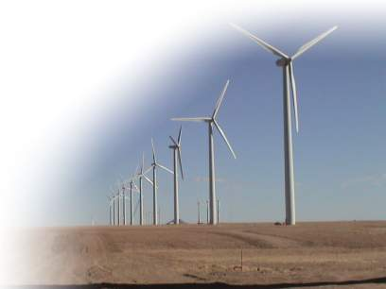
Conclusions
  Not possible to increase wind speed
  Slowing wind turbine reduces aerodynamic lift:
    Must avoid stall
  Must respect WTG component ratings:
    Mechanical loading
    Converter and generator electrical ratings
  Must respect other controls:
    Turbulence management
    Drive-train and tower loads management
  Active power control from very low power levels, whether due to deep curtailment or low wind speed is extremely challenging and subject to multiple physical and stability constraints.

Slide 25
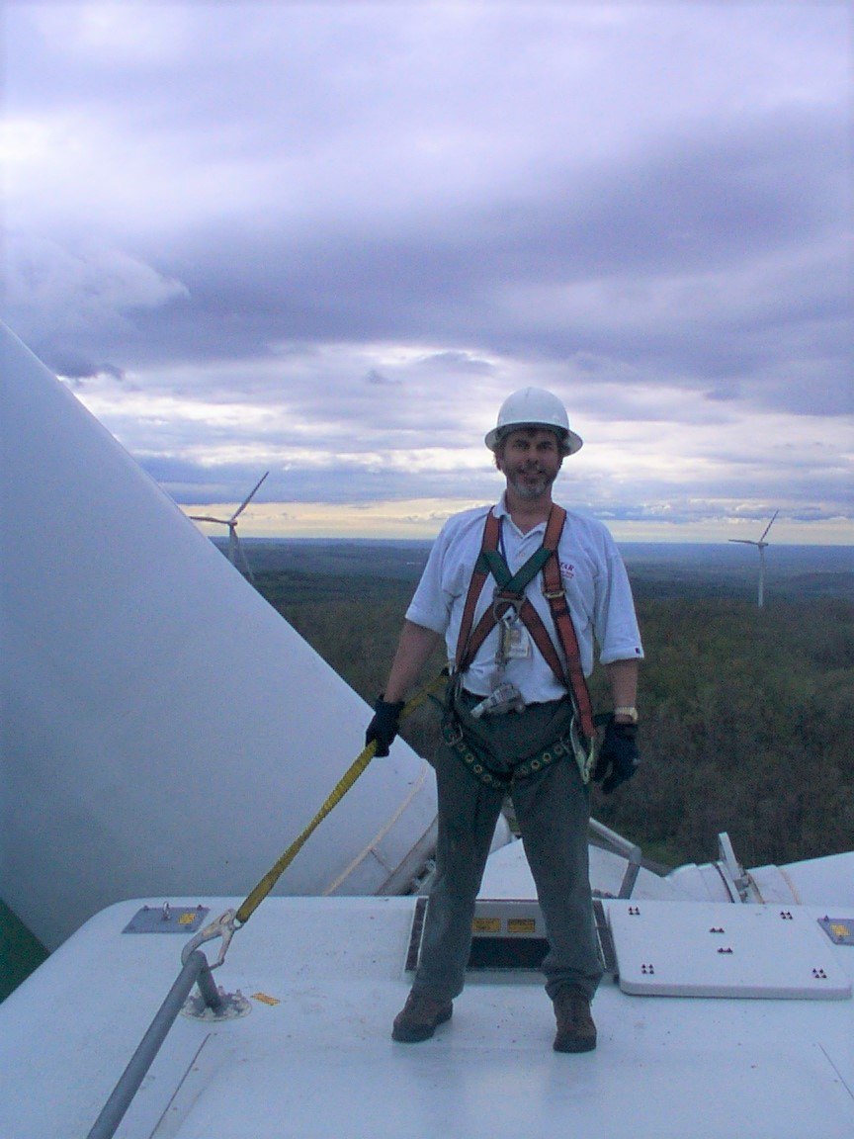
Thanks
nicholas.miller@hickoryledge.com

