Slide 1
EAL Change Proposals
Sanchir Dashnyam
ERCOT Market Credit Manager
ERCOT Public
November 15, 2024

Slide 2
Current EAL Formula vs. Proposal(s)
Current: Apply the forward factor to the highest extrapolated historical RTM average exposures over the look back period.
EAL = Max [IEL during the first 40-day period only beginning on the date that the Counter-Party commences activity in ERCOT markets, RFAF * Max {RTLE during the previous lrq days}, RTLF] + DFAF * DALE + Max [RTLCNS, Max {URTA during the previous lrq days}] + OUT + ILE
Scenario #6: Apply the forward factor to each historical netted average extrapolated exposures and take the highest over the look back period.
EAL = Max [Max {NLE*RFAF during the previous lrq days}, FAF*NLF] + Max [(RTLCNS + UDAA),Max {ULE during the previous lrq days}] + OUT + ILE
  NLE = Net liability extrapolated (Last 14 days RTM Initial Statement Average + Last 14 days DAM Initial Statement Average based on RTM Initial OD)*M1. Match RTM and DAM operating days.
  NLCD = (7 most recent Operating days Real time estimates + 7 DAM ODs day-ahead estimates) – no price cap. Match RTM and DAM operating days. Use actuals if available, if not, use estimates.
  NLF = net liability forward = 1.5 * NLCD
  FAF = 21 day futures prices / most recent days 7 RTM Prices corresponding to the 7 days in NLF. Set a floor of 1 for FAF.
  ULE = unbilled liability extrapolated (Last 14 days RTM Initial Statement Average + Last 14 days DAM Initial Statement Average based on RTM Initial OD)*M2. Match RTM and DAM operating days.
  RFAF_{i} = 21-day future prices / 14 days RTM Prices corresponding to the 14 days in NLE_{i.} Cap RFAF at 1.5. RFAF is applied against NLE. There is a floor for RFAF at 0.50. For each RFAF, we are using the corresponding Operating Day (and not Invoice Business Day) RTM settled prices, which match the respective operating Days in the NLE.
  For MCE use similar RFAF applied to NLE (No floor Or Cap) for a minimum of 2 days for load.
  Look-back periods:
    summer months: 40 days from May 16 through Sep 15
    non summer months: 20 days lookback from Sep 16 through May 15.
    Traders 20 days irrespective of months.
  Strip out impact of CARD invoices from both invoice exposures and TPEA. This is for analysis purposes only (CARD will stay in TPEA in implementation).

Slide 3
Current EAL Formula vs. Proposal(s)
Current: Apply the forward factor to the highest extrapolated historical RTM average exposures over the look back period.
EAL _{q} = Max [IEL during the first 40-day period only beginning on the date that the Counter-Party commences activity in ERCOT markets, RFAF * Max {RTLE during the previous lrq days}, RTLF] + DFAF * DALE + Max [RTLCNS, Max {URTA during the previous lrq days}] + OUT + ILE
Scenario #2c: Apply the forward factor to each extrapolated historical average exposures and take the highest over the look back period.
EAL q = Max [IEL during the first 40-day period only beginning on the date that the Counter-Party commences activity in ERCOT markets, Max{(RFAF * Max {RTLE) during the previous lrq days}, RTLF] + DFAF * DALE + Max [RTLCNS, Max {URTA during the previous lrq days}] + OUT + ILE
  Minimum of 2 days for MCE for load (vs. 1 day for the current framework)
  Look-back periods:
    40 days from May 16 through Sep 15 (summer months) and 20 days lookback from Sep 16 through May 15 (non summer months)
    Traders 20 days irrespective of months.

Slide 4
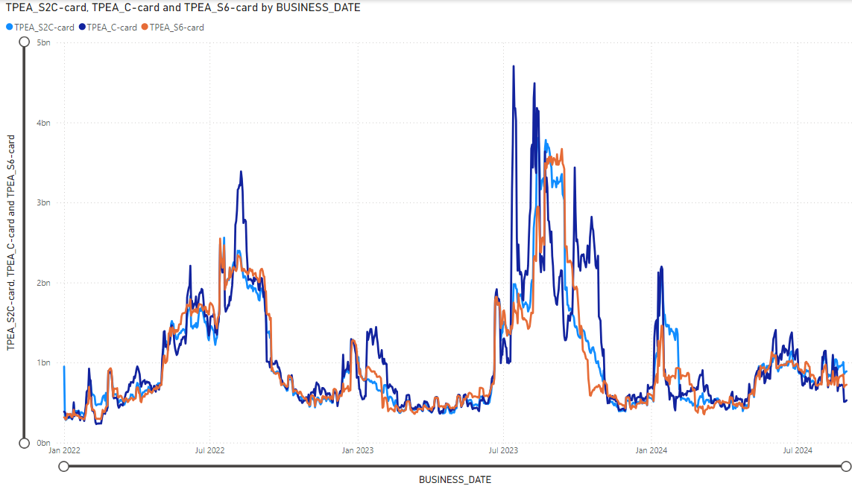
TPEA-Current vs TPEA for Final proposal: 1/1/2022 through 8/30/2024
Overall market
Overcollateralization issue caused by “Double top/higher 2nd top” is resolved
Lower peaks and higher valleys
Less sharp up/down volatility

Slide 5
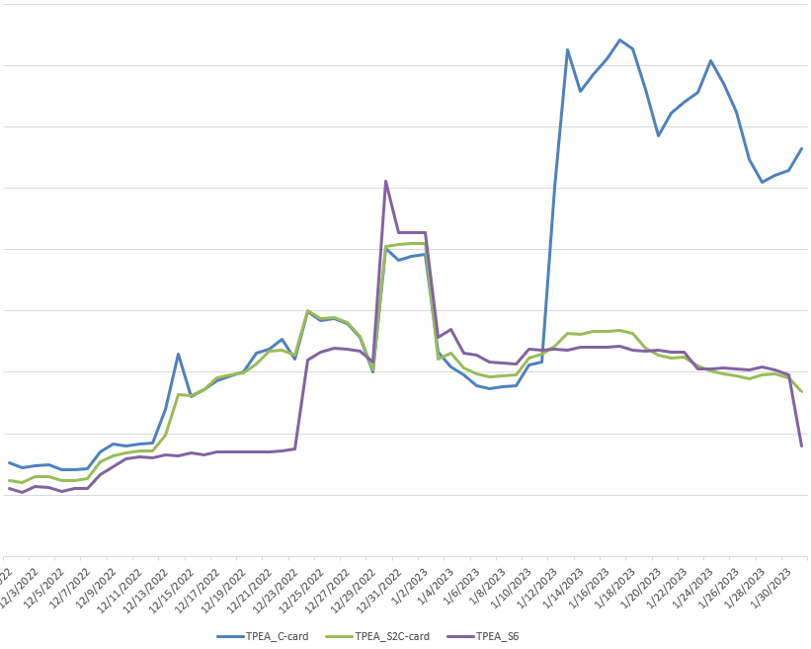
Double top or 2nd higher top example - TPEA
Disadvantage of the current EAL formula:
Overcollateralization and the related cost to the marketplace caused by “Double top or higher 2nd top”, which was brought up by a number of market participants. The current EAL/TPEA framework could lead to unreasonably high collateralization (large positive gaps), especially when the high volatility event is followed up by another price surge. This is due to the current framework applying the forward factor against the highest extrapolated historical exposure.

Slide 6
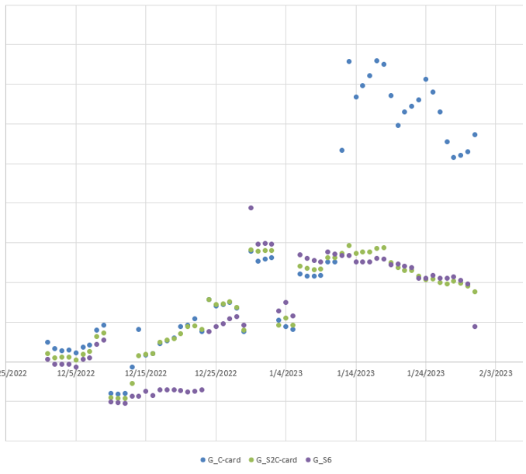
Double top or 2nd higher top example - gaps
Both proposals will address the “double top” issue.
However, S6 results in an increase in negative gaps vs. S2c in high stress events.

Slide 7
Negative and Positive Gaps: overall 1/1/22 through 8/30/24

Slide 8
Negative and Positive Gaps: Elliott (December 2022)

Slide 9
Negative and Positive Gaps: Heather (January 2024)

Slide 10
Negative and Positive Gaps: Summer of 2022

Slide 11
Negative and Positive Gaps: Summer of 2023

Slide 12
Cost of the proposed framework:
1/1/2022 through 8/30/24
Based on historical market behaviors, the proposed EAL framework (S2c) would have saved the market about 6% or approximately $17MM over the period analyzed with the specific breakout by market activity type as follows:
Cost estimate assumptions:
Cost of capital is 10% for all counterparties for each day during the period analyzed
10% cost is across all collateral instruments: cash, LC & Surety bonds
Excludes consideration for collateral for DAM, CRR or excess/discretionary collateral
Table above excluded data for inactive and CRRAH counterparties

Slide 13
ERCOT recommendation: S2c
Scenario #2c:
Advantages:
  Solves the overcollateralization issue due to “double top”
  Reduces negative gaps across the board for all MP activity type and all periods analyzed
  Easier to implement vs. S6:
    Scenario 2c cost estimate – $
    Scenario 6 cost range - $$$$
Disadvantages:
  For some entities and under certain circumstances EAL will lose the sensitivity to futures movements
Scenario #6:
Advantages:
  Solves the overcollateralization issue due to “double top”
  Reduces negative gaps for most entities, especially for load
Disadvantages:
  For some periods, increases negative gaps for some MP’s or segment of the market (e.g., Traders)
  Costly to implement vs. S2c. Cost and length of implementation could be as much 4 times compared to S2c
  For some entities and under certain circumstances EAL will lose the sensitivity to futures movements

