Slide 1
Update on Credit System Enhancements
Maruthi Gaddam
ERCOT Credit System Lead Analyst
ERCOT Public
November 15, 2024

Slide 2
CMM System and Report Enhancements in December 2024
Starting December 11, 2024, ERCOT will implement the following changes:
1) NPRR1184 will be fully implemented, specifically the following parts of Section 16 of the Protocols will be “unboxed”:
16.11.3 (1) (c) (iii) Alternative Means of Satisfying ERCOT Creditworthiness Requirements
16.11.4.7 (2) and (3) Credit Monitoring and Management Reports
As a result, ERCOT market participants will be able to see the following reports on MIS:
Collateral History and Interest – Annual
Collateral History and Interest – Monthly
2) Letter of Credit (LC) and Surety Bond (SB) – Add/Amend/Terminate Email Notifications
Automated Emails to all CP Credit contacts will be sent whenever there is a change in LC/SB postings, including addition/acceptance, amendment or termination.
3) ACL Report Changes
Daily ACL reports will list Letters of Credit / Surety Bonds with the respective current balances for each instrument.

Slide 3
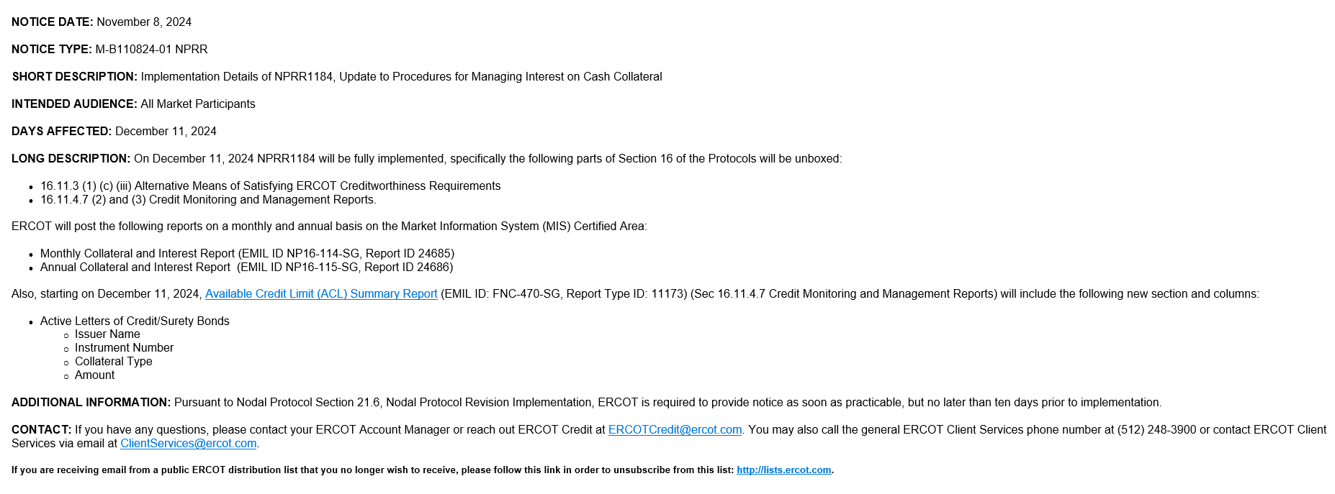
Upcoming CMM Report Enhancements – Market Notice

Slide 4
Upcoming CMM Report Enhancements – New Reports timeline
Collateral History and Interest – Annual
Prior years 2010 to 2023 Annual Reports will be published between December 11, 2024 to December 13, 2024.
2024 Annual 1st version of Report will be published on January 1, 2025 and every January 1st thereafter.
2024 2nd version of Report will be published on January 10, 2025 and every January 10th thereafter.
If 10th day falls under weekend/holiday, then it will be published on next Business Day.
1st version of report will only have collateral history details and will not have interest details of December, while 2nd version of report will include interest details of December.
Collateral History and Interest – Monthly
2024 months January to November Monthly Reports will be published between December 11, 2024 to December 13, 2024.
December 2024 Month 1st version of Report will be published on January 1, 2025 and every 1st of the month thereafter.
December 2024 Month 2nd version of Report will be published on January 10, 2025 and every 10th day of the month thereafter.
If 10th day falls under weekend/holiday, then Report will be published on next Business Day.
1st version of report will only have collateral history details and will not have interest details, while 2nd version of report will include interest details.

