Slide 1
Scaling Factors
ERCOT Staff
11/13/2024

Slide 2
Protocol reference to Scaling Factors
Potential additional language in Section 6.5.7.3 (12) grey box
SCED will enforce Resource-specific Ancillary Service constraints to ensure that Ancillary Service awards are aligned with a Resource’s qualifications and telemetered Ancillary Service capabilities.
  A scaling factor of 5/7 shall be used for Regulation Up award when ensuring that the SCED Base Point plus the product of this scaling factor and the Regulation Up award does not exceed HDL
  A scaling factor of 5/7 shall be used for Regulation Down award when ensuring that the SCED Base Point minus the product of this scaling factor and the Regulation Up award does not go below LDL

Slide 3
Appendix

Slide 4



Scaling Factor Up
Determines amount of ramp sharing between Base Point(energy) and Reg-Up Award.
Used in HDL constraint to ensure energy and Reg-Up awards are feasible most of time but recognizes that it’s rare for a Resource be fully ramped up for both energy and Reg-Up simultaneously
$${HDL}_{i}−{MW}_{i}^{EnergyOfferAward}−{ScalingFactorUp×MW}_{i}^{RegUpAward} ≥0$$
$${MW}_{i}^{RegUpAward}$$
LSL
LDL
$${MW}_{i}^{EnergyOfferAward}$$
HDL
HSL

Slide 5



Scaling Factor Down
Determined the amount of ramp sharing between Base Point (energy) and Reg-Down Award
Used in LDL constraints to ensure energy and Reg-Down awards are feasible most of time but recognizes that it’s rare for a Resource be fully ramped down for both energy and Reg-Down simultaneously
$${MW}_{i}^{EnergyOfferAward}−{ScalingFactorDn×MW}_{i}^{RegDnAward}−{LDL}_{i} ≥0$$
$${MW}_{i}^{RegDnAward}$$
LSL
LDL
$${MW}_{i}^{EnergyOfferAward}$$
HDL
HSL

Slide 6
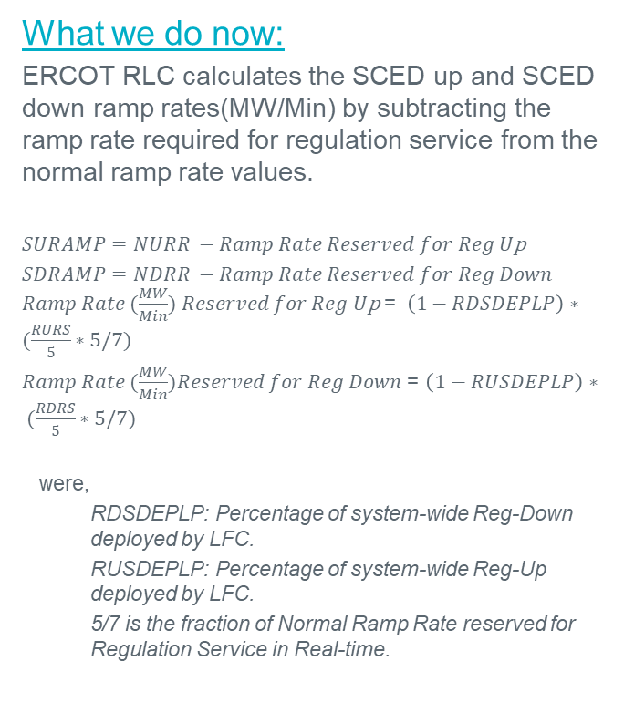

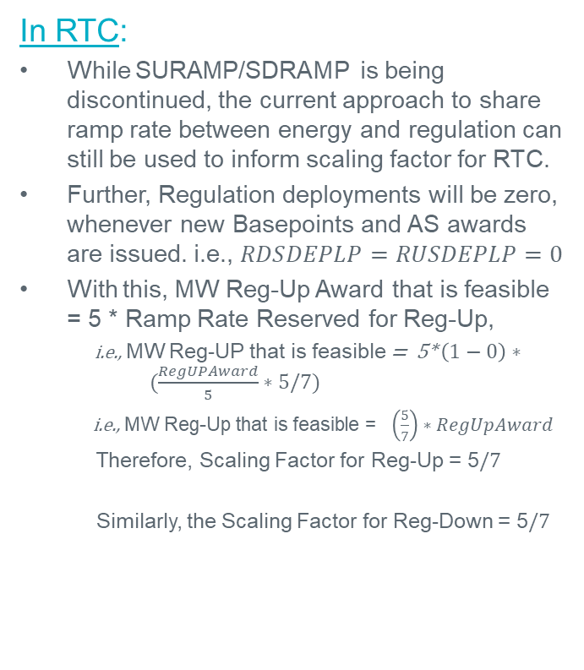
Existing Ramp Sharing → Scaling Factor
What we do now:
ERCOT RLC calculates the SCED up and SCED down ramp rates(MW/Min) by subtracting the ramp rate required for regulation service from the normal ramp rate values.
$SURAMP=NURR −Ramp Rate Reserved for Reg U$p
$SDRAMP=NDRR −Ramp Rate Reserved for Reg Down$ $Ramp Rate (\frac{MW}{Min}) Reserved for Reg U$p = $\left(1−RDSDEPLP\right)∗(\frac{RURS}{5}∗5/7)$
$Ramp Rate (\frac{MW}{Min})Reserved for Reg Down$ = $\left(1−RUSDEPLP\right)∗ (\frac{RDRS}{5}∗5/7)$
were,
  RDSDEPLP: Percentage of system-wide Reg-Down deployed by LFC.
  RUSDEPLP: Percentage of system-wide Reg-Up deployed by LFC.
  5/7 is the fraction of Normal Ramp Rate reserved for Regulation Service in Real-time.
In RTC:
While SURAMP/SDRAMP is being discontinued, the current approach to share ramp rate between energy and regulation can still be used to inform scaling factor for RTC.
Further, Regulation deployments will be zero, whenever new Basepoints and AS awards are issued. i.e., $RDSDEPLP=RUSDEPLP=0$
With this, MW Reg-Up Award that is feasible = 5 * Ramp Rate Reserved for Reg-Up,
i.e., MW Reg-UP that is feasible = 5* $\left(1−0\right)∗ (\frac{RegUPAward}{5}∗5/7)$
i.e., MW Reg-Up that is feasible = $\left(\frac{5}{7}\right)∗RegUpAward$
Therefore, Scaling Factor for Reg-Up = 5$/7$
Similarly, the Scaling Factor for Reg-Down = 5$/7$
Based on the current approach and the lack of identified concerns by ERCOT or market participants, ERCOT proposes to continue using a constant Scaling Factor Up/Down value of $5/7$

Slide 7
Discussion

