Slide 1
IBR Generation – End to End Testing Concerns
Oncor System Protection

Slide 2
Typical IBR Interconnection
Oncor Remote Station 1
Oncor 3CB Ring Bus
Oncor Remote Station 2
D
B
E
A
C
R
Interconnection Line
Generator Station
52
R
~
IBR
Oncor current standard protection for Generation interconnection lines:
SEL 421 – DCB or POTT
SEL 311L – Line Current Differential

Slide 3
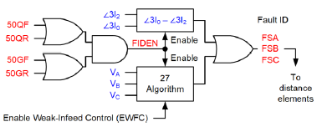
IBR Challenges in Protection
A paper from SEL called Transmission Line Protection for Systems With Inverter-Based Resources outlines several issues created in line relaying due to IBRs
The main problem we have seen thus far at Oncor is dependability of our Distance elements in clearing P-G faults due to the lack of negative sequence fault current
In a DCB scheme within SEL 421/311C line relays, Ground Distance Zones must have internal Fault Selector elements (FSA, FSB, FSC) assert to pick up the Distance elements
The Fault Selector elements are supervised by the relay Fault Identification (FIDS/FIDEN) logic
FIDS logic will only assert for ground faults based on a check of the Angular comparison of I0 (zero sequence) over I2 (negative sequence)
FIDS logic will also assert for single-phase Undervoltage conditions to accommodate scenarios where there is no negative sequence current, but this is only available in the POTT scheme!
POTT only
Graphs referenced from Transmission Line Protection for Systems With Inverter-Based Resources paper

Slide 4
IBR Challenges in Protection
We have had two instances thus far where the lack of negative sequence fault current from an IBR has defeated the relay FIDS logic not allowing our Ground Distance Zones to operate for line faults at 3-CB Ring Bus Stations
Distance elements also supervise our pilot communication schemes in DCB. High speed pilot tripping was thus similarly blocked for these events
Simplified Comm Trip for P-G Faults
Z2G
Ground Distance Zone 2
TRCOMM
67QG2S
Forward Carrier Ground IOC

Slide 5
IBR Challenges in Protection
Cook Field Rd Switch Event
Graham 345 kV Bus tripped to lockout due to storms in the area and had Bus support damage
Cook Field Rd Switch is a 3-CB Ring Bus with the Hackberry Wind Generator attached
A line to Graham is one of the adjacent lines at Cook Field Rd Switch which became outaged due to the Bus event leaving only lines to Long Creek Rd and the Generator as sources
At 08:20, a fault occurred along the Cook Field Rd to Long Creek line sourced only by the Generator
The SEL 421 and 311C relays at Cook Field Rd did not trip on high speed comm

Slide 6
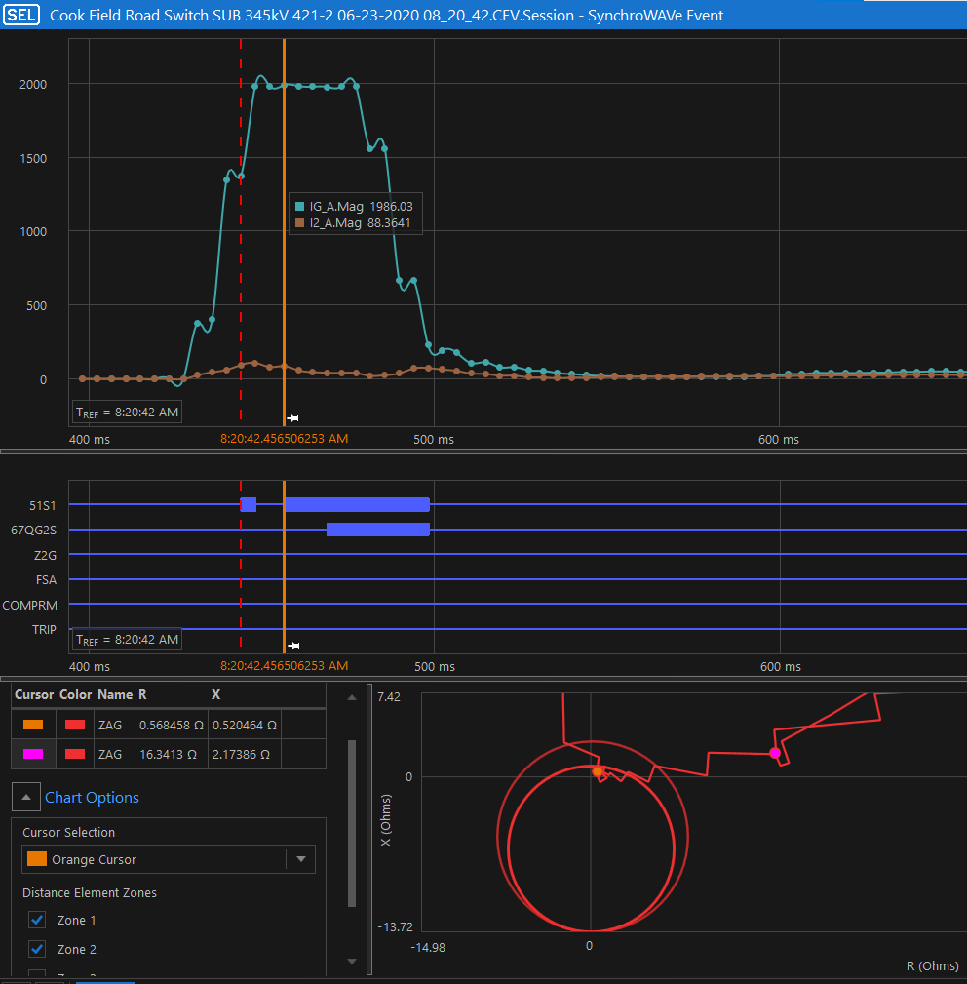
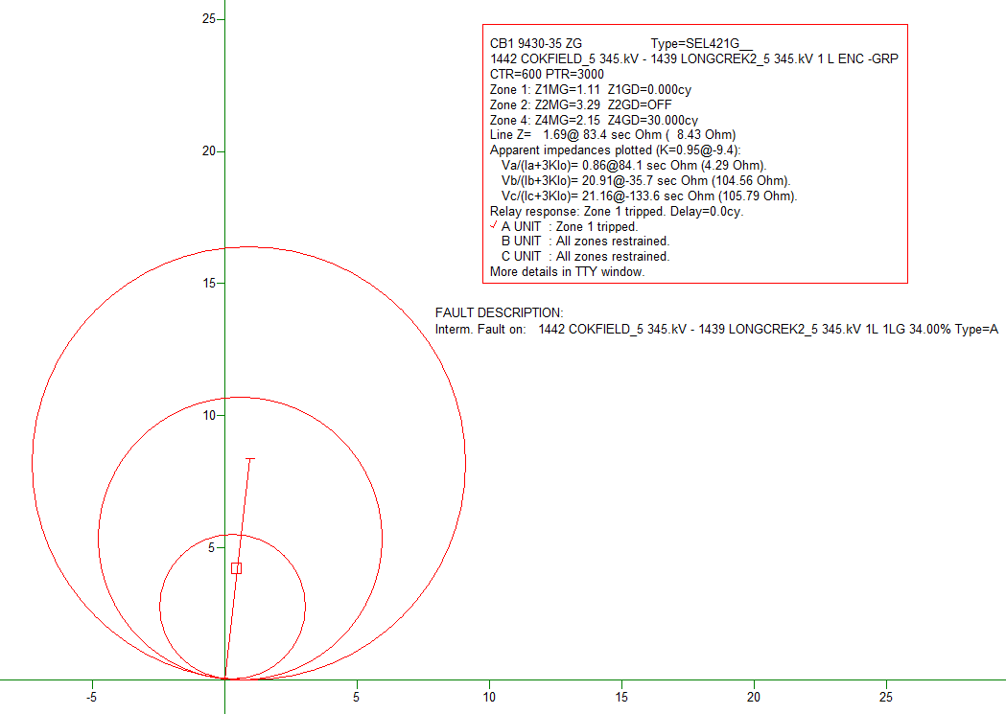
IBR Challenges in Protection
Relay Says NO TRIP!
Cook Field Rd Switch Event
ASPEN Says We Trip

Slide 7
Solutions at 3-CB Ring Bus IBR Interconnection Stations
We requested that SEL update their internal FIDS logic scheme in the SEL 421 to accommodate DCB schemes where FIDS would assert on Undervoltage, but the idea was not accepted
It is recommended to utilize POTT/DCUB and Line Current Differential on all 3 lines at a 3-CB Ring Bus when fiber is available
As fiber is only available in some areas of the Oncor system, most 3-CB Ring Bus additions still occur at lines with DCB over Power Line Carrier
Oncor Relay Standards Committee Team developed a logic change in the DCB scheme for Generation interconnections
Logic element added to TRCOMM to allow for assertion when Carrier Ground Trip IOC element is picked up and no negative sequence fault
Condition must last 5 cycles
Simplified Comm Trip for P-G Faults with IBR DCB Scheme Fix
Z2G
Ground Distance Zone 2
67QG2S
Forward Carrier Ground IOC
TRCOMM
OR
67G2
Carrier Ground Trip IOC
NOT 50QF
Forward Neg Sequence Fault Detector
PCT12Q
5 cycle timer

Slide 8
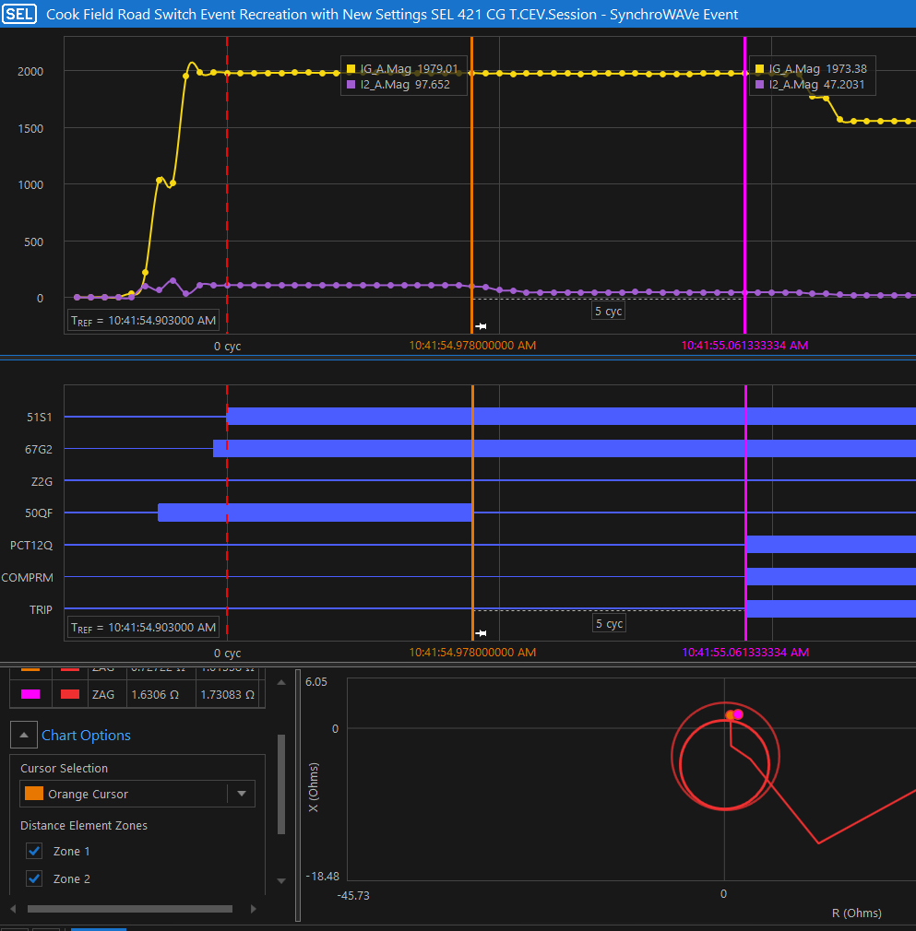
Solutions at 3-CB Ring Bus IBR Interconnection Stations
TRCOMM logic change in DCB schemes at 3-CB Ring Bus Generator interconnections was successfully tested in the Lab by Relay Support
Logic has been added to the DCB standard setting sheet templates for use

Slide 9
Tie Line with IBR Challenges
Same dependability issue due to lack of negative sequence occurs when working with Generator protection team
Generator typically utilizes a Contract Engineering Firm with varying level of experience
Generator line relaying will only have the IBR as a source
Dependability issue can be caught during the PRC-027 relay setting exchange or during End to End Testing
~

Slide 10
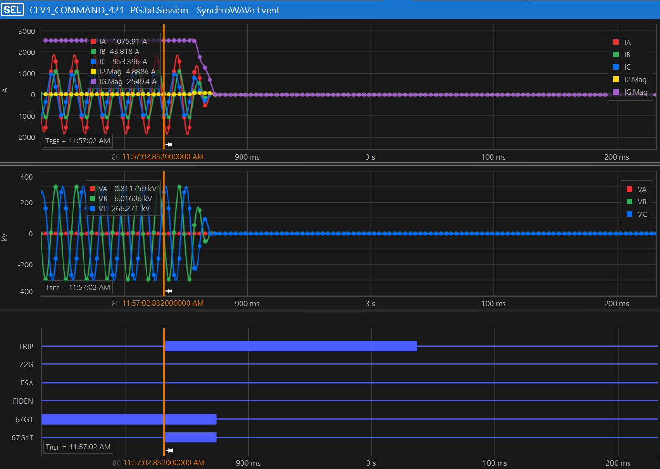
DCB Scheme Example
Generator SEL 421 did not trip for internal faults during End to End Testing - TRCOMM = Z2PGS
Generator Contractor enabled a Ground IOC with a 47 ~ time delay for security to obtain a trip

Slide 11
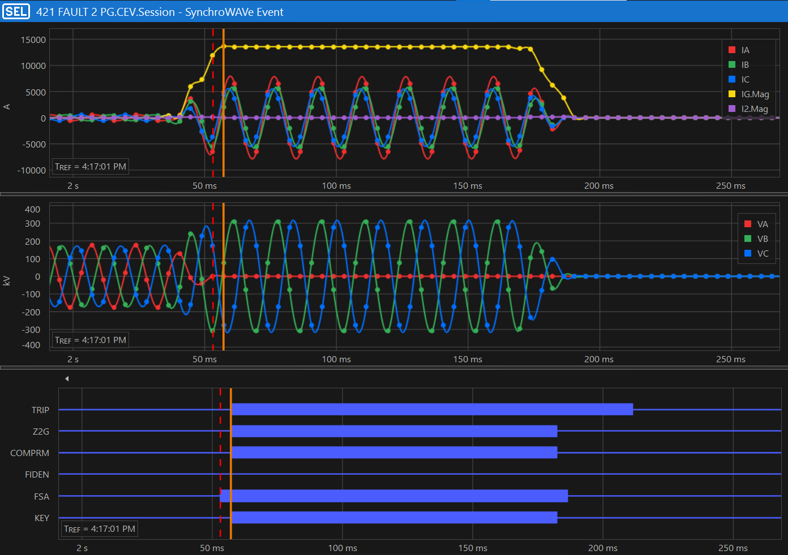
POTT/DCUB Scheme Example
Generator SEL 421 does trip for internal faults during End to End Testing - TRCOMM = Z2P OR 2G
Z2G is asserted via Undervoltage algorithm that satisfies the FIDS logic; KEY signal sent back to Oncor

Slide 12
Upcoming End to End Testing Issue
Currently working with a Generator Contractor for an SEL 421 DCB scheme protecting a tie line where they are disabling Phase Distance protection
Customer cites the Applying SEL Relays in Systems With Inverter-Based Resources paper as evidence to question the IBR positive sequence source for phase faults
Customer SEL 421 relay will not trip for phase faults
Oncor agreed during the PRC-027 setting exchange to send a Transfer Trip signal once the Oncor 421 relay has operated
Customer has accepted reliability for tripping in their 421 on the Oncor end
Scheme will be checked during upcoming End to End Testing

Slide 13
Questions?

