Slide 1
RTC Simulation Tool
Overview and Case Studies
Market Analysis
November 13, 2024

Slide 2
Agenda
Refresher: Overview of RTC Simulator
Additional Case Studies
  Operating Days with Volatile/Mild Pricing Outcomes
Case Data Posting

Slide 3
Simulator Overview
KP1.1 (8) - ERCOT will work with stakeholders prior to RTC go-live to develop a framework and reporting to periodically review RTC pricing outcomes relative to pricing outcomes that would have been realized through the ORDC for a reasonable period of time.
Inputs
Core Optimization
Outputs
System Data
GTBD
AS Plan
ASDC parameters
MCL, VOLL
System Outputs
System Lambda
Objective Function
Build and solve optimization problem
Resource Outputs
LMPs
Energy Awards
AS MCPCs
AS Awards
Resource Data
Status
Resource Type
Capacity and Ramping Limits
AS Capability and Qualification
Energy and AS Offers
Transmission Outputs
Constraint loading
Constraint shadow price
Transmission Constraints
Shift Factors

Slide 4
Simulation Assumptions and Limitations

Slide 5
Simulation Assumptions and Limitations
Only works for operating days post-ECRS implementation (06/10/2023)
Each interval was simulated individually, with no dependence upon the results of previous interval simulations
System parameters
  VOLL = $5000/MWh
  SWCAP = $2000/MWh
  Undergeneration Penalty = $7001.01/MWh
  Overgeneration Penalty = -$251/MWh
ASDCs
  Created using the methodology presented during February RTCBTF
  mu = 3760 and sigma = 1180
  AS quantities were taken from the relevant hour of the AS plan
Energy Offers
  SCED Step 2 energy offers
Ancillary Service Offers
  DAM AS offers
  Proxy AS offer segment created using methodology presented during September RTCBTF
  Proxy AS offer floor is a configurable parameter (studies have used $0/MWh and $2000/MWh)
Notes:
VOLL, SWCAP, PBPC

Slide 6
Simulation Assumptions
Ancillary Service Qualification
  Use qualified MW quantity. If qualified without a quantity, assume it is qualified for 9999 MW.
  Use qualification snapshot at the beginning of the Operating Day.
  Most Wind and Solar Resources were not qualified to provide any Ancillary Service for the base studies, only a few Wind Resources are qualified for REGDN.
Ancillary service ramp rates
  Assumed to equal real-time telemetered normal ramp rates
HDL LDL Constraints
  5/7 of regulation capacity counted towards HDL and LDL constraints
Pre-RTC to RTC Status Mapping
Pre-RTC Status | Resource Type | RTC Status
ONREG, ONOSREG, ONDSRREG, ONFFRRRS | All | ON
FRRSUP, FRRSDN | GR, ESR | ON
ONRGL, ONCLR, ONRL, ONFFRRRSL, ONECL, FRRSUP, FFRSDN | CLR, NCLR | ONL
OFFNS | GR | OFF
ONRR, ONECRS | GR | ONSC
‘ ‘ | All | OUT

Slide 7
Simulation Assumptions
NCLR self-arranged quantities
  Assumed to equal telemetered real-time responsibility.
Energy Storage Resources
  Combo model (GR/CLR), single model not implemented
  State of charge is not considered
Combined Cycle Frequency Responsive Capacity Telemetry Assumptions
  Use today’s NFRC telemetry to estimate Frequency Responsive Capacity RTC telemetry
    RespFactor
    HiRespLim
    LowRespLim
Transmission constraints
  Use transmission constraints that were activated in real-time.

Slide 8
Case Studies

Slide 9
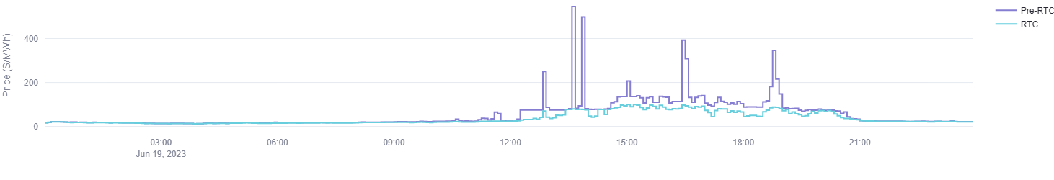
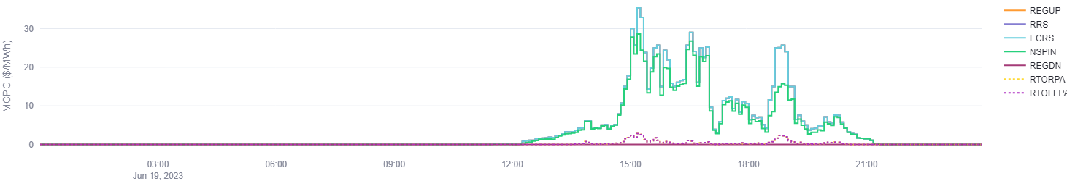
Case Study – Volatile Day (6/19/2023)
Pre-RTM prices volatile in the afternoon, primarily attributable to a mixture of periods of low dispatchable capacity associated with high loads and adverse wind ramping and pockets of congestion.
RTC able to smooth out the Pre-RTC price volatility due to RTC’s capability for better allocating AS
RTC AS MCPCs higher than ORDC price adders in pre-RTC due to RTCs ability to differentiate the kind of MW headroom capacity for different types of AS awards rather than just MW headroom that determines the current ORDC price adders.
RTM System Lambda
RTC RTM MCPCs

Slide 10
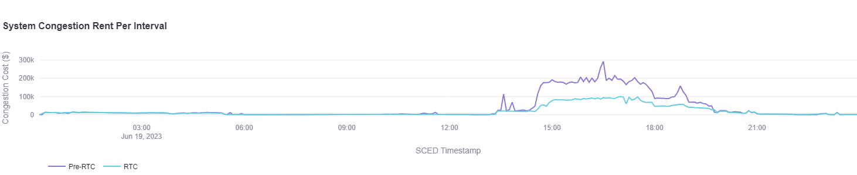
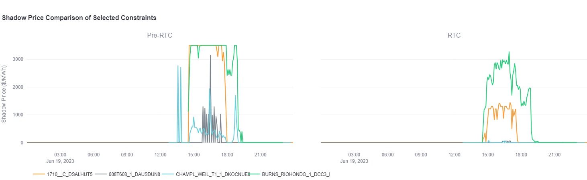
Case Study – Volatile Day (6/19/2023)
Significantly lower Congestion Rent observed under RTC
  RTC able to resolve constraint violations observed in Pre-RTC RTM
    Pre-RTC Congestion Rent = $10.9M
    RTC Congestion Rent = $5.5M

Slide 11
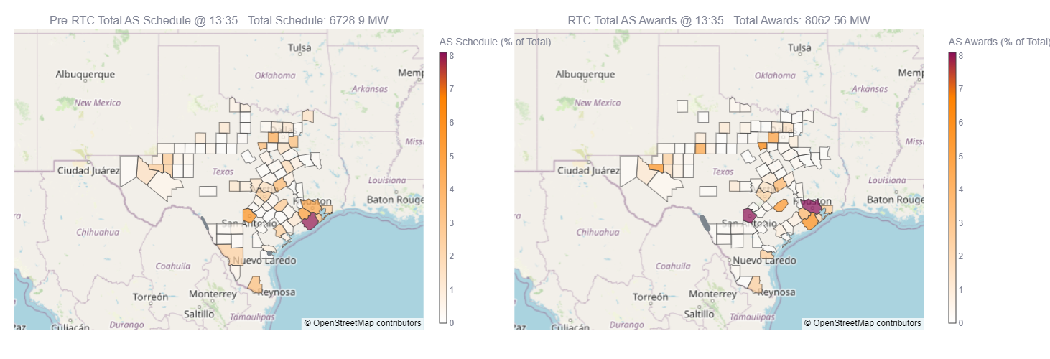
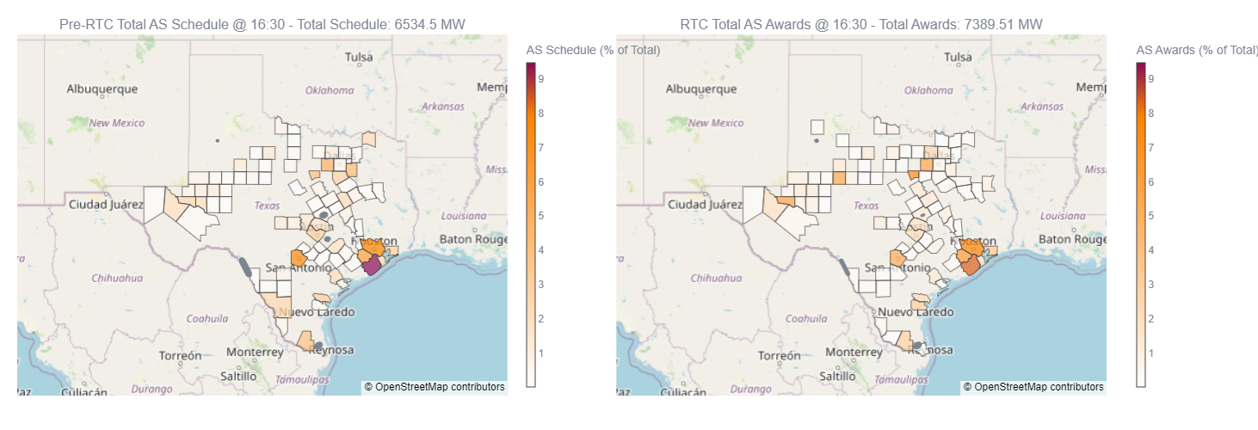
Case Study – Volatile day (6/19/2024)
A key benefit of RTC is the reallocation of ancillary services which can help reduce price spikes caused by ancillary service constraints and congestion in the Pre-RTC RTM.
While AS was moved, it was not necessarily concentrated behind a constraint.
  Price Spike due to Ramping Constraints
  Price Spike due to Congestion

Slide 12
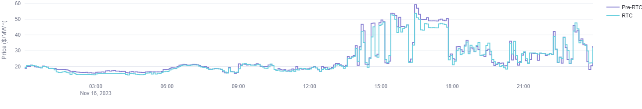
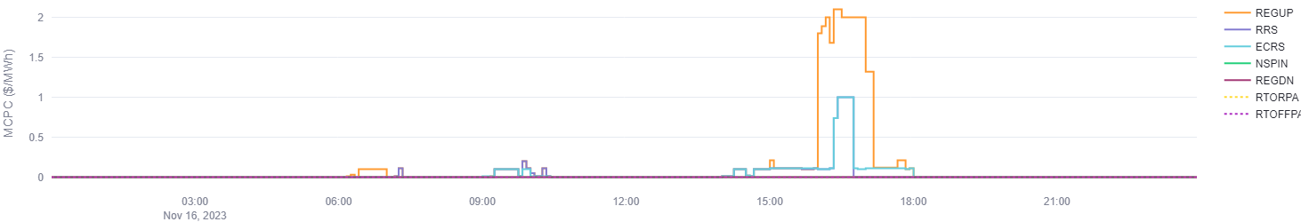
Case Study – Mild Day # 1 (11/16/2023)
Highest Pre-RTM prices observed in the afternoon and evening, which were primarily attributable to transmission congestion.
RTC energy prices track closely with Pre-RTC prices with periods of slight deviation, primarily where congestion was main driver of elevated Pre-RTC price, due to RTC’s capability for better allocating AS
RTC AS MCPCs higher than ORDC price adders in pre-RTC due to RTCs ability to differentiate the kind of MW headroom capacity for different types of AS awards rather than just MW headroom that determines the current ORDC price adders.
RTM System Lambda
RTC RTM MCPCs

Slide 13
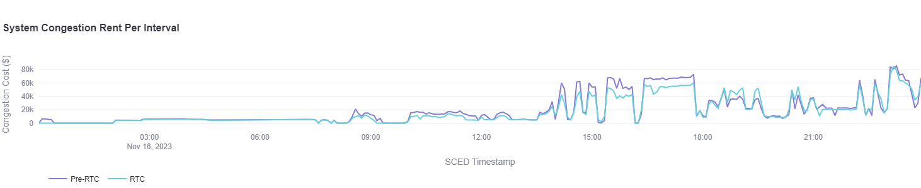
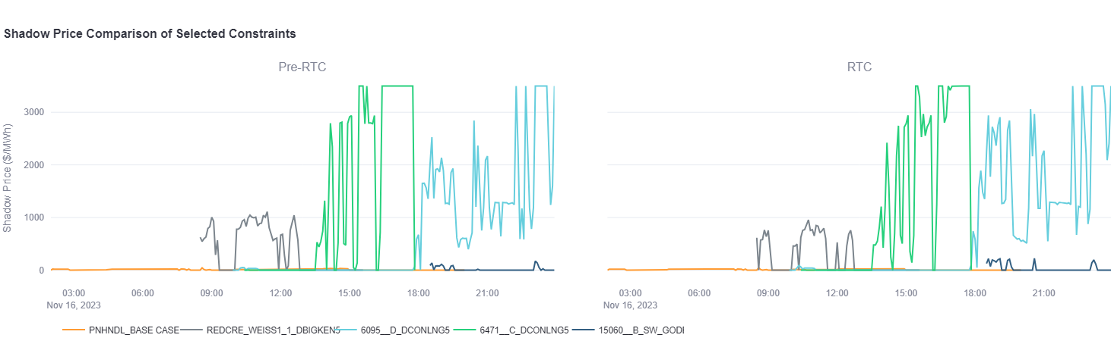
Case Study – Mild Day # 1 (11/16/2023)
Reduced transmission congestion rent observed under RTC
  Pre-RTC Congestion Rent = $5.6M
  RTC Congestion Rent = $4.9M

Slide 14
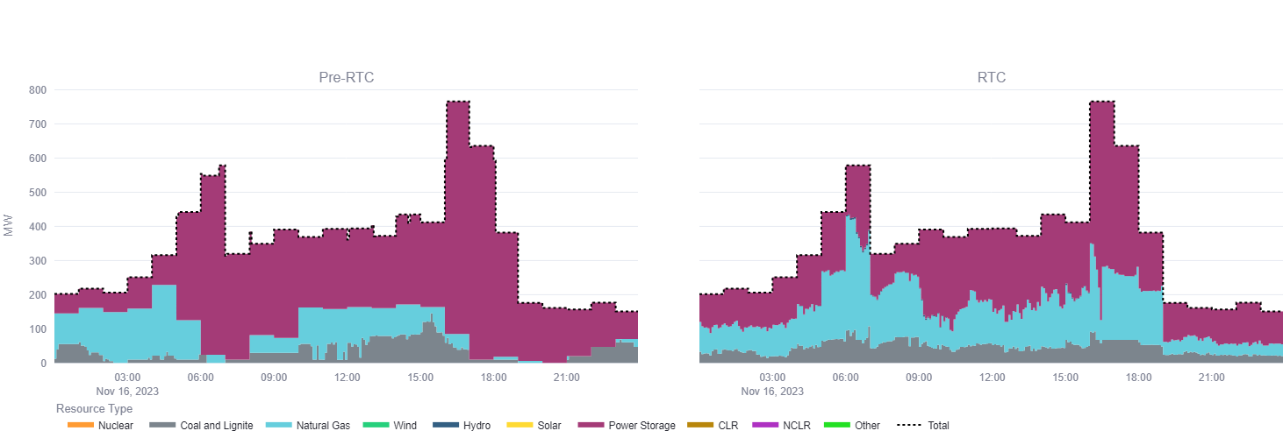
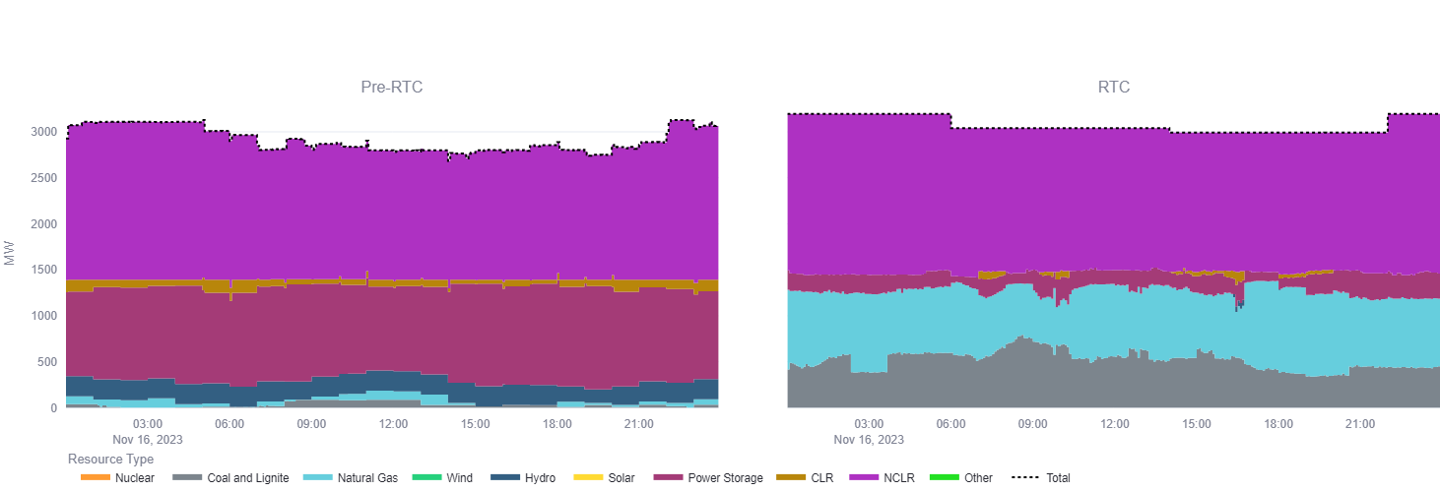
Case Study – Mild Day # 1 (11/16/2023)
On the mild day, procurement of Ancillary Service total quantities in alignment with AS plan except for Non-Spin, which is related to the tail quantities from the ORDC when reserves are plentiful.
  Reg Up
  RRS

Slide 15
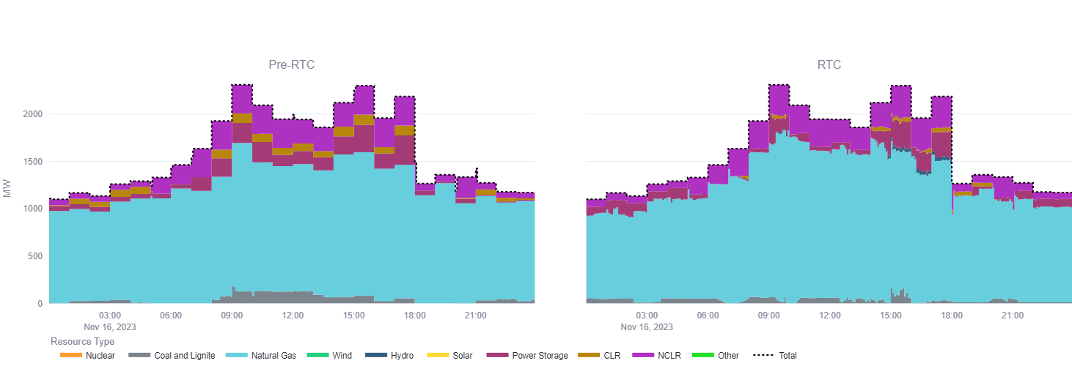
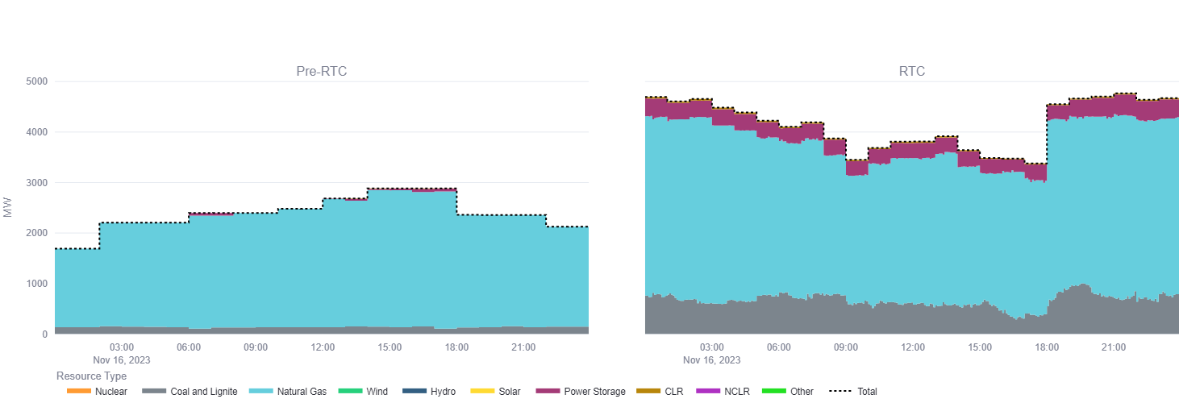
Case Study – Mild Day # 1 (11/16/2023)
On the mild day, procurement of Ancillary Service total quantities in alignment with AS plan except for Non-Spin, which is related to the tail quantities from the ORDC when reserves are plentiful.
  ECRS
  Non-spin

Slide 16
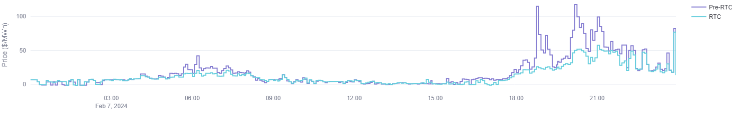
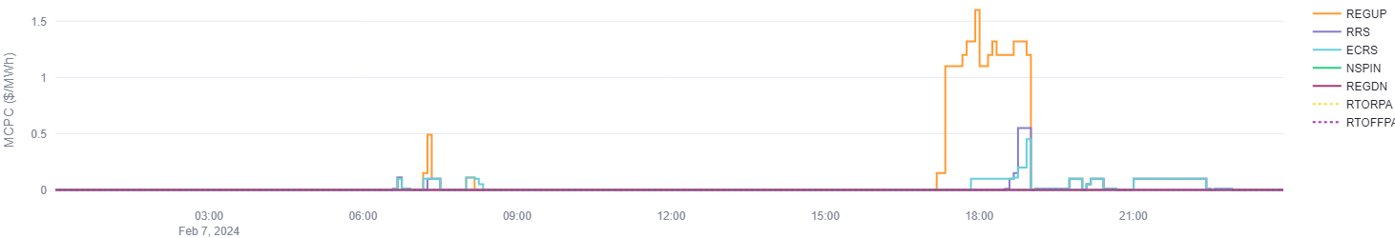
Case Study – Mild Day # 2 (2/7/2024)
Highest RTM prices observed in the evening, which were primarily attributable to transmission congestion.
RTC smooths out elevated jumps in RTM prices, due to RTC’s capability for better allocating AS
RTC AS MCPCs higher than ORDC price adders in pre-RTC due to RTCs ability to differentiate the kind of MW headroom capacity for different types of AS awards rather than just MW headroom that determines the current ORDC price adders.
RTM System Lambda
RTC RTM MCPCs

Slide 17
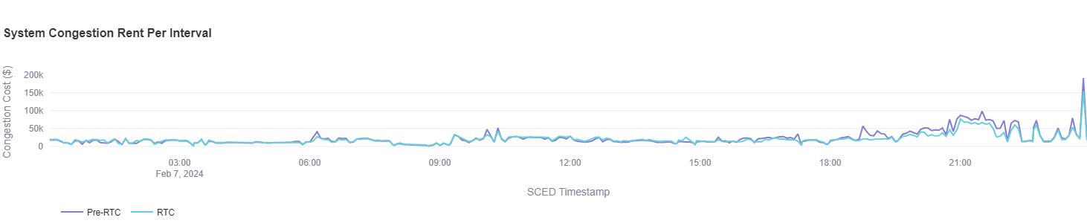
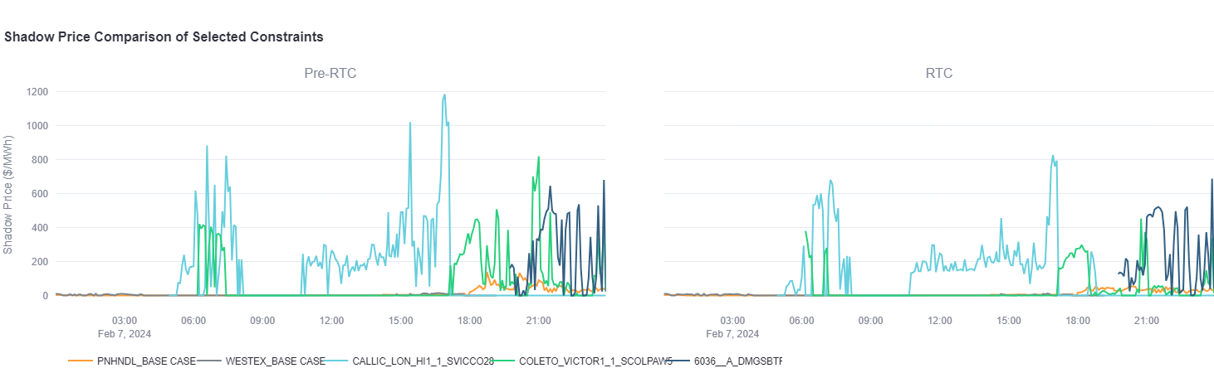
Case Study – Mild Day # 2 (2/7/2024)
Reduced transmission congestion rent observed under RTC
  No significant transmission limit violations in both cases
  Generally lower shadow prices on transmission constraints
    Pre-RTC Congestion Rent = $6.7M
    RTC Congestion Rent = $6.0M

Slide 18
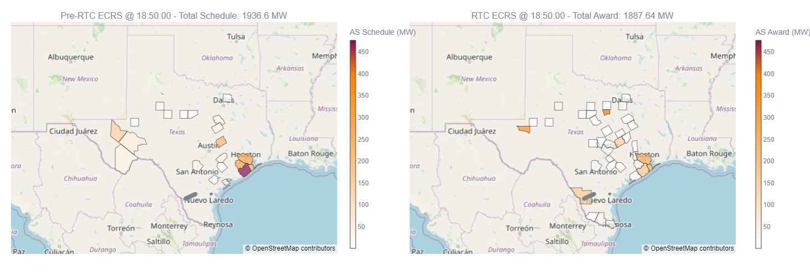
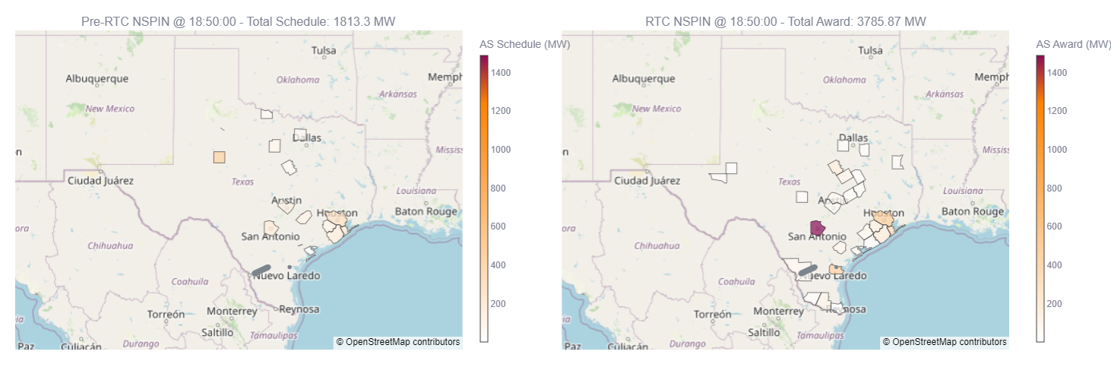
Case Study – Mild day # 2 (2/7/2024)
During the 18:45 – 19:10 SCED intervals, primarily ECRS and NSPIN quantities are moved to resources behind a thermal Valley constraint to aid in its mitigation.
  ECRS
  Non-spin

Slide 19
Takeaways
RTC simulation of volatile/mild days indicates that the RTC simulator produces pricing outcomes that track well with Pre-RTC RTM.
General features of RTC observed:
  More efficient allocation of reserves/dispatch of resources smoothing out price spikes and generally reducing RTM prices
  More efficient allocation of reserves/dispatch of resources able to reduce transmission congestion
RTC can differentiate the kind of MW headroom capacity for different types of AS awards rather than just MW headroom (whether it is frequency responsive or duct burner capacity) that determines the current ORDC price adders.

