Slide 1
Parameters for Proxy Ancillary Service Offer Floors – 3rd Discussion
David Maggio
Principal, Market Design & Analytics
RTCBTF
November 13, 2024

Slide 2
Recap of the October Presentation and Discussion
At the last meeting in October, we had looked at the different proposals for proxy Ancillary Offer Curve floor values.
ERCOT’s initial recommendation that the values be set to $0/MW per hour.
An approach where the values were set at the Real-Time System-Wide Offer Cap (SWCAP), i.e., $2,000/MW per hour.
 | $0/MW per hour | Real-Time SWCAP
Pros* | Value believed to be most in alignment with expected Real-Time Ancillary Service offer behavior Would not result in artificial Ancillary Service award shortages | Resources not offered by their QSE would generally be awarded after Resources that were offered Better incentives for QSEs that want to provide Ancillary Services to properly submit offers
Cons* | Resources not being offered by their Qualified Scheduling Entity (QSE) could be awarded ahead of other Resources Less incentive for QSEs that want to provide Ancillary Services to properly submit offers | Could result in artificial Ancillary Service award shortages, particularly for ERCOT Contingency Reserve Service (ECRS) and Non-Spinning Reserve Service (Non-Spin) Could result in higher Ancillary Service prices not in alignment with energy prices, even when reserve capability is available
* This table is intended to reflect a combination of ERCOT’s thoughts and stakeholder feedback from previous task force discussions.

Slide 3
New Idea Being Evaluated (“ASDC Derived”)
To try and find some compromise between the two approaches, a third approach was evaluated for the discussion today.
Under this third approach, the proxy Ancillary Service Offer floor price can vary by Ancillary Service and is set equal to the minimum of:
$2,000/MW per hour; and
The point on the Ancillary Service Demand Curve (ASDC) that intersects with the quantity of Ancillary Services in the Ancillary Services Plan
The thought is that this will:
Reduce the likelihood that Resources not being offered by their QSE would be awarded ahead of other Resources.
Relative to the $0/MW per hour approach
Address the issue of artificial Ancillary Service award shortages and reduce the likelihood of high Ancillary Service prices not in alignment with energy prices and physical reserve capability.
Relative to the Real-Time SWCAP approach

Slide 4
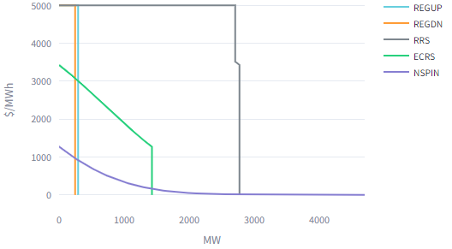
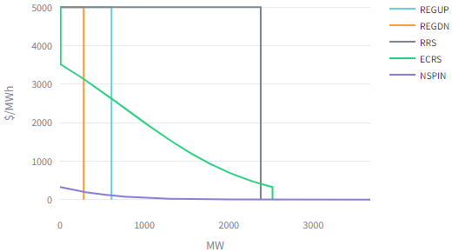
Illustration of the Third Approach
Example from 6/20/24 Hour Ending 5
Value by Ancillary Service (in $/MW per hour)
Regulation Up Service (Reg-Up): 2,000
Regulation Down Service (Reg-Down): 2,000
Responsive Reserve Service (RRS): 2,000
ECRS:1,270.71
Non-Spin: 12.30
Real-Time SWCAP
Example from 6/20/24 Hour Ending 13
Value by Ancillary Service (in $/MW per hour)
Reg-Up: 2,000
Reg-Down: 2,000
RRS: 2,000
ECRS:327.36
Non-Spin: 0.14
Real-Time SWCAP

Slide 5
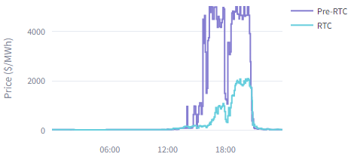
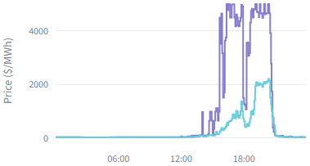
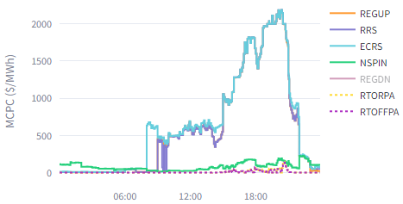
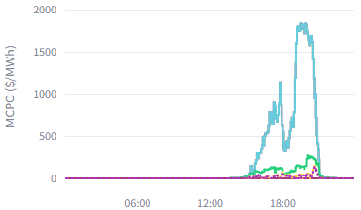
Previously Shared Illustration (Prices): June 20, 2023
Proxy Offer Floor = $2,000/MW per hour
Proxy Offer Floor = $0/MW per hour
Energy Prices
Energy Prices
Limited scarcity and lower prices
Limited scarcity and lower prices
Ancillary Service Prices
Ancillary Service Prices
Higher prices and lower awards
Limited scarcity and lower prices

Slide 6
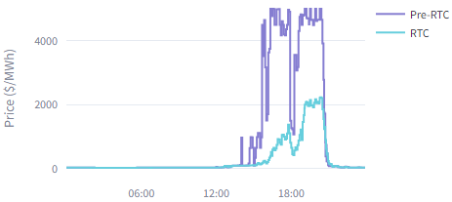
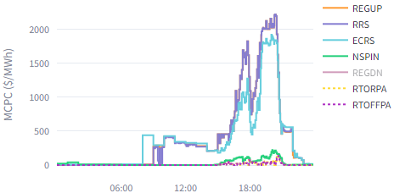
Illustration for New Approach (Prices): June 20, 2023
Proxy Offer Floor = ASDC Derived
Energy Prices
Energy pricing perspective:
There is limited differences between any of the three cases.
Energy scarcity is limited to the late afternoon and evening hours where they eventually hover around $2,000/MWh.
Ancillary Service pricing perspective:
The new approach lands in the middle, but results are more in alignment with an SWCAP approach.
Elevated Reg-Up, RRS, and ECRS prices during the middle part of the day with prices driven by the proxy Ancillary Service Offers.
Limited scarcity and lower prices
Ancillary Service Prices
Higher prices but limited award scarcity

Slide 7
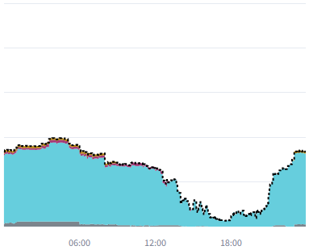
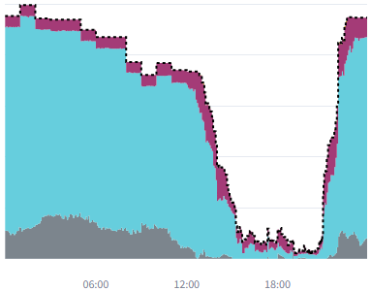
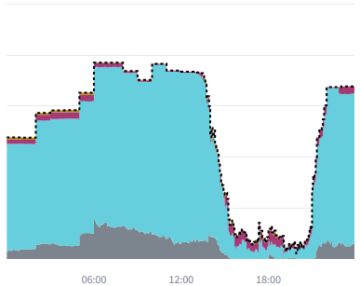
Previously Shared Illustration (Awards): June 20, 2023
Proxy Offer Floor = $2,000/MW per hour
Proxy Offer Floor = $0/MW per hour
RTC Non-Spin Awards
RTC Non-Spin Awards
3,678 MW
1,278 MW
Proxy Offer Floor = ASDC Derived
RTC Non-Spin Awards
For the new approach, the awards are largely in alignment with the Ancillary Service Plan during non-scarcity hours.
Less “extra” Non-Spin procured in the morning and night hours, as compared to the $0/MW per hour floor approach.
Unwarranted scarcity avoided with the new approach.
3,676 MW

Slide 8
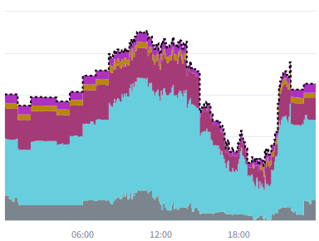
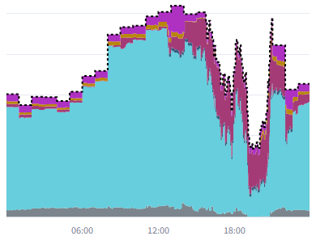
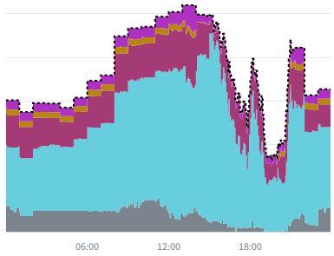
Previously Shared Illustration (Awards): June 20, 2023
Proxy Offer Floor = $2,000/MW per hour
Proxy Offer Floor = $0/MW per hour
RTC ECRS Awards
RTC ECRS Awards
2,117 MW
2,519 MW
Proxy Offer Floor = ASDC Derived
2,519 MW
RTC ECRS Awards
For the new approach, awards largely in alignment with the Ancillary Service Plan during non-scarcity hours.
Total awards very similar to results for the $0/MW per hour floor approach
Again, unwarranted scarcity avoided with the new approach.

Slide 9
ASDCs with a “Ramp-In” for All Ancillary Service Products
The updated recommendation is to leverage ASDCs for proxy Ancillary Services Offer floors.
This recommendation strikes a balance between minimizing unwarranted Ancillary Service shortages and mitigating the concern of proxy offers undercutting QSE-submitted offers.
While this new approach has merit, the specifics may be impacted by having ASDCs where there is also a “ramp-in” for Reg-Up, Reg-Down, RRS, and ECRS.
For example, consider the case where the ASDC ramps to zero at a quantity equal the Ancillary Service Plan. The new approach would take us back to a condition where the proxy Ancillary Service Offer floor is $0/MW per hour.
If there is agreement on using the ASDCs to derive floors, then we’ll need to finalize the details for the proxy Ancillary Service Offer floors after any on-going ASDC discussion is further along.

Slide 10
Questions, Additional Discussion, and Next Steps

