Slide 1
WMWG update to wms November 6, 2024

Slide 2
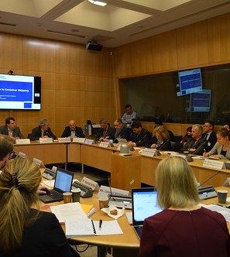
AGENDA
General items
NPRR1202: refundable deposit of large load interconnection studies
CARD allocation discussion
This Photo by Unknown Author is licensed under CC BY-NC-ND

Slide 3
General items
WMWG discussed an aging “Open Items” list of WMS assignments. The list will be streamlined and red-lined for discussion at next month’s meeting before returning a recommendation to WMS on what items should remain pending.
ERCOT’s Cory Carswell gave a presentation of his analysis of the pricing impacts of the LDL Override decisions that ERCOT made during the April 8th solar eclipse. The pricing impacts were minimal.
NPRR1229, RTM CMP Energy Payment, remains on WMWG’s agenda, but was not discussed.
NPRR1235, Dispatchable Reliability Reserve Service, will be discussed in SAWG.
NPRR1241, Firm Fuel Supply Service Availability and Hourly Standby Fee, remains on WMWG’s agenda. Luminant’s Katie Rich reported that Luminant is working on draft language to discuss next month.
A question about NPRR1253, Incorporate ESR Charging Load Information into ICCP, was raised by CPS’s David Detelich. ERCOT’s Dave Maggio offered to present materials at a future meeting on how Wholesale Storage Load is considered in ERCOT’s load forecasts.

Slide 4
NPRR1202, Refundable deposit of large load interconnection studies
Longhorn Power’s Bob Wittmeyer presented comments on NPRR1202, expressing a desire to accelerate the process for getting large loads interconnected in ERCOT by collecting a fee or fees that could be used to hire or contract additional resources for ERCOT or otherwise improve systems.
TCPA’s Michele Richmond presented comments that expressed support for the proposal to use fees to refine and expedite the queue projects.
Several market participants expressed support for the idea of using fees to expedite the interconnection process. Others supported an initial, but not recurring fees. The IMM’s Andrew Reimers suggested using the fees to offset TCOS, if ERCOT was not able to use them to directly hire additional resources. Some market participants believed that would create cross-subsidization issues that they opposed.
ERCOT staff responded that they are supportive of trying to expedite and streamline the interconnection process, but are not supportive of NPRR1202, or an additional fee at this time. Instead, ERCOT would like to see what improvements can be achieved through the implementation of NPRR1234, Interconnection Requirements for Large Loads and Modeling Standards for Loads 25 MW of Greater (pending at PRS) and associated PGRR115 (pending at ROS).

Slide 5
CARD Discussion
The IMM’s Andrew Reimers updated market participants on the IMM’s analysis regarding CRR Auction Revenue Distribution (CARD) allocation.
ERCOT requested more formal direction from WMS on which of the various proposals it should focus on when drafting changes to the current process.
Proposals will be presented to WMS at today’s meeting, with a vote requested in December.

Slide 6
THANK YOU

