Slide 1
CARD & CRRBA Allocation options November 6, 2024

Slide 2
ISSUE and TIMELINE of DISCUSSION
ISSUE – The current allocation method for the CARD & CRRBA distribution is based on each QSEs load ratio share in the peak load 15-minute settlement interval of the corresponding month (MLRS). This creates an adverse incentive for load (specifically fast ramping load) to increase consumption during the peak load interval to capture more of the CARD & CRRBA revenue.
ERCOT is seeking a different allocation method to mute the adverse incentive.
TIMELINE
Jul 10 – ERCOT introduced the issue at WMS along with proposals to solve the issue
Aug 7 – ERCOT presented their proposals again at WMS and stakeholders suggested new proposals
Sep 24 – WMWG took up the discussion. The IMM, Vistra, and City of Georgetown Utilities presented details on new proposals.
Oct 18 – WMWG discussed opinions on proposals that were presented at the Sep 24 meeting
Nov 6 – WMWG presents proposals discussed to WMS
Nov 11 – WMWG will host additional discussion if needed
Dec 4 – WMS votes on proposals and ERCOT will draft an NPRR based on consensus position

Slide 3
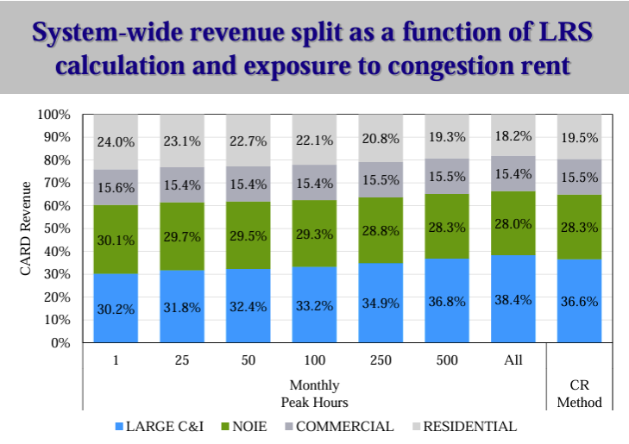
IMM Proposal
Allocate CARD and CRRBA based on the peak 500 hours in the month
The IMM’s position is that the allocation between load classes should be based on each specific load class’s exposure to congestion rent
The IMM produced an analysis looking at historical data (Jun 23 – May 24) that weighted QSEs’ load ratio share according to hourly congestion rent over each month while also highlighting the allocation percentages between load classes (Large C&I, NOIE, Commercial, Residential)
This allocation share (“CR Method”) was then compared to differing sets of monthly peak hours until a reasonable load class correlation was identified. A correlation was identified between 400-500 monthly peak hours.
Pro - additional intervals reduce incentive for loads to change consumption to increase CARD revenues; easy to calculate
Con - moves revenues from residential to industrial consumers

Slide 4
CITY of Georgetown UTILITIES PROPOSAL
Allocate CARD and CRRBA using the same allocation that Transmission Cost of Service (TCOS) considers.
TCOS is allocated to QSEs based on the load ratio share (LRS) average of their four monthly coincident peak (4CP) load intervals in Jun-Sep each year
COG’s position is that entities that pay for the transmission system should receive an equitable share of the benefits that the CARD & CRRBA distribute
Additionally, COG states that by adjusting the allocation to this method it will eliminate the real-time price distortion caused by the CARD and CRRBA while also minimizing the real-time price distortion caused by the 4CP allocation (and related load response). There is a natural incentive for load to reduce consumption during these intervals.
Example of how it would work in practice: For each monthly allocation in 2024 (CARD or CRRBA) consider the average of the LRS realized in the 2023 4CP 15-minute settlement intervals
Pro - aligns CRR benefits and transmission cost incentives
Con - calculation lag that is hard to apply; CARD revenues are not related to transmission costs (separate issues)

Slide 5
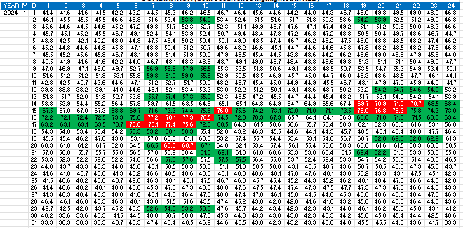
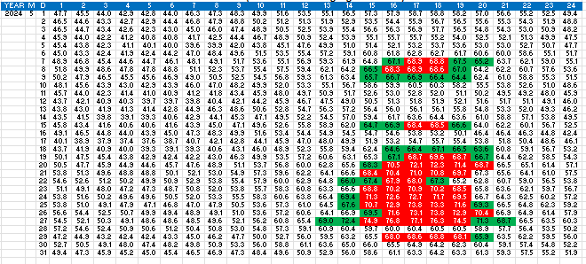
VISTRA PROPOSAL
Allocate CARD and CRRBA by averaging the LRS realized in the top 60 hours for the month along with the top 4 hours of the top 15 peak days for the month.
Vistra’s position is that this two-factor approach is conceptually straightforward but difficult to predict and would disincentivize the adverse behavior.
Additionally, Vistra states this approach has less risk of unintended consequences (i.e., shifting the allocation between load classes) as it includes a fewer number of hours than other proposals suggested previously (e.g., LRS average of all hours in month, LRS average in 8 hours of each day, etc.)
Pro - easy to calculate but hard to predict, reducing incentive for loads to change consumption to increase CARD revenues, keys in on seasonality
Con - more complicated than IMM approach

Slide 6
THANK YOU

