Slide 1
Unregistered Distributed Generation Report:
2024 Q3 Update
Resource Adequacy
11/6/2024

Slide 2
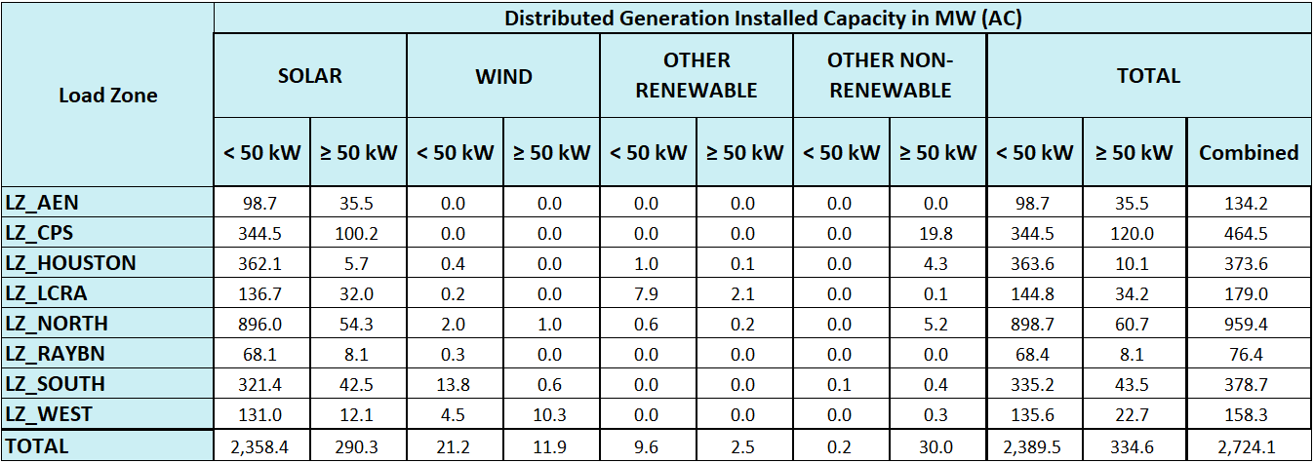
2024 Q3 Unregistered Distributed Generation Report
DG Battery Energy Storage not included in the table above
(31.49 MW Competitive, 41.43 MW NOIEs, 72.92 MW Total)
Totals may not match the sum of their columns/rows due to rounding
Notes:
Competitive and NOIE breakdown:
Competitive: 1,550 MW
NOIE: 1,174 MW
* For this quarterly report, NOIE capacity below 50 kW is only included from NOIEs that have an aggregate unregistered DG capacity of more than two MW for those sites that are less than 50 kW in size, as described in Nodal Protocols Section 3.2.5.1 (2)
* Other Renewable category includes: biomass (wood/wood wastes), landfill gas, other biomass gases, and water
* Other Non-Renewable category includes: bituminous coal, subbituminous coal, lignite coal, petroleum coke, distillate fuel oil, natural gas, other gases, and waste heat not directly attributed to a fuel source

Slide 3
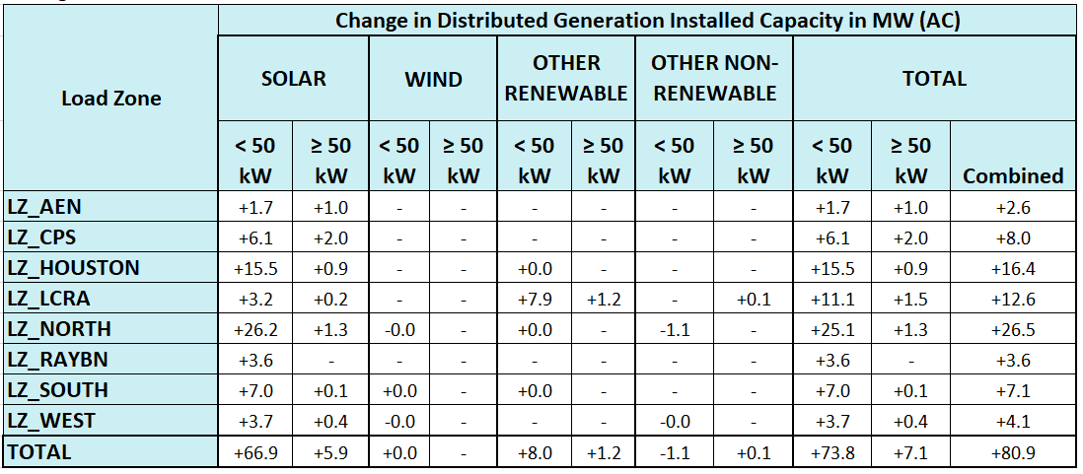
2024 Q2 → 2024 Q3 Change
MW decrease in Other Non-Renewable <50 kW sites represents battery energy storage captured in the Q2 update that were removed in the Q3 update.
Totals may not match the sum of their columns/rows due to rounding

Slide 4
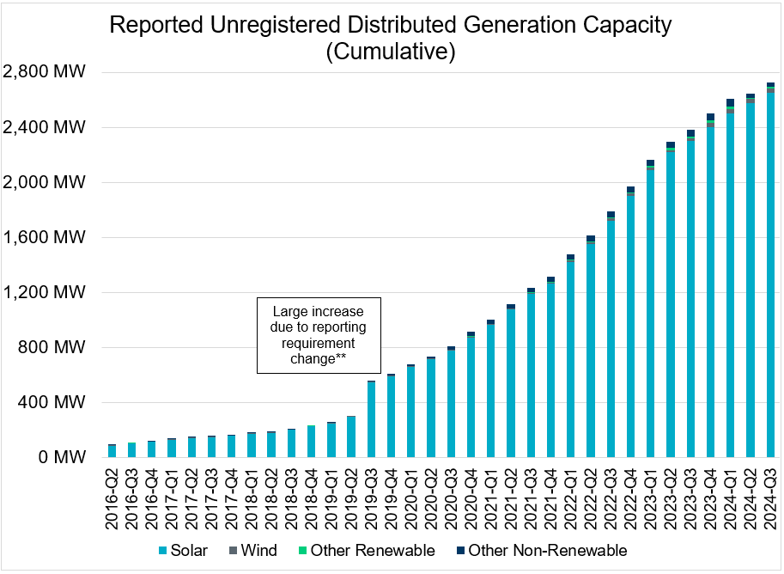
Unregistered DG Growth: 2016-Q2* to 2024-Q3
* 2016-Q2 was the first report published after implementation of report changes per NPRR794/COPMGR044
** 2019-Q3 was the first report published after implementation of report changes per NPRR891
2024-Q2 was the first report published excluding Battery Energy Storage systems.

