Slide 1
Project Update
October 17, 2024
Troy Anderson
ERCOT Portfolio Management

Slide 2
Project Update Agenda
  Recent / Upcoming Project Highlights
  2024 Release Targets
  2025 Release Targets
  Revision Request Project Updates
  Priority/Rank Recommendations for Revision Requests with Impacts
    NPRR1239 – Access to Market Information
    NPRR1240 – Access to Transmission Planning Information
    NPRR1249 – Publication of Shift Factors for All Active Transmission Constraints in the RTM
  Technology Working Group (TWG)
    Next meeting is 10/24/2024
Location of Revision Request Project Information: http://www.ercot.com/services/projects

Slide 3
Recent / Upcoming Project Highlights
2024 September Release – R9 – 9/26/2024 Complete
  NPRR1002 – BESTF-5 ESR Single Model Registration and Charging Restrictions in Emergency Conditions
  RRGRR023 – Related to NPRR1002
  NOGRR208 – Related to NPRR1002
  Forecast Presentation Platform – CDR Reports
2024 October Off-Cycle Release – 10/1/2024 Complete
  NPRR1217 – Remove VDI Requirement for Deployment and Recall of Load Resources and ERS Resources
    XML and VDI will both be issued until 12/1/2024
2024 October Off-Cycle Release – 10/9/2024 Complete
  SCR799 – ERCOT Outage Study Cases in the System Operations Test Environment (SOTE)
2024 November Off-Cycle Release – 11/1/2024 In Flight
  NPRR1205(b) – Revisions to Credit Qualification Requirements of Banks and Insurance Companies
    Credit rating requirements
2024 November TX SET 5.0 Release – 11/10/2024 In Flight
  NPRR1095 – Texas SET V5.0 Changes
  SCR817 – MarkeTrak Validation Revisions Aligning with Texas SET V5.0
  SCR823 – ERCOT Mass System “County Name” File Updates for Texas SET V5.0
  RMGRR168 – Modify ERCOT's Mass Transition Responsibilities
  RMGRR169 – Related to NPRR1095
  RMGRR172 – Texas SET V5.0 Continuous Service Agreements Changes
  RMGRR179 – TDSP Temporary Emergency Electric Energy Facility (TEEEF) Deployment Transactional Processing
Note: Projected Go-Live dates are subject to change.
Please watch for market notices as the effective dates approach.

Slide 4
2024 Release Targets – Approved NPRRs / SCRs / xGRRs
R1
R3
R5
January 1/25 | February 2/22 | March 3/28 | April 4/25 | May 5/30 | June 6/27
NPRR1092(b) PGRR098(a) ESR Telemetry Public API Enhancements | NPRR1132(a) RRGRR032 NOGRR249(b) NPRR1184(a) NPRR1026(b) NPRR1172(a) | NPRR1040 NOGRR247(a) NPRR1165 NPRR989(a) NPRR1038 NOGRR204(a) |  | SCR819 NPRR1111 Securitization Default Charge Supporting Data | NPRR1149 NPRR1186 NPRR1196 NPRR1121 NPRR1090 NPRR962 NPRR1139 NPRR1205(a)
R2
R4
R6
ü
ü
ü
ü
ü
ü
ü
ü
ü
ü
ü
ü
ü
ü
ü
ü
ü
ü
ü
ü
ü
ü
ü
ü
ü
ü
ü
ü
ü
ü
1/1
3/11
Various effective dates
2/1
2/26
4/1
6/1
2/16
3/1
ü
7/1
ü
R7
R9
July 7/25 | August 8/22 | September 9/26 |  | TX SET 5.0 11/10 | December 12/11-12/12
 | NPRR1058 NPRR1131 NPRR1186(b) OBDRR040 SCR821 | Forecast Presentation Platform (CDR rpts) NPRR1002 RRGRR023 NOGRR208 | NPRR1217 SCR799 NPRR1205(b) | NPRR1095 SCR817 SCR823 RMGRRs: 168,169, 172,179 | NPRR1183 NPRR1184 PGRR088 PGRR094 NPRR945
R8
R11
10/1
ü
ü
ü
ü
ü
E
E
E
E
E
E
E
E
10/9
ü
11/1
12/18
E
Go-live dates can differ from Protocol effective dates – Please refer to market notices for more details
APPENDIX
Red Text: New additions and target release changes
Strike-Through Text: Previous target release
(a), (b), etc.: Multiple phase release
Project Status Codes
NS = Not Started
I = Initiation
P = Planning
E = Execution
H = On Hold
NPRR989(a) – ESR tech. req.
NPRR1026(b) – SLF – Reporting
NPRR1092(b) – Limit RUC Opt-Out
NPRR1132(a) – RIOO portion
NPRR1172(a) – RUC Process/Clawback
NPRR1184(a) – Interest calcs
NPRR1186(b) – 60 Day Reports
NPRR1205(a) – Credit Limit %
NPRR1205(b) – Credit Rating
NOGRR204(a) – ESR tech req
NOGRR247(a) – UFLS changes
NOGRR249(b) – MIS posting
PGRR098(a) – Section 4.1.1.8
Release targets are subject to change

Slide 5
2025 Release Targets – Approved NPRRs / SCRs / xGRRs
R1
R3
R5
January 1/30 | February 2/26 | March 3/26 | April 4/23 | May 5/28 | June 6/25
 |  | NPRR1145 NPRR1183 |  | RTC+B Market Trials begin
R2
R4
R6
P
P
RTC QSE Submission Testing
RTC QSE Telemetry Check-out
RTC+B
12/5
July 7/24 | August 8/20 | September 9/24 | October 10/22 |  | December 12/10
 |  |  |  |  | RTC+B Stabilization begins
R7
R8
R9
R10
E
R11
NPRR1007-1013
NPRR963(a)
NPRR965
NPRR1000
NPRR1014
NPRR1054
NPRR1058
NPRR1172
NPRR1204
NPRR1216
NPRR1236
NPRR1245
NPRR1246
NOGRR211
NOGRR268
OBDRR020
OBDRR052
PGRR118
RTC QSE Submission Testing
Open-loop RTC SCED
Closed-loop SCED/LFC
RTC QSE Telemetry Check-out
QSE Telemetry Tests
Day-Ahead Market
Go-live dates can differ from Protocol effective dates – Please refer to market notices for more details
APPENDIX
Red Text: New additions and target release changes
Strike-Through Text: Previous target release
(a), (b), etc.: Multiple phase release
Project Status Codes
NS = Not Started
I = Initiation
P = Planning
E = Execution
H = On Hold
NPRR963(a) – Portion of NPRR
RTC+B Market Trials
RTC+B Stabilization
Release targets are subject to change

Slide 6
Revision Request Project Updates
RR | Description | Project Phase | Additional Detail
NPRR965 | GREDP Shutdown Exemption | Not Started | Unable to implement prior to RTC+B go-live Adding to scope of RTC+B
NPRR1004 | Load Distribution Factor Process Update | Not Started | Additional complexities discovered before project initiated Implement after RTC+B
NPRR1035 | DC Tie Schedules Protected Information Expiry and Posting | Not Started | Unable to fit into a window prior to RTC+B freeze Implement after RTC+B
NPRR1128 | Allow FFR Procurement up to FFR Limit Without Proration | On Hold | Vendor impact discovered shortly after the project started Implement after RTC+B
NPRR1208 | Creation of Invoice Report | Not Started | Unable to fit into a window prior to RTC+B freeze Implement after RTC+B
SCR805 | Provide Early Access to Certain 60-Day Reports to TSPs Upon Request | Not Started | Unable to fit into a window prior to RTC+B freeze Implement after RTC+B
SCR825 | ERCOT Voice Communications Aggregation | Not Started | EMS and MMS impacts push this to post-RTC+B Implement after RTC+B

Slide 7
Priority / Rank Recommendations for Revision Requests with Impacts
Recommendations for…
Revision Request | Description | Priority | Rank | Comments
NPRR1239 | Access to Market Information | 2026 | 4720 | $250k-$350k, 8-12 months Impacted System(s): Public API Impacts with RTC+B resources
NPRR1240 | Access to Transmission Planning Information | 2026 | 4730 | $150k-$250k, 7-10 months Impacted System(s): Public API Impacts with RTC+B resources
NPRR1249 | Publication of Shift Factors for All Active Transmission Constraints in the RTM | 2026 | 4740 | $25k-$45k, 3-5 months Impacted System(s): CDR, MMS Impacts with RTC+B resources
PPL Rank Information
Next available 2025 Rank in Business Strategy = 4540
Next available 2026 Rank in Business Strategy = 4720
Next available Rank in Regulatory = 400

Slide 8
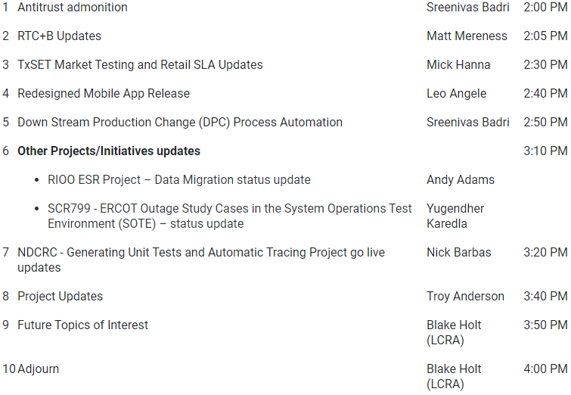
Technology Working Group (TWG)
Agenda for TWG meeting held on 9/26/2024:
Next TWG scheduled for 10/24/2024

