Slide 1

NPRR1226 Demand Response Monitor- ERCOT Overview
October 2024 TWG Meeting

Slide 2
NPRR1226 Review
NPRR was submitted as a data request to build and display an aggregation of State Estimator Points that represents non-conforming loads which respond to various DR signals.
This data is intended to only provide an “indicator” of the direction certain ”ERCOT identified” transmission loads are responding and not to be an estimation of aggregate Demand Response occurring in ERCOT.
The NPRR Sponsor has stated this must be available as a visual dashboard.
ERCOT has sole control over the dashboards so NPRR will remain tabled at PRS until ERCOT develops a process for MPs to request dashboard data. In the interim PRS remanded the concept to TWG to review and provide feedback.

Slide 3
NPRR1226 Review
Data Requirements
  ERCOT to identify which State Estimator Load (SEL) include meaningful MWs of non-conforming load (load that is not impacted by weather conditions).
    SELs selected by ERCOT
    SELs selected have historically shown to respond to signals like LMPs, 4CP/Near 4CP, voluntary energy conservation notices, or other ERCOT actions.
  Once identified aggregate these SELs into a single real-time value for each SCED run.
  Determine Demand Response.
    NPRR was fairly descriptive and stated Demand Response shall be calculated by comparing the positive difference in peak consumption of a Load in the past two hours to the current SEL of selected substation.
    This requirement would result in inaccurate DR values since events like 4CP/Near 4CP are shown to be longer than 2 hours. (see next slide)
    ERCOT suggest using our Demand Response Baseline Methodologies instead.
  Calculate running Demand Response by comparing the single real-time values to the baseline of the SEL.

Slide 4
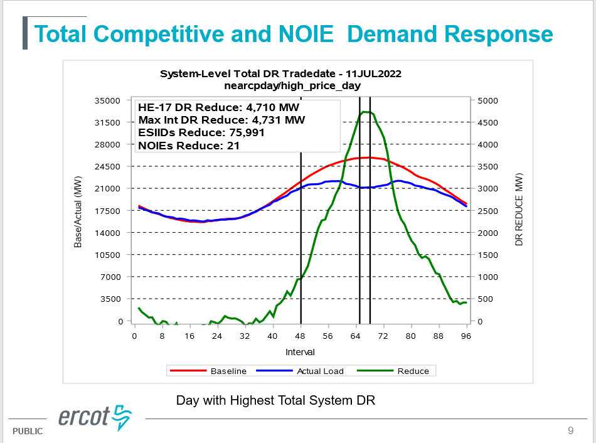

Slide 5
NPRR1226 Review
Periodic review of the SELs selected should be considered (e.g. every 6 months, yearly?)
ERCOT currently provides similar data to the ERCOT Control room on the Steel Mill Loads and LFLs.
  Steel Mills and LFLs are shown separately (not recommended for public)
  For the purpose of this data request SEL’s that include Steel Mill loads would not be used (subject to unpredictable load swings).
NPRR provides ERCOT sole responsibility of identifying which SELs to include in the aggregation. Those SELs selected must not be made public to maintain load confidentiality.
The issue of “quality of the data” was raised at PRS. This may not be an issue since the data is intended soley as a DR indicator. Suggest TWG give opinion.
Load switching on the Transmission system could be an issue
Is Dashboard a must have or is some alternative format acceptable?

Slide 6
Thank You!

