Slide 1
ERCOT Technology Working Group (TWG)
October 24, 2024

Slide 2
ERCOT TWG
WELCOME

Slide 3
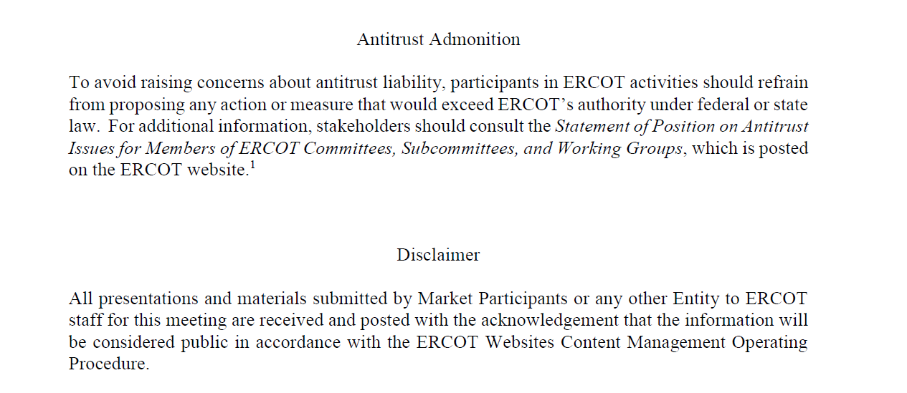
ERCOT TWG

Slide 4
ERCOT TWG Agenda
Item # | Item Description | Presenter | Start Time
1 | Antitrust admonition | Sreenivas Badri | 2:00 PM
2 | NERC Update – EMSWG | Wei Qiu | 2:05 PM
3 | Project Updates | Troy Anderson | 2:15 PM
4 | RTC+B Updates | Matt Mereness | 2:25 PM
5 | RTC+B Market Submissions – System Configurations | Sreenivas Badri | 2:45 PM
6 | NPRR1226 - Demand Response Monitor – Technical Discussion | Mark Patterson | 3:00 PM
7 | LCRA DPC Submission Process | Blake Holt (LCRA) | 3:15 PM
8 | Other Projects/Initiatives updates
 | Texas Set Timeline Reminder | Mick Hanna | 3:30 PM
9 | Round Table Discussion | Blake Holt (LCRA) | 3:50 PM
10 | Adjourn | Blake Holt (LCRA) | 4:00 PM

Slide 5
NERC EMSWG Update
NERC EMSWG Update – Wei Qiu

Slide 6
RTC+B Updates
RTC+B Updates – Matt Mereness

Slide 7
RTC+B Market Submissions - System Configurations
RTC+B Market Submissions - System Configurations – Sreenivas Badri

Slide 8
NPRR1226 - Demand Response Monitor – Technical Discussion
NPRR1226 - Demand Response Monitor – Technical Discussion – Market Patterson

Slide 9
LCRA DPC Submission Process
LCRA DPC Submission Process – Blake Holt

Slide 10
Other Projects/Initiatives Status Updates
Texas Set Timeline Reminder – Mick Hanna

Slide 11
ERCOT TWG – Round Table Discussion
ERCOT TWG – Round Table Discussion – Blake Holt (LCRA)
  Future Topics of Interest
  Topics and presentations from TWG members

Slide 12
ERCOT TWG
Thank You
You can reach Sreenivas at
Sreenivas.Badri@ercot.com and Blake at Blake.Holt@LCRA.ORG

