Slide 1
Resource Integration Topics
Jenifer Fernandes
ERCOT
Resource Integration Working Group
October 24, 2024

Slide 2
Grid Interconnection Organization Updates
Kenisha Webber: Large Gen Supervisor
John Lawson: Small Gen Supervisor

Slide 3
RIOO Update –ESR conversion
Plan for collecting new ESR information, converting combo models, and final cleanup of data
ESRs with PLDs on or prior to Sep. 2024
  Done - RFI information collected via DocuSign
ESRs with PLDs of 10/2 and 11/1
  Modeling to send RFI template to directly to AR and BAR of ESR
    Completed spreadsheet should be submitted as an attachment-only RSCR
  Convert to single model via script with RFI data.
  Deadline to submit the RFI data in RIOO-RS is 12/2/2024.
ESRs with PLDs of 12/4, 1/8, and 2/5
  Resource Integration to provide RFI template to RE.
    Completed spreadsheet should be submitted with the INR in RIOO-IS
  After graduation, convert to single model via script with RFI data
  Deadline to submit the RFI data in RIOO-IS is 12/2/2024.
All in-flight ESR with 3/5 after or without PLD converted in RIOO-IS:
  Within IS, run script to convert to single model
  RE to provide all required data via RIOO panels
Note: Providing good quality data is necessary to efficiently convert from Combo Model to Single Model.

Slide 4
Quarterly Stability Assessment (QSA)
Planning Guide 5.3.5
Next Deadline for QSA
If a GINR is not included in QSA, its Initial Synchronization date will be automatically delayed to the next quarter
All-Inclusive Generation Resource Initial Synchronization Date | Last Day for an IE to meet prerequisites as listed in paragraph (4) below | Completion of Quarterly Stability Assessment
Upcoming January, February, March | Prior August 1 | End of October
Upcoming April, May, June | Prior November 1 | End of January
Upcoming July, August, September | Prior February 1 | End of April
Upcoming October, November, December | Prior May 1 | End of July

Slide 5
Quarterly Stability Assessment (QSA)
Planning Guide 5.3.5, Quarterly Stability Assessment
Issue’s seen in previous QSA’s
  10 day comment period for FIS
    Needs to be complete before QSA deadline
    TSPs need to plan for it
  Dynamic/PSCAD Model Review
    Dependent on FIS Stability study
    Need to meet PG 6.9 15 to 30 days prior to QSA deadline
PSSE Model Quality Test Required
PSCAD Model Quality Test, Unit Model Validation and Template is required. PSCAD template is required starting August 1st QSA.
TSAT Model Required – If PSSE model is UDM, then TSAT model should be UDM and should include MQT

Slide 6
PGRR112: Feb 1,2025 QSA implementation
FIS studies finalized and posted in RIOO-IS 45 days prior to quarterly stability assessment deadline.
Dynamic models (PSEE, PSCAD, TSAT (UDM)) and MQT report submitted in RIOO-IS.
From Planning guide Section 5.3.5 (2): Last Day for an IE to meet prerequisites as listed in paragraph (4) below | 45 day deadline
Prior August 1 | June 17
Prior November 1 | September 17
Prior February 1 | December 18
Prior May 1 | March 17

Slide 7
PGRR088- Include Financial Security Amount in RIOO-IS
RIOO-IS implementation 12/11/2024
Planning guide 5.2.8.1 (5):
5) Within ten Business Days of providing the TSP both the notice to proceed with construction of the interconnection for the Generation Resource and the financial security sufficient to fund the interconnection facilities pursuant to the SGIA, the IE must submit a change request via the online RIOO system to provide the financial security amount if it is not redacted in the public version of the SGIA filed with the Public Utility Commission of Texas (PUCT). ERCOT will include in the monthly Generator Interconnection Status report the name of the interconnecting TSP and the total amount of financial security sufficient to fund the interconnection facilities, if provided by the IE.

Slide 8
PGRR094: Requirement for Generator Construction Commencement or Completion
Implemented in RIOO-IS. IE/RE can add submit or update the Construction Start and End Date via Change Request in RIOO-IS.
Construction Start Date
Enter (1) the date that physical on-site work of a significant nature (such as footing excavation or concrete pouring for foundations) has begun and is on-going, or (2) the date that major equipment items have been delivered to the site. Physical work of a significant nature does not include preliminary activities such as surveying, site clearing, test drilling and decommissioning of existing facilities.
Construction End Date
Enter the date when all plant systems are ready for commissioning/starting activities.

Slide 9
Commissioning Requests Submission- New Email Address
ERCOT has established a new, dedicated email address for Market Participants to submit new generator Commissioning Checklist for review.
Starting June 10, 2024, all new Commissioning Checklists (Parts 1-3) should be emailed to CommissioningRequests@ercot.com in addition to being submitted to RIOO-IS.
Commissioning Checklists (Parts 1-3) submitted to ResourceIntegrationDepartment@ercot.com after June 21, 2024, will not be processed.
Commissioning Plans should not be emailed for review to the new Commissioning Request email address.

Slide 10
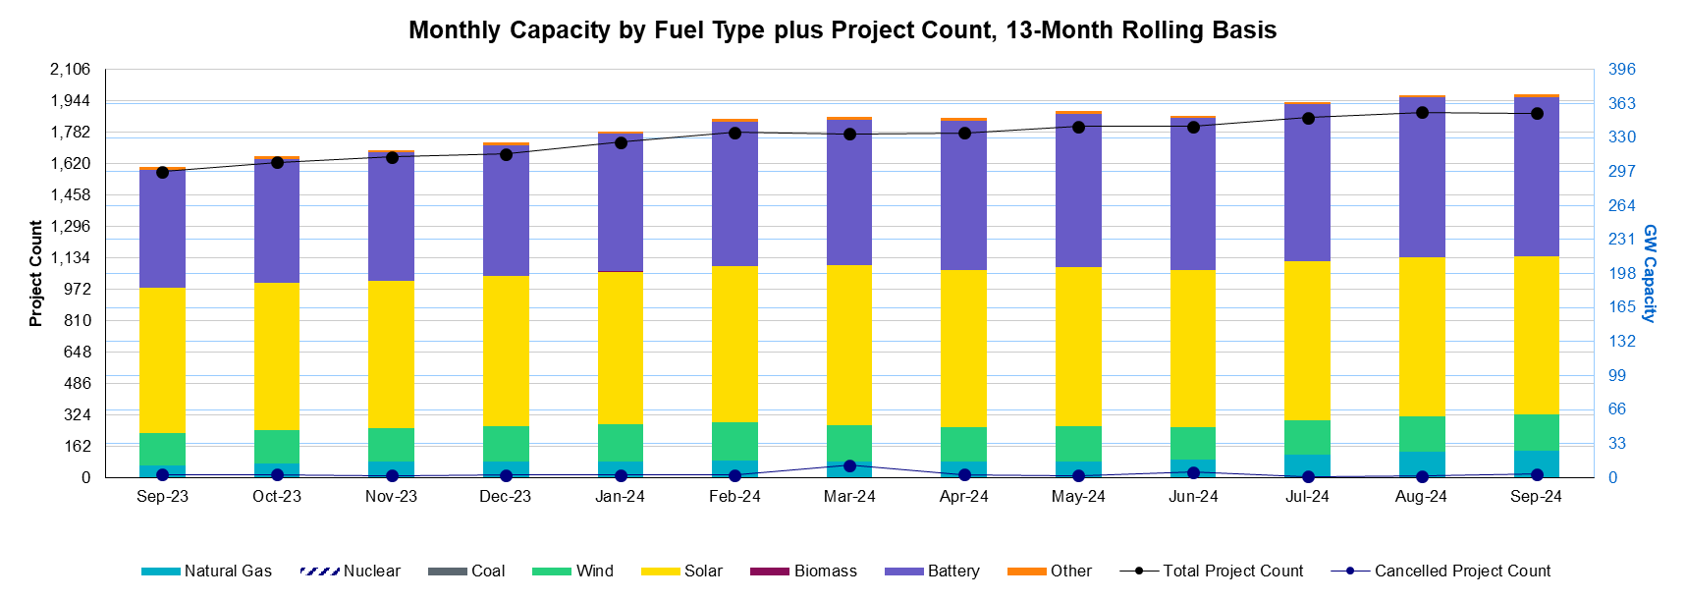
Generation Interconnection Requests
1,881 active generation interconnection requests totaling 372 GW as of September 30th, 2024
(Solar 154 GW, Wind 35 GW, Gas 26 GW, and Battery 154 GW)
(Excludes capacity associated with projects designated as Inactive per Planning Guide Section 5.7.6)

Slide 11
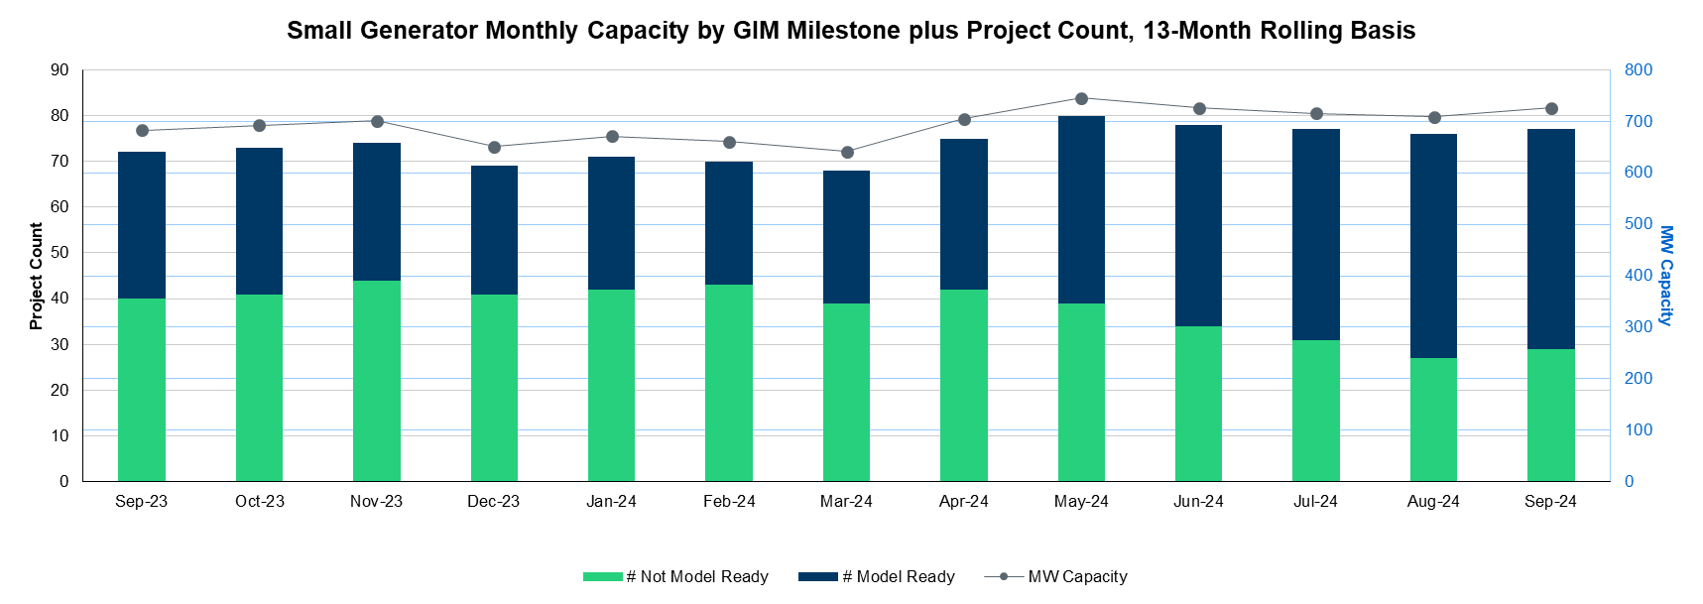
Generation Interconnection Requests
Small Gen- 29 projects Not Model Ready, 48 projects Model Ready

Slide 12
Other contact information
ResourceIntegrationDepartment@ercot.com is distribution list for Resource Integration department
Mailing List
  RESOURCE_INTEGRATION@LISTS.ERCOT.COM

Slide 13

Questions?
Thank you!

