Slide 1
NPRR1254
Overview, Key Concepts, and Impact to the Generation Interconnection Process
RIWG
October 24, 2024

Slide 2
Introduction
ERCOT submitted NPRR1254 on October 2, 2024.
This Revision Request primarily addresses the need for Resource Entities to provide initial Resource Registration data one month prior to existing PLD deadlines (four months prior to inclusion in ERCOT Network Operations Model).
PRS approved the first vote on the combo ballot 10/17/2024. Will need to come back November for IA approval. Implementation to not consider upcoming projects targeting PLD under the current calendar, so as not to cause delays.

Slide 3
NPRR1254
Modeling Deadline for Initial Submission of Resource Registration Data

Slide 4
NPRR1234 – Modeling Deadline for Initial Submission of Resource Registration Data
This NPRR requires Resource Entities to submit the initial Resource Registration data for a Generator Interconnection or Modification (GIM) project, required by paragraph (6) of Planning Guide Section 6.8.1, Resource Registration, four months prior to target inclusion in the ERCOT Network Operations Model.
This new deadline provides a one-month period for ERCOT and the Resource Entities to address errors or deficiencies consistent with the process outlined in Planning Guide Section 6.8.2, Resource Registration Process. Without this period, ERCOT does not have sufficient time to process the initial data submissions, which often consist of voluminous and complicated data, requiring discussion with the submitter to correct errors or deficiencies prior to ERCOT modeling.
ERCOT has been receiving a growing number of these submissions 1-2 days before the current deadline in paragraph (3) of Section 3.10.1.
Language in Section 3.10.1 paragraph (3) has been revised to include a reference to an additional paragraph (4), including a table referencing the month out deadline and previous three-month timeline prior to the physical equipment change.

Slide 5
Relevant Sections for Change
Planning Guide Section 6.8.1 paragraph (6):
“As required by Section 5, Generator Interconnection or Modification, Generation Resources shall provide accurate initial data for inclusion in the ERCOT Network Operations Model. The data will be used to model future generation for Steady State Working Group (SSWG), Dynamics Working Group (DWG), and System Protection Working Group (SPWG) base cases.”
Planning Guide Section 6.8.2 paragraph (2) & (4):
“Upon receipt of the Resource Registration data, ERCOT shall review the completeness and accuracy of the data submission. ERCOT shall provide notice of acceptance and/or deficiencies to the Resource Entity.”
“If ERCOT’s notice reports deficiencies through the data submission process or through subsequent validation processes, the Resource Entity shall make necessary changes specified and re-submit the Resource Registration data as necessary, until acceptance of the total set of registered data is granted.”

Slide 6
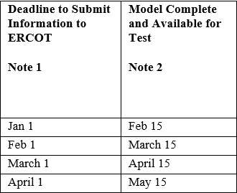
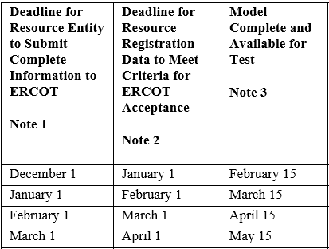
NPRR1234 – Registration Data – Additional Details
3.10.1 Paragraph (3)
Current
3.10.1 Paragraph (4)
New addition

