Slide 1
RTC+B Task Force
Update
Matt Mereness
RTCBTF
October 22, 2024

Slide 2
Outline
Brief Program update: RTC+B Program Update from Board T&S
Reminder of RTCBTF Review Cycle
Reminder of Scope of RTC+B Program
Current Issues for RTCBTF Review
Update on RTCBTF Policy Parameters
Proceed with rest of RTCBTF Agenda

Slide 3
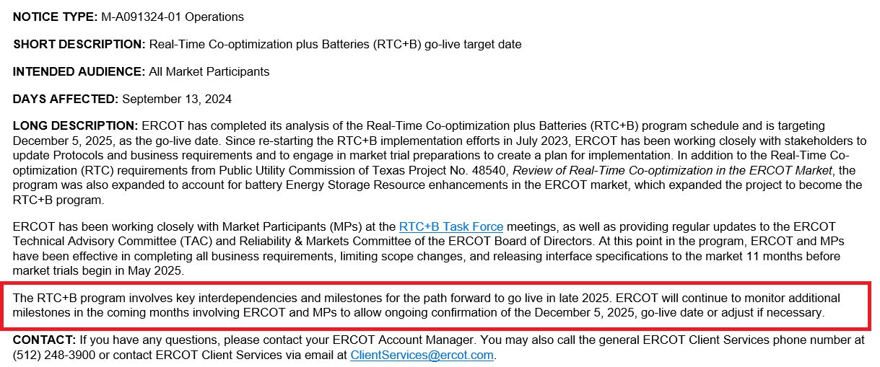
RTC+B Program Go-Live Announcement
Links to:
Market Notice
Press Release
Trending Topic Paper

Slide 4
RTC+B Program Update
(excerpt from October Board T&S RTC Update)

Slide 5
Sequence and Dates for Market Trials to Go-Live
30-day Market Notice
11/5/25
Start
5/5/25
Start
7/7/25
Start
9/2/25
Go-Live
12/5/25*
May 2025
June 2025
July 2025
Aug 2025
Sep 2025
Oct 2025
Nov 2025
Dec 2025
QSE Scorecards & Exit Criteria for each Trial Phase
RTC QSE Submission Testing
(Submit COP, RT AS Offers,
DAM Virtual AS, Outages for ESRs)
Open-loop RTC SCED
(QSE offers, SCED non-binding award/dispatch)
Ongoing Open-Loop
& Periodic Closed-loop SCED/LFC
(QSE RTC offers and telemetry to support closed-loop frequency control test 2-3 tests of 2-4 hour durations)
Transition to Go-Live
Upon completion of testing, confirmation of ERCOT and market readiness for Go-Live.
RTC QSE Telemetry Check-out (QSEs add/verify new telemetry points for UDSP, New ramp rates, ESR telemetry)
QSE Telemetry Tests
(Individual QSE to follow UDSP and support new ramp rate and ESR telemetry)
Day-Ahead Market
(Non-binding DAM using QSE offers for at least 2 tests)
* Go-Live date reflects 12/5/2025 as first Operating Day
where 12/4/2025 is planned software migration.

Slide 6
Plans for Meetings and Review Cycles
Reminder of RTC+B Program Scope
  RTC Key Principles were approved to lay foundation of NPRR1007-1013
    Consolidated Key Principles: https://www.ercot.com/files/docs/2020/04/01/RTC_Key_Principle_Quick_Reference.docx
    Library of Key Principles: https://www.ercot.com/mktrules/puctDirectives/rtCoOptimization
  Battery Key Topic Concepts approved to lay foundation of NPRR1014
    https://www.ercot.com/mktrules/keypriorities/bes
  RTC State-of-Charge accounting in NPRR1204
Objective is to present concepts or issues that need to be resolved for an effective implementation.
  Coordinating timelines for interface requirements and testing,
  Providing the forum for any analysis or policy decisions (such as parameter values)
  Coordinating market readiness and cutover activities,
  Review draft Revision Requests or other artifacts necessary to successfully implement the program within the identified timeframes, and discussing other details as needed.
Lessons learned from RTCTF to avoid being delayed in decisions:
  Meeting #1: Initial concept presented by ERCOT staff
  Meeting #2: Comments and alternatives presented by MPs
  Meeting #3: RTCTF consensus achieved or escalated to TAC for a vote to decide the matter.

Slide 7
Reminder of Details Scope of RTC+B Program
(Excel version posted with meeting)

Slide 8
RTCBTF Issues List
Parameter and Policy dates defined
RTC Simulator Analysis and priorities of what to study
More details coming for Market Readiness progression

Slide 9
Update on RTCBTF Policy Parameters
When RTCTF developed RTC key principles and protocols in 2019-2020 with MPs there was agreement to focus on mechanics of RTC design and “not get stuck” on challenging or technical details that could be resolved at a later date and implemented as parameters.
ERCOT flagged those items as TAC approved parameters for RTC in protocols:
  Example: Protocol 6.5.7.3 (5) (d) Proxy Ancillary Service Offer price floors shall be approved by TAC and posted on the ERCOT website.
This current approach has some issues:
  In recent years, ERCOT has been migrating away from Other Binding documents, such as TAC approved processes or values.
  It is worth noting these values were not designated as “TAC approved” so they could be frequently changed, rather they were deferred until they could be settled.
  There is a risk that some issues may be controversial and the “TAC approved parameter” may be appealed with no clear governance to follow to ensure timely resolution.
As such ERCOT legal is advising that ERCOT work with RTCBTF to sponsor a single NPRR to capture the “TAC approved items” and the values being vetted in the coming months into protocols.

Slide 10
Proceed with rest of meeting (likely longer meeting today)
3. Scaling Factors for Ramp sharing
    First round review
4. Review RTC and ESR Clarifying Revision Requests
    RTC- NPRR1245 (PRS unanimous approval)
    ESR- NPRR1246, NOGRR268, PGRR118, OBDRR52 (if no further discussion, ERCOT will file comments that RTCBTF review complete)
5. Market Trials Plan Review
    Final/4th Review and will be seeking TAC endorsement
6. Discuss Approach to Training/Readiness
    Second review to solicit any feedback, no TAC endorsement needed
7. Review of Parameters for AS Proxy Offer Curves
    Second round review- soliciting market feedback
8. RTC Simulator update
    Congestion Case – 07/10/2023
    Scarcity Case – 09/06/2023
    Reliability Deployment Adder Case – 10/20/2023
9. Placeholder for MPs Discussion of AS Demand Curves
    IMM Discussion
ERCOT has posted all 2025 RTCBTF meeting dates on calendar
Going forward RTCBTF meeting can include RTC+B “Technical Workshops”
At end of meeting, discuss planned and potential topics for November 13th RTCBTF meeting.

