Slide 1
Long-Term Load Forecast Schedule
Sam Morris and Kate Lamb
Load Forecasting & Analysis

Slide 2
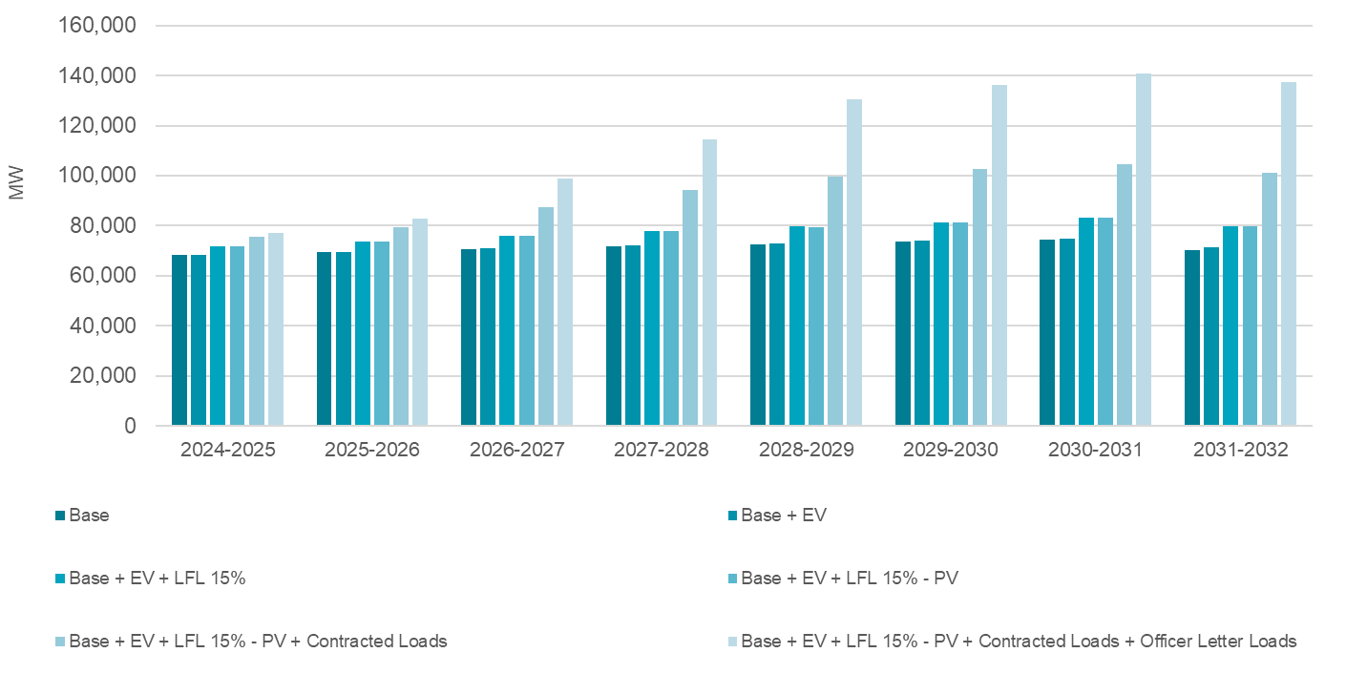
December LTLF Update
Updates to Base Economic Forecast, Large Flexible Load Forecast, Electric Vehicle Forecast, and Roof-top PV Forecast
Contract and Officer Letter adjustments will remain the same
Results will be presented at RPG and SAWG and posted to the website in December

Slide 3
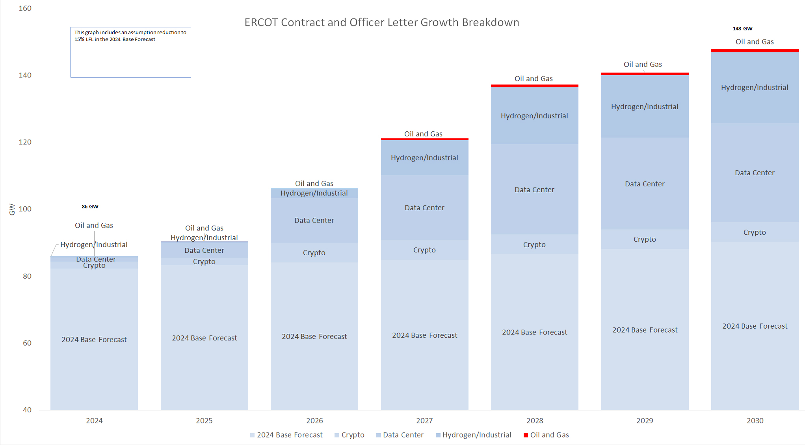
March/April Update
Base Economic Forecast, Electric Vehicle Forecast, Large Flexible Load Forecast, and Roof-top PV Forecast will remain the same as our December Posting
RFI for new updated Contracts and Officer Letter ramps will be sent out in January
Contract and Officer Letter loads in the LTLF will reflect the updates of the RFI and be comparable to the RTP study

Slide 4
Questions?

