Slide 1
Credit Exposure Update
Market Credit Work Group
ERCOT Public
October 23, 2024

Slide 2
Monthly Highlights: August 2024 – September 2024
Market-wide average Total Potential Exposure (TPE) decreased from $1.88 billion in August 2024 to $1.72 billion in September 2024.
  TPE decreased due to both lower real-time/day-ahead prices and forward adjustment factors
    Discretionary Collateral is defined as Secured Collateral in excess of TPE,CRR Locked ACL and DAM Exposure
  Average Discretionary Collateral decreased from $4.26 billion in August 2024 to $3.92 billion in September 2024
No unusual collateral call activity

Slide 3
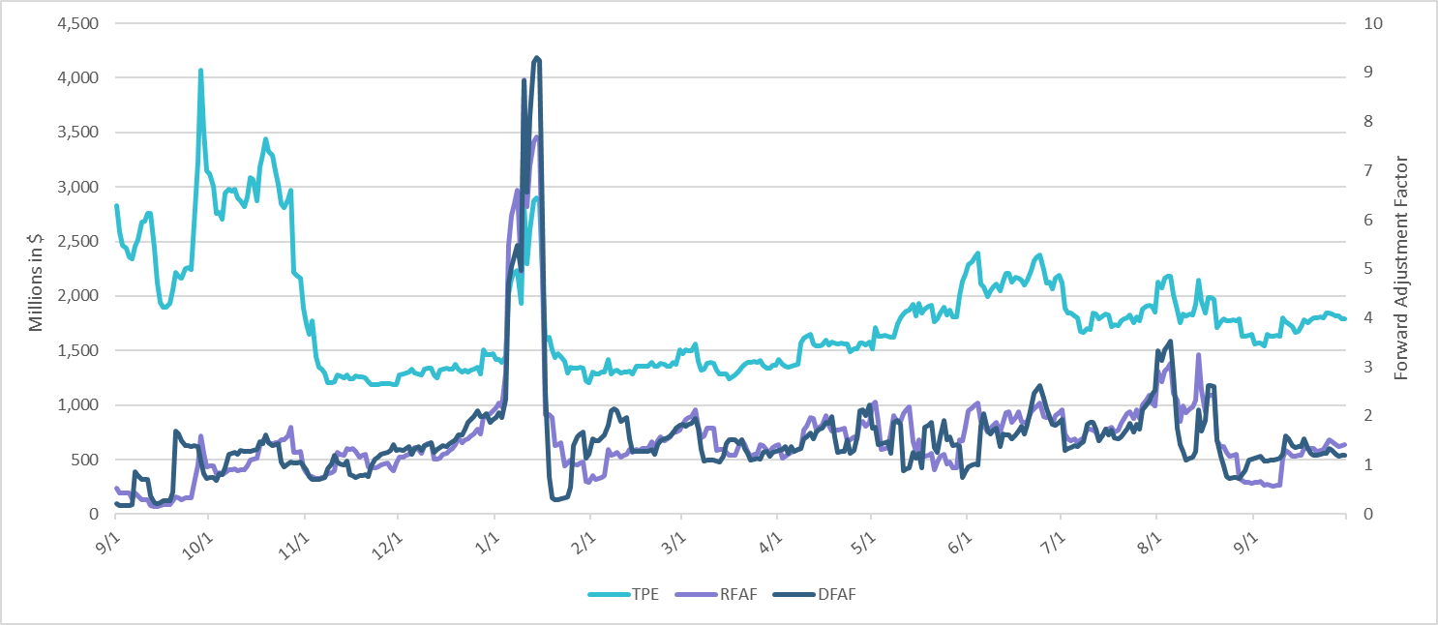
TPE and Forward Adjustment Factors: September 2023 – September 2024

Slide 4
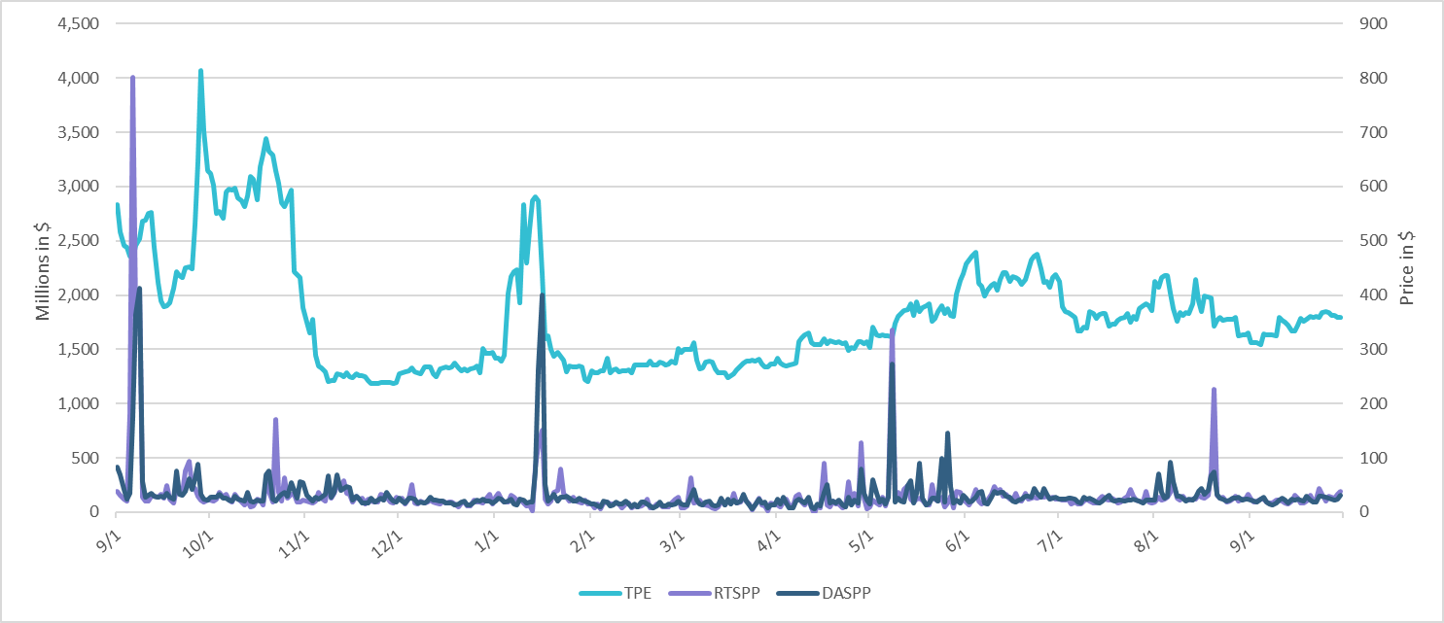
TPE/Real-Time & Day-Ahead Daily Average Settlement Point Prices for HB_NORT:H September 2023 – September 2024

Slide 5
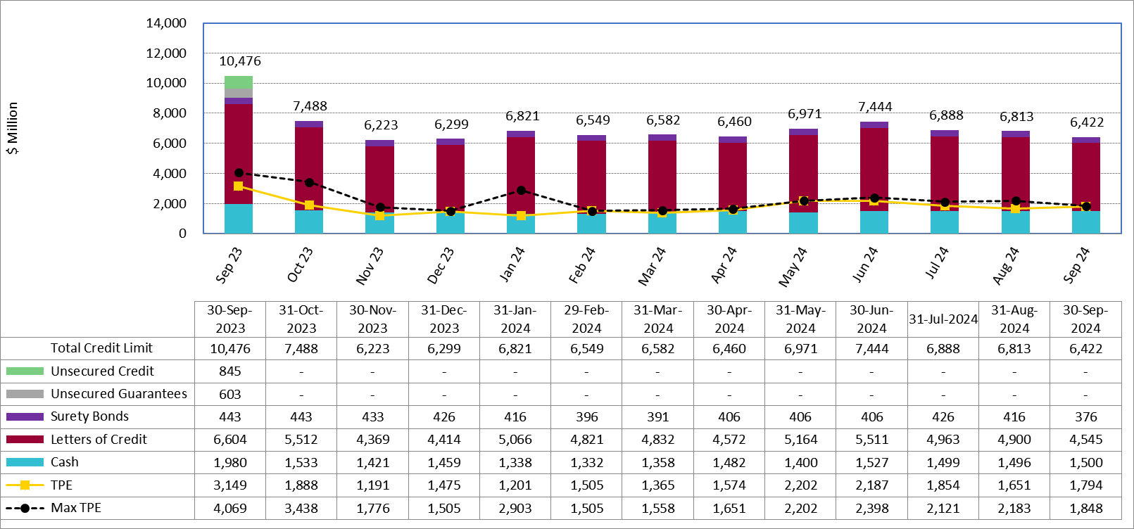
Available Credit by Type Compared to Total Potential Exposure (TPE):
September 2023 – September 2024
Numbers are as of month-end except for Max TPE
Max TPE is the highest TPE for the corresponding month

Slide 6
Issuer Credit Limits vs Total LC Amounts Per Issuer: End-August 2024
As of September 30, 2024
There are a total of 39 banks that have issued LCs.

Slide 7
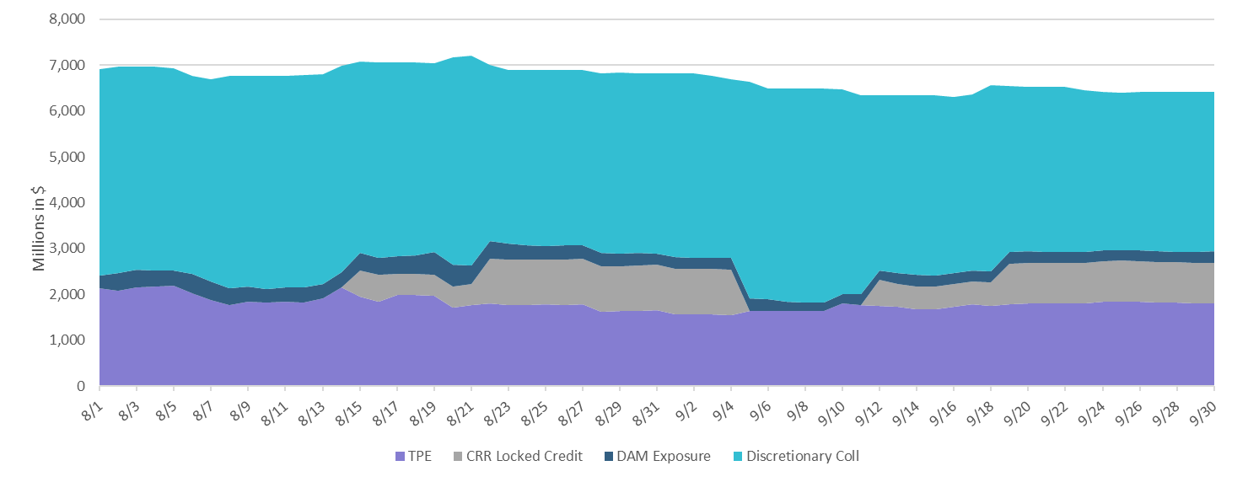
Discretionary Collateral August 2024 – September 2024

Slide 8
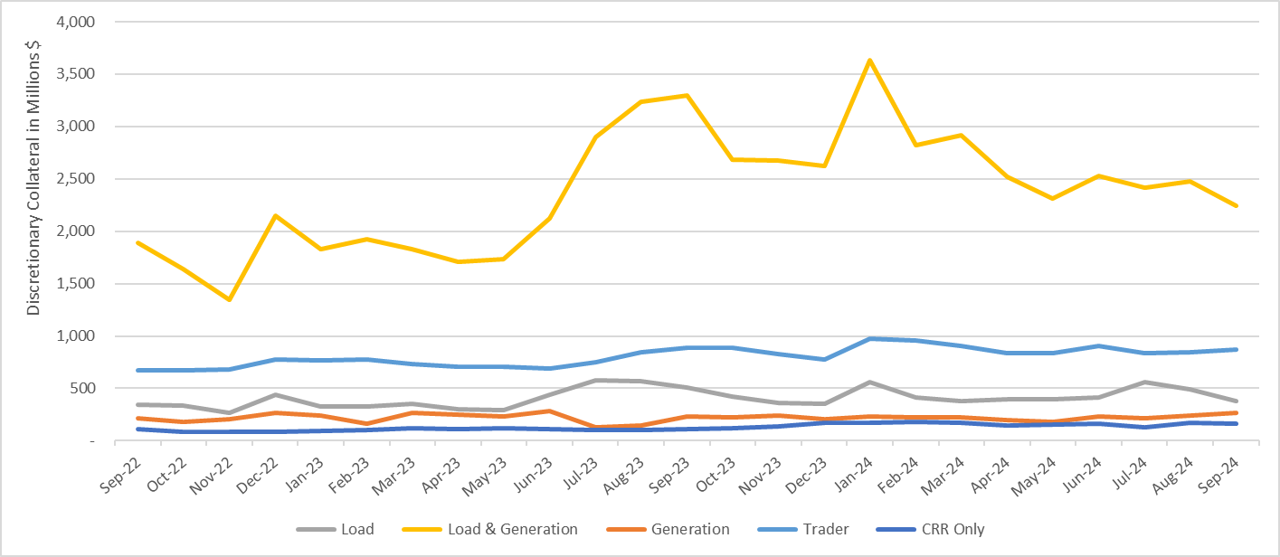
Discretionary Collateral by Market Segment September 2022 - September 2024
* Discretionary Collateral adjusted to exclude short pay amounts eliminating data skew

Slide 9
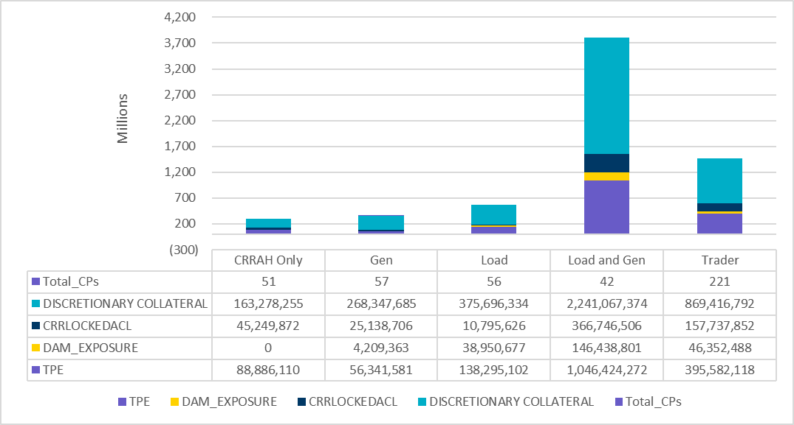
TPE and Discretionary Collateral by Market Segment - September 2024
Load and Generation entities accounted for the largest portion of discretionary collateral

Slide 10
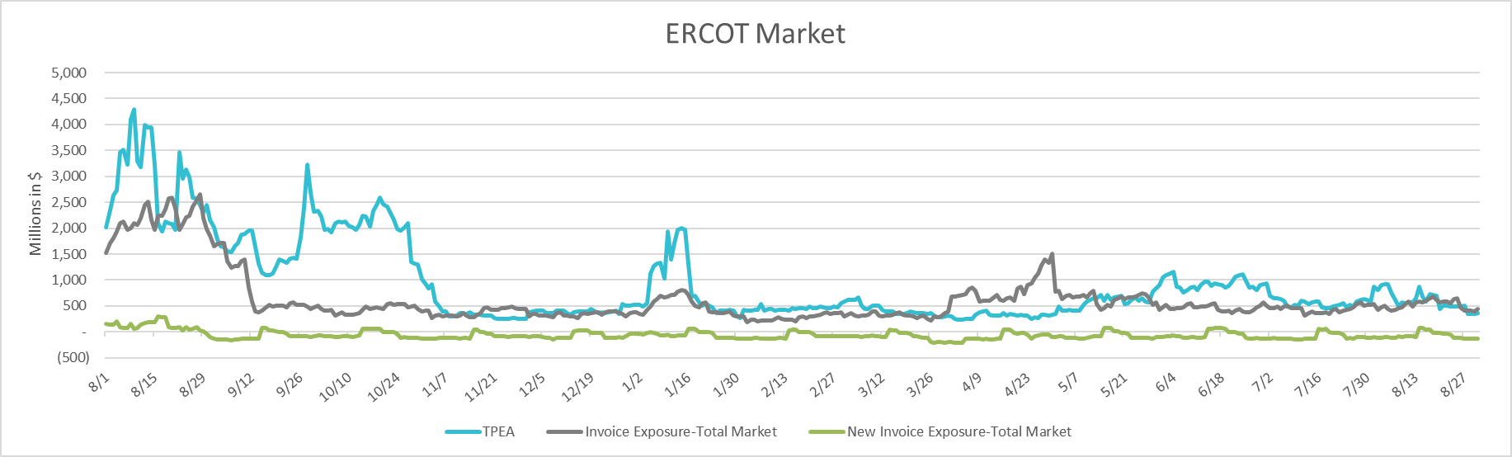
TPEA Coverage of Settlements August 2023 - August 2024
Invoice Exposure | Historical | Future
Existing Invoice Exposure | RTLCNS + UDAA | M1 Days (including current day) Forward Charge Invoice Amounts
New Invoice Exposure | 7 Days Back Net Invoice Amounts (Charges & Credits) | M1 Days (including current day) Forward Net Invoice Amounts (Charges & Credits); Excluding: 1) Securitization Invoices; 2) CRR Auction Invoices; and 3) Subchapter N Funds Distribution Invoice
TPEA closely approximates actual/invoice exposure

Slide 11
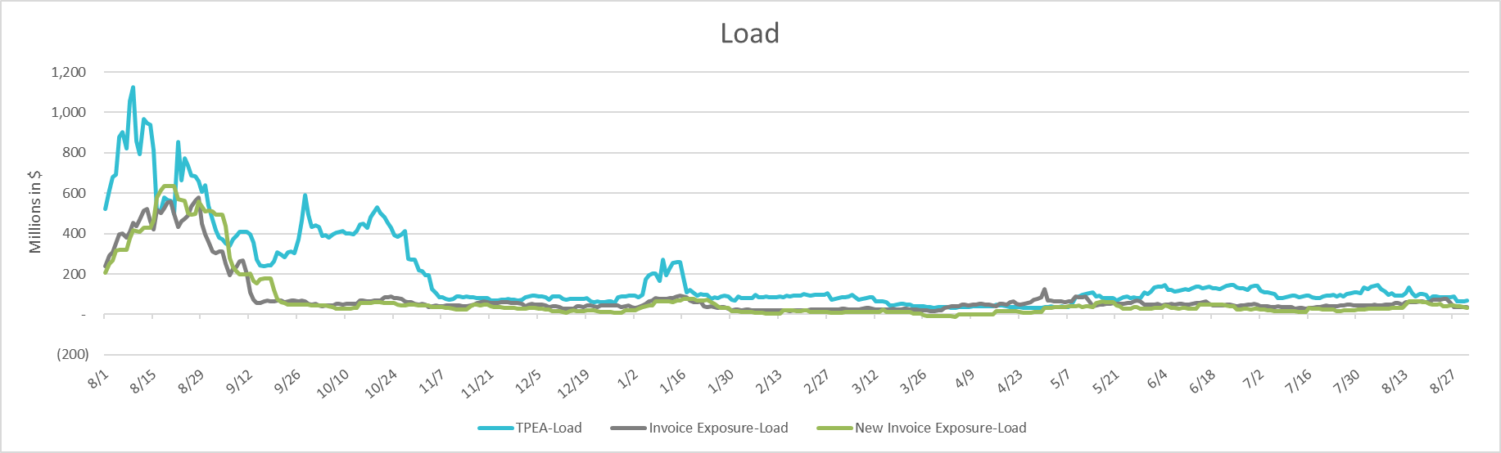
TPEA Coverage of Settlements August 2023 - August 2024
Invoice Exposure | Historical | Future
Existing Invoice Exposure | RTLCNS + UDAA | M1 Days (including current day) Forward Charge Invoice Amounts
New Invoice Exposure | 7 Days Back Net Invoice Amounts (Charges & Credits) | M1 Days (including current day) Forward Net Invoice Amounts (Charges & Credits); Excluding: 1) Securitization Invoices; 2) CRR Auction Invoices; 3) Subchapter N Funds Distribution Invoice
*TPEA exceeds invoice exposure

Slide 12
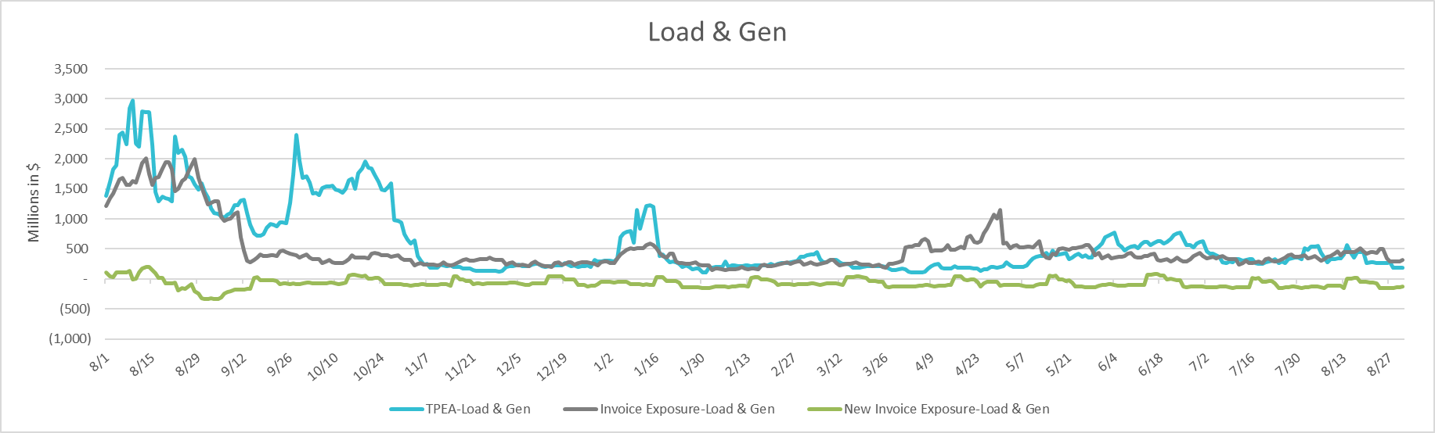
TPEA Coverage of Settlements August 2023 - August 2024
Invoice Exposure | Historical | Future
Existing Invoice Exposure | RTLCNS + UDAA | M1 Days (including current day) Forward Charge Invoice Amounts
New Invoice Exposure | 7 Days Back Net Invoice Amounts (Charges & Credits) | M1 Days (including current day) Forward Net Invoice Amounts (Charges & Credits); Excluding: 1) Securitization Invoices; 2) CRR Auction Invoices; 3) Subchapter N Funds Distribution Invoice
Invoice exposure generally exceeds TPEA

Slide 13
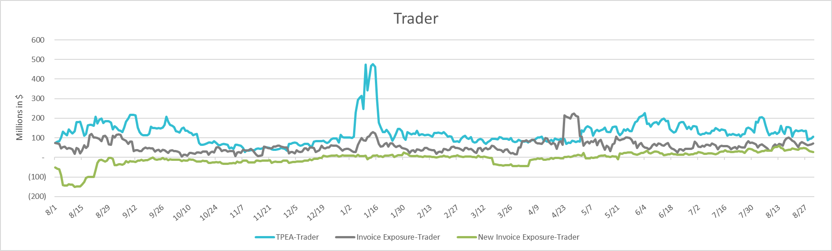
TPEA Coverage of Settlements August 2023 – August 2024
Invoice Exposure | Historical | Future
Existing Invoice Exposure | RTLCNS + UDAA | M1 Days (including current day) Forward Charge Invoice Amounts
New Invoice Exposure | 7 Days Back Net Invoice Amounts (Charges & Credits) | M1 Days (including current day) Forward Net Invoice Amounts (Charges & Credits); Excluding: 1) Securitization Invoices; 2) CRR Auction Invoices; 3) Subchapter N Funds Distribution Invoice
*TPEA generally exceeds invoice exposure

Slide 14
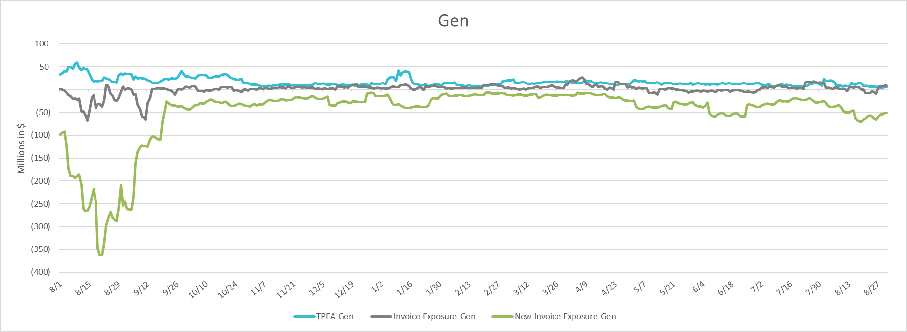
TPEA Coverage of Settlements August 2023 - August 2024
Invoice Exposure | Historical | Future
Existing Invoice Exposure | RTLCNS + UDAA | M1 Days (including current day) Forward Charge Invoice Amounts
New Invoice Exposure | 7 Days Back Net Invoice Amounts (Charges & Credits) | M1 Days (including current day) Forward Net Invoice Amounts (Charges & Credits); Excluding: 1) Securitization Invoices; 2) CRR Auction Invoices; 3) Subchapter N Funds Distribution Invoice
* TPEA generally exceeds Invoice exposure

Slide 15
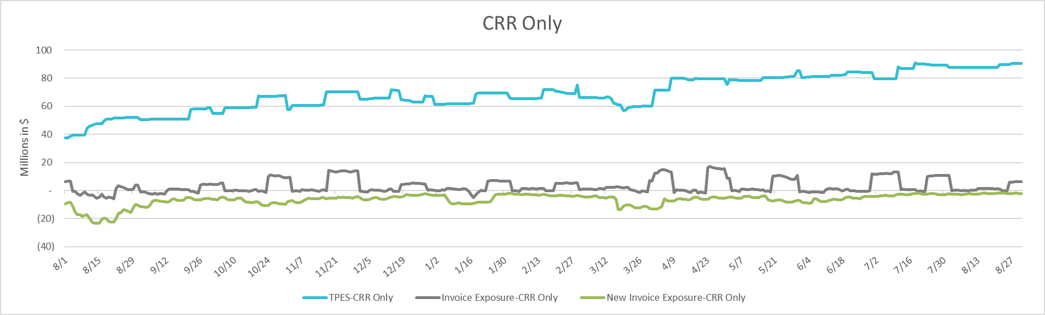
TPEA Coverage of Settlements August 2023 - August 2024
Invoice Exposure | Historical | Future
Existing Invoice Exposure | RTLCNS + UDAA | M1 Days (including current day) Forward Charge Invoice Amounts
New Invoice Exposure | 7 Days Back Net Invoice Amounts (Charges & Credits) | M1 Days (including current day) Forward Net Invoice Amounts (Charges & Credits); Excluding: 1) Securitization Invoices; 2) CRR Auction Invoices; 3) Subchapter N Funds Distribution Invoice
*TPES exceeds actual/invoice exposure

Slide 16
Questions

