Slide 1
EAL Change Proposals: Capping FAF and proposal summary
Sanchir Dashnyam
ERCOT Market Credit Manager
ERCOT Public
October 23, 2024

Slide 2
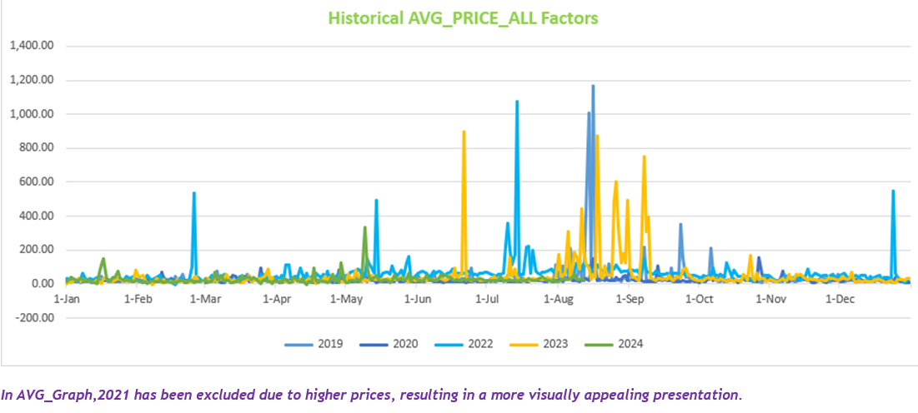
Historical average price comparison

Slide 3
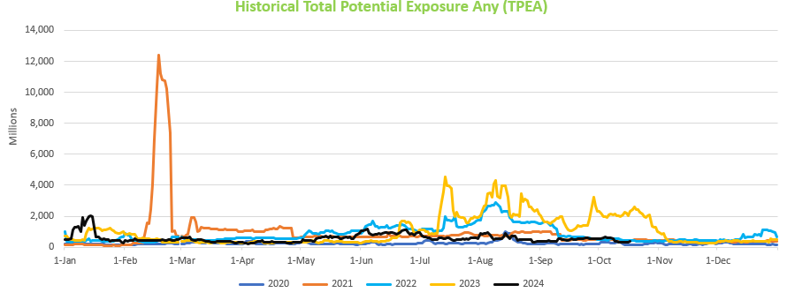
Historical TPEA comparison

Slide 4
Invoice Exposures – Definitions
Invoice exposures – New
M1 days forward invoices + 7 days look back actual invoices
M1 days could range from 10 to 21 days depending on weekends/holidays, MP activity
Invoices exclude M&N securitization invoices, CRR auction invoices, miscellaneous invoices relating to $2B distributed to market for Sec N on 6/21/22
Excluded CARD invoices
TPEA excludes Uri invoices, PUL uplift
Excluded CARD credits from OUT
Oct 2024 data has a correction for M2 days: ERCOT discovered the error (M2=12 instead of 9) and made the correction.
TPEA – Invoice exposures = Gap
Negative gap is when invoice exposures exceed TPEA (less than -$10,000)
Positive gap is when TPEA exceeds invoice exposures (more than $10,000)
Independent amounts posted as a result of NPRR1165 are not included in these calculations. IA’s are part of TPES.
Years reviewed
Conclusions are mostly based on data covering a period of 1/1/2022 through 8/30/2024. Also, we had analyzed 2021 including Yuri and 2020.
Data for 2019 was not presented since activity type classification was implemented in June 2019. Data prior to that did not have the activity type classification.

Slide 5
Current EAL Formula vs. Final proposal (Scenarios #6)
Current: EAL _{q} = Max [IEL during the first 40-day period only beginning on the date that the Counter-Party commences activity in ERCOT markets, RFAF * Max {RTLE during the previous lrq days}, RTLF] + DFAF * DALE + Max [RTLCNS, Max {URTA during the previous lrq days}] + OUT _{q} + ILE _{q}
OUT _{q} = OIA _{q} + UDAA _{q} + UFA _{q} + UTA _{q} + CARD*
Scenario #6: Take Scenario #5D as a basis: EAL = Max [Max {NLE*RFAF during the previous lrq days}, FAF*NLF] + Max [(RTLCNS + UDAA),Max {ULE during the previous lrq days}] + OUT _{q} + ILE _{q}
OUT _{q} = OIA _{q} + UFA _{q} + UTA _{q} + CARD*
  NLE = Net liability extrapolated (Last 14 days RTM Initial Statement Average + Last 14 days DAM Initial Statement Average based on RTM Initial OD)*M1. Match RTM and DAM operating days.
  NLCD = (7 most recent Operating days Real time estimates + 7 DAM ODs day-ahead estimates) – no price cap. Match RTM and DAM operating days. Use actuals if available, if not, use estimates.
  NLF = net liability forward = 1.5 * NLCD
  FAF = 21 day futures prices / most recent days 7 RTM Prices corresponding to the 7 days in NLF. Set a floor of 1 for FAF.
  ULE = unbilled liability extrapolated (Last 14 days RTM Initial Statement Average + Last 14 days DAM Initial Statement Average based on RTM Initial OD)*M2. Match RTM and DAM operating days.
  RFAF_{i} = 21-day future prices / 14 days RTM Prices corresponding to the 14 days in NLE_{i.} Cap RFAF at 1.5. RFAF is applied against NLE. There is a floor for RFAF at 0.50. For each RFAF, we are using the corresponding Operating Day (and not Invoice Business Day) RTM settled prices, which match the respective operating Days in the NLE.
  For MCE use similar RFAF applied to NLE (No floor Or Cap) for a minimum of 2 days for load.
  Look-back periods:
    summer months: 40 days from May 16 through Sep 15
    non summer months: 20 days lookback from Sep 16 through May 15.
    Traders 20 days irrespective of months.
  Strip out impact of CARD invoices from both invoice exposures and TPEA. This is for analysis purposes only (CARD will stay in TPEA in implementation).

Slide 6
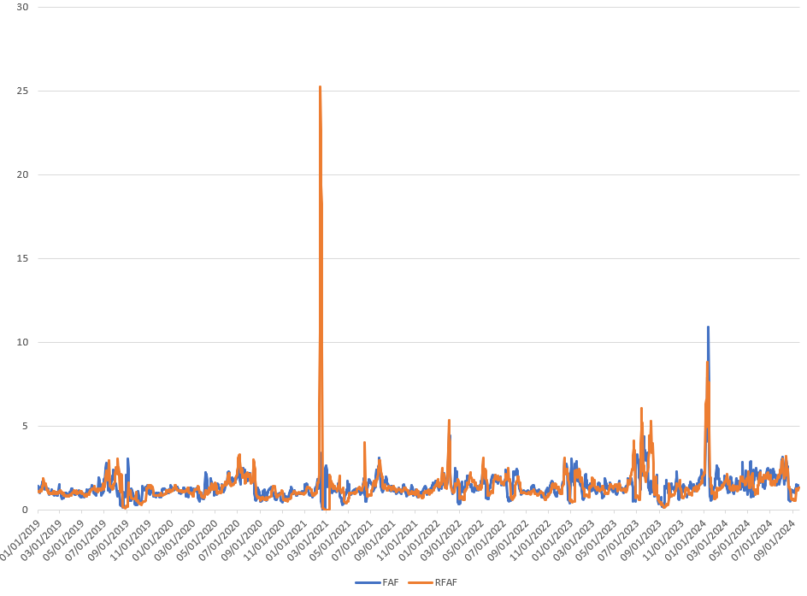
Capping FAF: RFAF vs FAF, Last 5 years
By definition, FAF relies on the most recent 7 days average RTM prices corresponding to the 7 days in NLCD/NLF, which in turn reflects the most recent 7-day activity.
As such, FAF is “more current” or “more sensitive” or better aligned with the futures prices, since we are not waiting for the settled prices (as compared to RFAF, which uses settled 14-day average RTM prices).

Slide 7
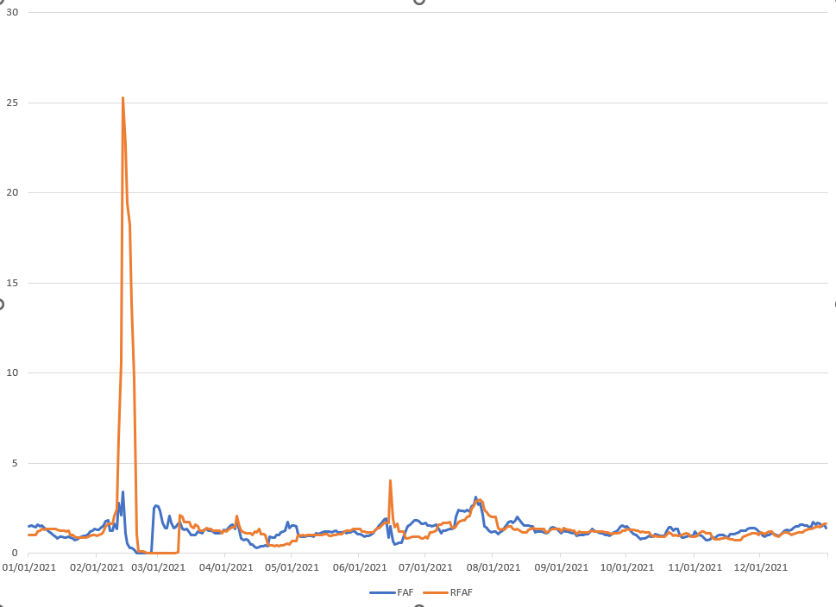
RFAF vs FAF, Winter Storm Uri
During Uri FAF topped out at 3.41. The same day on 2/13/2021 RFAF reached 25.3.

Slide 8
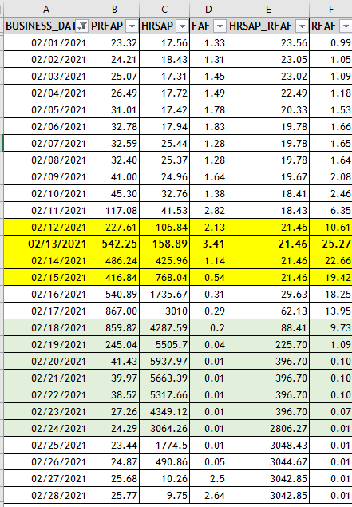
FAF – cap is not needed, Winter Storm Uri
During Uri FAF topped out at 3.41 vs. RFAF which reached 25.3 on 2/13/21 (unadjusted; eventually adjusted to 10.61).
The reason for the difference is due to average prices used in the denominator since numerator is the same for both RFAF and FAF (21 day average futures prices): RFAF uses 14 day settled historical RTM prices vs. FAF uses most recent 7 days historical average prices.
Therefore, RFAF tends to “lag” and is more volatile to the upside as opposed to FAF.
FAF still captures the market volatility, but the peaks are subdued since it is aligned to the most recent prices.
In essence, FAF auto corrects itself: as futures reflect high prices it starts going up, but, as soon as those higher futures prices get realized and included in the most recent 7 day prices, the denominator starts going up. Therefore, because of this self correcting feature, ERCOT does not believe we need to put a cap on FAF.
The current approach could be excessively conservative under certain circumstances by the virtue of potentially applying high RFAF against MaxRTLE, which is already M1 days extrapolated.
The proposed framework will correct this, while still covering the exposures most of the time.

Slide 9
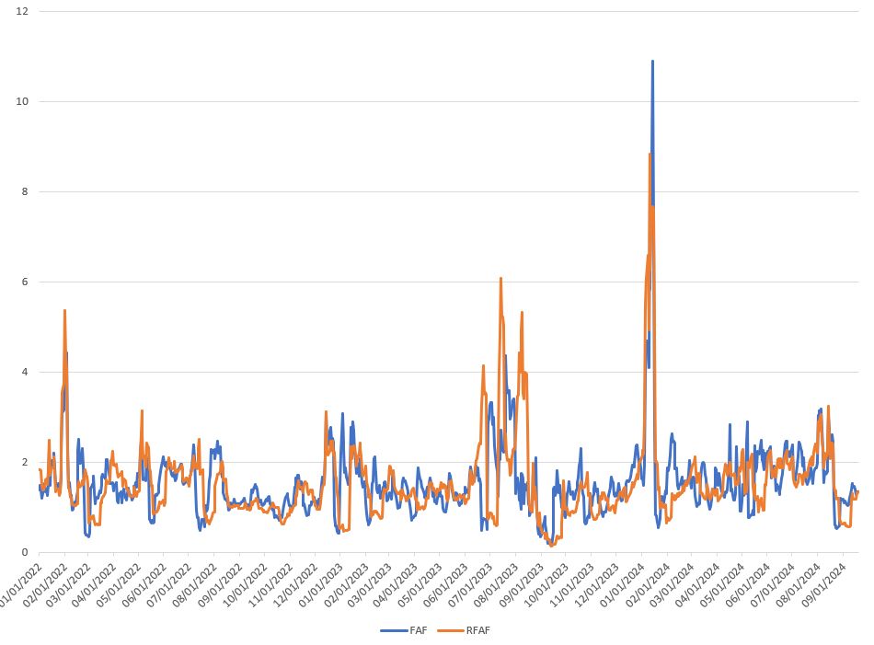
RFAF vs FAF, 2022-current
Peak FAF during the last five years occurred during Winter Storm Heather at almost 11.

Slide 10
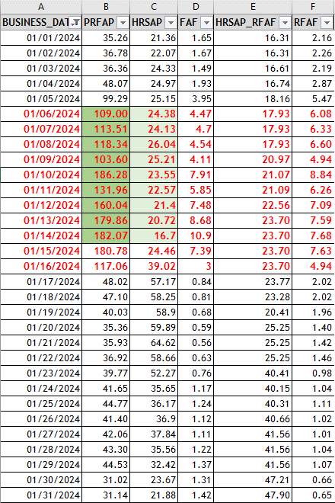
FAF – cap is not needed, Winter Storm Heather
During Heather, historical most recent 7-day prices leading up to the event were subdued and in fact started going down Jan 10-14, while the futures kept going up.
On 1/14/24, most recent historical 7-day prices averaged 16.7 while 21-day futures average prices reached 182. FAF reaching 10.9 is reasonable and expected.
As soon as the actual realized prices start going up (and rolls into the denominator), FAF rapidly self corrects and drops below 1 in a couple of days.
Under the existing framework RFAF is applied against MaxRTLE, which is extrapolated over M1 days. Under the new proposal FAF is applied against the most recent 7-day activity multiplied by 1.5 factor (NLF).
Thus, the proposed framework will correct the excessive overcollateralization driven by RFAF*MaxRTLE function, especially when RFAF shoots up and/or stays elevated.
By design, FAF self corrects itself and putting a cap on FAF will reduce the effectiveness of the proposed formula.

Slide 11
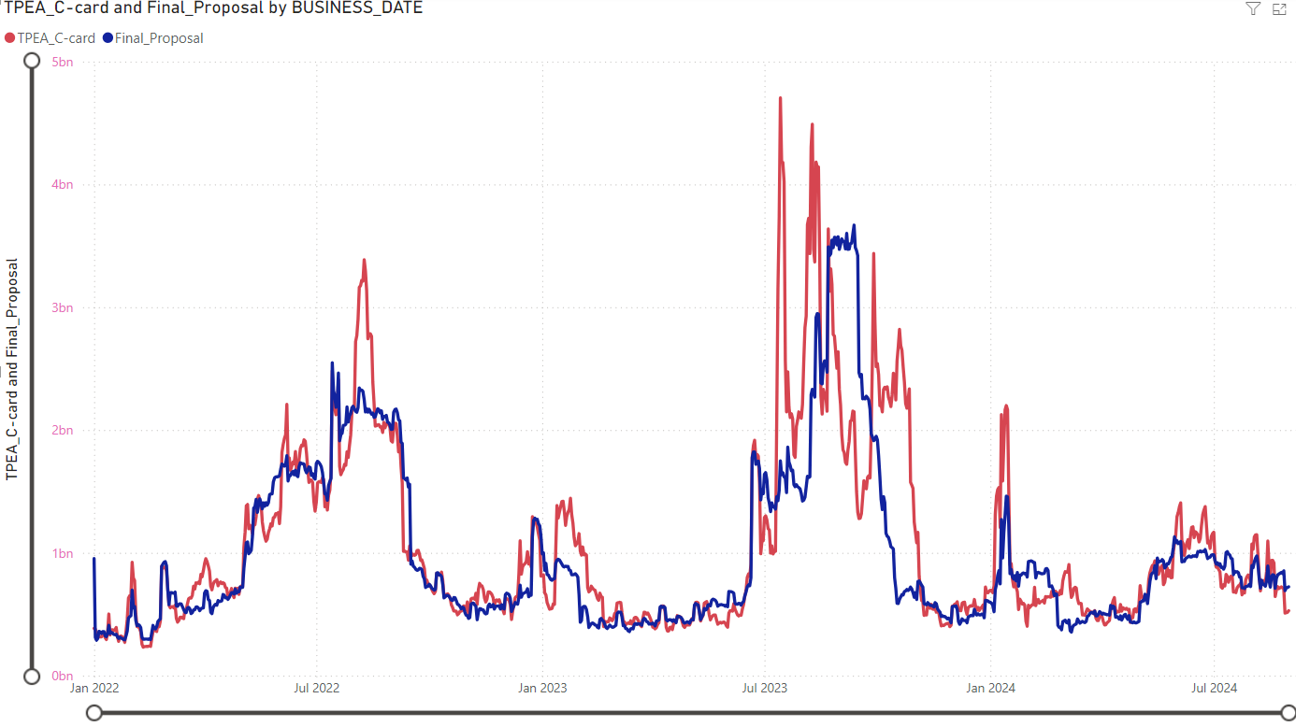
TPEA-Current vs TPEA for Final proposal: 1/1/2022 through 8/30/2024
Overall market
“Double top/higher 2nd top” issue resolved
Lower peaks and higher valleys
Less sharp up/down volatility
During summer, exposures reach a plateau and fall off as the look back period rolls off

Slide 12
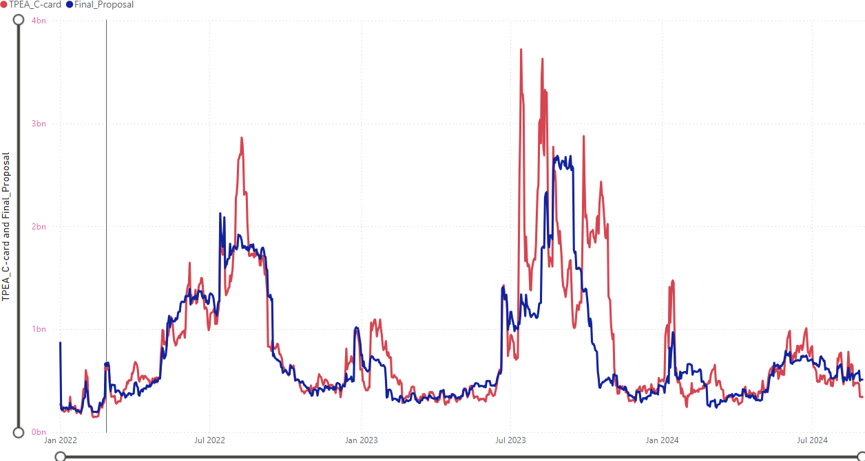
TPEA-Current vs TPEA for Final proposal: 1/1/2022 through 8/30/2024
Load & generation

Slide 13
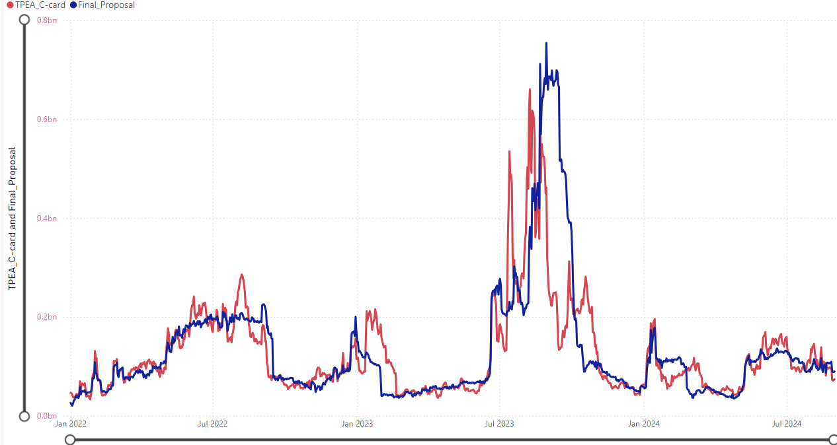
TPEA-Current vs TPEA for Final proposal: 1/1/2022 through 8/30/2024
Load

Slide 14
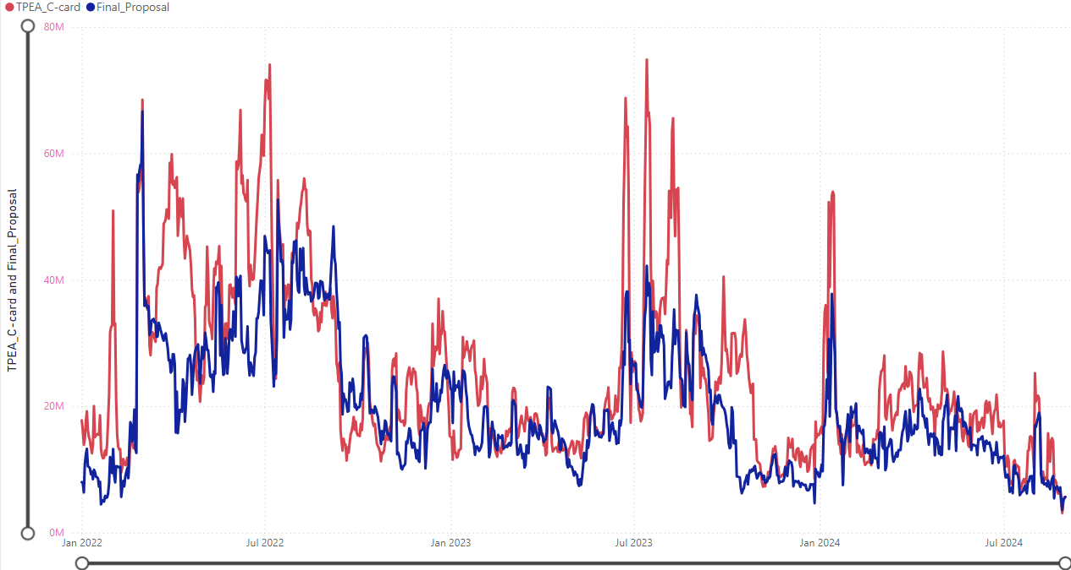
TPEA-Current vs TPEA for Final proposal: 1/1/2022 through 8/30/2024
Generation

Slide 15
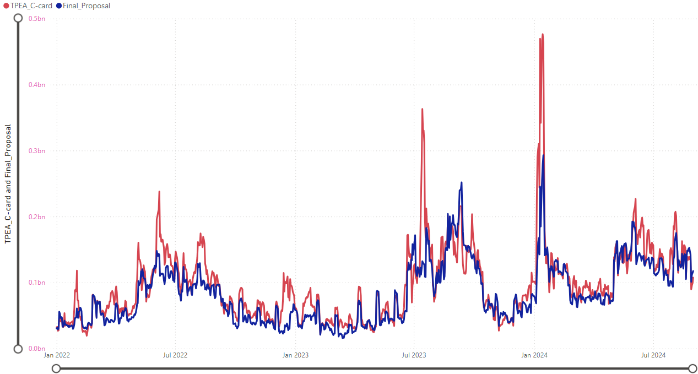
TPEA-Current vs TPEA for Final proposal: 1/1/2022 through 8/30/2024
Traders

Slide 16
Negative and Positive Gaps: overall 1/1/22 through 8/30/24

Slide 17
Negative and Positive Gaps: Elliott (December 2022)

Slide 18
Negative and Positive Gaps: Heather (January 2024)

Slide 19
Negative and Positive Gaps: Summer of 2022

Slide 20
Negative and Positive Gaps: Summer of 2023

Slide 21
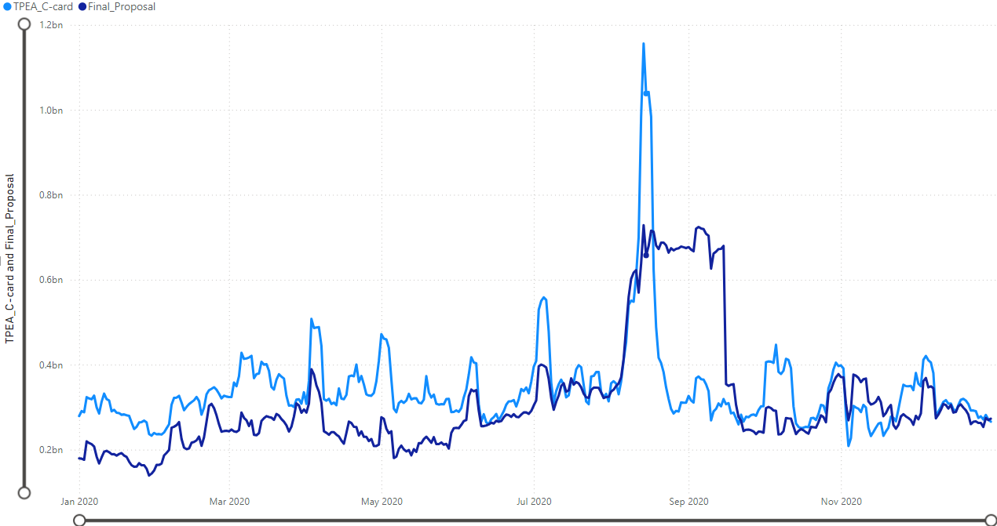
TPEA-Current vs TPEA for Final proposal - 2020
“Double top/higher 2nd top” issue resolved
Less sharp up/down volatility
During summer exposures reach a plateau and fall off as the look back period rolls off
Until July 9, 2020, M1 value was zero in the final proposal due to NPRR907 (M1 values were not stored prior to that date). Data after July 10, 2020 is a more accurate representation.

Slide 22
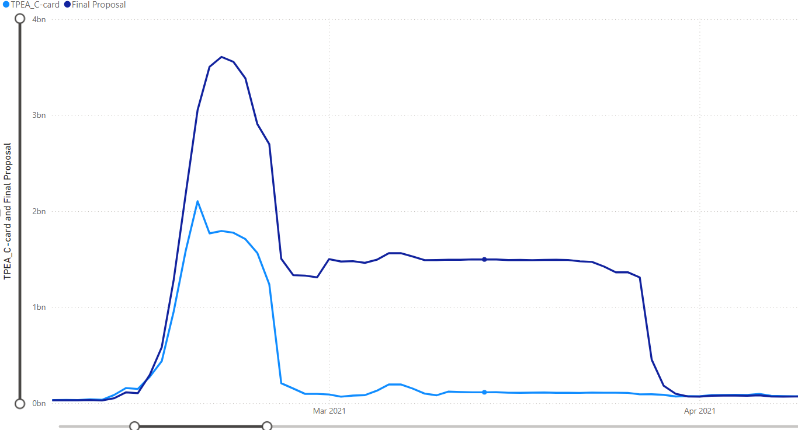
TPEA-Current vs TPEA for Final proposal – Uri
TPEA-Current data is historical “as is” data from ERCOT credit database. During Uri ERCOT has made a number of manual adjustments (please see the details in the attached presentation made to CWG/MCWG on March 25, 2021).
Considering the extent of manual changes made during Uri and their timing, it was determined ineffective to go back and re-compose the historical data based on the current methodology.
Short pays were not excluded from the TPEAs above.

Slide 23
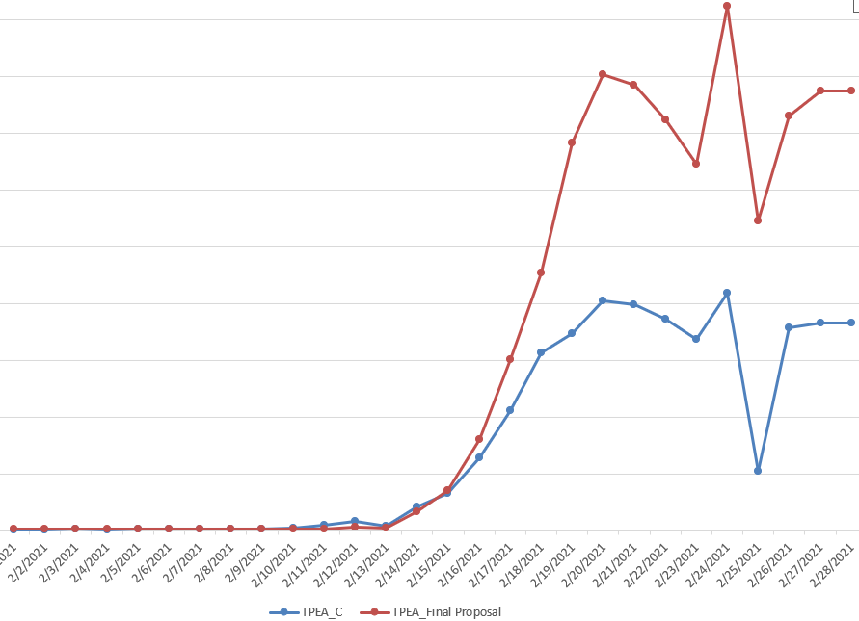
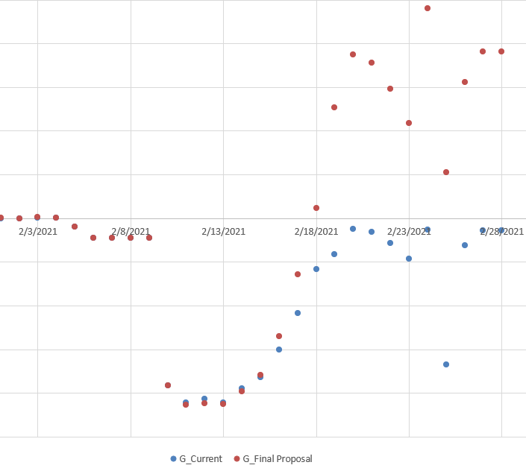
TPEA & Gap behavior during Uri: Sample #1

Slide 24
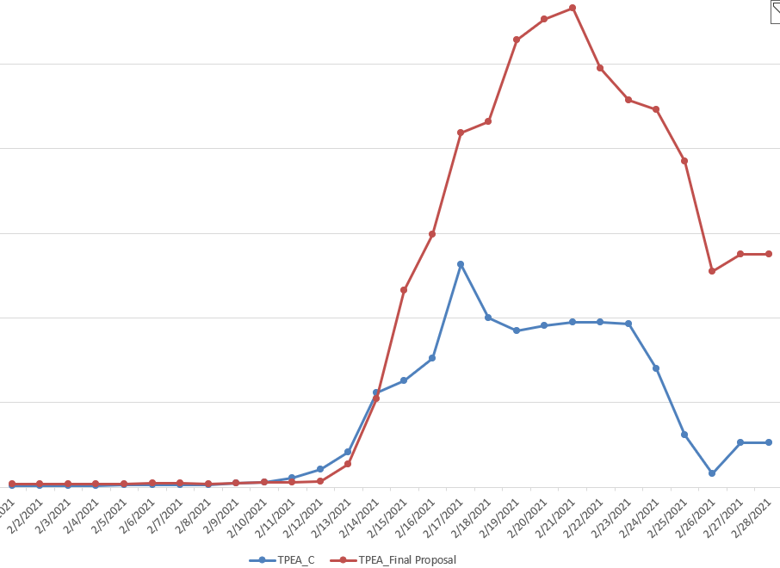
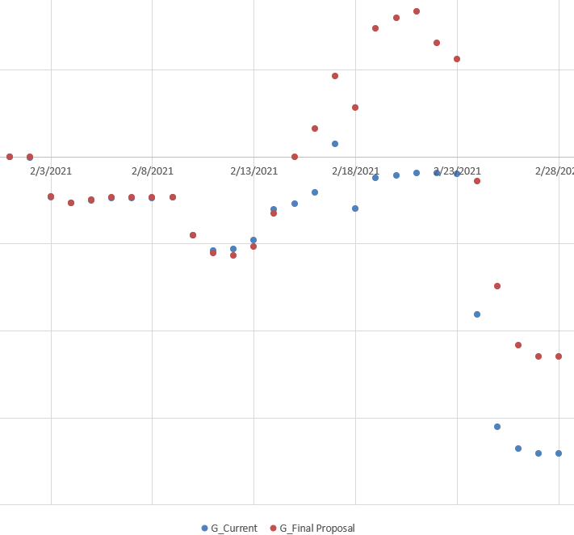
TPEA & Gap behavior during Uri: Sample #2

Slide 25
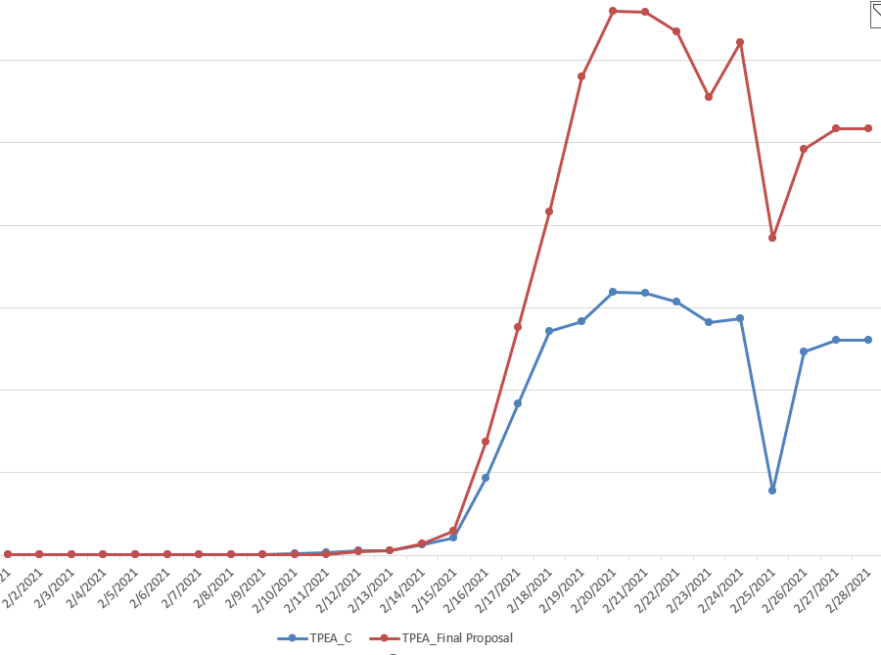
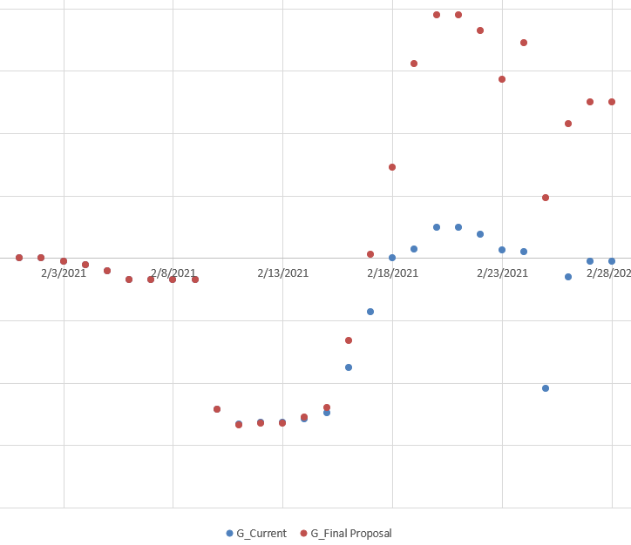
TPEA & Gap behavior during Uri: Sample #3

Slide 26
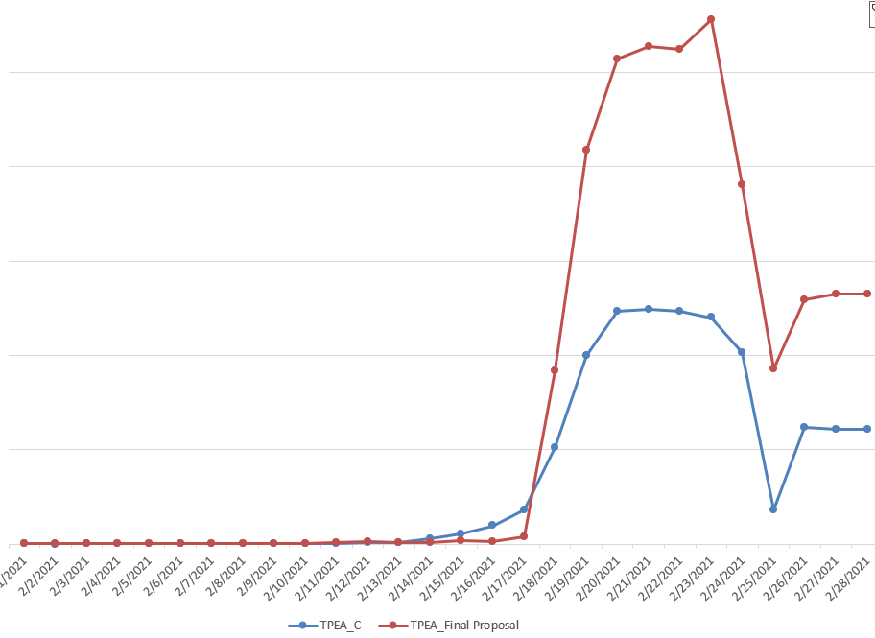
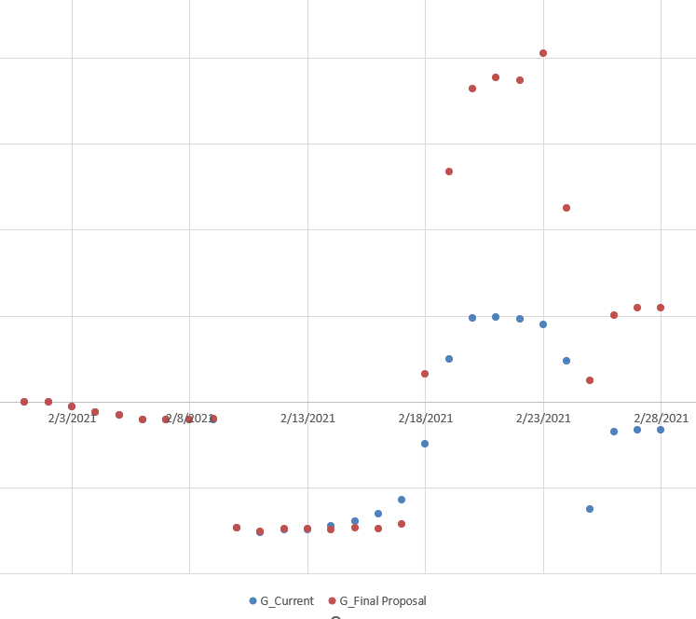
TPEA & Gap behavior during Uri: Sample #4

Slide 27
Questions?

Slide 28
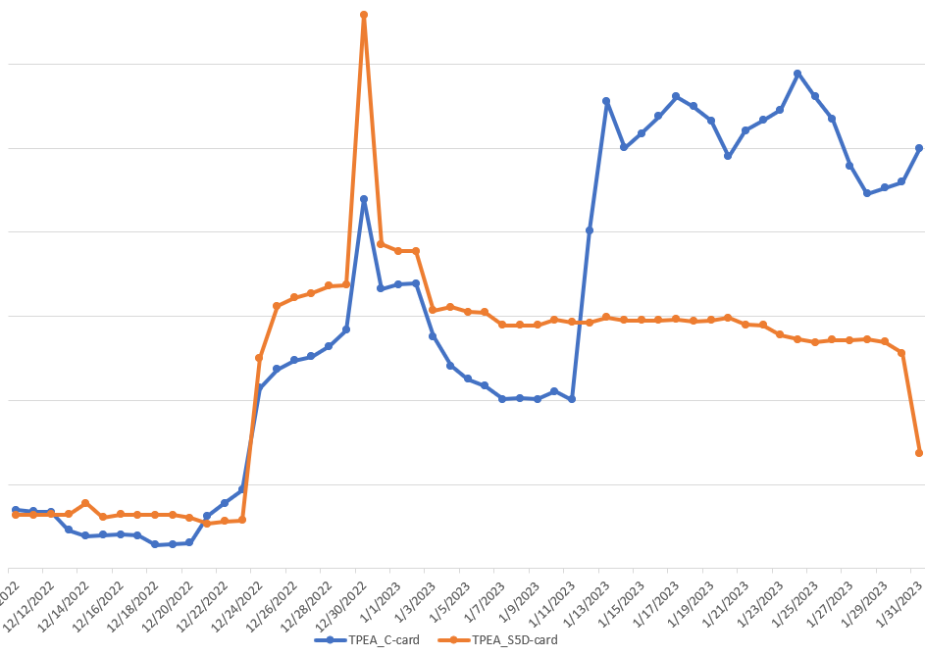
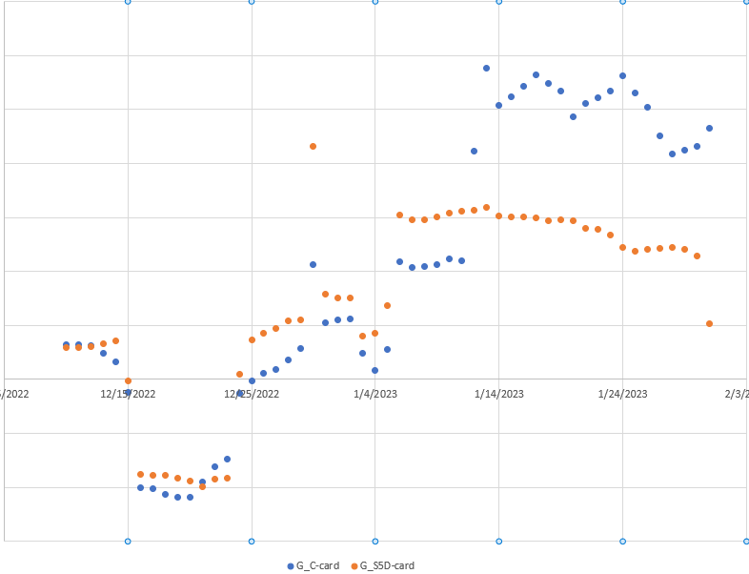
Strength of the proposal
“Double top/higher 2nd top” issue is resolved and the positive gaps are reduced.
Due to increased MCE for 2 days for load, TPEA under the proposed framework going into a high volatility period could result in a higher cushion as opposed to the existing formula.
Also, due to netting RTM activity against DAM activity and applying FAF against the most recent activity, the sensitivity of TPEA is higher during the event.
After the event passes, there will be no excessive over collateralization caused by the “double top/higher 2nd top”.

Slide 29
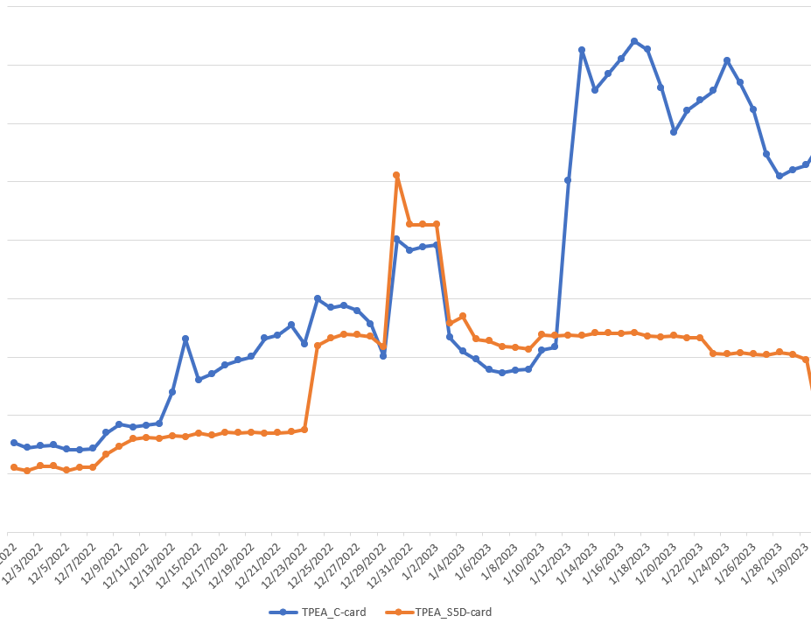
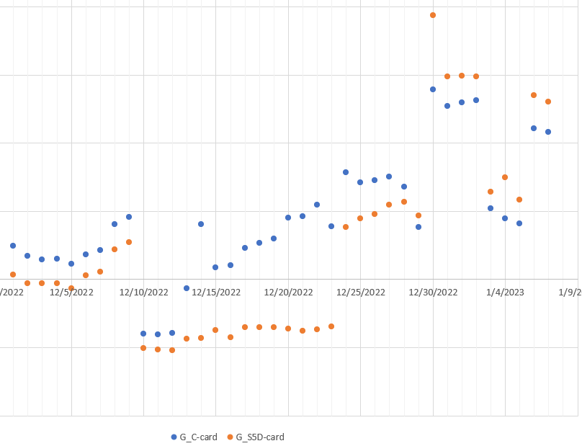
Potential disadvantage of the proposal
For some CPs the sensitivity or the speed of growth in TPEA corresponding to the increase in futures prices will be lost (or will no be as strong as it is under the existing framework). Under certain circumstances/for some counterparties, TPEA under the proposed framework will not be as sensitive to the ratcheting up in futures prices as the current TPEA, which could potentially lead to higher under-collateralization.

Slide 30
Cost of the proposed framework:
1/1/2022 through 8/30/24
Based on historical market behaviors, the proposed EAL framework would have saved the market about 7% or approximately $21MM over the period analyzed with the specific breakout by market activity type as follows:
Cost estimate assumptions:
Cost of capital is 10% for all counterparties for each day during the period analyzed
10% cost is across all collateral instruments: cash, LC & Surety bonds
Excludes consideration for collateral for DAM, CRR or excess/discretionary collateral
Table above excluded data for inactive and CRRAH counterparties

Slide 31
Conclusion
What problem(s) are we trying to solve?
“Double top or higher 2nd top” issue was brought up by a number of market participants. The main concern is that the current EAL/TPEA framework could lead to unreasonably high collateralization (large positive gaps), especially when the high volatility event is followed up by another price surge. Under certain theoretical scenario, the extent of collateral calls could be endangering the stability of the market place and lead to a cascade of defaults due to inability to meet collateral calls. This could be especially aggravating and unnecessary when the underlying credit exposures have not changed much and the TPEA increase is driven by pure “mechanics” of the formula.
Concern about high volatility in TPEA relative to underlying credit exposure it is trying to measure
Concern about over collateralization and the related cost to the marketplace
What will be the impact of the proposed EAL framework?
The proposed EAL framework will address the above “Double top or higher 2nd top” issue.
Generally, it will reduce overall volatility.
Reduction in volatility will be achieved without increasing risk. In fact, we expect overall reduction in instances and the extent of under collateralization. The exact impact will depend on each counterparty, its behavior in the marketplace (bilateral hedges, DAM purchases, exposure to RTM and AS markets) and the volatility in different markets (RTM, DAM and AS).
It will reduce overall collateral cost to the marketplace.
What is the disadvantage of the proposed EAL framework?
Under certain circumstances and for some counterparties, the proposed EAL framework could lead to an increase in instances and extent of under collateralization. The solution to this issue could be to increase the cap on RFAF, however, this will lead to higher positive gaps/cost to the market.

Slide 32
Appendix

Slide 33
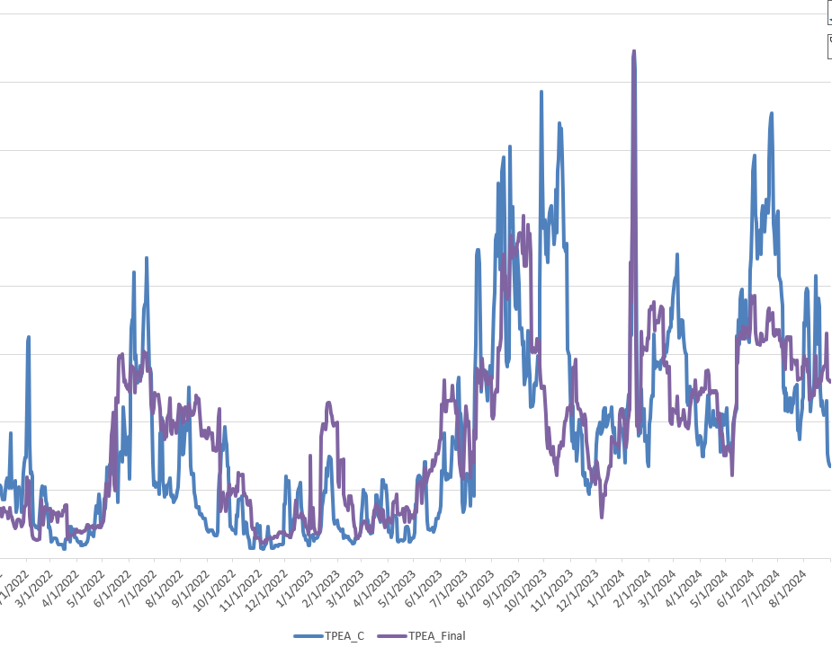
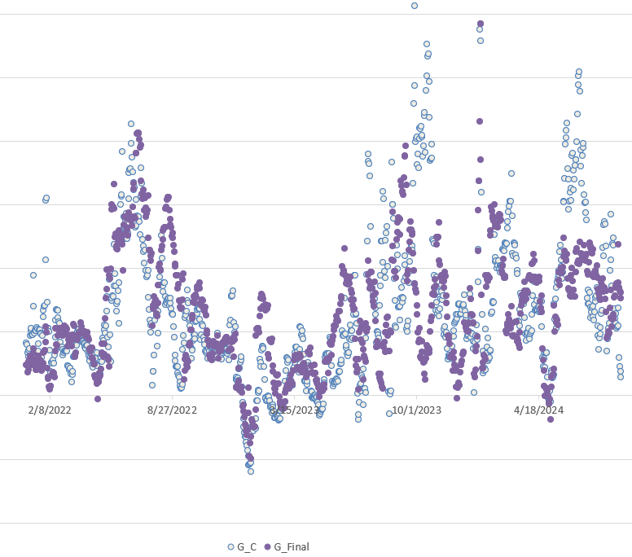
TPEA & Gap behavior: Sample #1

Slide 34
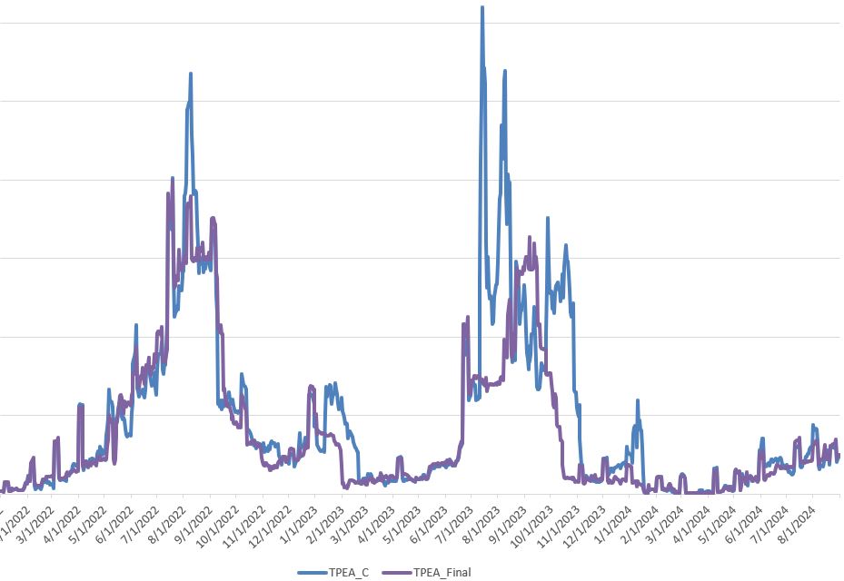
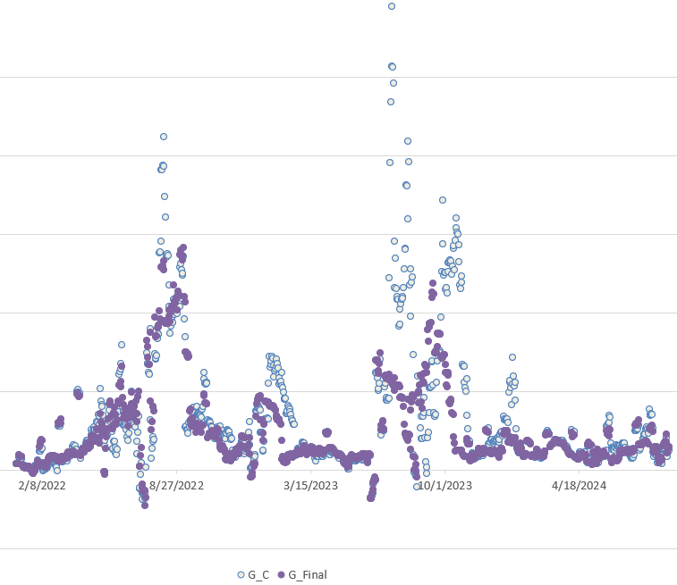
TPEA & Gap behavior: Sample #2

Slide 35
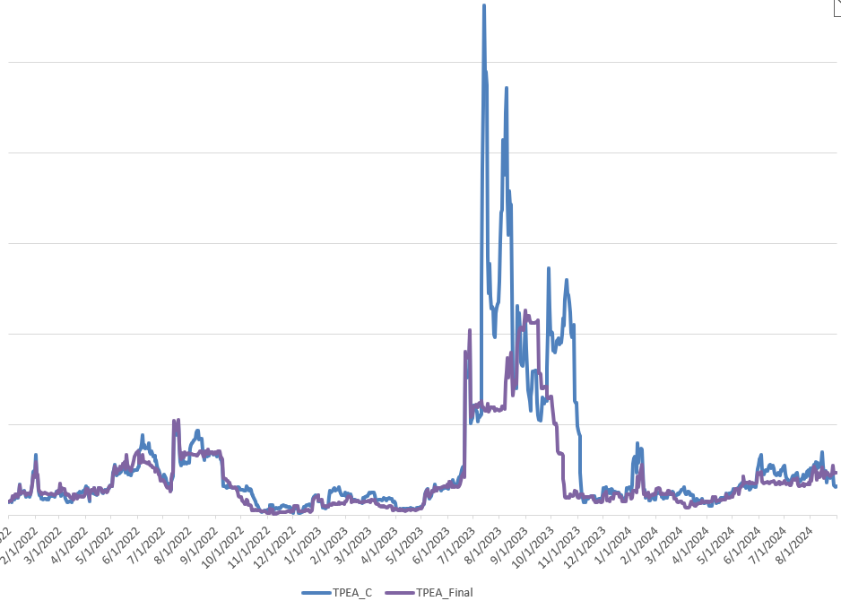
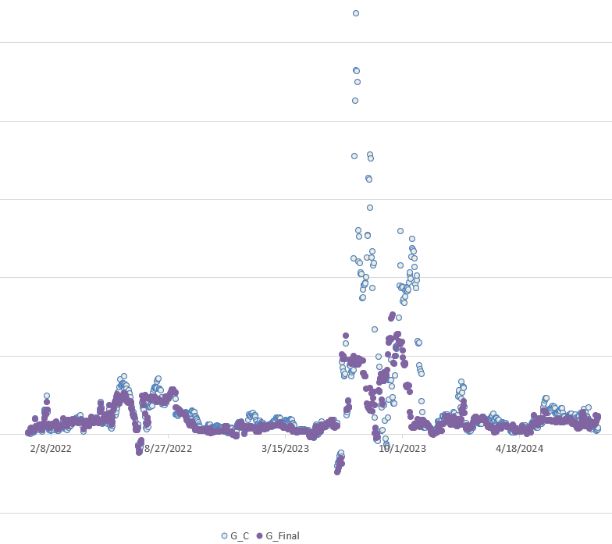
TPEA & Gap behavior: Sample #3

Slide 36
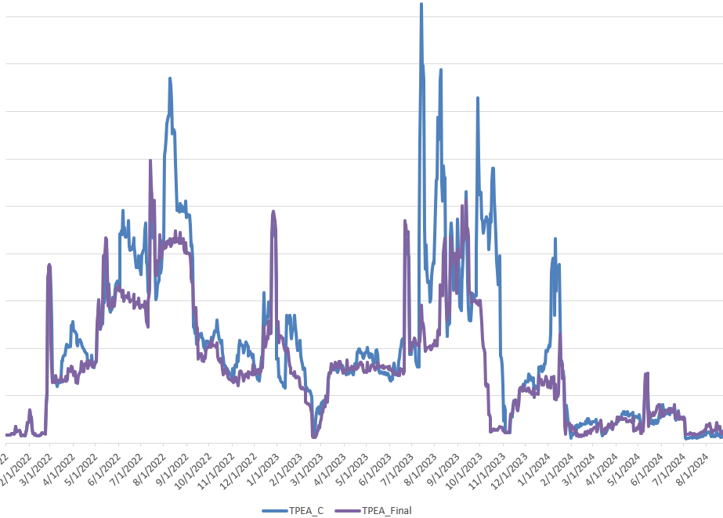
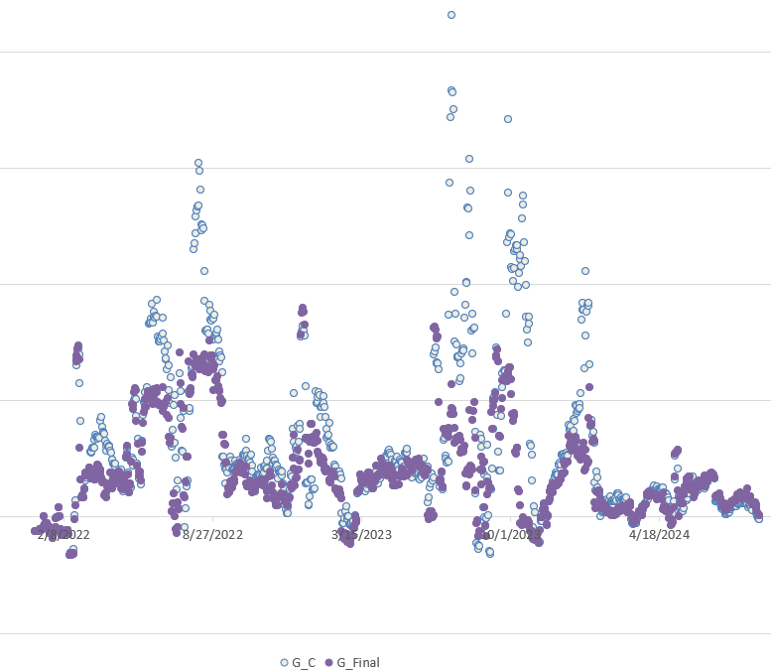
TPEA & Gap behavior: Sample #4

Slide 37
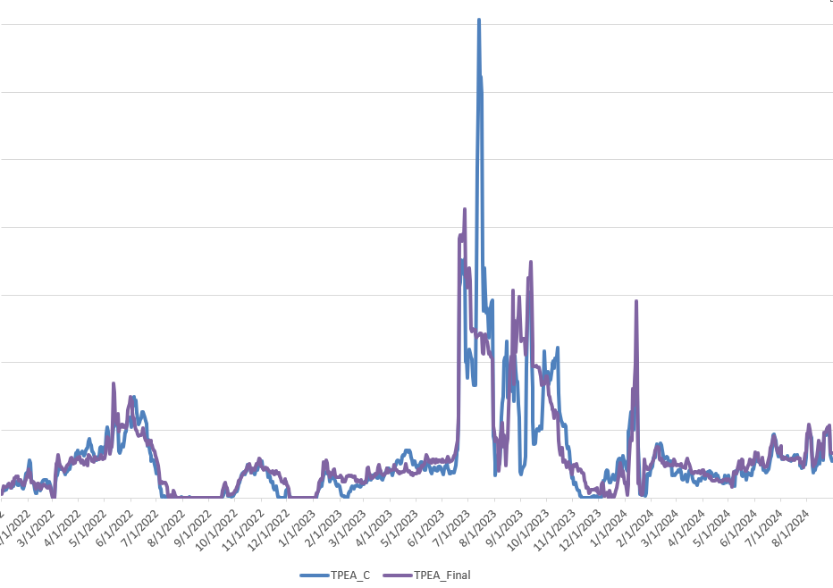
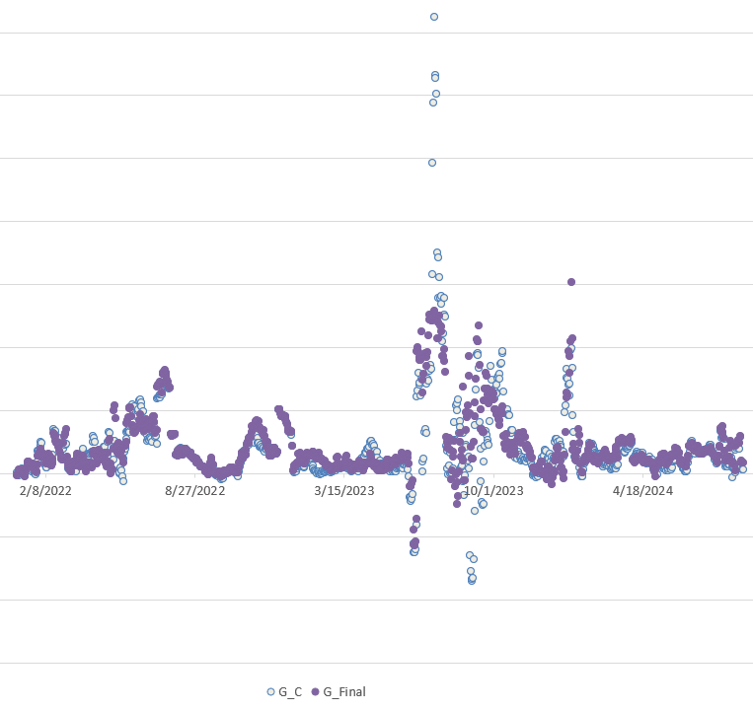
TPEA & Gap behavior: Sample #5

