Slide 1
ERCOT Frequency Events
September 2024
ERCOT
Operations Planning
PDCWG | October 16, 2024

Slide 2
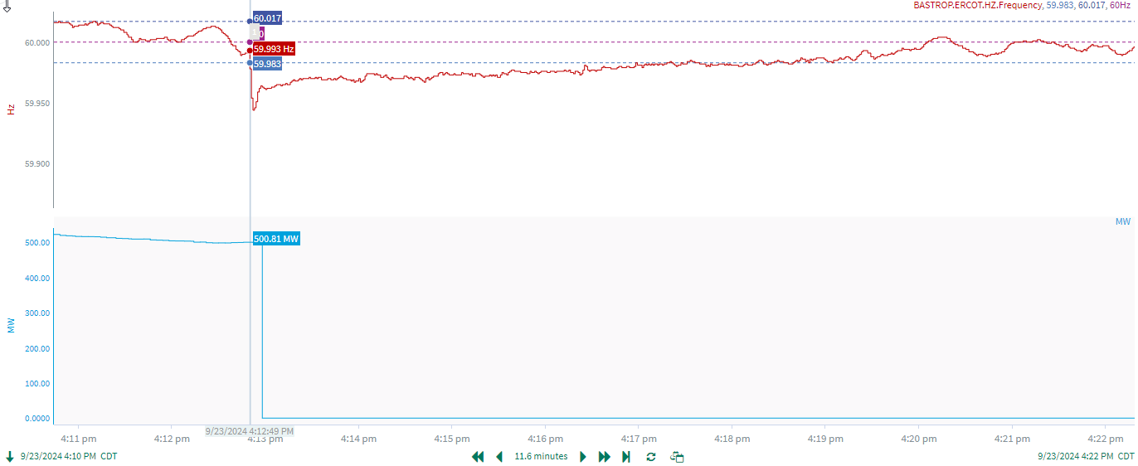
9/23/2024 16:12:49(Non-FME)
Notes:
The unit experienced a runback and tripped offline while carrying ~500 MW
Starting Frequency: 59.993 Hz
Minimum Frequency: 59.946 Hz
A-C Time : 3 seconds
Recovery Time(back to deadband): 4 minutes 30 seconds
ECRS Released: 0 MW
Trip Reason: Boiler issue
Contextual Information: A total of 313 MW of regulation Up was deployed during the event
No Selection Reason: C point is too small

Slide 3
Questions?
Thank you!

