Slide 1
Pricing Impacts of LDL Override Decisions made during April 8th Total Eclipse
Cory Carswell
Engineer, Market Analysis & Validation
ERCOT
Wholesale Market Working Group(WMWG)
October 18, 2024

Slide 2
Summary of LDL Override Analysis during April 8th, Total Solar Eclipse
Solar Eclipse Overview:
Occurred on April 8th, 2024, with solar generation dropping from 13,792 MW at 12:20 PM to 734 MW during totality at 13:37 PM.
Full recovery to 13,792 MW occurred by 14:54.
LDL Overrides Impact:
Active from 11:45 to 14:12, targeting 7 unique coal resources to increase their ramp-up capabilities.
Minimal impact on system-wide prices, resource mix, shadow prices, and deployment price adders.
Sequential Rerun Methodology:
Reset Limits: Set LDL override flags to zero, releasing previous resource constraints.
Carry Forward Dispatch Limits: Calculate HDL and LDL from the previous interval’s solution for the next interval's inputs.
Carry Over Line Flows: Calculate line flow solutions from the previous interval to the next to maintain system continuity.
Optimization Execution: Run SCED to solve for the new optimal dispatch based on updated inputs and constraints.
Net Impact to Value of Energy:
Calculated over the duration of LDL overrides, with the highest variance observed in the Houston load zone.
Total net impact to value of energy approximately $70,709.
Conclusion:
LDL overrides are one of several precautionary measures, with minimal overall impact on market outcomes.

Slide 3
LDL Overrides Impact to System-Wide Prices
Key Takeaways
Impact to system-wide prices were minimal during the early intervals
Minor impact to the Real-Time Reliability Deployment Price Adder.
Notes:
System Lambda Scale – down to $1000

Slide 4
LDL Overrides Impact to Resource Mix
Key Takeaway
LDL overrides had minimal impact to the resource mix

Slide 5
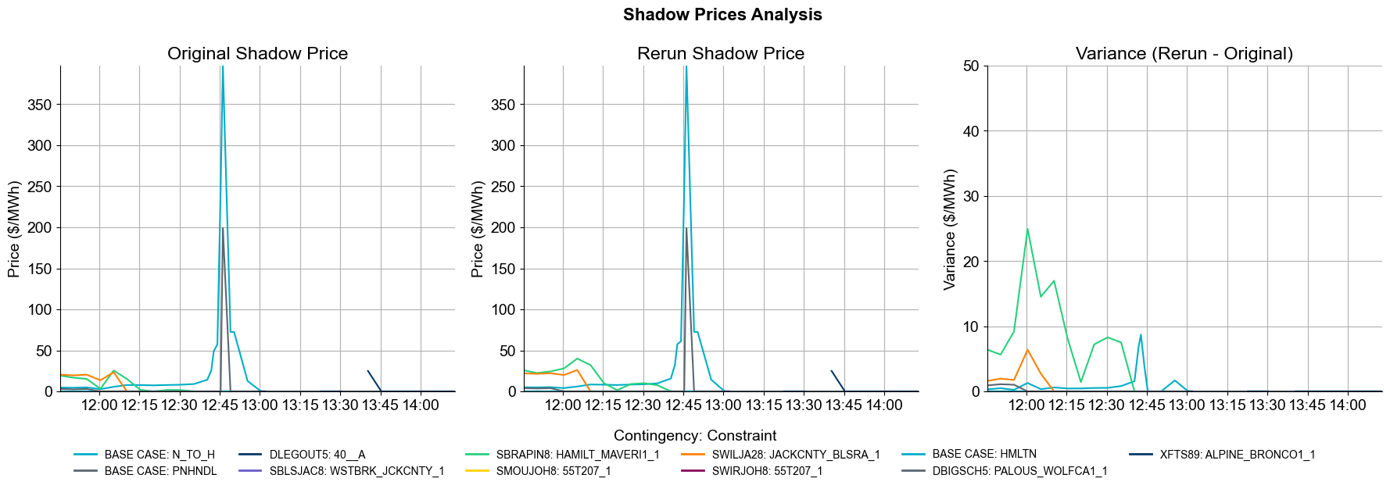
LDL Overrides Impact to Congestion Cost
Key Takeaways
The impact of LDL overrides on congestion costs is minimal.

Slide 6
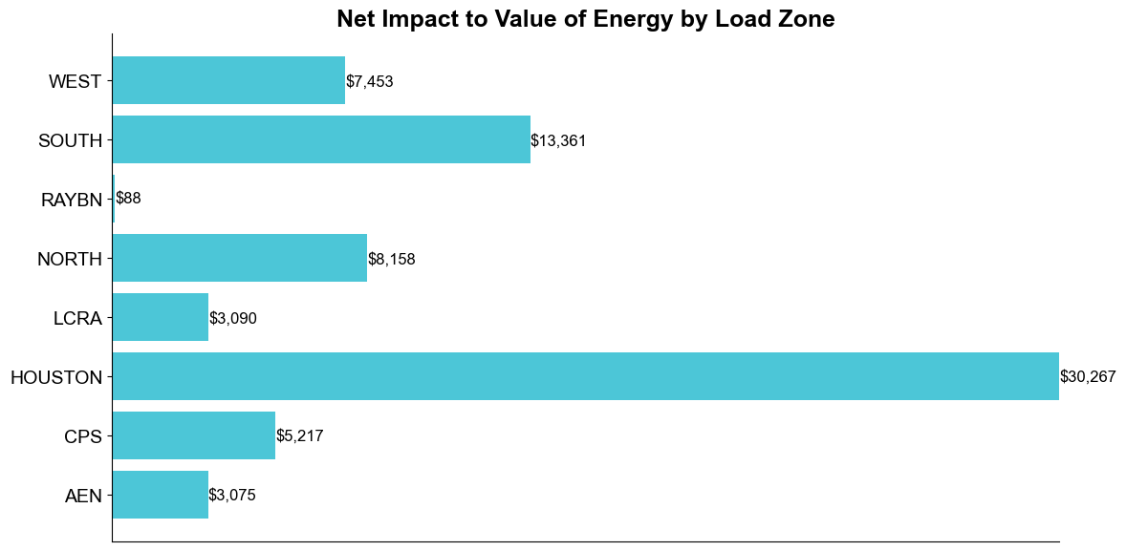
LDL Overrides Impact to Net Impact to Value of Energy by Load Zone
Key Takeaway
Total net impact to the value of energy is approximately $70,709.

