Slide 1
ERCOT Frequency Control Report
September 2024
ERCOT
Operations Planning
PDCWG | October 16, 2024

Slide 2
Summary of September 2024
CPS1: 176.90%
Current CPS1 12-Month Rolling Average: 175.20%
0 BAAL Exceedance(s)
0 hourly CPS1 score below 100%
BAAL-003 Events have updated through 2023
2023 BAAL-003 FRM Performance: -1130.21
2024 RMS1 Statistics
  Mean: 14.97 mHz
  Min: 11.55 mHz
  Max: 19.16 mHz
Energy Statistics
  Total Energy: 41,254,213 MWh
  Wind Energy: 5,962,137 MWh
  Percent Energy from Wind: 14.45%
  Solar Energy: 4,825,490 MWh
  Percent Energy from Solar: 11.70%
Minimum System Inertia
  Mean: 295,552 MW*s
  Max: 329,186 MW*s on September 2
  Min: 250,548 MW*s on September 8

Slide 3
Frequency Control
CPS1, BAAL, & RMS1

Slide 4
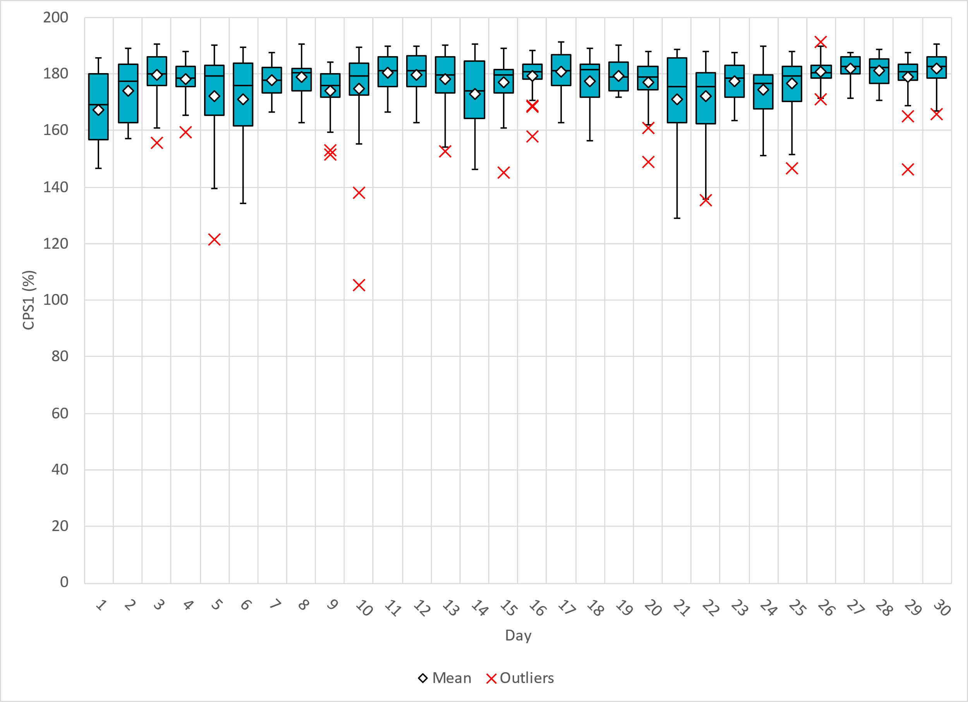
Hourly CPS1 by Day
Sep-24 CPS1 (%): 176.90
Notes:
September CPS1 Score is 176.90%

Slide 5
BAAL Exceedances & Violations
There were 0 BAAL exceedance(s) in September.

Slide 6
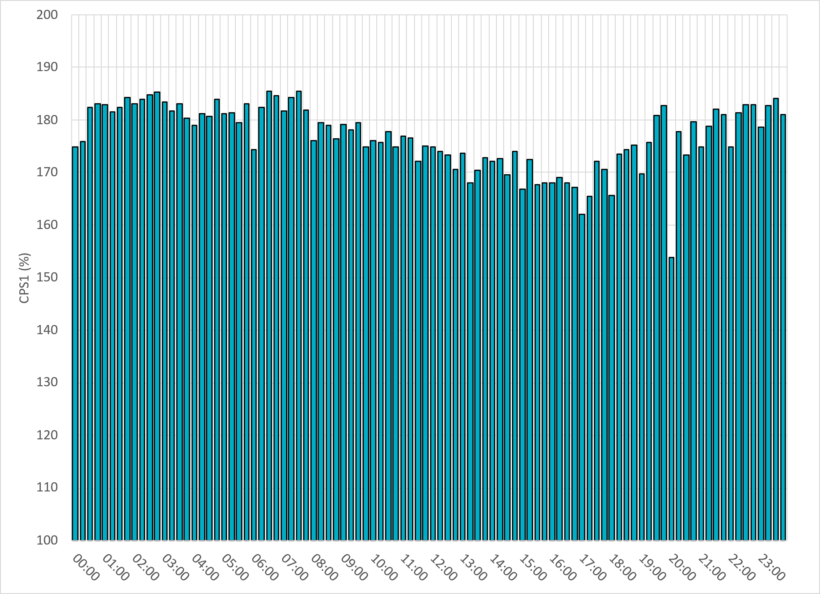
15-Minute Average CPS1%
Sep-24 CPS1 (%): 176.90
Notes:
CPS1 score is above 130% for all 15-minute intervals.

Slide 7
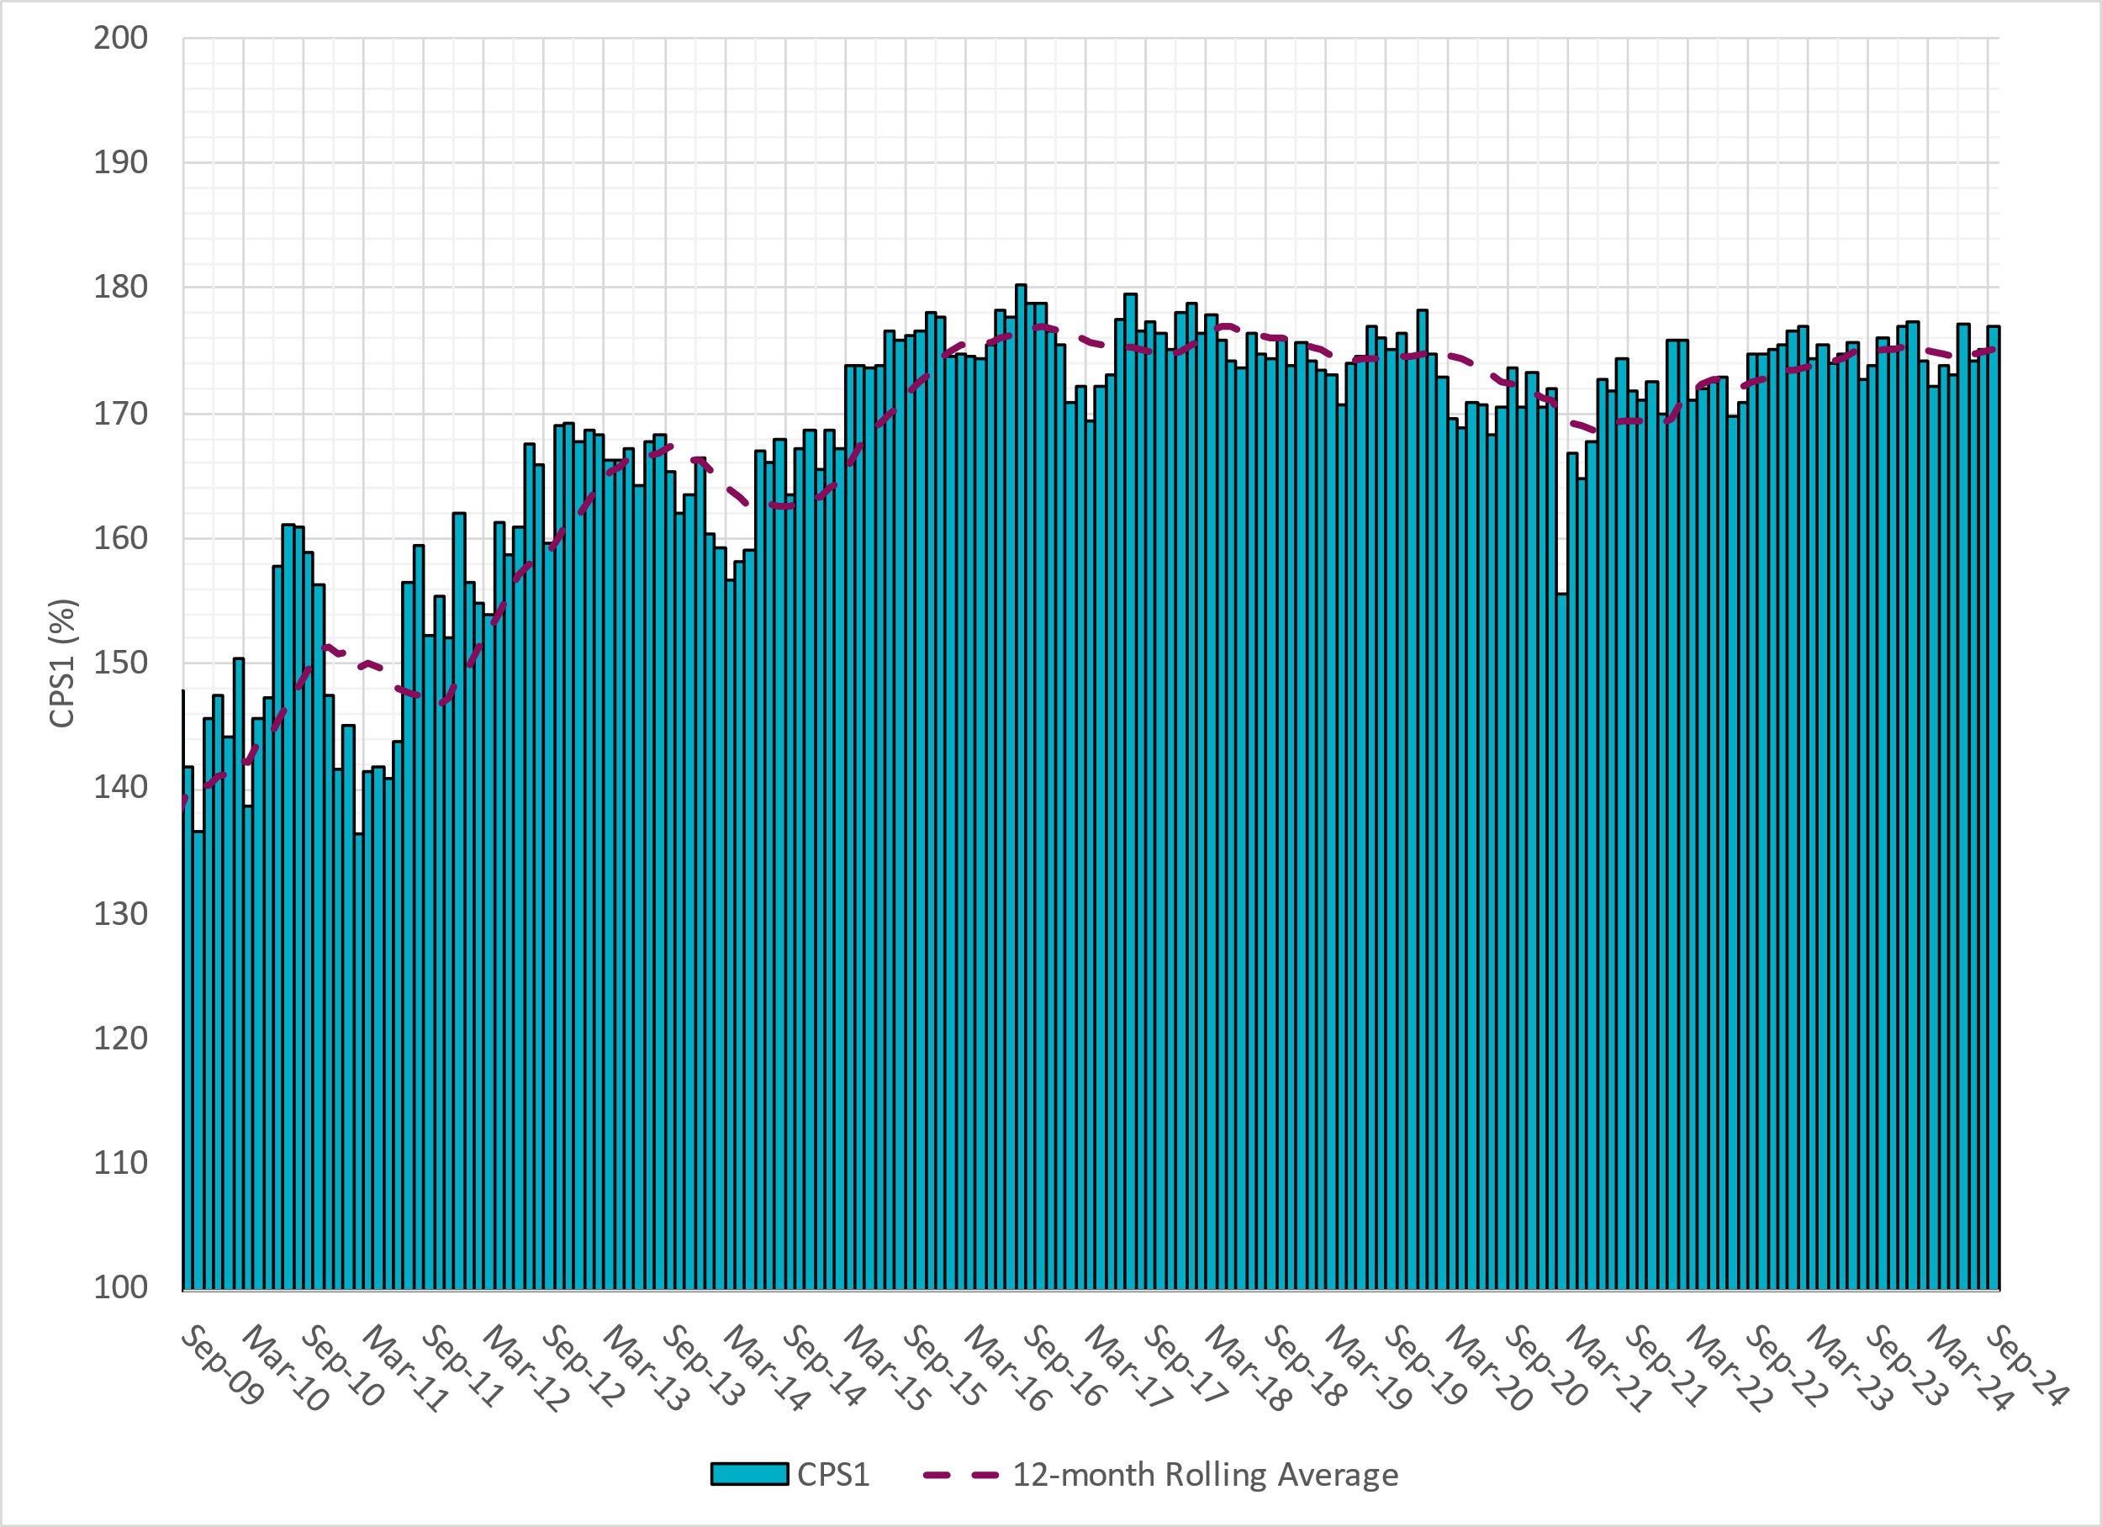
12-Month Rolling Average CPS1
Current 12-Month Rolling Average 175.20%
Notes:
12 month rolling average CPS1 score is 175.20 which is in line with expectations, and the CPS1 score for September is consistent with previous months.

Slide 8
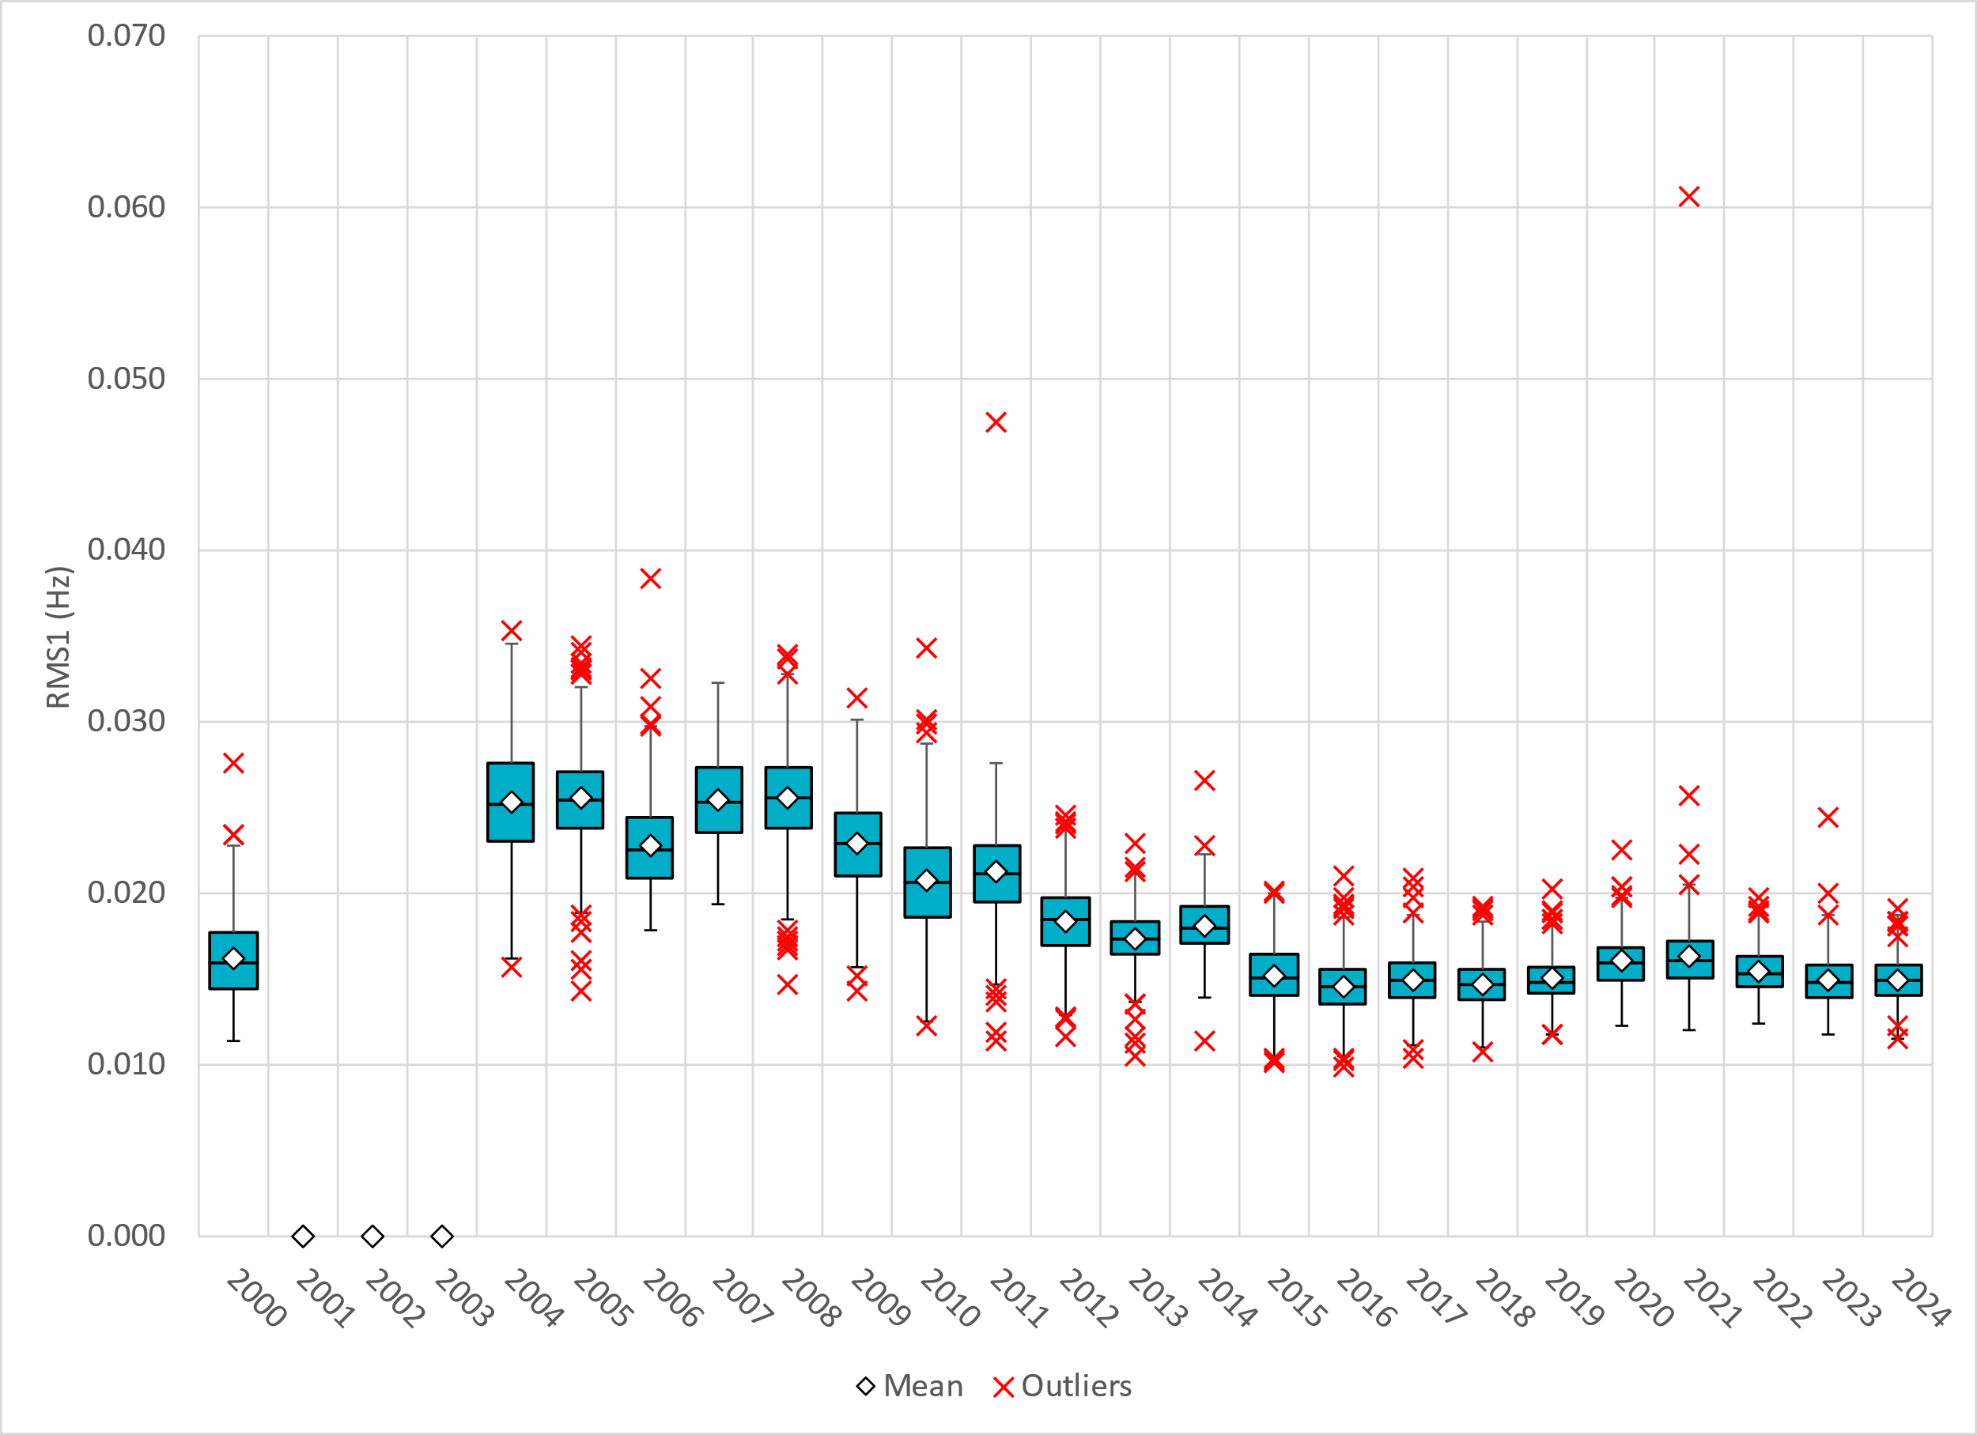
Daily RMS1 of ERCOT Frequency by Year
Notes:
Daily RMS1 frequency by year is similar compared to 2023.
2024 Stats:
Mean: 14.97 mHz
Min: 11.55 mHz
Max 19.16 mHz

Slide 9
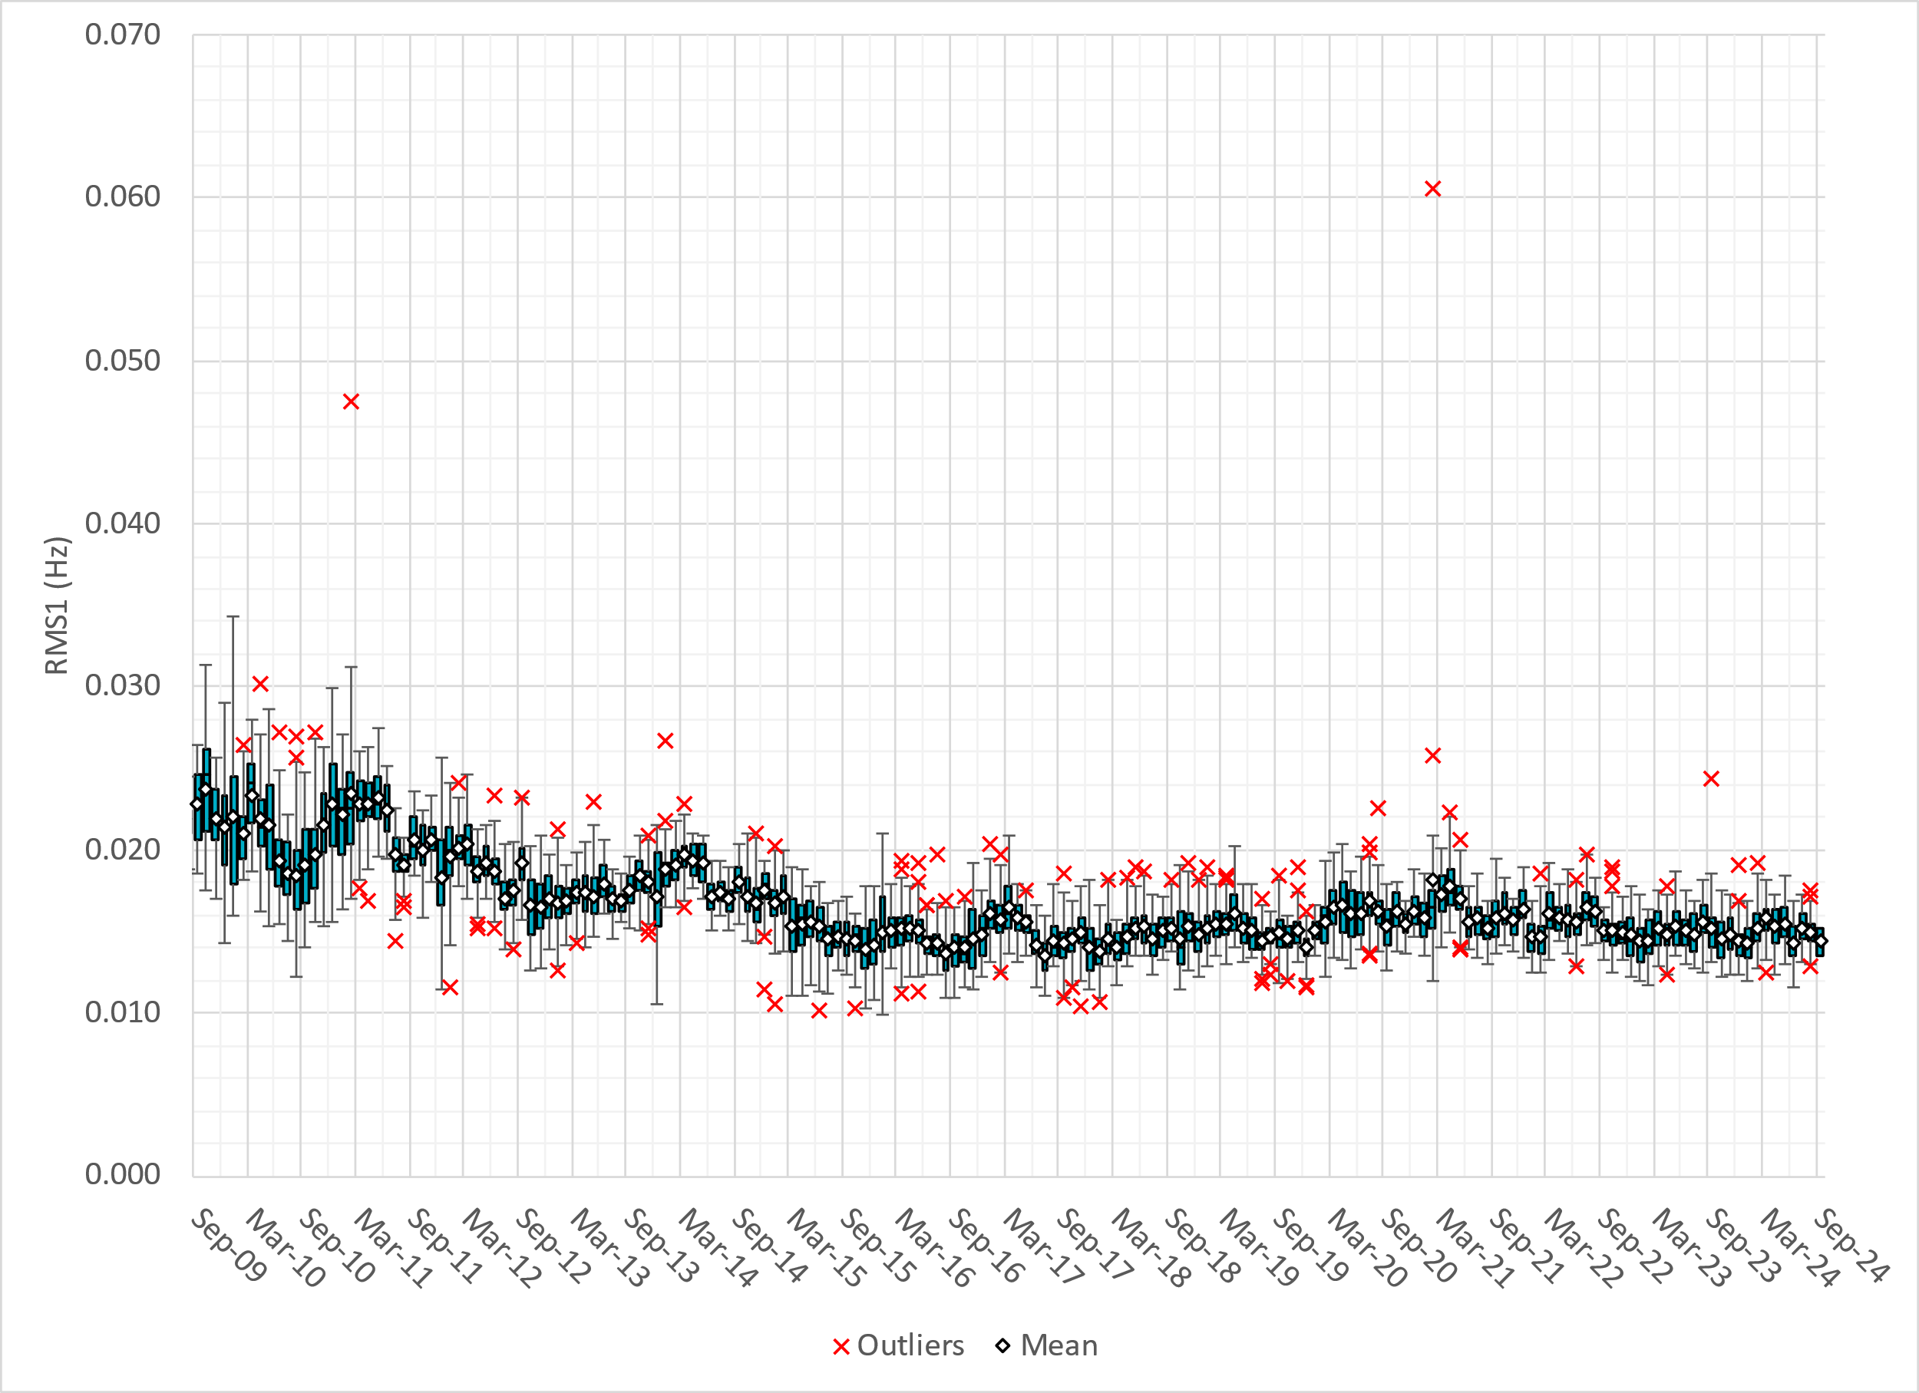
Daily RMS1 of ERCOT Frequency by Month
Notes:
A More granular look at last 15 years of RMS1 by month
14.39 mHz on avg for September 2024

Slide 10
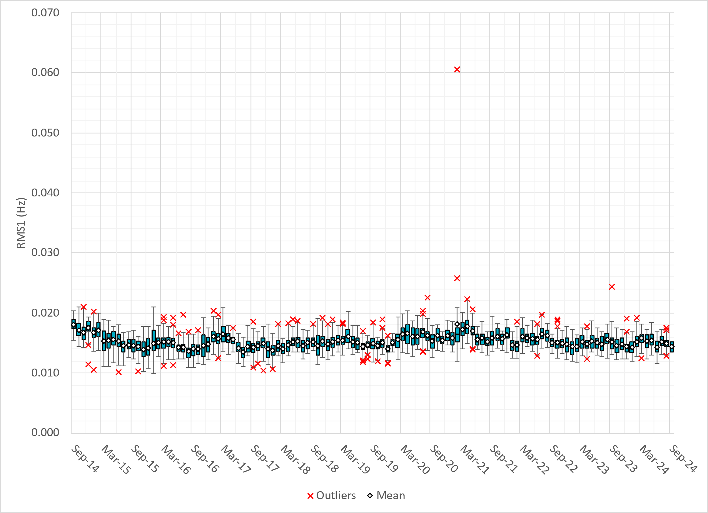
Daily RMS1 of ERCOT Frequency by Month
Notes:
Same data with 10 years shown instead of 15

Slide 11
Frequency Profile Comparison

Slide 12
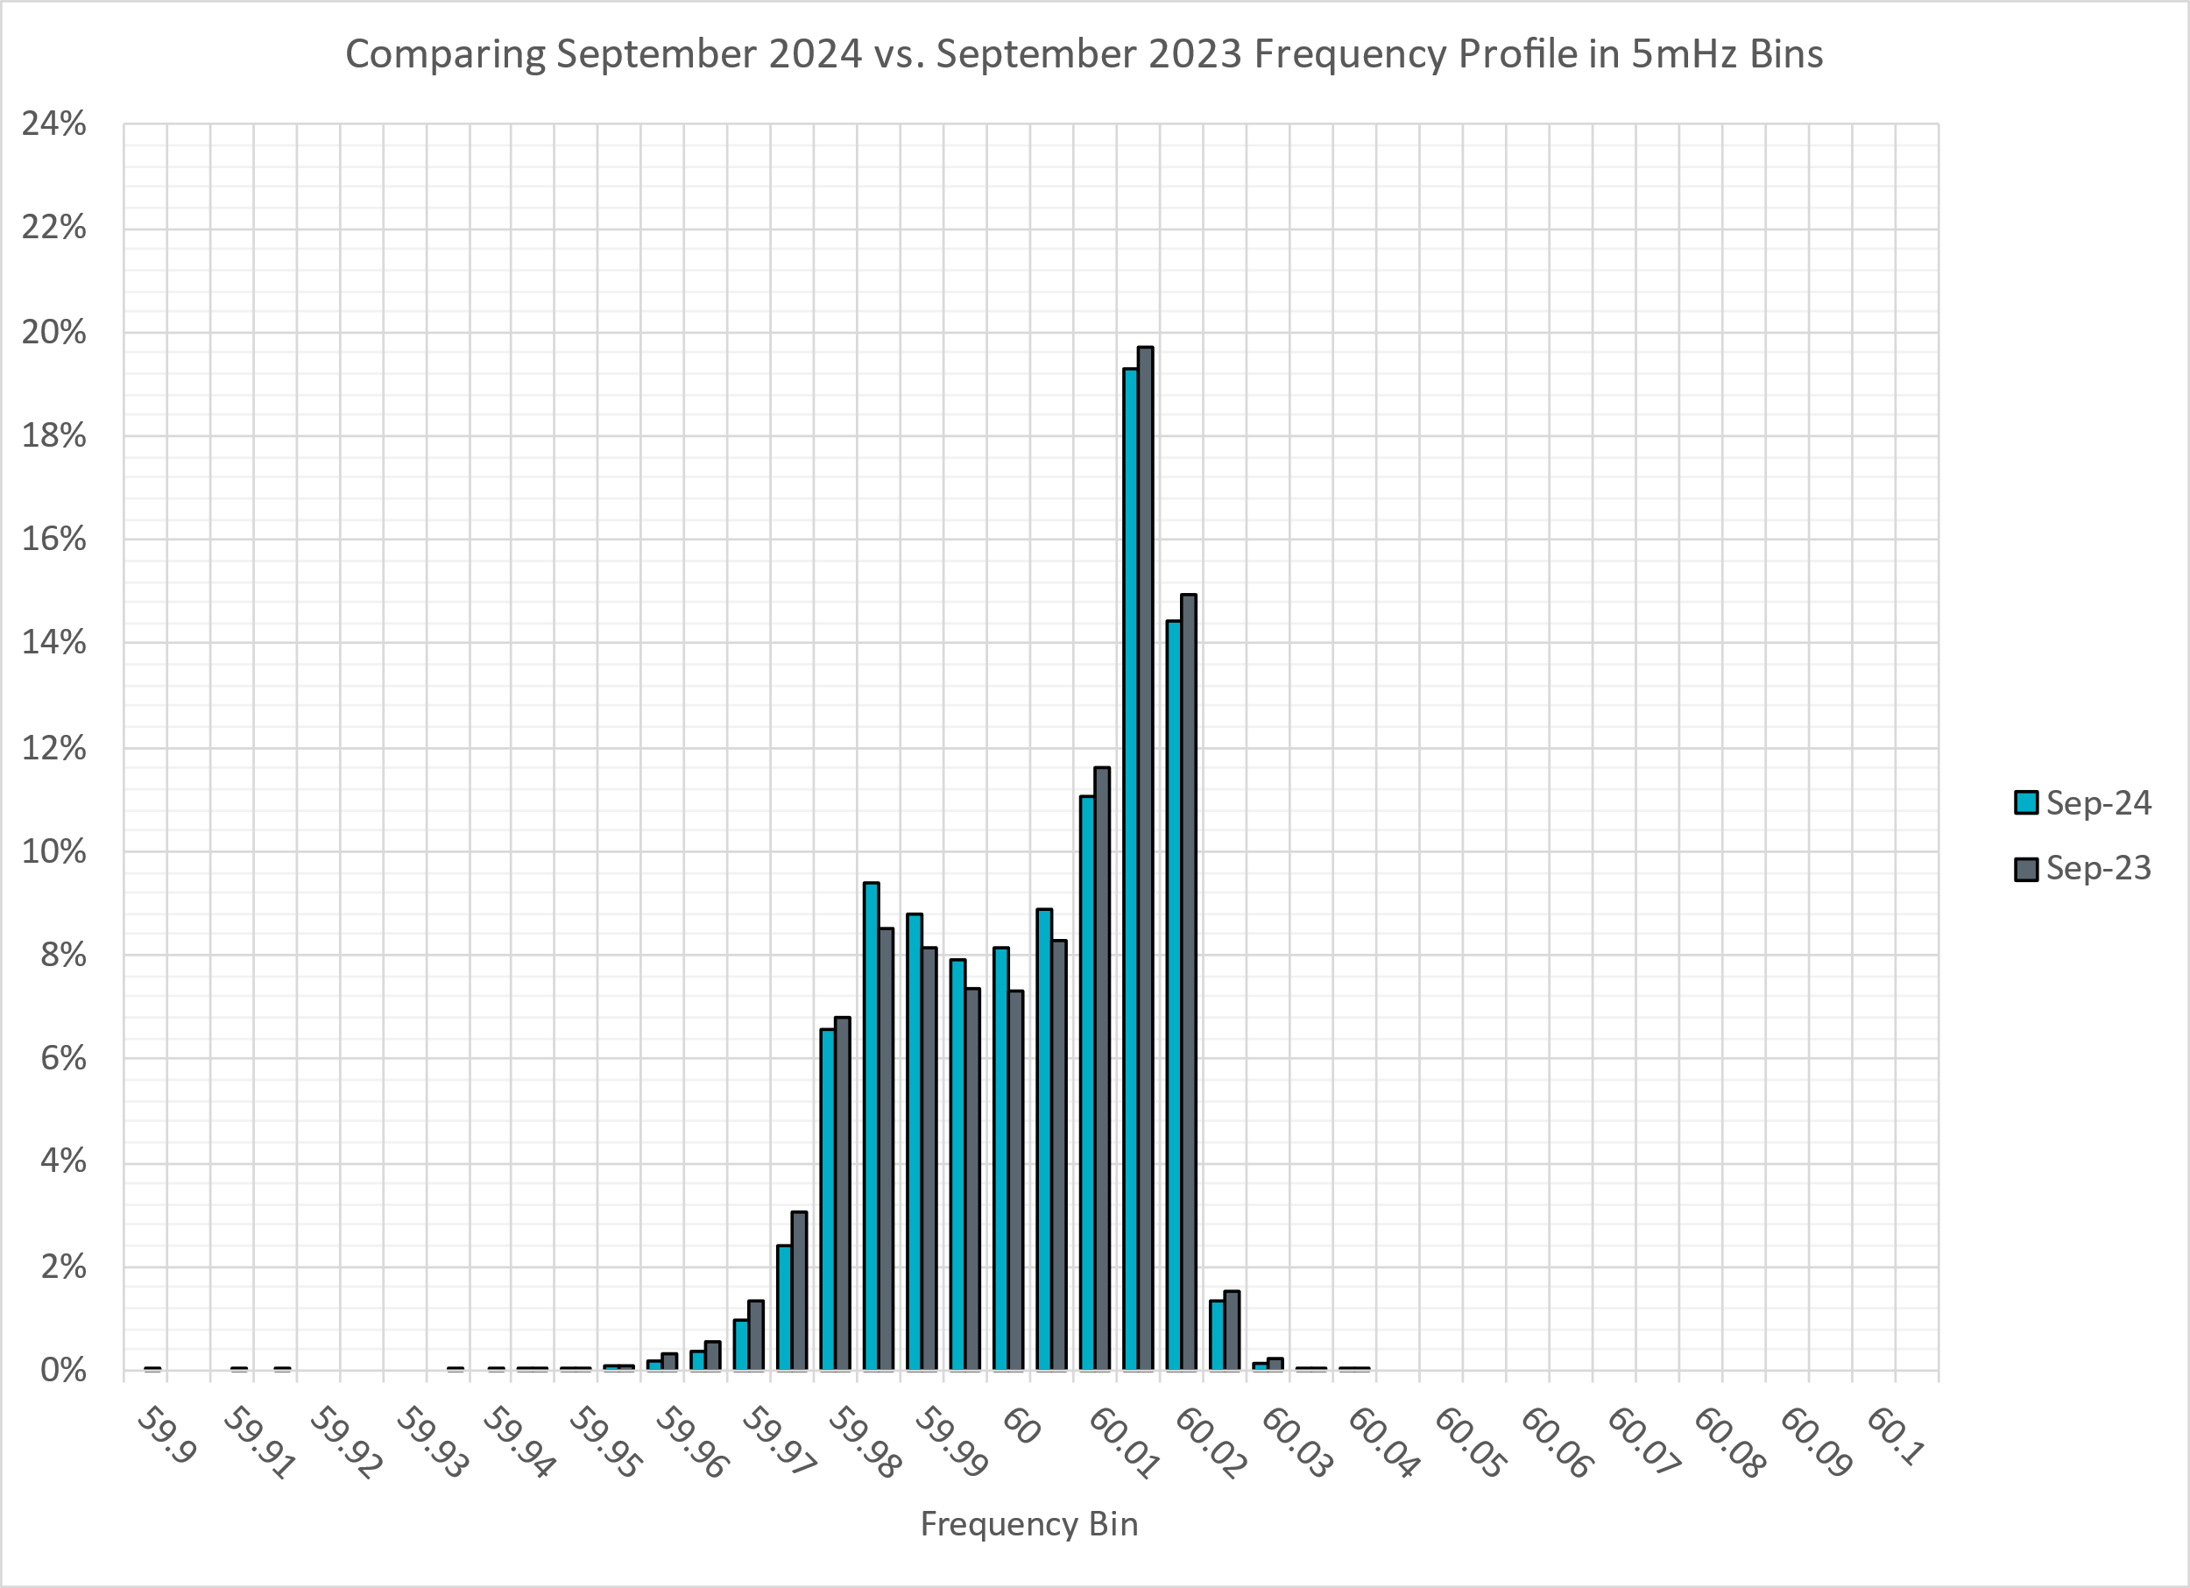
Frequency Profile Comparison
Notes:
Comparison of frequency profile between September 2023 and September 2024. Compared to last year, there are slightly less instances of frequency hovering around the dead bands.

Slide 13
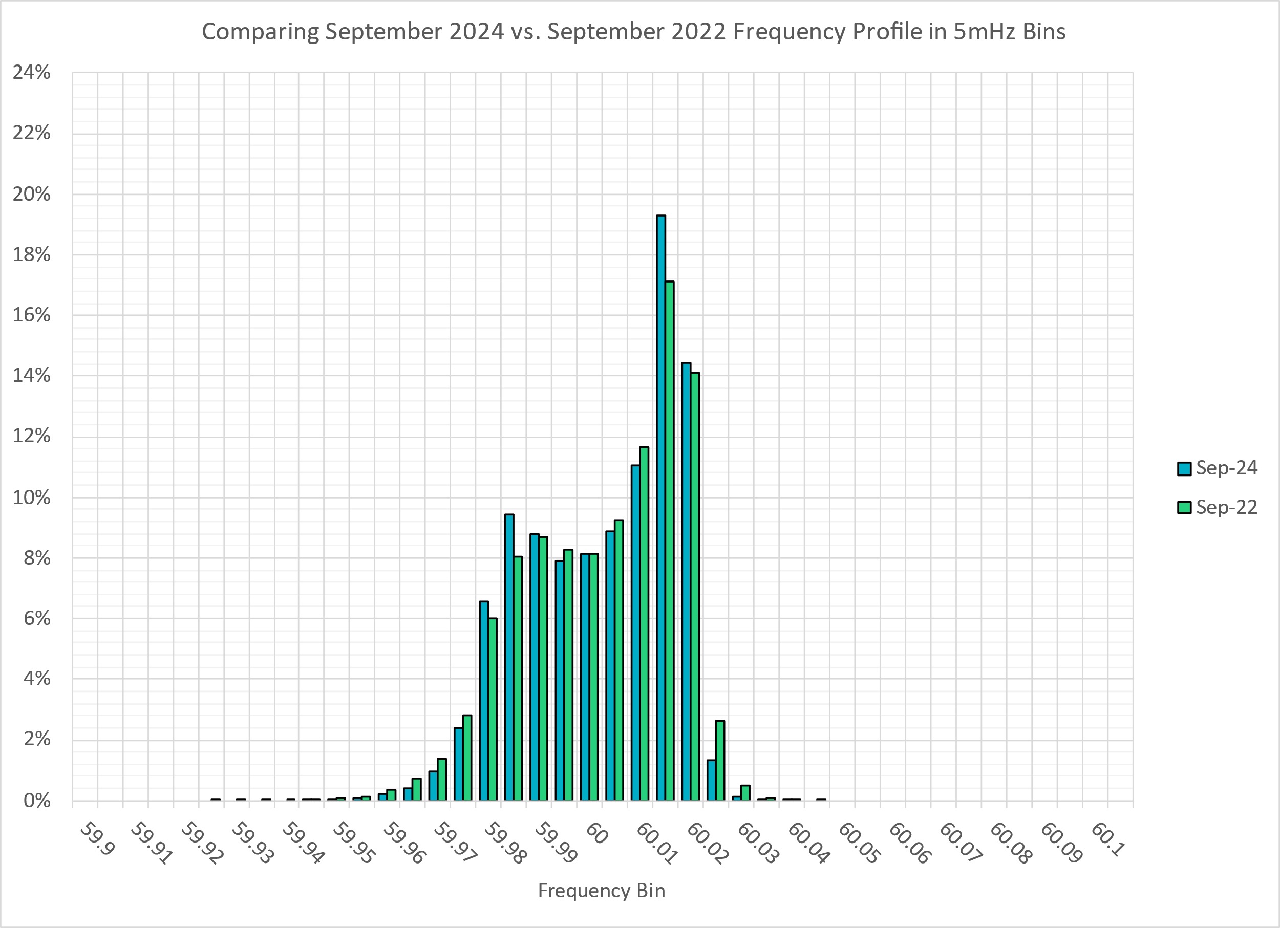
Frequency Profile Comparison
Notes:
Comparison of frequency profile between September 2022 and September 2024. Similar to the previous slide, compared to 2022, there are less instances of frequency hovering around the dead bands.

Slide 14
Time Error Correction

Slide 15
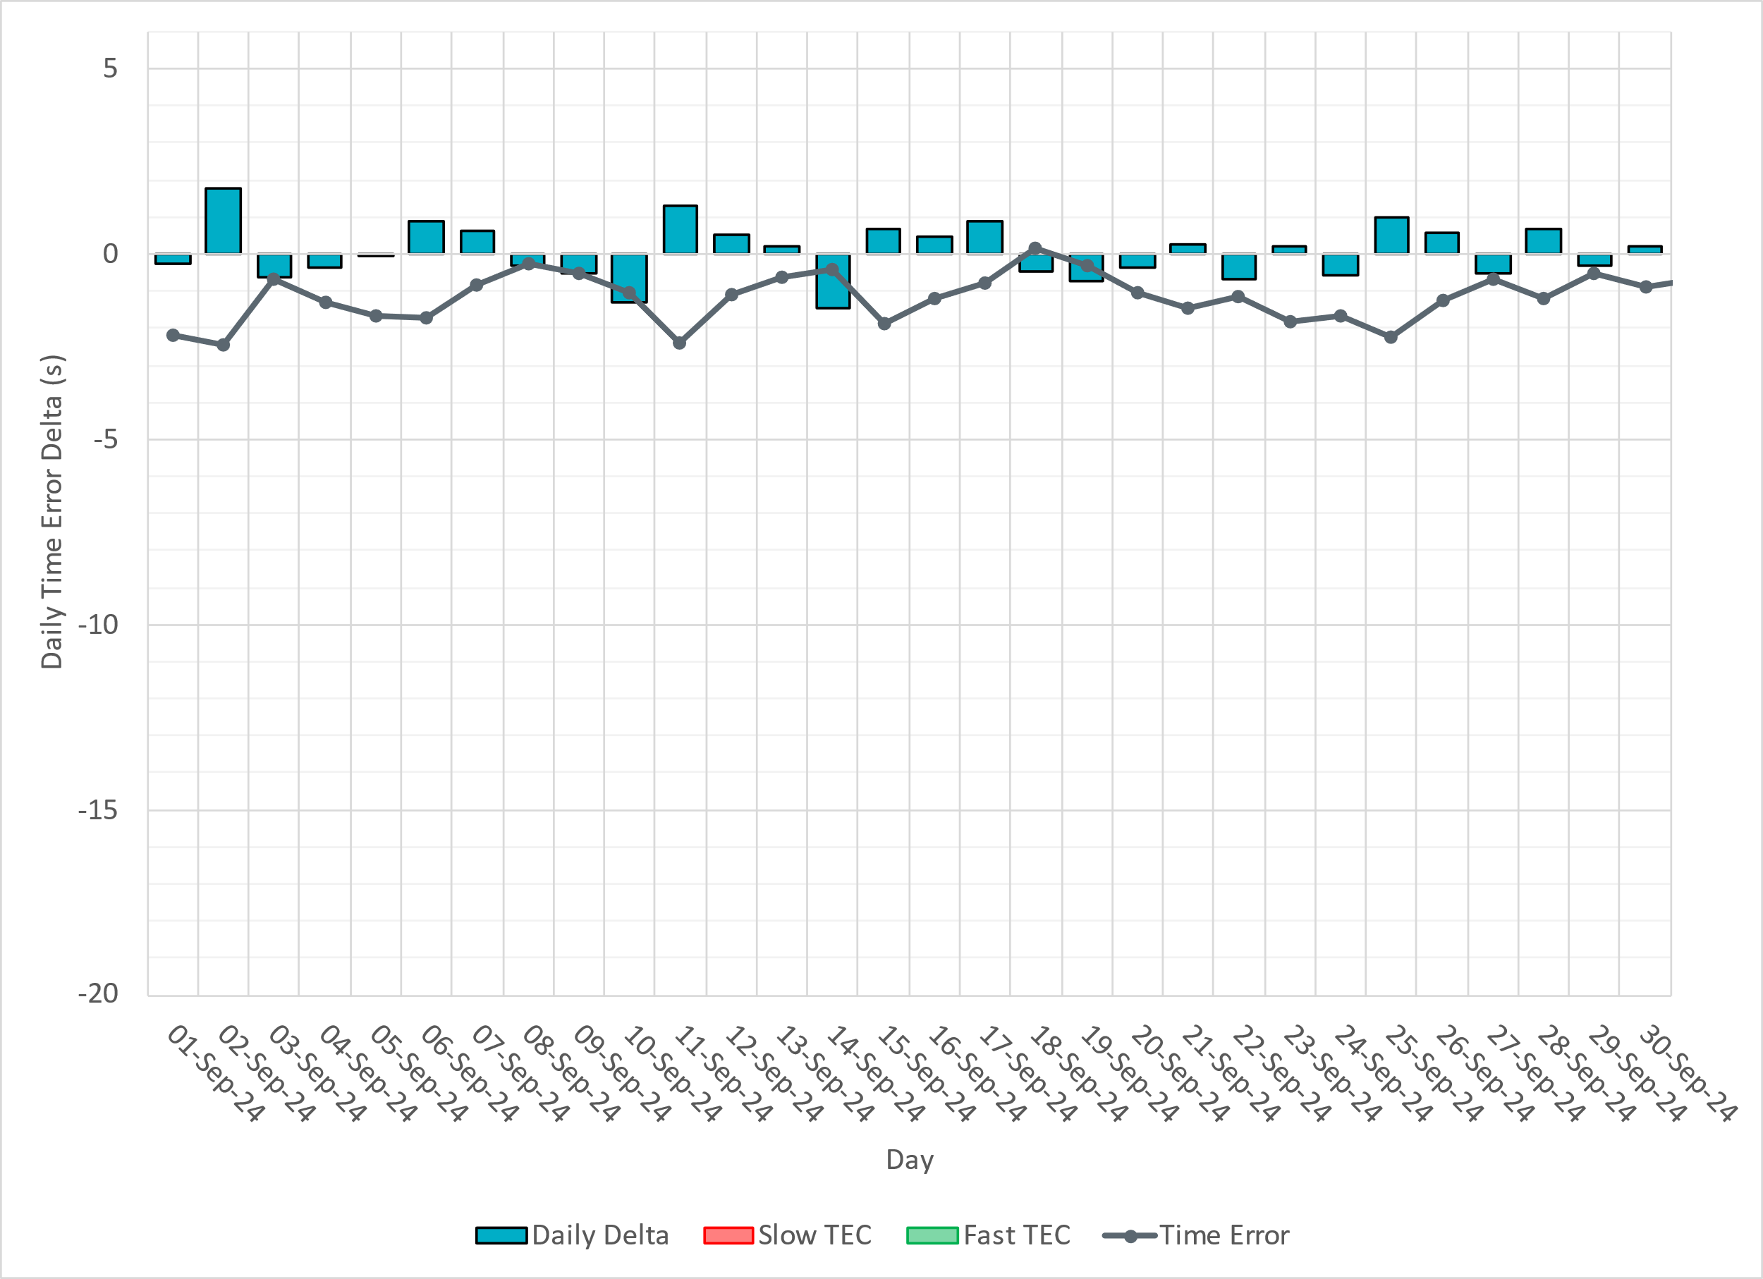
ERCOT Daily Time Error

Slide 16
Time Error Corrections Log Summary
There have been no time error corrections since December 2016

Slide 17
BAL-003 Performance

Slide 18
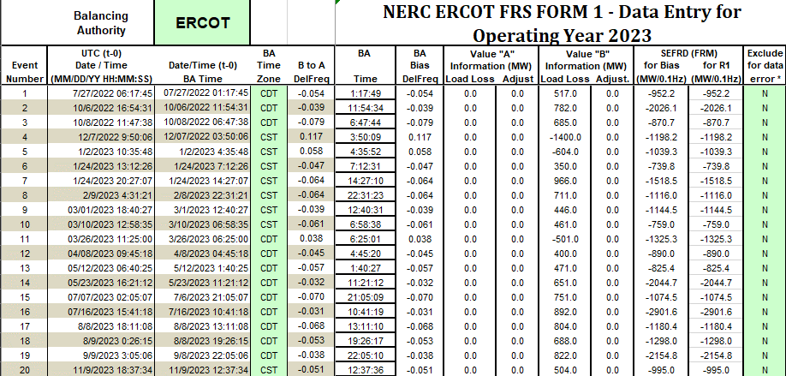
Op. Year 2023 BAL-003 Selected Events – Update
Notes:
BAL-003

Slide 19
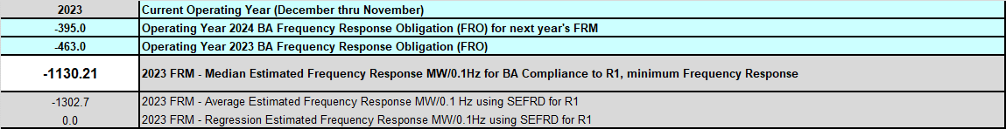
Op. Year 2023 BAL-003 FRM Performance - Update
Notes:
OP2018: FRO = -381.0, FRM_median = -843.17, FRM_average = -959.7
OP2019: FRO = -381.0, FRM_median = -811.14, FRM_average = -892.5
OP2020: FRO = -425.0, FRM median = -789.34, FRM average = -879.0
OP2021: FRO = -471.0, FRM median = -913.56, FRM average = -992.
OP2022: FRO = -463.0, FRM median = -1060.40, FRM average = -1153.4
OP2023: FRO = -395.0, FRM median = -1130.21, FRM average = -1302.7

Slide 20
ERCOT Energy Statistics

Slide 21
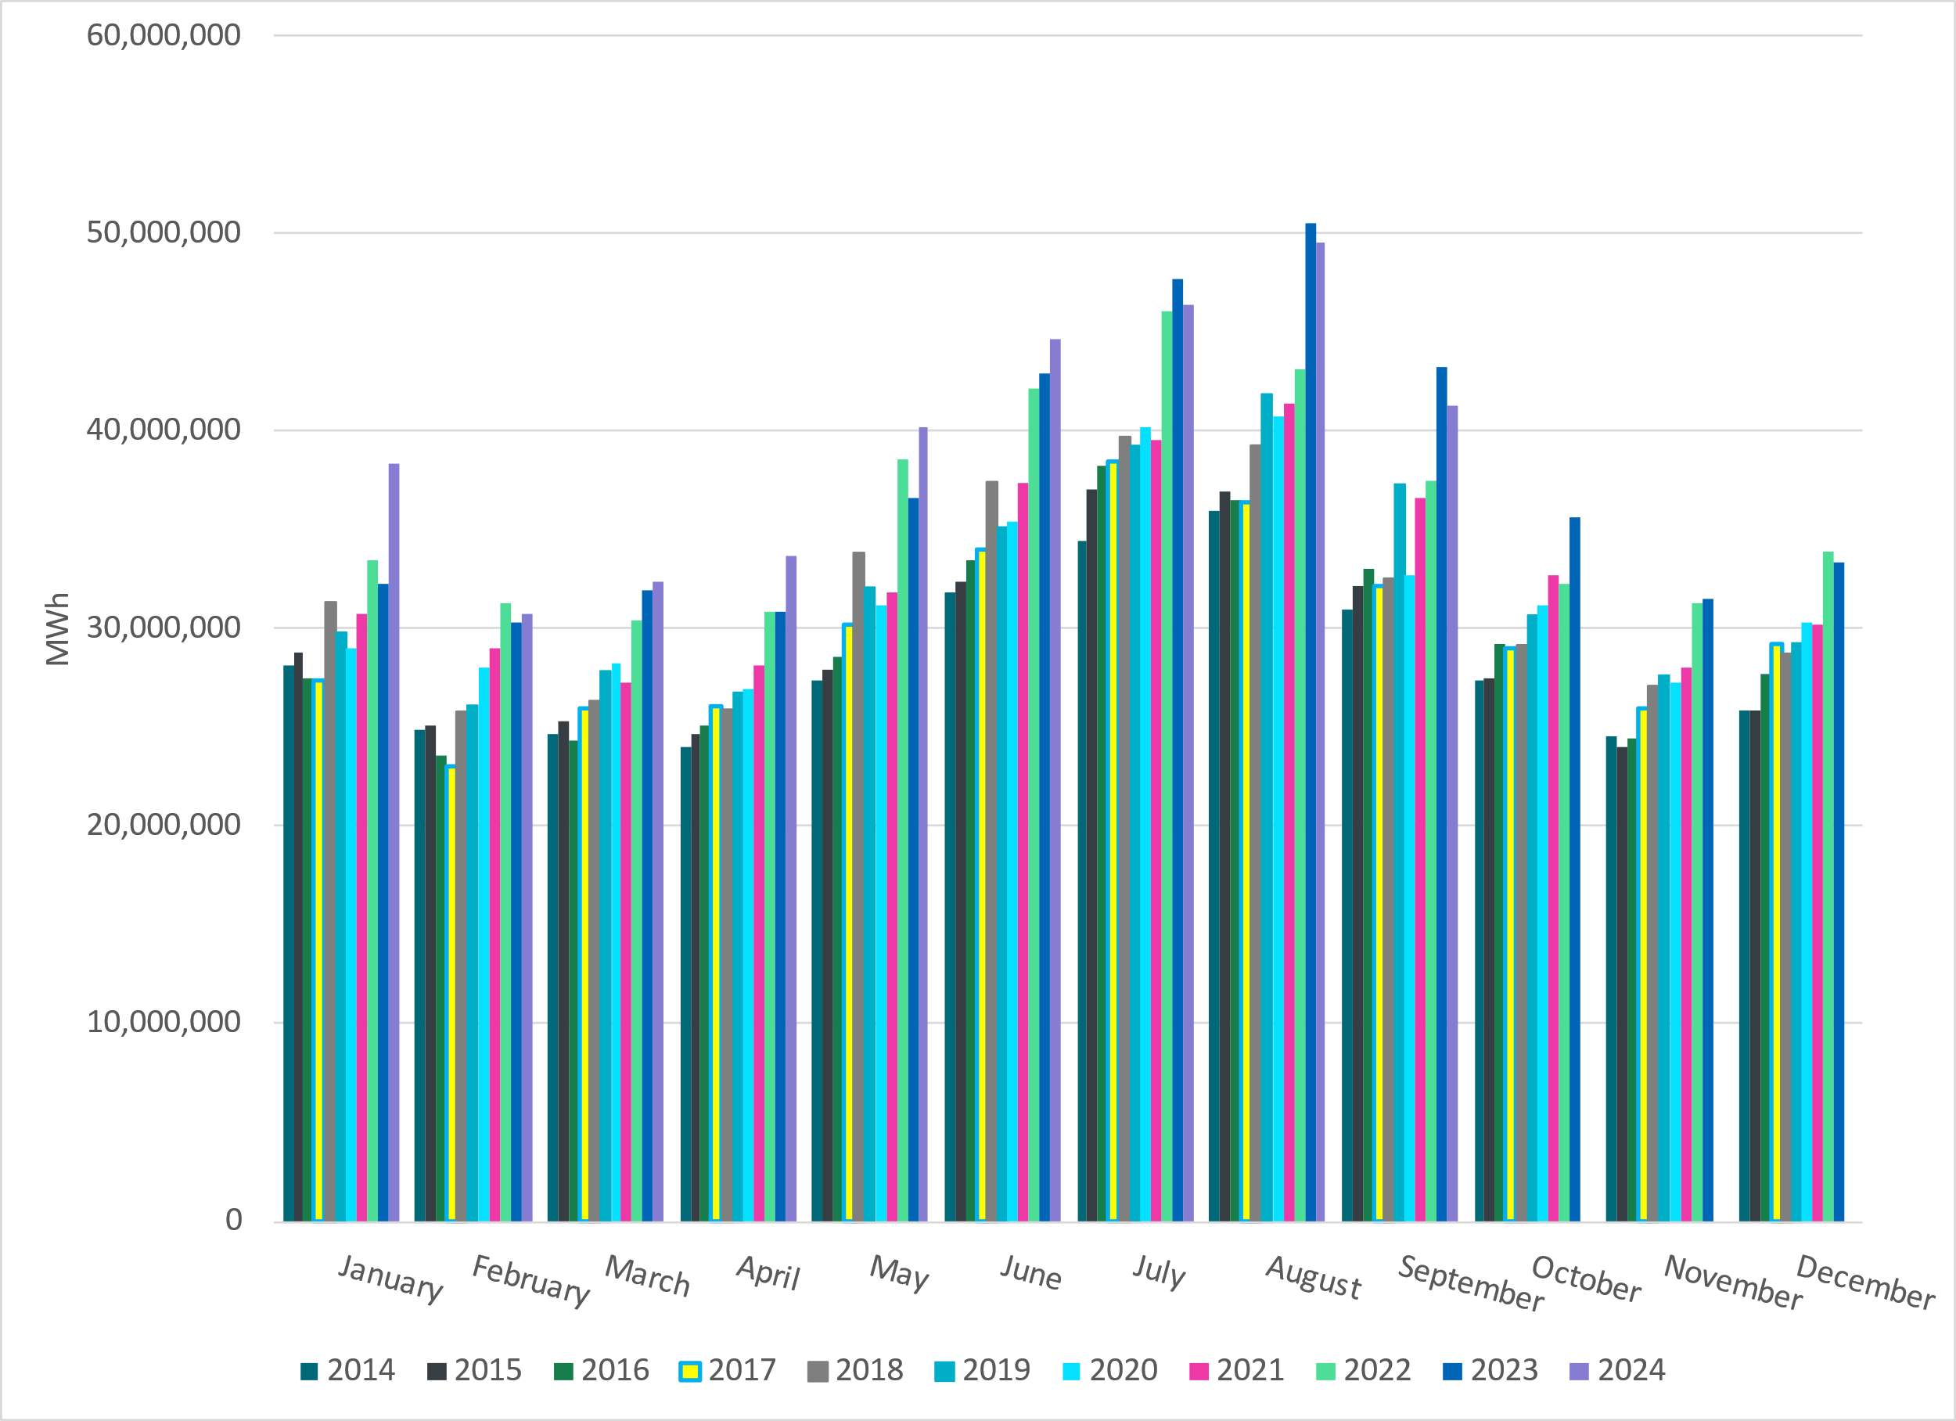
Total Energy
Notes:
41,254,213 MWh

Slide 22
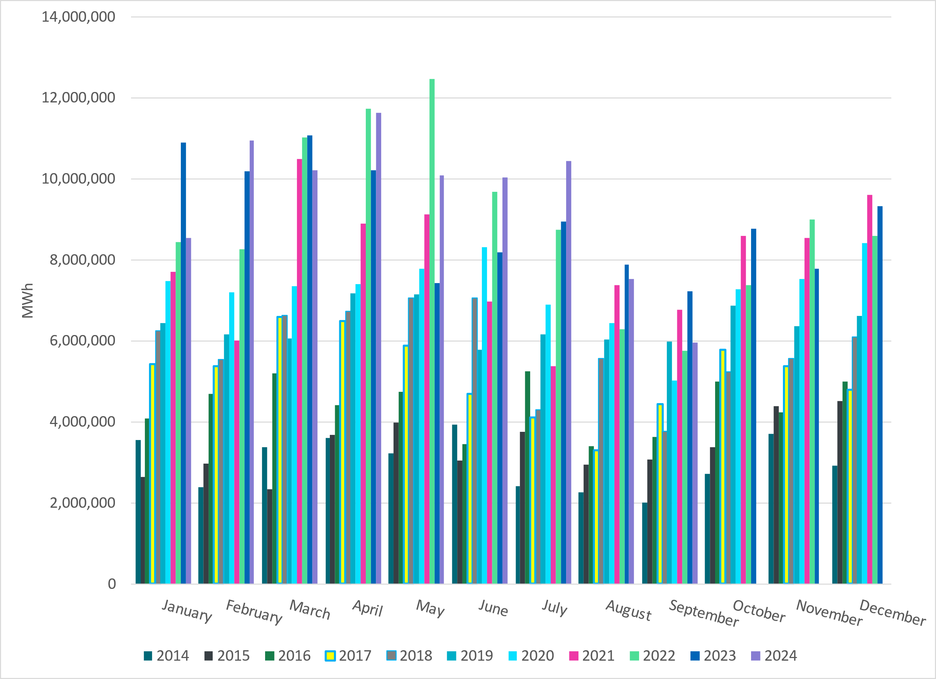
Total Energy from Wind Generation
Notes:
5,962,137 MWH

Slide 23
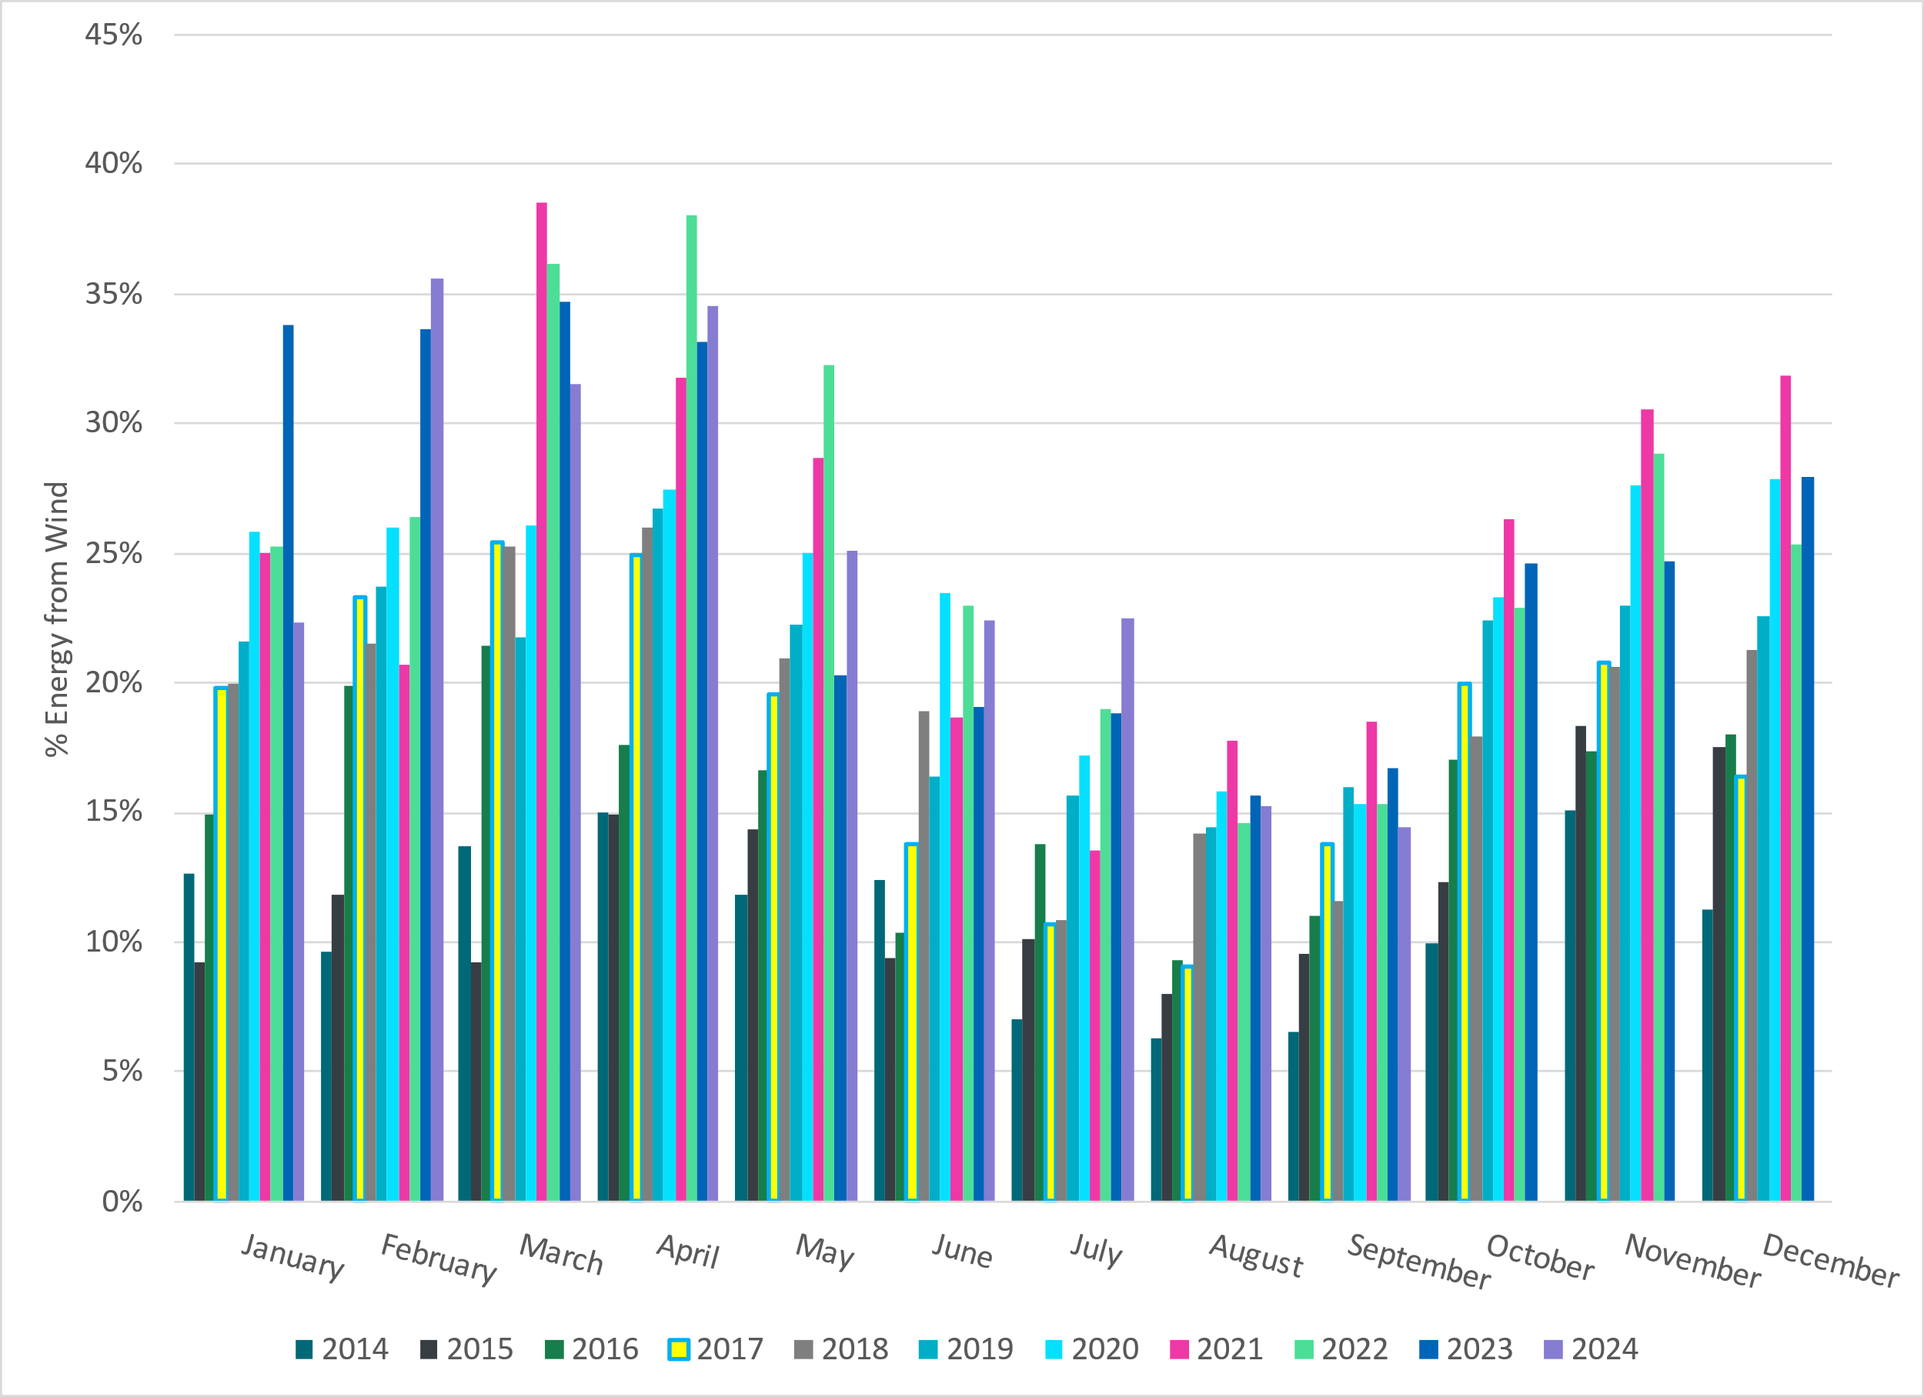
% Energy from Wind Generation
Notes:
14.45% of total energy was provided by wind generation

Slide 24
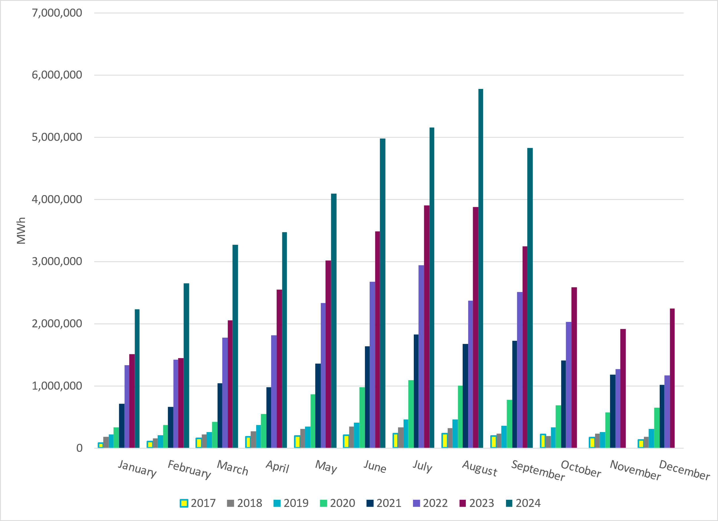
Total Energy From Solar Generation
Notes:
4,825,490 MWh

Slide 25
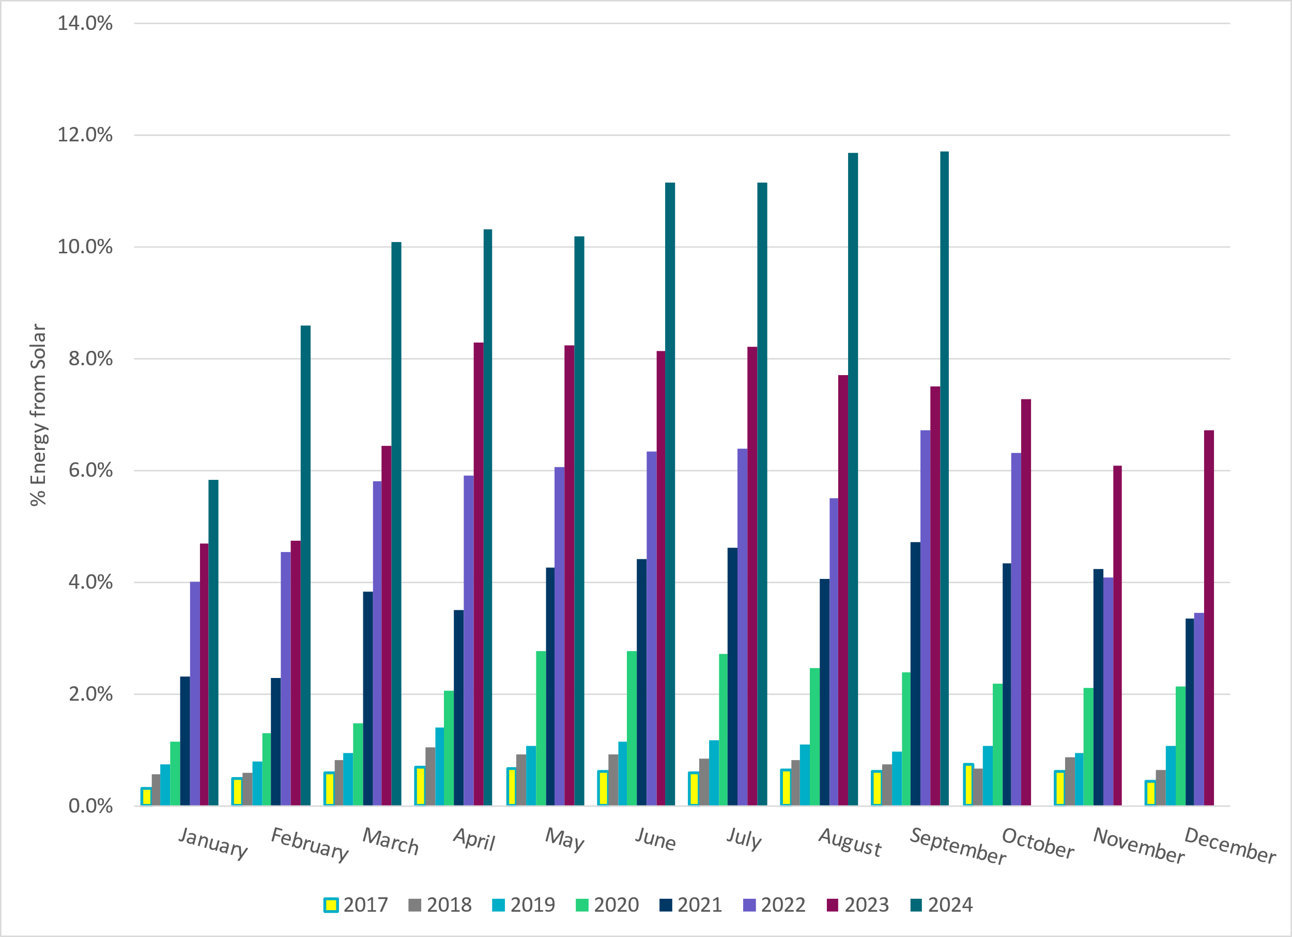
% Energy from Solar Generation
Notes:
11.70% of total energy was provided by solar generation

Slide 26
ERCOT System Inertia

Slide 27
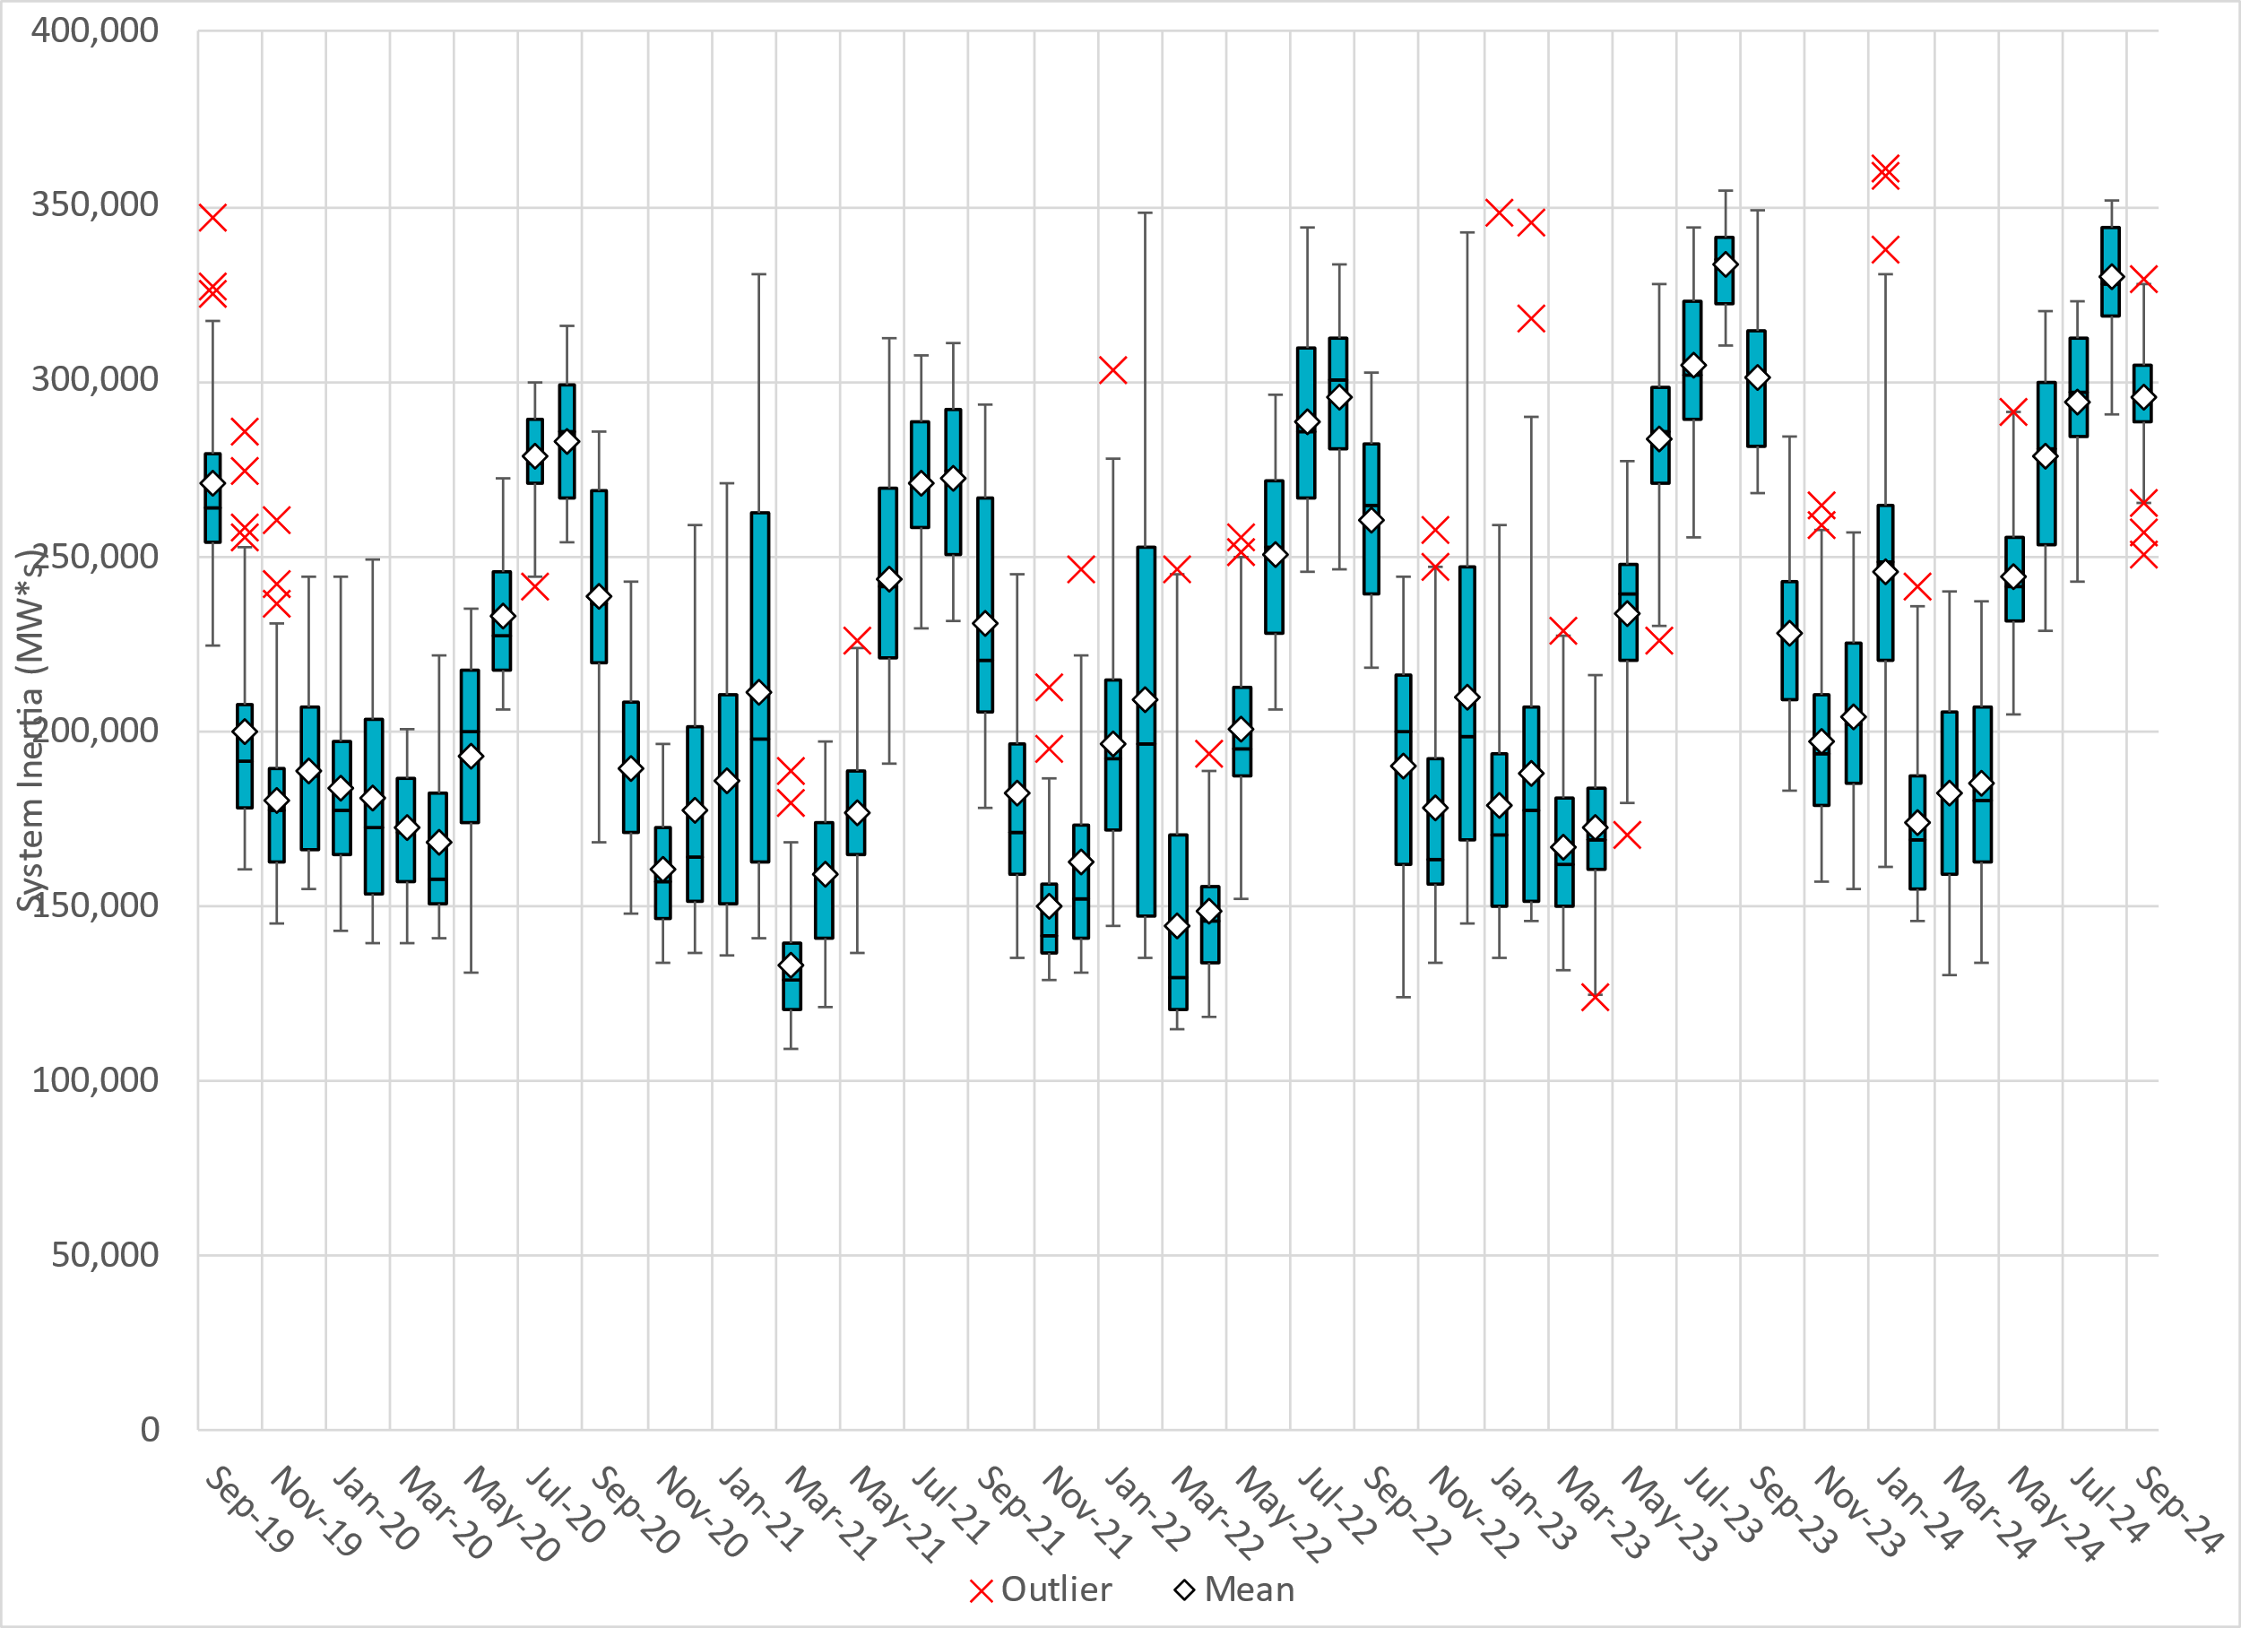
Daily Minimum System Inertia
Notes:
Minimum Inertia in September 2024 = 250,548 MW*s on September 8th
Historical Overall Minimum was 109,029 MW*s on 3/22/2021
September Data:
Mean: 295,552 MW*s
Max: 329,186 MW*s on September 2nd
Min: 250,548 MW*s on September 8th

Slide 28
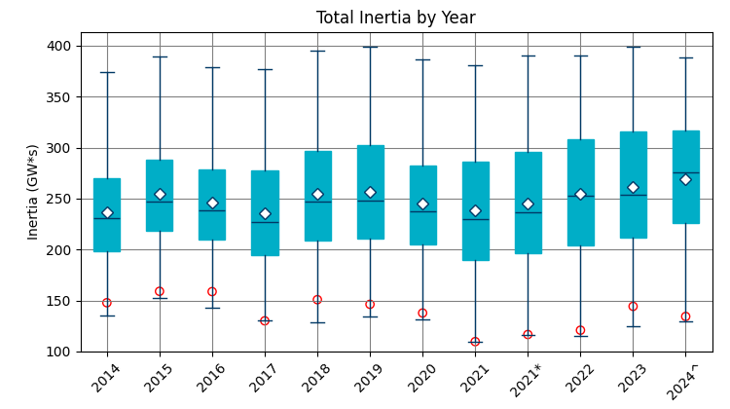
ERCOT Inertia 2014-2024
Date and Time | 2014 3/30 3:00 AM | 2015 11/25 2:00 AM | 2016 4/10 2:00 AM | 2017 10/27 4:00 AM | 2018 11/03 3:30 AM | 2019 3/27 1:00 AM | 2020 05/01 2:00 AM | 2021 03/22 00:00 AM | 2022 03/21 01:00 AM | 2023 04/18 02:00 AM | 2024 03/29 03:00 AM
Min synch. Inertia (GW*s) | 135 | 152 | 143 | 130 | 128.8 | 134.5 | 131.1 | 109 | 115 | 124 | 130
System load at minimum synch. Inertia (MW) | 24,540 | 27,190 | 27,831 | 28,425 | 28,397 | 29,883 | 30,679 | 32,599 | 33,365 | 35,799 | 37,297
Non-synch. Gen. in % of System Load | 34 | 42 | 47 | 54 | 53 | 50 | 57 | 65 | 66 | 61 | 68
Notes:
Summary of ERCOT intertia for the previous 10 years. Lowest inertia this year was on March 29th.
For each box, the central mark (red line) is the median, the edges of the box (in blue) are the 25th and 75th percentiles, the whiskers correspond to +/- 2.7 sigma (i.e., represent 99.3% coverage, assuming the data are normally distributed. The corresponding lowest inertia in each year is given in the table.
The circle on each boxplot is showing inertia during time when highest portion of load was served by wind/solar generation in that year.

Slide 29
Questions?
Thank you!

