Slide 1
Monthly Review of Reliability Unit Commitment Market Impacts – September 2024
Wholesale Market Working Group
ERCOT Staff

Slide 2
RUC Resource-Hours
September 2024 | Total | Opt-Out | Non-Opt-Out
Instructed Resource-Hours
Total Count | 121.0 | 0.0 | 121.0
Effective Resource-Hours*
Total Count | 97.8 | 0.0 | 97.8
Average Megawatts (MW) for Effective Resource Hours
Average LSL | 51.9 | 0.0 | 51.9
Average LDL | 64.7 | 0.0 | 64.7
Average BP | 73.8 | 0.0 | 73.8
Average HSL | 198.0 | 0.0 | 198.0
* The difference between “Instructed” and “Effective” values is a result of Resources starting up, shutting down, receiving partial hour instructions, or otherwise not being dispatchable by SCED.

Slide 3
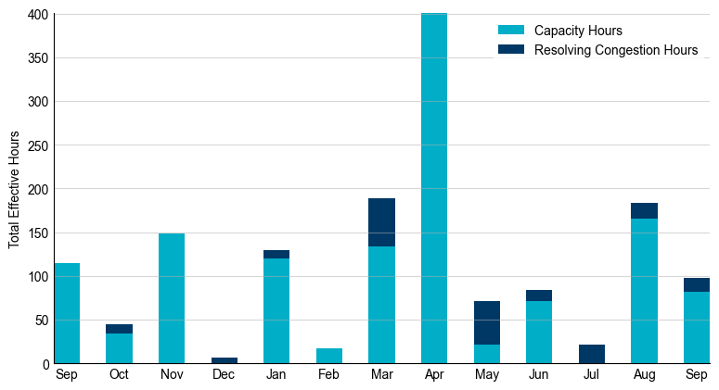
RUC Instruction Reasons: Last 13 Months
RUC instructions in September 2024 were primarily to ensure sufficient capacity but also to resolve congestion.

Slide 4
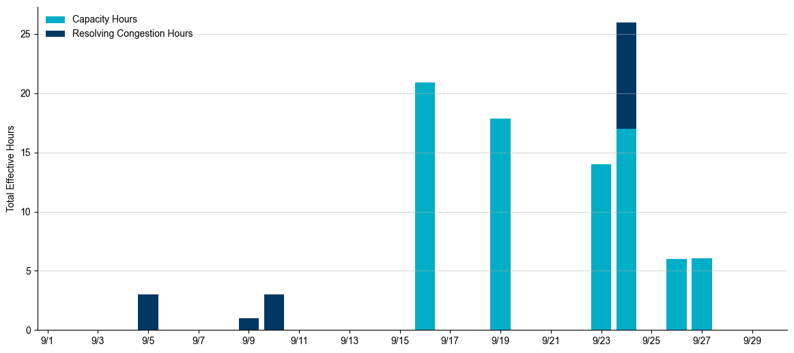
RUC Instruction Reasons in September 2024
97.8 RUC effective Resource-hours.
  81.8 hours (83.65%) for capacity.
  16.0 hours (16.35%) for congestion.

Slide 5
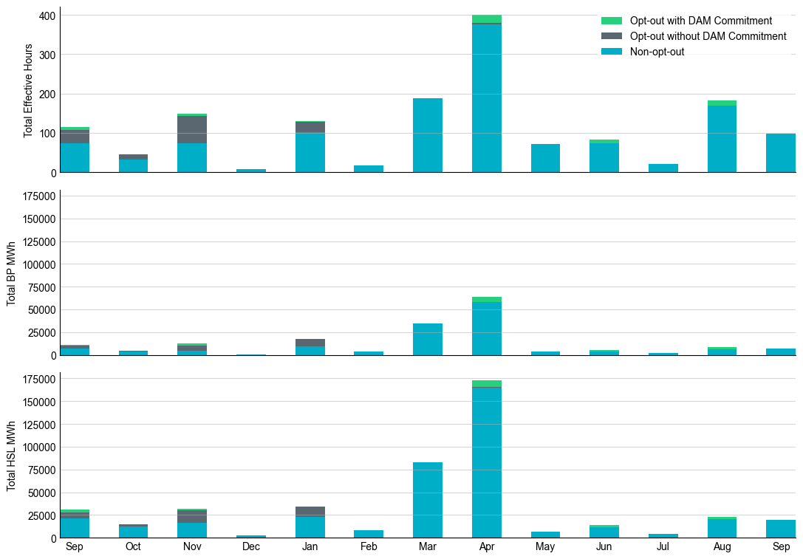
Non-opt-out and Opt-out Totals: Last 13 Months
September 2024 had a total of 97.8 non-opt-out effective Resource-hours (100%) and no opt-out effective Resource-hours.

Slide 6
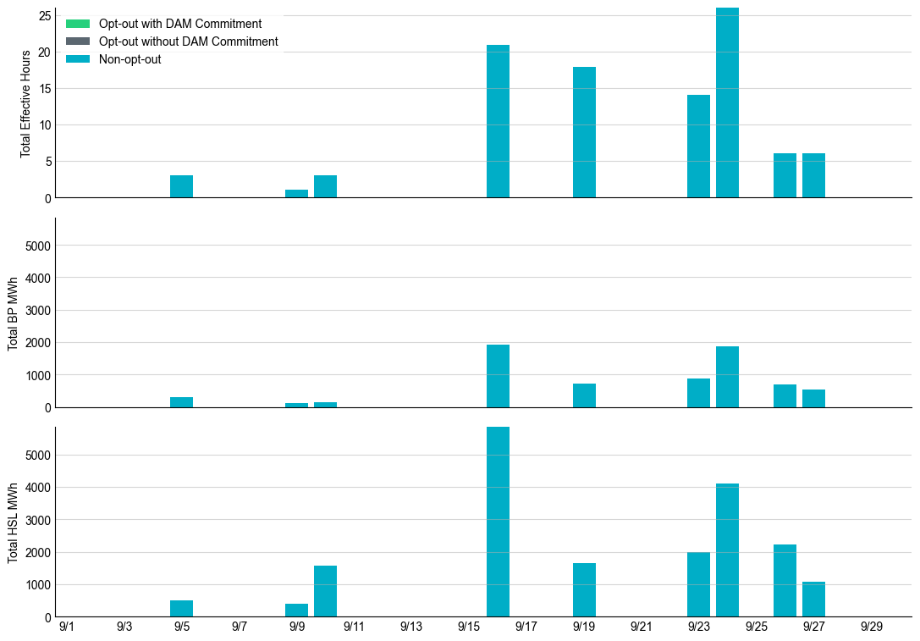
Non-opt-out and Opt-out Totals: September 2024

Slide 7
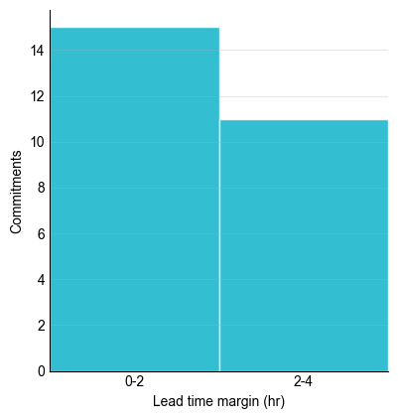
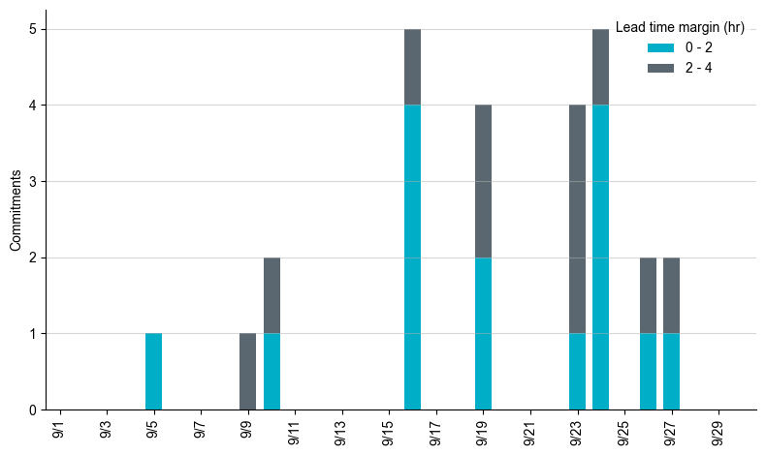
RUC Lead Time Margin: September 2024
All RUC commitment windows had a lead time margin at or below 4 hours.
Lead time refers to the length of time between a RUC instruction and the start of the commitment window.
Lead time margin is the difference between lead time and the Resource’s startup time.
  In cases where a Resource is committed for multiple back-to-back time blocks, lead time margin is calculated from the first instruction.

Slide 8
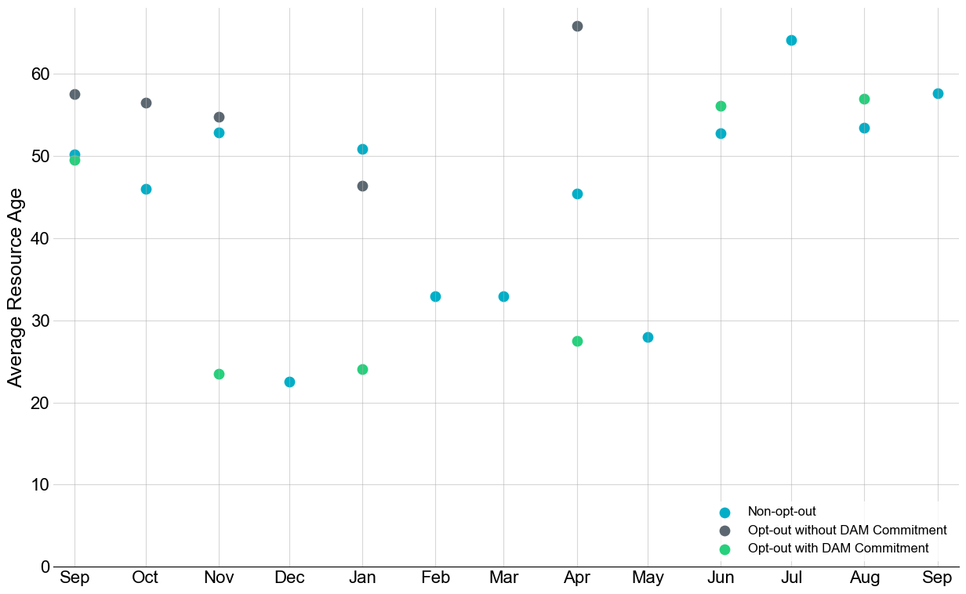
Average Resource Age: Last 13 Months
In September 2024, the average age of RUC-committed Resources was 57.0 years for non-opt-out Resource-hours.
Note: For Resource configurations with multiple physical generators, the age of the oldest generator is used.

Slide 9
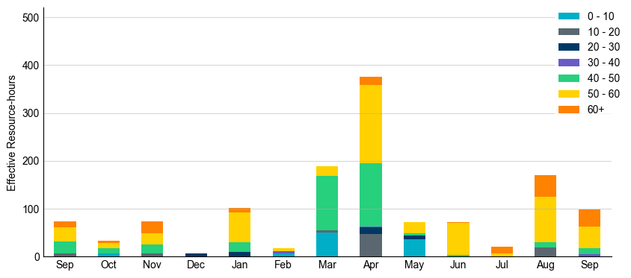
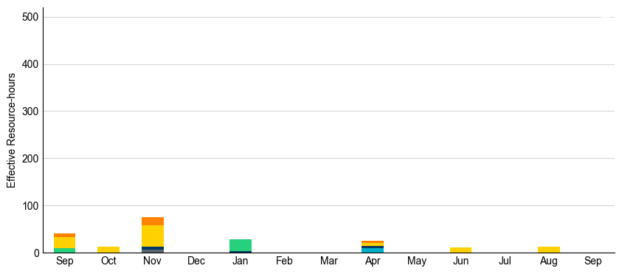
Age Category: Last 13 Months
Most RUC-committed Resources in September 2024 were more than 50 years old.
Non-opt-out
Opt-out

Slide 10
RUC-Instructed Resource Dispatch above LDL
September 2024
There were 20.7 effective Resource-hours in which Resources that did not successfully opt out were dispatched above their LDL.
  For 1.7 of these Resource-hours, the LMP for the RUC-instructed Resource was above the RUC offer floor.
  For 19.0 of these Resource-hours, the LMP for the RUC-instructed Resource was below the RUC offer floor.
    For these 19.0 Resource-hours, the RUC-instructed Resource was mitigated.
There were no Exceptional Fuel Cost submissions for any RUC-committed Resources.

Slide 11
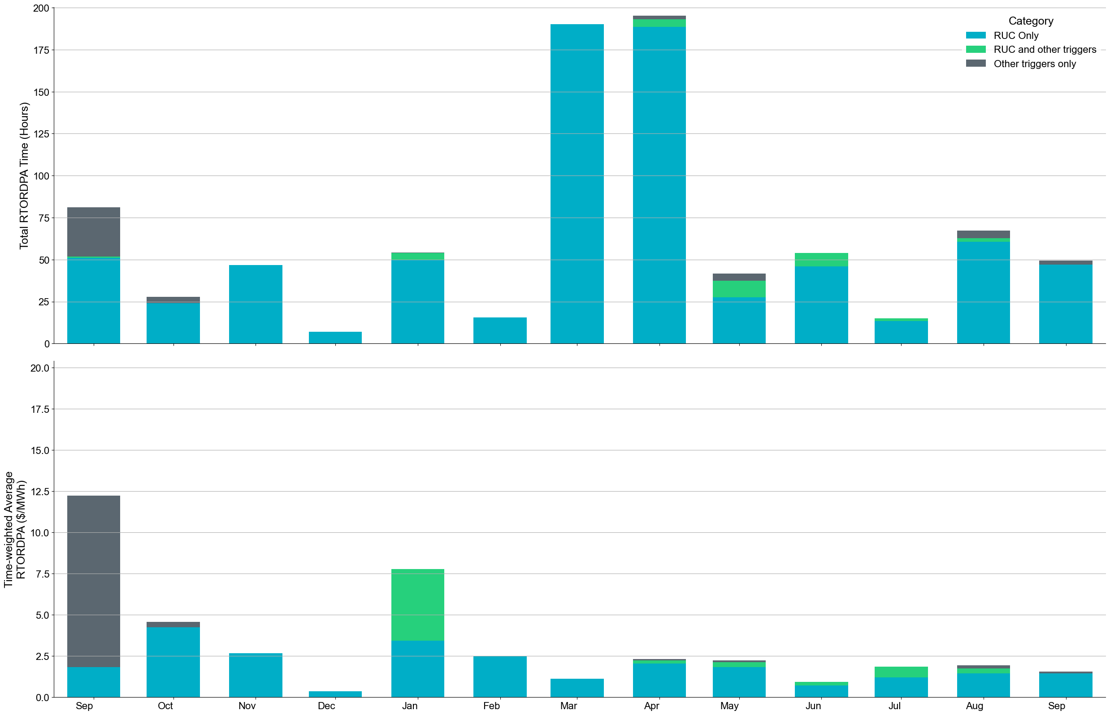
Reliability Deployment Price Adder: Last 13 Months
September 2024 had a total of 49.33 RTORDPA hours with an average value of $0.51/MWh.
These graphs show RTORDPA instances by reliability action: 'RUC Only' for instances triggered solely by Reliability Unit Commitment, 'RUC and other triggers' for instances with RUC and additional triggers, and 'Other triggers only' for instances with non-RUC triggers. The daily average RTORDPA is calculated using the total duration across all categories. See ERCOT protocol section 6.5.7.3.1 for details.

Slide 12
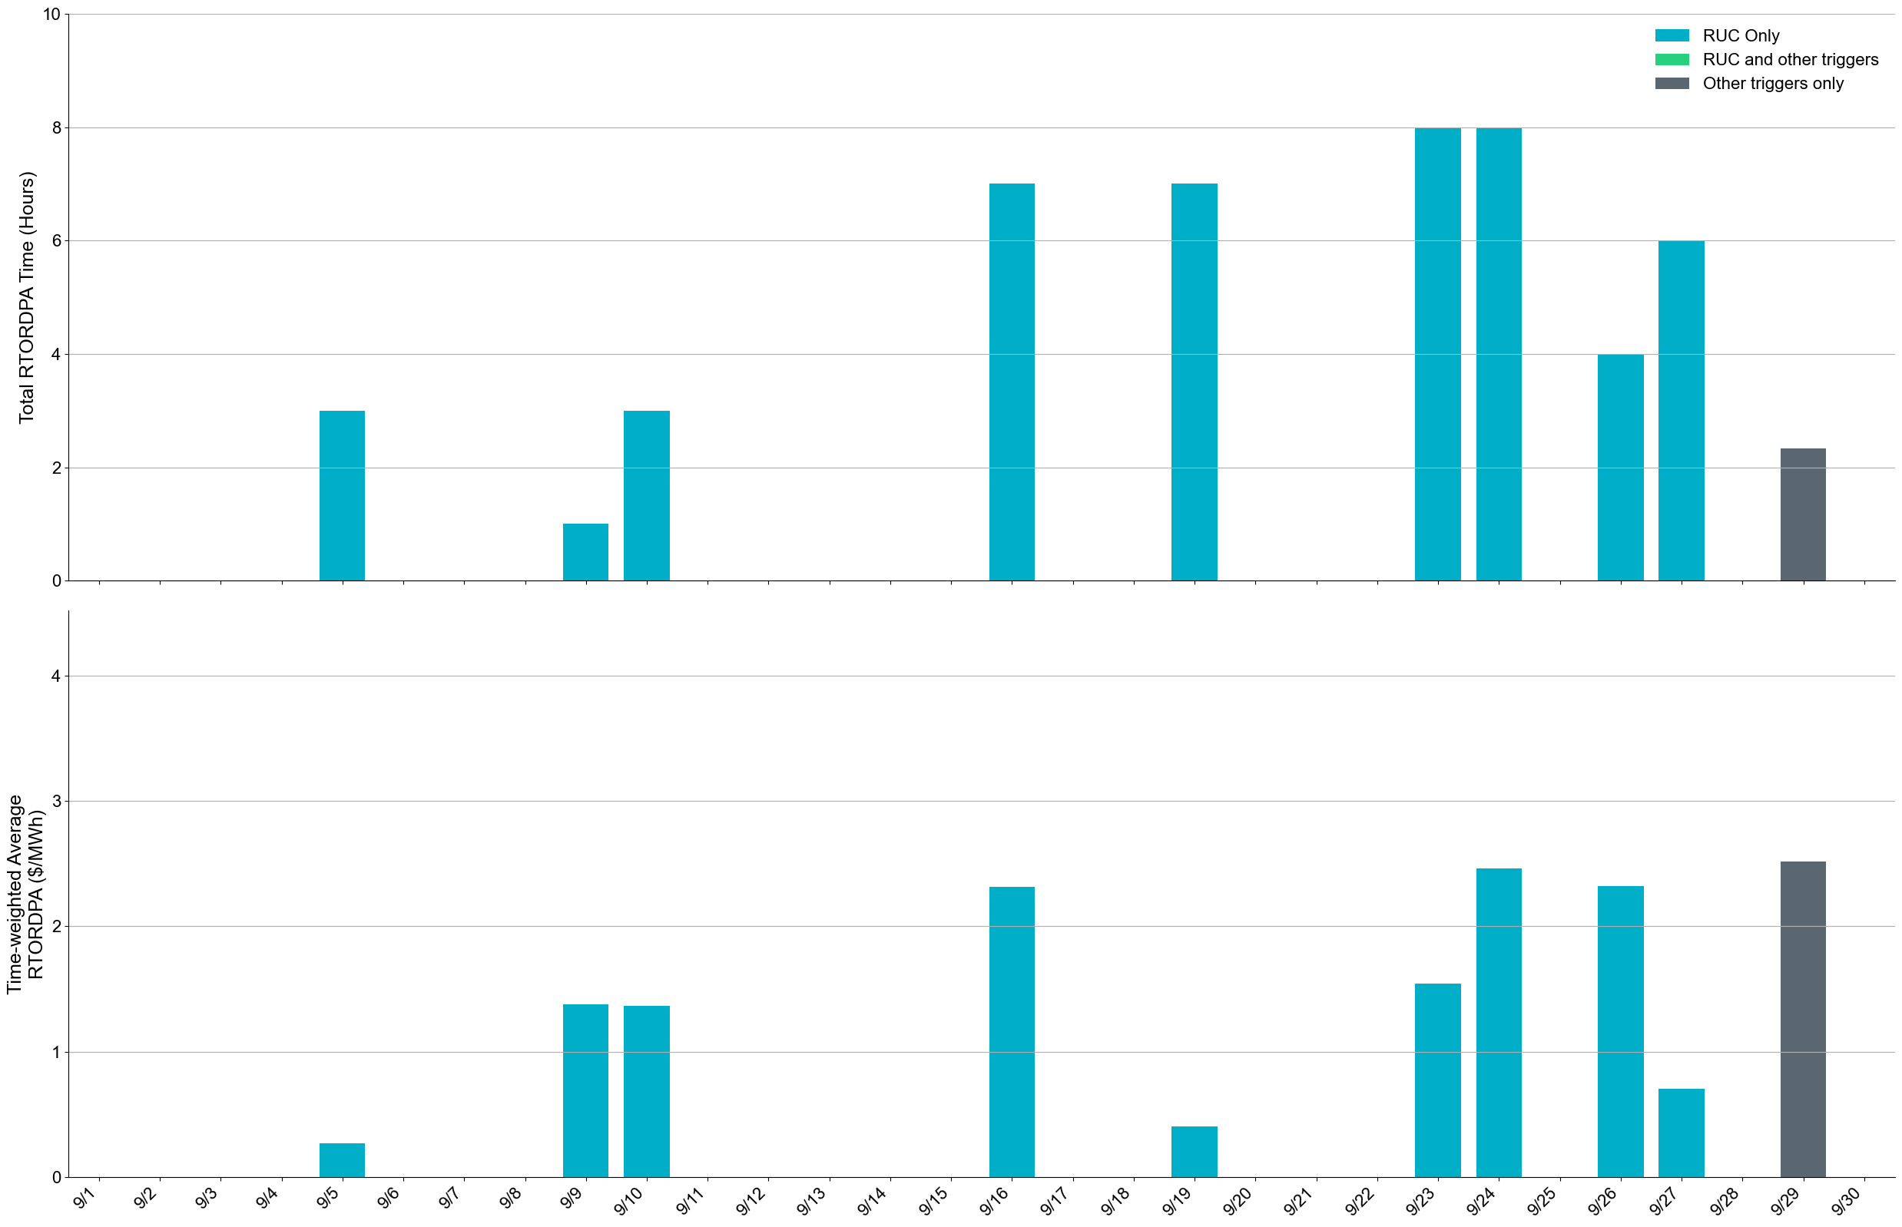
Reliability Deployment Price Adder: September 2024
OD 9/29 had the highest daily time-weighted average RTORDPA of $2.33/MWh.
Note:
These graphs show RTORDPA instances by reliability action: 'RUC Only' for instances triggered solely by Reliability Unit Commitment, 'RUC and other triggers' for instances with RUC and additional triggers, and 'Other triggers only' for instances with non-RUC triggers. The daily average RTORDPA is calculated using the total duration across all categories. See ERCOT protocol section 6.5.7.3.1 for more details.
2. The non-zero RTORDPA in grey bar on OD 9/29 was triggered by NCLR Non-Spin Deployment.

Slide 13
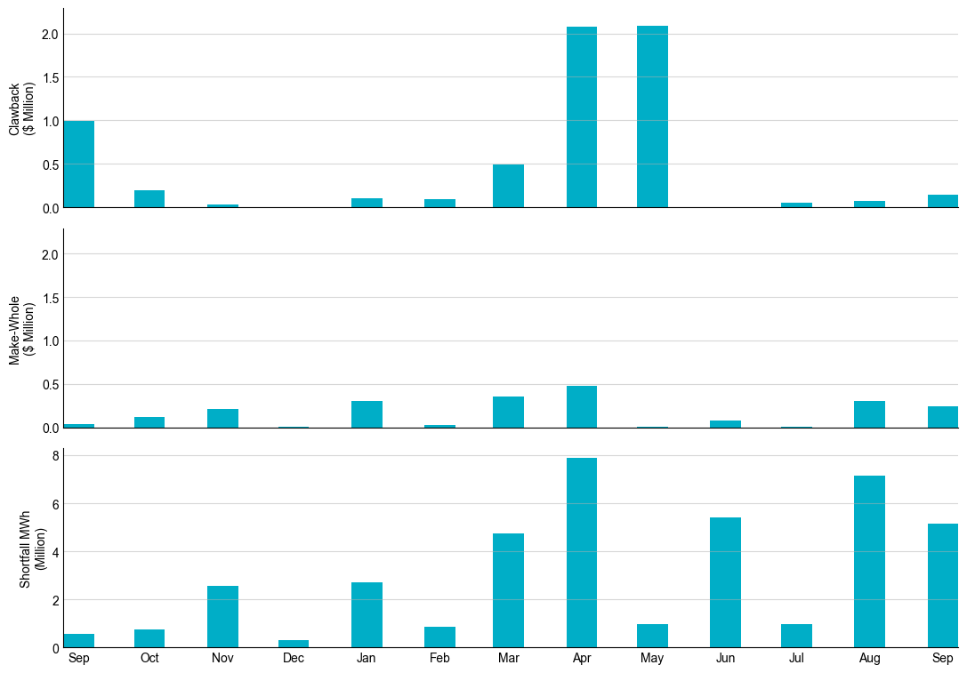
RUC Clawback, Make-Whole, and Shortfall
For September 2024, the total Clawback Charge was $140,239. The total Make-Whole Payment was $239,681.
Of the $239,681 in Make-Whole Payments made in September 2024, $1.92 was uplifted to load due to rounding.
The remaining amount was collected through Capacity-Short Charges.
Data as of October 16th, 2024

Slide 14
RUC Clawback by Settlement Type
Month | Initial Settlement ($) | Final Settlement Change ($) | True-up Settlement Change ($) | Net as of October 16, 2024 ($)
Sep ‘23 | 997,843 | 0 | 0 | 997,843
Oct ‘23 | 190,721 | 0 | 0 | 190,721
Nov ‘23 | 29,684 | 0 | 0 | 29,684
Dec ‘23 | 0 | 0 | 0 | 0
Jan ‘24 | 107,176 | -4,657 | 0 | 102,519
Feb ‘24 | 88,220 | 0 | 0 | 88,220
Mar ‘24 | 487,193 | 0 | 0 | 487,193
Apr ‘24 | 2,092,224 | 0 | - | -
May ‘24 | 2,084,416 | 0 | - | -
Jun ’24 | 58 | 0 | - | -
Jul ‘24 | 47,627 | 0 | - | -
Aug ‘24 | 73,690 | - | - | -
Sep ‘24 | 140,239 | - | - | -
Negative dollars represent a payment from ERCOT to a market participant
“-” indicates settlement has yet to be completed.
Net figures may differ slightly due to rounding.

Slide 15
RUC Make-Whole by Settlement Type
Month | Initial Settlement ($) | Final Settlement Change ($) | True-up Settlement Change ($) | Net as of October 16, 2024 ($)
Sep ‘23 | -35,168 | 0 | 0 | -35,168
Oct ‘23 | -72,477 | -43,063 | 0 | -115,540
Nov ‘23 | -194,731 | 0 | -17,934 | -212,665
Dec ‘23 | -5,316 | 0 | 0 | -5,316
Jan ‘24 | -253,466 | -79,942 | 31,417 | -301,991
Feb ‘24 | -19,673 | 0 | -9,004 | -28,677
Mar ‘24 | -353,562 | 0 | 0 | -353,562
Apr ‘24 | -443,178 | 0 | - | -
May ‘24 | -2,957 | 0 | - | -
Jun ’24 | -76,670 | 0 | - | -
Jul ‘24 | -4,297 | 0 | - | -
Aug ‘24 | -305,171 | - | - | -
Sep ‘24 | -239,681 | - | - | -
Negative dollars represent a payment from ERCOT to a market participant
“-” indicates settlement has yet to be completed.
Net figures may differ slightly due to rounding.

