Slide 1

TDTMS Update
RMS
October 15th, 2024

Slide 2
TDTMS
ERCOT Reporting
2025 SLO & Release Calendar – ERCOT finalizing; however, was discussed during September TDTMS that the structure will be the same as 2024 with more frequent, yet shorter duration and one longer retail release. ERCOT provided the updated SLAs with the proposed adjusted times to be reviewed at October’s TDTMS with RMS presentment and approval in November.
System Instances & MT Performance – All August SLAs met. MarkeTrak performance remains well within SLO.
Listservs – No issues.
Robust discussion concerning aligning retail releases with other production releases; possibly to be performed during the week but that may affect intermittent activity of Find MIS, Find Transactions, and MarkeTrak applications. Additional discussion and protocol updates are needed to align; this may be held off until 2026 calendar year.

Slide 3
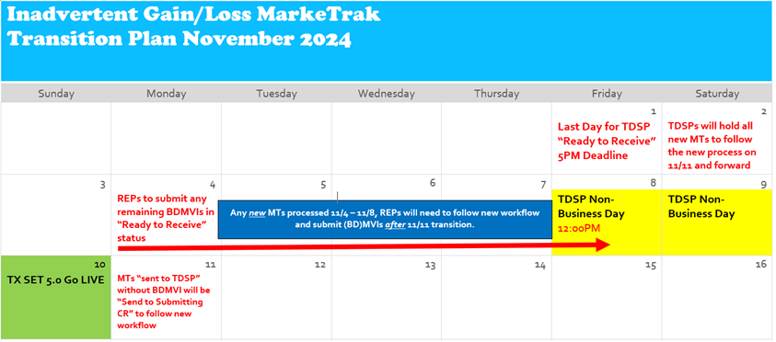
TDTMS
SCR 817
WSDL currently being tested with no changes identified thus far. Please send questions to ERCOT Retail Operations.
Proposed Transition Plan - UPDATED
Market Training was held September 18, 2024 for the SCR817 - MarkeTrak Changes Associated with TXSET v5.0. It was largely attended by market participants with more than 163 attendees
The RMTE was made available over the weekend of 9/14- 9/15
ERCOT update: On line modules and User’s Guide updates will be made available on 11/11 at Go Live!

Slide 4
TDTMS
SCR 817 Testing & Training
SCR817 Training/Testing Dates
10/24/24 – Training, in-depth, SCR817 changes @ 9:30 AM with TDTMS scheduled at 1:00 PM
SCR817 Functionality is available in RMTE as of 9/16/24 and a market notice was sent.

Slide 5
TDTMS
MarkeTrak Subtypes Volumes Analysis
Reviewed the initial data for first half of 2024

Slide 6
TDTMS
MarkeTrak Subtypes Volumes Analysis

Slide 7
TDTMS
Next Meeting – Thursday, October 44th
DRAFT Agenda:
ERCOT Reports
Thursday, October 24th @ 1:00 PM WebEx Only
System Instances & MT Performance
SCR817 Business Requirements Discussion
Updates – Service Address approach
MarkeTrak Subtypes Volume Analysis 2024 - Results
Usage & Billing – Missing
Listserv
2025 Retail Release Calendar Proposed Revisions
Retail Release Calendars aligning with Production Releases
Communicating Transition Plan updates
SCR817 training feedback
On line module & User’s Guide’s availability
Switch Hold

