Slide 1
Market Coordination Team Update
RMS: October 15, 2024

Slide 2
Reviewed updated Texas SET Implementation Plan
Finalized Texas SET v5.0 Implementation Guides and requesting RMS Approval

Slide 3
Texas SET 5.0 Implementation Plan
Please see the official Implementation Plan posted on the MCT page
Friday, November 8th and Saturday, November 9th will be treated as a TDSP Non-Business Day
  Requested date for Move Ins, Move Outs and Switches must be for Monday, November 11, 2024 and beyond
CRs to suspend Initiating transactions Friday, November 8th at 12:00 PM
TDSPs suspend response transactions and log MarkeTrak Issue for the Initial County Load file Friday, November 8th at 1:00 PM
TDSPs suspend 867s Saturday, November 9th at 5:00 AM
TDSPs suspend 814_20 transactions and LSE Files to ERCOT Saturday, November 9th at 6:00 AM
All Market Participants suspend 997s Saturday, November 9th at 6:00 AM
ERCOT shuts down inbound and outbound processing and MarkeTrak Saturday, November 9th

Slide 4
Future Meetings
October 23rd
December 3rd

Slide 5
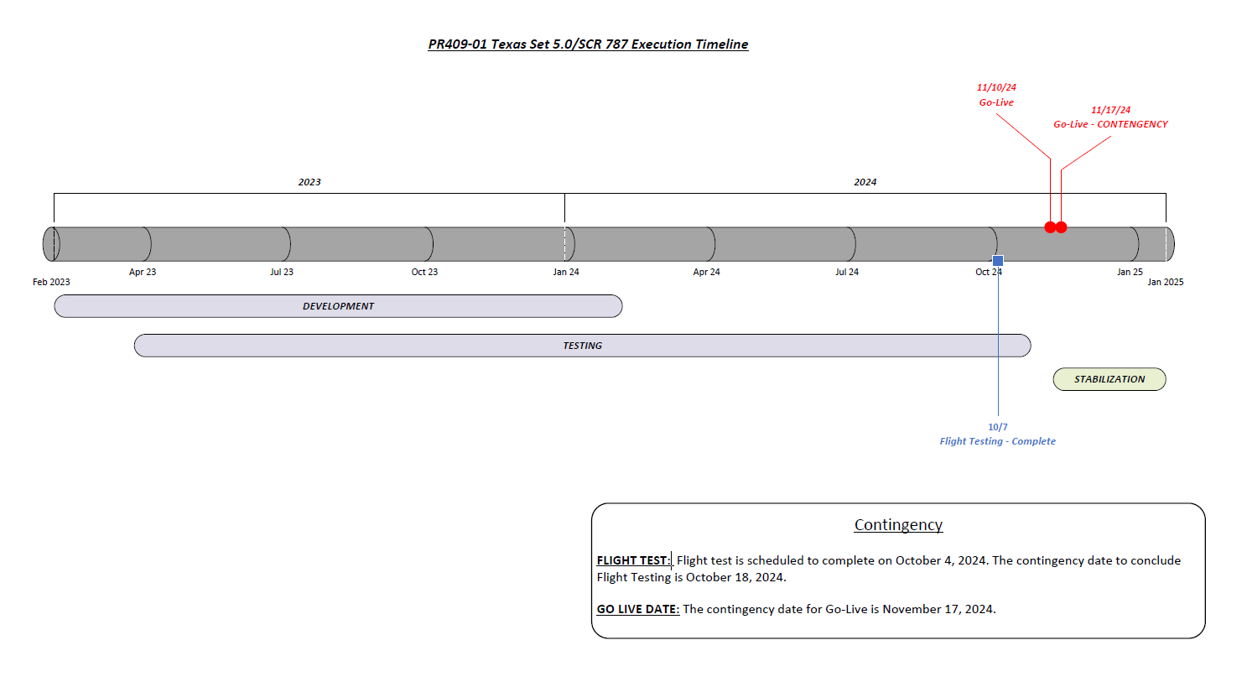

Slide 6
Reminder: The following documents can be found on the MCT page on ERCOT.com
  Texas SET v5.0 Business Requirements
  DDL for TDSP ESIID Extract
  DDL for the Siebel Service Order Extract
  Zip file containing all approved Texas SET v5.0 Change Controls
  Texas SET v5.0 DRAFT Redlines
  Texas SET v5.0 DRAFT SEF Files
  Texas SET v5.0 Implementation Plan
  Market Coordination Team for Texas SET Version Releases (ercot.com)

